Slide 1

Direct Variation
Warm Up
Lesson Presentation
Lesson Quiz
Holt Algebra 1
Holt McDougal Algebra 1

Slide 2
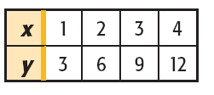


Warm Up
Solve for y.
1. 3 + y = 2x 2. 6x = 3y
y = 2x – 3
y = 2x
Write an equation that describes the relationship.
3.
y = 3x
Solve for x.
4.
9
5.
0.5

Slide 3
Objective
Identify, write, and graph direct variation.

Slide 4
Vocabulary
direct variation
constant of variation

Slide 5
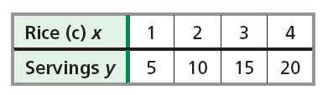
A recipe for paella calls for 1 cup of rice to make 5 servings. In other words, a chef needs 1 cup of rice for every 5 servings.
The equation y = 5x describes this relationship. In this relationship, the number of servings varies directly with the number of cups of rice.

Slide 6
A direct variation is a special type of linear relationship that can be written in the form y = kx, where k is a nonzero constant called the constant of variation.

Slide 7
Example 1A: Identifying Direct Variations from Equations
Tell whether the equation represents a direct variation. If so, identify the constant of variation.
y = 3x
This equation represents a direct variation because it is in the form of y = kx. The constant of variation is 3.

Slide 8
Example 1B: Identifying Direct Variations from Equations
Tell whether the equation represents a direct variation. If so, identify the constant of variation.
3x + y = 8
Solve the equation for y.
–3x –3x
Since 3x is added to y, subtract 3x from both sides.
y = –3x + 8
This equation is not a direct variation because it cannot be written in the form y = kx.

Slide 9


Example 1C: Identifying Direct Variations from Equations
Tell whether the equation represents a direct variation. If so, identify the constant of variation.
–4x + 3y = 0
Solve the equation for y.
+4x +4x
Since –4x is added to 3y, add 4x to both sides.
3y = 4x
Since y is multiplied by 3, divide both sides by 3.
This equation represents a direct variation because it is in the form of y = kx. The constant of variation is .

Slide 10

Check It Out! Example 1a
Tell whether the equation represents a direct variation. If so, identify the constant of variation.
3y = 4x + 1
This equation is not a direct variation because it is not written in the form y = kx.

Slide 11



Check It Out! Example 1b
Tell whether the equation represents a direct variation. If so, identify the constant of variation.
3x = –4y
Solve the equation for y.
–4y = 3x
Since y is multiplied by –4, divide both sides by –4.
This equation represents a direct variation because it is in the form of y = kx. The constant of variation is .

Slide 12
Check It Out! Example 1c
Tell whether the equation represents a direct variation. If so, identify the constant of variation.
y + 3x = 0
Solve the equation for y.
– 3x –3x
Since 3x is added to y, subtract 3x from both sides.
y = –3x
This equation represents a direct variation because it is in the form of y = kx. The constant of variation is –3.

Slide 13


What happens if you solve y = kx for k?
y = kx
Divide both sides by x (x ≠ 0).
So, in a direct variation, the ratio is equal to the constant of variation. Another way to identify a direct variation is to check whether is the same for each ordered pair (except where x = 0).

Slide 14
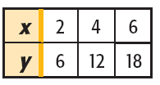
Example 2A: Identifying Direct Variations from Ordered Pairs
Tell whether the relationship is a direct variation. Explain.
Method 1 Write an equation.
y = 3x
Each y-value is 3 times the corresponding x-value.
This is direct variation because it can be written as y = kx, where k = 3.

Slide 15

Example 2A Continued
Tell whether the relationship is a direct variation. Explain.
Method 2 Find for each ordered pair.
This is a direct variation because is the same for each ordered pair.

Slide 16
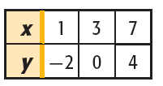
Example 2B: Identifying Direct Variations from Ordered Pairs
Tell whether the relationship is a direct variation. Explain.
Method 1 Write an equation.
y = x – 3
Each y-value is 3 less than the corresponding x-value.
This is not a direct variation because it cannot be written as y = kx.

Slide 17

Example 2B Continued
Tell whether the relationship is a direct variation. Explain.
Method 2 Find for each ordered pair.
…
This is not direct variation because is the not the same for all ordered pairs.

Slide 18
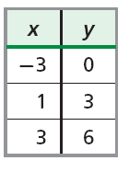

Check It Out! Example 2a
Tell whether the relationship is a direct variation. Explain.
Method 2 Find for each ordered pair.
This is not direct variation because is the not the same for all ordered pairs.

Slide 19
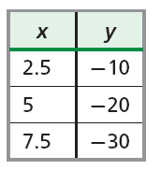
Check It Out! Example 2b
Tell whether the relationship is a direct variation. Explain.
Method 1 Write an equation.
Each y-value is –4 times the corresponding x-value .
y = –4x
This is a direct variation because it can be written as y = kx, where k = –4.

Slide 20
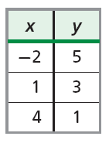

Check It Out! Example 2c
Tell whether the relationship is a direct variation. Explain.
Method 2 Find for each ordered pair.
This is not direct variation because is the not the same for all ordered pairs.

Slide 21

Example 3: Writing and Solving Direct Variation Equations
The value of y varies directly with x, and y = 3, when x = 9. Find y when x = 21.
Method 1 Find the value of k and then write the equation.
y = kx
Write the equation for a direct variation.
3 = k(9)
Substitute 3 for y and 9 for x. Solve for k.
Since k is multiplied by 9, divide both sides by 9.
The equation is y = x. When x = 21, y = (21) = 7.

Slide 22

Example 3 Continued
The value of y varies directly with x, and y = 3 when x = 9. Find y when x = 21.
Method 2 Use a proportion.
In a direct variation is the same for all values of x and y.
9y = 63
Use cross products.
y = 7
Since y is multiplied by 9 divide both sides by 9.

Slide 23
Check It Out! Example 3
The value of y varies directly with x, and y = 4.5 when x = 0.5. Find y when x = 10.
Method 1 Find the value of k and then write the equation.
y = kx
Write the equation for a direct variation.
4.5 = k(0.5)
Substitute 4.5 for y and 0.5 for x. Solve for k.
9 = k
Since k is multiplied by 0.5, divide both sides by 0.5.
The equation is y = 9x. When x = 10, y = 9(10) = 90.

Slide 24

Check It Out! Example 3 Continued
The value of y varies directly with x, and y = 4.5 when x = 0.5. Find y when x = 10.
Method 2 Use a proportion.
In a direct variation is the same for all values of x and y.
0.5y = 45
Use cross products.
y = 90
Since y is multiplied by 0.5 divide both sides by 0.5.

Slide 25
Example 4: Graphing Direct Variations
A group of people are tubing down a river at an average speed of 2 mi/h. Write a direct variation equation that gives the number of miles y that the people will float in x hours. Then graph.
Step 1 Write a direct variation equation.
distance
=
2 mi/h
times
hours
y
=
2
•
x

Slide 26
Example 4 Continued
A group of people are tubing down a river at an average speed of 2 mi/h. Write a direct variation equation that gives the number of miles y that the people will float in x hours. Then graph.
Step 2 Choose values of x and generate ordered pairs.
x
y = 2x
(x, y)
0
y = 2(0) = 0
(0, 0)
1
y = 2(1) = 2
(1, 2)
2
y = 2(2) = 4
(2, 4)

Slide 27
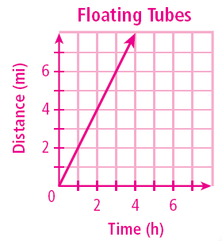
Example 4 Continued
A group of people are tubing down a river at an average speed of 2 mi/h. Write a direct variation equation that gives the number of miles y that the people will float in x hours. Then graph.
Step 3 Graph the points and connect.

Slide 28
Check It Out! Example 4
The perimeter y of a square varies directly with its side length x. Write a direct variation equation for this relationship. Then graph.
Step 1 Write a direct variation equation.
perimeter
=
4 sides
times
length
y
=
4
•
x

Slide 29
Check It Out! Example 4 Continued
The perimeter y of a square varies directly with its side length x. Write a direct variation equation for this relationship. Then graph.
Step 2 Choose values of x and generate ordered pairs.
x
y = 4x
(x, y)
0
y = 4(0) = 0
(0, 0)
1
y = 4(1) = 4
(1, 4)
2
y = 4(2) = 8
(2, 8)

Slide 30
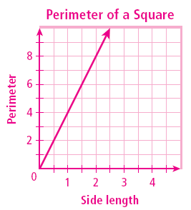
Check It Out! Example 4 Continued
The perimeter y of a square varies directly with its side length x. Write a direct variation equation for this relationship. Then graph.
Step 3 Graph the points and connect.

Slide 31
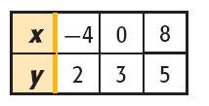
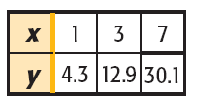


Lesson Quiz: Part I
Tell whether each equation represents a direct variation. If so, identify the constant of variation.
1. 2y = 6x
yes; 3
2. 3x = 4y – 7
no
Tell whether each relationship is a direct variation. Explain.
3.
4.

Slide 32
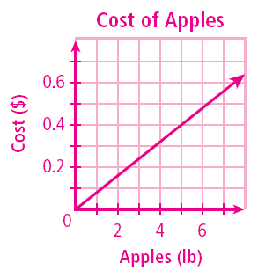
Lesson Quiz: Part II
5. The value of y varies directly with x, and
y = –8 when x = 20. Find y when x = –4.
1.6
6. Apples cost $0.80 per pound. The equation y = 0.8x describes the cost y of x pounds of apples. Graph this direct variation.
6
4
2

