Slide 1

Exponential Functions
Warm Up
Lesson Presentation
Lesson Quiz
Holt McDougal Algebra 1
Holt Algebra 1

Slide 2


Warm Up
Simplify each expression. Round to the nearest whole number if necessary.
1. 3²
9
2. 5⁴
625
3. 2(3)³
54
4.
54
5. –5(2)⁵
–160
6.
–32
7. 100(0.5)²
25
8. 3000(0.95)⁸
1990

Slide 3
Objectives
Evaluate exponential functions.
Identify and graph exponential functions.

Slide 4
Vocabulary
Exponential function

Slide 5
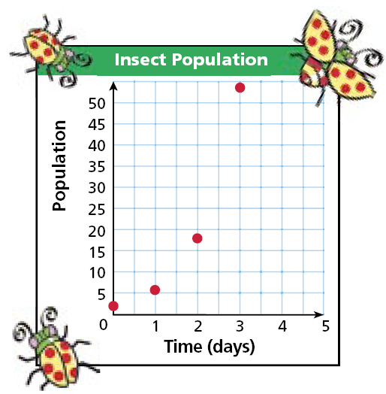
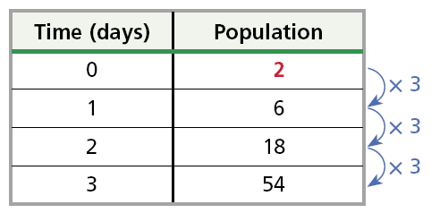
The table and the graph show an insect population that increases over time.

Slide 6
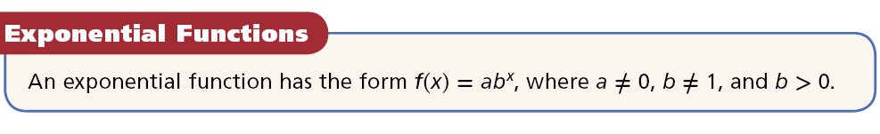
A function rule that describes the pattern above is f(x) = 2(3)^{x}. This type of function, in which the independent variable appears in an exponent, is an exponential function. Notice that 2 is the starting population and 3 is the amount by which the population is multiplied each day.

Slide 7
Example 1A: Evaluating an Exponential Function
The function f(x) = 500(1.035)^{x} models the amount of money in a certificate of deposit after x years. How much money will there be in 6 years?
f(x) = 500(1.035)^{x}
Write the function.
f(6) = 500(1.035)⁶
Substitute 6 for x.
= 500(1.229)
Evaluate 1.035⁶.
= 614.63
Multiply.
There will be $614.63 in 6 years.

Slide 8
Example 1B: Evaluating an Exponential Function
The function f(x) = 200,000(0.98)^{x}, where x is the time in years, models the population of a city. What will the population be in 7 years?
f(x) = 200,000(0.98)^{x}
Substitute 7 for x.
f(7) = 200,000(0.98)⁷
Use a calculator. Round to the nearest whole number.
≈ 173,625
The population will be about 173,625 in 7 years.

Slide 9
Check It Out! Example 1
The function f(x) = 8(0.75)^{X} models the width of a photograph in inches after it has been reduced by 25% x times. What is the width of the photograph after it has been reduced 3 times?
f(x) = 8(0.75)^{x}
Substitute 3 for x.
f(3) = 8(0.75)³
Use a calculator.
= 3.375
The size of the picture will be reduced to a width of 3.375 inches.

Slide 10
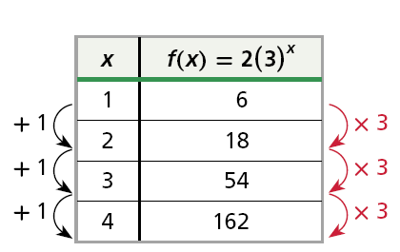
Remember that linear functions have constant first differences and quadratic functions have constant second differences. Exponential functions do not have constant differences, but they do have constant ratios.
As the x-values increase by a constant amount, the y-values are multiplied by a constant amount. This amount is the constant ratio and is the value of b in f(x) = ab^{x}.

Slide 11
Example 2A: Identifying an Exponential Function
Tell whether each set of ordered pairs satisfies an exponential function. Explain your answer.
{(0, 4), (1, 12), (2, 36), (3, 108)}
This is an exponential function. As the x-values increase by a constant amount, the y-values are multiplied by a constant amount.
x | y
0 | 4
1 | 12
2 | 36
3 | 108
+ 1
× 3
+ 1
× 3
+ 1
× 3

Slide 12
Example 2B: Identifying an Exponential Function
Tell whether each set of ordered pairs satisfies an exponential function. Explain your answer.
{(–1, –64), (0, 0), (1, 64), (2, 128)}
This is not an exponential function. As the x-values increase by a constant amount, the y-values are not multiplied by a constant amount.
x | y
–1 | –64
0 | 0
1 | 64
2 | 128
+ 1
+ 64
+ 1
+ 64
+ 1
+ 64

Slide 13
Check It Out! Example 2a
Tell whether each set of ordered pairs satisfies an exponential function. Explain your answer.
{(–1, 1), (0, 0), (1, 1), (2, 4)}
This is not an exponential function. As the x-values increase by a constant amount, the y-values are not multiplied by a constant amount.
x | y
–1 | 1
0 | 0
1 | 1
2 | 4
+ 1
– 1
+ 1
+ 1
+ 1
+ 3

Slide 14
Check It Out! Example 2b
Tell whether each set of ordered pairs satisfies an exponential function. Explain your answer.
{(–2, 4), (–1 , 2), (0, 1), (1, 0.5)}
This is an exponential function. As the x-values increase by a constant amount, the y-values are multiplied by a constant amount.
x | y
–2 | 4
–1 | 2
0 | 1
1 | 0.5
+ 1
× 0.5
+ 1
× 0.5
+ 1
× 0.5

Slide 15
To graph an exponential function, choose several values of x (positive, negative, and 0) and generate ordered pairs. Plot the points and connect them with a smooth curve.

Slide 16
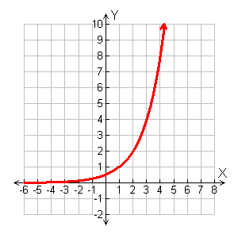
Example 3: Graphing y = ab^{x} with a > 0 and b > 1
Graph y = 0.5(2)^{x}.
Choose several values of x and generate ordered pairs.
Graph the ordered pairs and connect with a smooth curve.
x | y = 0.5(2)^{x}
–1 | 0.25
0 | 0.5
1 | 1
2 | 2
•
•
•
•

Slide 17
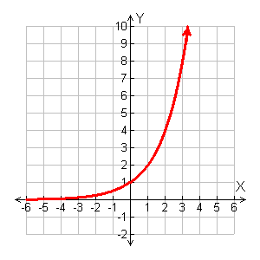
Check It Out! Example 3a
Graph y = 2^{x}.
Choose several values of x and generate ordered pairs.
Graph the ordered pairs and connect with a smooth curve.
x | y = 2^{x}
–1 | 0.5
0 | 1
1 | 2
2 | 4
•
•
•
•

Slide 18
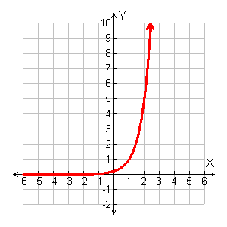
Check It Out! Example 3b
Graph y = 0.2(5)^{x}.
Choose several values of x and generate ordered pairs.
Graph the ordered pairs and connect with a smooth curve.
x | y = 0.2(5)^{x}
–1 | 0.04
0 | 0.2
1 | 1
2 | 5
•
•
•
•

Slide 19

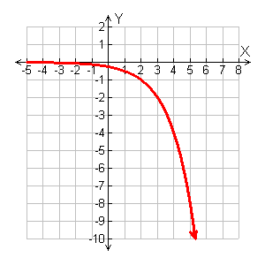
Example 4: Graphing y = ab^{x} with a < 0 and b > 1
Choose several values of x and generate ordered pairs.
Graph the ordered pairs and connect with a smooth curve.
1
x
–1 | –0.125
0 | –0.25
1 | –0.5
2 | –1
y =– (2)^{x}
4
•
•
•
•

Slide 20
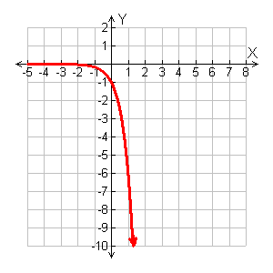
Check It Out! Example 4a
Graph y = –6^{x}.
Choose several values of x and generate ordered pairs.
Graph the ordered pairs and connect with a smooth curve.
x | y = –6^{x}
–1 | –0.167
0 | –1
1 | –6
2 | –36
•
•
•

Slide 21
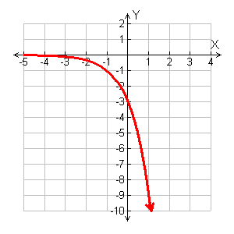
Check It Out! Example 4b
Graph y = –3(3)^{x}.
Choose several values of x and generate ordered pairs.
Graph the ordered pairs and connect with a smooth curve.
x | y = –3(3)^{x}
–1 | –1
0 | –3
1 | –9
2 | –27
•
•
•

Slide 22

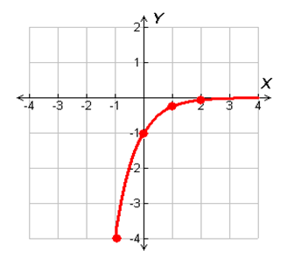
Example 5A: Graphing y = ab^{x} with 0 < b < 1
Graph each exponential function.
Graph the ordered pairs and connect with a smooth curve.
Choose several values of x and generate ordered pairs.
1
–1 | –4
0 | –1
1 | –0.25
2 | – 0.0625
x
y = –1( )^{x}
4

Slide 23
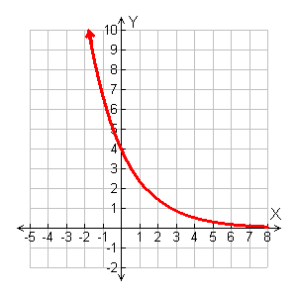
Example 5B: Graphing y = ab^{x} with 0 < b < 1
Graph each exponential function.
y = 4(0.6)^{x}
Choose several values of x and generate ordered pairs.
Graph the ordered pairs and connect with a smooth curve.
x | y = 4(0.6)^{x}
–1 | 6.67
0 | 4
1 | 2.4
2 | 1.44
•
•
•
•

Slide 24

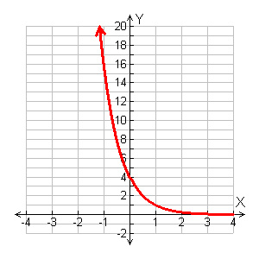
Check It Out! Example 5a
Graph each exponential function.
Graph the ordered pairs and connect with a smooth curve.
Choose several values of x and generate ordered pairs.
1
–1 | 16
0 | 4
1 | 1
2 | .25
x
y = 4( )^{x}
4
•
•
•
•

Slide 25
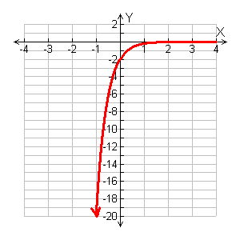
Check It Out! Example 5b
Graph each exponential function.
y = –2(0.1)^{x}
Choose several values of x and generate ordered pairs.
Graph the ordered pairs and connect with a smooth curve.
x | y = –2(0.1)^{x}
–1 | –20
0 | –2
1 | –0.2
2 | –0.02
•
•
•
•

Slide 26
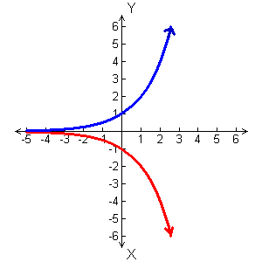
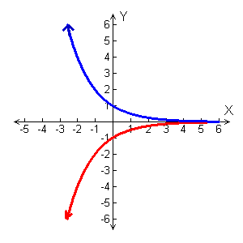
The box summarizes the general shapes of exponential function graphs.
Graphs of Exponential Functions
a > 0
a > 0
a < 0
a < 0
For y = ab^{x}, if b > 1, then the graph will have one of these shapes.
For y = ab^{x}, if 0 < b < 1, then the graph will have one of these shapes.

Slide 27
Example 6: Application
In 2000, each person in India consumed an average of 13 kg of sugar. Sugar consumption in India is projected to increase by 3.6% per year. At this growth rate the function f(x) = 13(1.036)^{x} gives the average yearly amount of sugar, in kilograms, consumed per person x years after 2000. Using this model, in about what year will sugar consumption average about 18 kg per person?

Slide 28
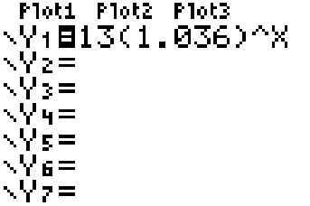

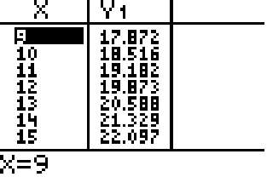
Example 6 Continued
Enter the function into the Y = editor of a graphing calculator.
Press . Use the arrow keys to find a y-value as close to 18 as possible. The corresponding x-value is 9.
The average consumption will reach 18kg in 2009.

Slide 29
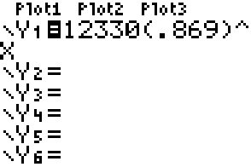
Check It Out! Example 6
An accountant uses f(x) = 12,330(0.869)^{x}, where x is the time in years since the purchase, to model the value of a car. When will the car be worth $2000?
Enter the function into the Y = editor of a graphing calculator.

Slide 30
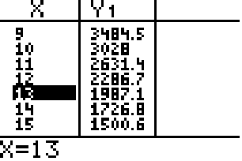
Check It Out! Example 6 Continued
An accountant uses f(x) = 12,330(0.869)^{x}, is the time in years since the purchase, to model the value of a car. When will the car be worth $2000?
Press . Use the arrow keys to find a y-value as close to 2000 as possible. The corresponding x-value is 13.
The value of the car will reach $2000 in about 13 years.

Slide 31
Lesson Quiz: Part I
Tell whether each set of ordered pairs satisfies an exponential function. Explain your answer.
1. {(0, 0), (1, –2), (2, –16), (3, –54)}
No; for a constant change in x, y is not multiplied by the same value.
2. {(0,–5), (1, –2.5), (2, –1.25), (3, –0.625)}
Yes; for a constant change in x, y is multiplied by the same value.

Slide 32
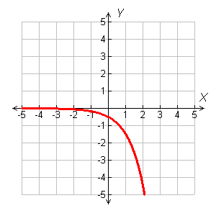
Lesson Quiz: Part II
3. Graph y = –0.5(3)^{x}.

Slide 33
Lesson Quiz: Part III
4. The function y = 11.6(1.009)^{x} models residential energy consumption in quadrillion Btu where x is the number of years after 2003. What will residential energy consumption be in 2013?
≈ 12.7 quadrillion Btu
5. In 2000, the population of Texas was about 21 million, and it was growing by about 2% per year. At this growth rate, the function f(x) = 21(1.02)^{x} gives the population, in millions, x years after 2000. Using this model, in about what year will the population reach 30 million?
2018

