Slide 1

Geometric Sequences
Warm Up
Lesson Presentation
Lesson Quiz
Holt McDougal Algebra 1
Holt Algebra 1

Slide 2


Warm Up
Find the value of each expression.
1. 2⁵
32
2. 2^{–5}
3. –3⁴
–81
4. (–3)⁴
81
5. (0.2)³
0.008
6. 7(–4)²
112
7.
8. 12(–0.4)³
–0.768

Slide 3
Objectives
Recognize and extend geometric sequences.
Find the nth term of a geometric sequence.

Slide 4
Vocabulary
geometric sequence
common ratio

Slide 5
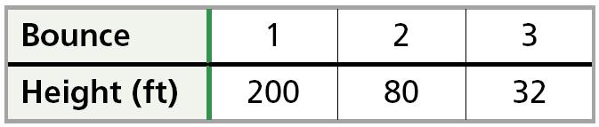
The table shows the heights of a bungee jumper’s bounces.
The height of the bounces shown in the table above form a geometric sequence. In a geometric sequence, the ratio of successive terms is the same number r, called the common ratio.

Slide 6
Geometric sequences can be thought of as functions. The term number, or position in the sequence, is the input, and the term itself is the output.
1 2 3 4 Position
3 6 12 24 Term
a₁ a₂ a₃ a₄
To find a term in a geometric sequence, multiply the previous term by r.

Slide 7
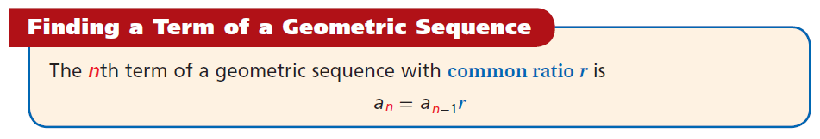

Slide 8
Writing Math
The variable a is often used to represent terms in a sequence. The variable a₄ (read “a sub 4”)is the fourth term in a sequence.

Slide 9

Example 1A: Extending Geometric Sequences
Find the next three terms in the geometric sequence.
1, 4, 16, 64,…
Step 1 Find the value of r by dividing each term by the one before it.
1 4 16 64
The value of r is 4.

Slide 10

Example 1A Continued
Find the next three terms in the geometric sequence.
1, 4, 16, 64,…
Step 2 Multiply each term by 4 to find the next three terms.
64 256 1024 4096
×4 ×4 ×4
The next three terms are 256, 1024, and 4096.

Slide 11







Example 1B: Extending Geometric Sequences
Find the next three terms in the geometric sequence.
Step 1 Find the value of r by dividing each term by the one before it.
The value of r is .
–

Slide 12
Helpful Hint
When the terms in a geometric sequence alternate between positive and negative, the value of r is negative.

Slide 13



Example 1B Continued
Find the next three terms in the geometric sequence.
Step 2 Multiply each term by to find the next three terms.
The next three terms are

Slide 14



Check It Out! Example 1a
Find the next three terms in the geometric sequence.
5, –10, 20,–40,…
Step 1 Find the value of r by dividing each term by the one before it.
5 –10 20 –40
The value of
r is –2.

Slide 15
Check It Out! Example 1a Continued
Find the next three terms in the geometric sequence.
5, –10, 20,–40,…
Step 2 Multiply each term by –2 to find the next three terms.
–40 80 –160 320
×(–2) ×(–2) ×(–2)
The next three terms are 80, –160, and 320.

Slide 16


Check It Out! Example 1b
Find the next three terms in the geometric sequence.
512, 384, 288,…
Step 1 Find the value of r by dividing each term by the one before it.
512 384 288
The value of
r is 0.75.

Slide 17
Check It Out! Example 1b Continued
Find the next three terms in the geometric sequence.
512, 384, 288,…
Step 2 Multiply each term by 0.75 to find the next three terms.
288 216 162 121.5
×0.75 ×0.75 ×0.75
The next three terms are 216, 162, and 121.5.

Slide 18
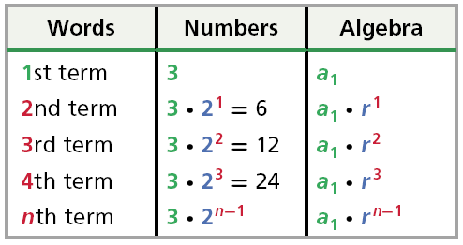
To find the output a_{n} of a geometric sequence when n is a large number, you need an equation, or function rule.
The pattern in the table shows that to get the nth term, multiply the first term by the common ratio raised to the power n – 1.

Slide 19
If the first term of a geometric sequence is a₁, the nth term is a_{n} , and the common ratio is r, then
a_{n} = a₁r^{n–1}
nth term
1st term
Common ratio

Slide 20
Example 2A: Finding the nth Term of a Geometric Sequence
The first term of a geometric sequence is 500, and the common ratio is 0.2. What is the 7th term of the sequence?
a_{n} = a₁r^{n–1}
Write the formula.
a₇ = 500(0.2)^{7–1}
Substitute 500 for a₁,7 for n, and 0.2 for r.
= 500(0.2)⁶
Simplify the exponent.
= 0.032
Use a calculator.
The 7th term of the sequence is 0.032.

Slide 21
Example 2B: Finding the nth Term of a Geometric Sequence
For a geometric sequence, a₁ = 5, and r = 2. Find the 6th term of the sequence.
a_{n} = a₁r^{n–1}
Write the formula.
a₆ = 5(2)^{6–1}
Substitute 5 for a₁,6 for n, and 2 for r.
= 5(2)⁵
Simplify the exponent.
= 160
The 6th term of the sequence is 160.

Slide 22



Example 2C: Finding the nth Term of a Geometric Sequence
What is the 9th term of the geometric sequence 2, –6, 18, –54, …?
2 –6 18 –54
The value of r is –3.
a_{n} = a₁r^{n–1}
Write the formula.
a₉ = 2(–3)^{9–1}
Substitute 2 for a₁,9 for n, and –3 for r.
= 2(–3)⁸
Simplify the exponent.
= 13,122
Use a calculator.
The 9th term of the sequence is 13,122.

Slide 23
Caution
When writing a function rule for a sequence with a negative common ratio, remember to enclose r in parentheses. –2¹² ≠ (–2)¹²

Slide 24




Check It Out! Example 2
What is the 8th term of the sequence 1000, 500, 250, 125, …?
1000 500 250 125
The value of r is .
a_{n} = a₁r^{n–1}
Write the formula.
Substitute 1000 for a₁,8 for n, and for r.
a₈ = 1000( )^{8–1}
Simplify the exponent.
= 7.8125
Use a calculator.
The 8th term of the sequence is 7.8125.

Slide 25


Example 3: Application
A ball is dropped from a tower. The table shows the heights of the balls bounces, which form a geometric sequence. What is the height of the 6th bounce?
Bounce | Height (cm)
1 | 300
2 | 150
3 | 75
300 150 75
The value of r is 0.5.

Slide 26
Example 3 Continued
a_{n} = a₁r^{n–1}
Write the formula.
a₆ = 300(0.5)^{6–1}
Substitute 300 for a₁, 6 for n, and 0.5 for r.
= 300(0.5)⁵
Simplify the exponent.
= 9.375
Use a calculator.
The height of the 6th bounce is 9.375 cm.

Slide 27


Check It Out! Example 3
The table shows a car’s value for 3 years after it is purchased. The values form a geometric sequence. How much will the car be worth in the 10th year?
Year | Value ($)
1 | 10,000
2 | 8,000
3 | 6,400
10,000 8,000 6,400
The value of r is 0.8.

Slide 28
Check It Out! Example 3
a_{n} = a₁r^{n–1}
Write the formula.
a₆ = 10,000(0.8)^{10–1}
Substitute 10,000 for a₁,10 for n, and 0.8 for r.
= 10,000(0.8)⁹
Simplify the exponent.
= 1,342.18
Use a calculator.
In the 10th year, the car will be worth $1342.18.

Slide 29

Lesson Quiz: Part I
Find the next three terms in each geometric sequence.
1. 3, 15, 75, 375,…
2.
3. The first term of a geometric sequence is 300 and the common ratio is 0.6. What is the 7th term of the sequence?
4. What is the 15th term of the sequence 4, –8, 16, –32, 64…?

Slide 30

Lesson Quiz: Part I
Find the next three terms in each geometric sequence.
1. 3, 15, 75, 375,…
2.
3. The first term of a geometric sequence is 300 and the common ratio is 0.6. What is the 7th term of the sequence?
4. What is the 15th term of the sequence 4, –8, 16, –32, 64…?
1875; 9375; 46,875
13.9968
65,536

Slide 31
Lesson Quiz: Part II
Find the next three terms in each geometric sequence.
5. The table shows a car’s value for three years
after it is purchased. The values form a
geometric sequence. How much will the car be
worth after 8 years?
Year | Value ($)
1 | 18,000
2 | 15,300
3 | 13,005
$5570.39

