Slide 1

Point-Slope Form
Warm Up
Lesson Presentation
Lesson Quiz
Holt Algebra 1
Holt McDougal Algebra 1

Slide 2

Warm Up
Find the slope of the line containing each pair of points.
1. (0, 2) and (3, 4) 2. (–2, 8) and (4, 2)
3. (3, 3) and (12, –15)
Write the following equations in slope-intercept form.
4. y – 5 = 3(x + 2)
5. 3x + 4y + 20 = 0
–1
–2
y = 3x + 11

Slide 3
Objectives
Graph a line and write a linear equation using point-slope form.
Write a linear equation given two points.

Slide 4
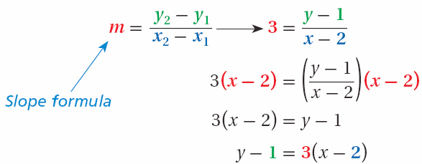
If you know the slope and any point on the line, you can write an equation of the line by using the slope formula. For example, suppose a line has a slope of 3 and contains (2, 1) . Let (x, y) be any other point on the line.
Substitute into the slope formula.
Multiply both sides by (x - 2).
Simplify.

Slide 5
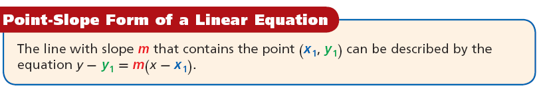

Slide 6


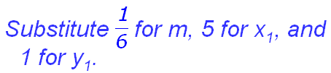

Additional Example 1A: Writing Linear Equations in Point-Slope Form
Write an equation in point slope form for the line with the given slope that contains the given point.
y – y₁ = m (x – x₁)
Write the point-slope form.

Slide 7
Additional Example 1B: Writing Linear Equations in Point-Slope Form
Write an equation in point slope form for the line with the given slope that contains the given point.
slope = –4; (0, 3)
y – y₁ = m(x – x₁)
Write the point-slope form.
Substitute –4 for m, 0 for x₁ and 3 for y₁.
y – 3 = –4(x – 0)
y – 3 = –4(x – 0)

Slide 8
Additional Example 1C: Writing Linear Equations in Point-Slope Form
Write an equation in point slope form for the line with the given slope that contains the given point.
slope = 1; (–1, –4)
y – y₁ = m(x – x₁)
Write the point-slope form.
Substitute 1 for m, –1 for x₁, and –4 for y₁.
y – (–4) = 1(x – (–1))
y + 4 = 1(x + 1)
Rewrite subtraction of negative numbers as addition.

Slide 9
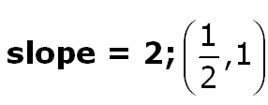
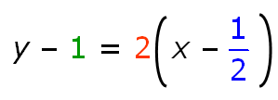

Check It Out! Example 1a
Write an equation in point slope form for the line with the given slope that contains the given point.
y – y₁ = m(x – x₁)
Write the point-slope form.
Substitute 2 for m, for x₁ and 1 for y₁.

Slide 10
Check It Out! Example 1b
Write an equation in point slope form for the line with the given slope that contains the given point.
slope = 0; (3, –4)
y – y₁ = m(x – x₁)
Write the point-slope form.
Substitute 0 for m, 3 for x₁ and –4 for y₁.
y – (–4) = 0(x – 3)
Rewrite subtraction of negative numbers as addition.
y + 4 = 0(x – 3)

Slide 11
In Lesson 5-7, you graphed a line given its equation in slope-intercept form. You can also graph a line when given its equation in point-slope form. Start by using the equation to identify a point on the line. Then use the slope of the line to identify a second point.

Slide 12
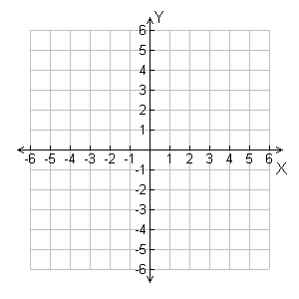

Additional Example 2A: Using Point-Slope Form to Graph
Graph the line described by the equation.
y – 1 = 2(x – 3)
y – 1 = 2(x – 3) is in the form y – y₁= m(x – x₁).
(2,5)
(1,3)
The line contains the point (3, 1).
Step 1 Plot (3, 1).
Step 2 Count 2 units up and 1 unit right and plot another point.
Step 3 Draw the line connecting the two points.

Slide 13

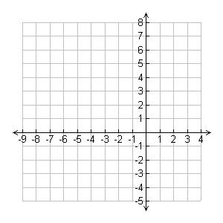


Additional Example 2B: Using Point-Slope Form to Graph
Graph the line described by the equation.
(2,7)
y – 4 = (x – (–2)) is in the
form y – y₁= m(x – x₁).
(-2,4)
The line contains the point (–2, 4).
slope: m =
Step 1 Plot (–2, 4).
Step 2 Count 3 units up and 4 units right and plot another point.
Step 3 Draw the line connecting the two points.

Slide 14
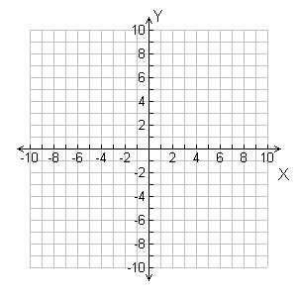
Additional Example 2C: Using Point-Slope Form to Graph
Graph the line described by the equation.
y + 3 = 0(x – 4)
y – (–3) = 0(x – 4) is in the form y – y₁= m(x – x₁).
The line contains the point (4, –3).
slope: m = 0
Step 1 Plot (4, –3).
Step 2 There slope is 0. Every value of x will be at y = –3.
Step 3 Draw the line connecting the points.

Slide 15

Check It Out! Example 2a
Graph the line described by the equation.
y + 2 = –(x – 2)
y – (–2) = –1(x − 2) is in the form y – y₁ = m(x – x₁).
The line contains the point (2, –2).
Step 1 Plot (2, –2).
Step 2 Count 1 unit down and 1 unit right and plot another point.
Step 3 Draw the line connecting the points.

Slide 16
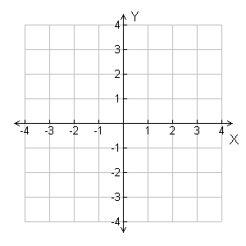
Check It Out! Example 2b
Graph the line described by the equation.
y + 3 = –2(x – 1)
y – (–3) = –2(x − 1) is in the form y – y₁= m(x – x₁).
The line contains the point (1, –3).
slope: m = –2
(0,-1)
Step 1 Plot (1, –3).
(1,-3)
Step 2 Count 2 units up and 1 unit left and plot another point.
Step 3 Draw the line connecting the points.

Slide 17
Additional Example 3A: Writing Linear Equations in Slope-Intercept Form
Write the equation that describes each line in slope-intercept form.
Slope = 3, (–1, 4) is on the line.
Step 1 Write the equation in point-slope form:
y – y₁ = m(x – x₁)
y – 4 = 3[x – (–1)]
Step 2 Write the equation in slope-intercept form by solving for y.
Rewrite subtraction of negative numbers as addition.
y – 4 = 3(x + 1)
Distribute 3 on the right side.
y – 4 = 3x + 3
+ 4 + 4
Add 4 to both sides.
y = 3x + 7

Slide 18

Additional Example 3B: Writing Linear Equations in Slope-Intercept Form
Write the equation that describes the line in slope-intercept form.
(2, –3) and (4, 1)
Step 1 Find the slope.
Step 2 Substitute the slope and one of the points into the point-slope form.
y – y₁ = m(x – x₁)
y – (–3) = 2(x – 2)
Choose (2, –3).

Slide 19
Additional Example 3B Continued
Write an equation in slope-intercept form for the line through the two points.
(2, –3) and (4, 1)
Step 3 Write the equation in slope-intercept form.
y + 3 = 2(x – 2)
y + 3 = 2x – 4
–3 –3
y = 2x – 7

Slide 20

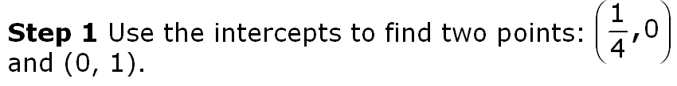
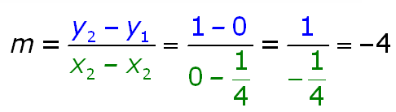
Additional Example 3C: Writing Linear Equations in Slope-Intercept Form
Write the equation that describes the line in slope-intercept form.
Step 2 Find the slope.

Slide 21
Additional Example 3C Continued
Write the equation that describes the line in slope-intercept form.
Step 3 Write the equation in slope-intercept form.
y = mx + b
Write the slope-intercept form.
y = –4x + 1
Substitute –4 for m and 1 for b.

Slide 22
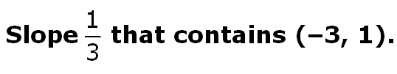
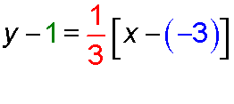
Check It Out! Example 3a
Write the equation that describes the line in slope-intercept form.
Step 1 Write the equation in point-slope form:
y – y₁ = m(x – x₁)

Slide 23
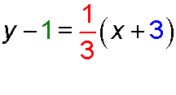


Check It Out! Example 3a Continued
Write an equation in slope-intercept form for the line with slope that contains (–3, 1).
Step 2 Write the equation in slope-intercept form by solving for y.
Rewrite subtraction of negative numbers as addition.
Distribute on the right side.
+1 +1
Add 1 to both sides.

Slide 24

Check It Out! Example 3b
Write an equation in slope-intercept form for the line through the two points.
(1, –2) and (3, 10)
Step 1 Find the slope.
Step 2 Substitute the slope and one of the points into the point-slope form.
y – y₁ = m(x – x₁)
y – (–2) = 6(x – 1)
Choose (1, –2).
y + 2 = 6(x – 1)

Slide 25
Check It Out! Example 3b Continued
Write an equation in slope-intercept form for the line through the two points.
(1, –2) and (3, 10)
Step 3 Write the equation in slope-intercept form.
y + 2 = 6(x – 1)
Distribute 6 on the right side.
y + 2 = 6x – 6
– 2 – 2
Subtract 2 from both sides.
y = 6x – 8

Slide 26



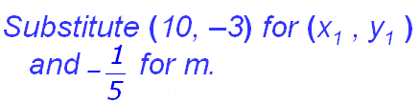



Additional Example 4: Using Two Points Find Intercepts
Write an equation in slope-intercept form for the line through (10, –3) and (5, –2).
Step 1 Find the slope.
Step 2 Write the equation in slope-intercept form.
Write the point-slope form.
Subtract 3 from both sides.

Slide 27
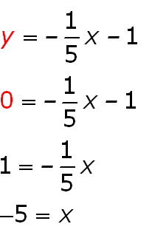
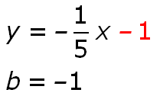
Additional Example 4 Continued
Step 3 Find the intercepts.
x-intercept:
y-intercept:
Use the slope-intercept form to indentify the y-intercept.
Replace y with 0 and solve for x.
The x-intercept is –5, and the y-intercept is –1.

Slide 28

Check It Out! Example 4
Write an equation in slope-intercept form for the line through the two points.
(2, 15) and (–4, –3)
Step 1 Find the slope.
Step 2 Write the equation in slope-intercept form.
y – y₁ = m(x – x₁)
y − 15 = 3(x − 2)
Choose (2, 15).
y − 15 = 3x − 6
Distribute 3 on the right side.
y = 3x + 9
Add 15 to both sides.

Slide 29
Check It Out! Example 4 Continued
Step 3 Find the intercepts.
x-intercept: y-intercept:
Use the slope-intercept form to indentify the y-intercept.
Replace y with 0 and solve for x.
y = 3x + 9
y = 3x + 9
0 = 3x + 9
b = 9
–9 = 3x
–3 = x
The x-intercept is –3, and the y-intercept is 9.

Slide 30

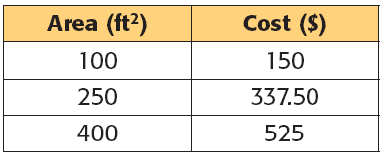
Example 5: Problem-Solving Application
The cost to stain a deck is a linear function of the deck’s area. The cost to stain 100, 250, 400 square feet are shown in the table. Write an equation in slope-intercept form that represents the function. Then find the cost to stain a deck whose area is 75 square feet.

Slide 31

Example 5 Continued
1
Understand the Problem
• The answer will have two parts—an equation in slope-intercept form and the cost to stain an area of 75 square feet.
• The ordered pairs given in the table—(100, 150), (250, 337.50), (400, 525)—satisfy the equation.

Slide 32

Example 5 Continued
2
Make a Plan
You can use two of the ordered pairs to find the slope. Then use point-slope form to write the equation. Finally, write the equation in slope-intercept form.

Slide 33


Example 5 Continued
3
Solve
Step 1 Choose any two ordered pairs from the table to find the slope.
Use (100, 150) and (400, 525).
Step 2 Substitute the slope and any ordered pair from the table into the point-slope form.
y – y₁ = m(x – x₁)
y – 150 = 1.25(x – 100)
Use (100, 150).

Slide 34
Example 5 Continued
3
Solve
Step 3 Write the equation in slope-intercept form by solving for y.
y – 150 = 1.25(x – 100)
y – 150 = 1.25x – 125
Distribute 1.25.
y = 1.25x + 25
Add 150 to both sides.
Step 4 Find the cost to stain an area of 75 sq. ft.
y = 1.25x + 25
y = 1.25(75) + 25 = 118.75
The cost of staining 75 sq. ft. is $118.75.

Slide 35

Example 5 Continued
4
Look Back
If the equation is correct, the ordered pairs that you did not use in Step 2 will be solutions. Substitute (400, 525) and (250, 337.50) into the equation.
y = 1.25x + 25
y = 1.25x + 25
y = 1.25x + 25
525 1.25(400) + 25
337.50 1.25(250) + 25
525 500 + 25
337.50 312.50 + 25
525 525
✓
✓
337.50 337.50

Slide 36
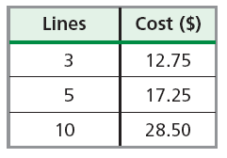
Check It Out! Example 5
What if…? At a newspaper the costs to place an ad for one week are shown. Write an equation in slope-intercept form that represents this linear function. Then find the cost of an ad that is 21 lines long.

Slide 37
Check It Out! Example 5 Continued
1
Understand the problem
• The answer will have two parts—an equation in slope-intercept form and the cost to run an ad that is 21 lines long.
• The ordered pairs given in the table—(3, 12.75), (5, 17.25),(10, 28.50)—satisfy the equation.

Slide 38
Check It Out! Example 5 Continued
2
Make a Plan
You can use two of the ordered pairs to find the slope. Then use the point-slope form to write the equation. Finally, write the equation in slope-intercept form.

Slide 39

Check It Out! Example 5 Continued
3
Solve
Step 1 Choose any two ordered pairs from the table to find the slope.
Use (3, 12.75) and (5, 17.25).
Step 2 Substitute the slope and any ordered pair from the table into the point-slope form.
y – y₁ = m(x – x₁)
y – 17.25 = 2.25(x – 5)
Use (5, 17.25).

Slide 40
Check It Out! Example 5 Continued
3
Solve
Step 3 Write the equation in slope-intercept form by solving for y.
y – 17.25 = 2.25(x – 5)
y – 17.25 = 2.25x – 11.25
Distribute 2.25.
y = 2.25x + 6
Add 17.25 to both sides.
Step 4 Find the cost for an ad that is 21 lines long.
y = 2.25x + 6
y = 2.25(21) + 6 = 53.25
The cost of the ad 21 lines long is $53.25.

Slide 41
Check It Out! Example 5 Continued
4
Look Back
If the equation is correct, the ordered pairs that you did not use in Step 2 will be solutions. Substitute (3, 12.75) and (10, 28.50) into the equation.
y = 2.25x + 6
y = 2.25x + 6
12.75 2.25(3) + 6
28.50 2.25(10) + 6
12.75 6.75 + 6
28.50 22.50 + 6
12.75 12.75
✓
28.50 28.50
✓

Slide 42


Lesson Quiz: Part I
Write an equation in slope-intercept form for the line with the given slope that contains the given point.
1. Slope = –1; (0, 9)
y − 9 = –(x − 0)
2. Slope = ; (3, –6)
y + 6 = (x – 3)
Write an equation that describes each line the slope-intercept form.
3. Slope = –2, (2, 1) is on the line
y = –2x + 5
4. (0, 4) and (–7, 2) are on the line
y = x + 4

Slide 43
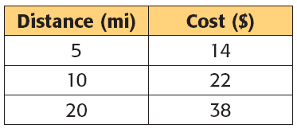
Lesson Quiz: Part II
5. The cost to take a taxi from the airport is a linear function of the distance driven. The cost for 5, 10, and 20 miles are shown in the table. Write an equation in slope-intercept form that represents the function.
y = 1.6x + 6

