Slide 1

Rate of Change and Slope
Warm Up
Lesson Presentation
Lesson Quiz
Holt Algebra 1
Holt McDougal Algebra 1

Slide 2
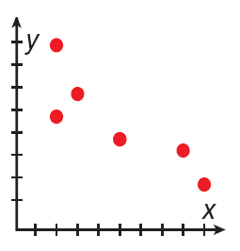
Warm Up
1. Find the x- and y-intercepts of 2x – 5y = 20.
Describe the correlation shown by the scatter plot.
2.
x-int.: 10; y-int.: –4
negative

Slide 3
Objectives
Find rates of change and slopes.
Relate a constant rate of change to the slope of a line.

Slide 4
Vocabulary
rate of change
rise
run
slope

Slide 5

A rate of change is a ratio that compares the amount of change in a dependent variable to the amount of change in an independent variable.

Slide 6
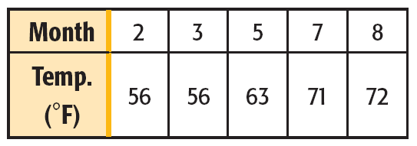
Example 1: Application
The table shows the average temperature (°F) for five months in a certain city. Find the rate of change for each time period. During which time period did the temperature increase at the fastest rate?
Step 1 Identify the dependent and independent variables.
dependent: temperature independent: month

Slide 7








Example 1 Continued
Step 2 Find the rates of change.
2 to 3
3 to 5
5 to 7
7 to 8
The temperature increased at the greatest rate from month 5 to month 7.

Slide 8
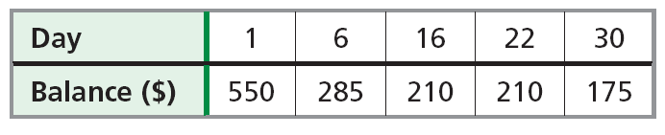
Check It Out! Example 1
The table shows the balance of a bank account on different days of the month. Find the rate of change during each time interval. During which time interval did the balance decrease at the greatest rate?
Step 1 Identify the dependent and independent variables.
dependent: balance independent: day

Slide 9








Check It Out! Example 1 Continued
Step 2 Find the rates of change.
1 to 6
6 to 16
16 to 22
22 to 30
The balance declined at the greatest rate from day 1 to day 6.

Slide 10
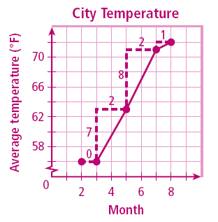
Example 2: Finding Rates of Change from a Graph
Graph the data from Example 1 and show the rates of change.
Graph the ordered pairs. The vertical segments show the changes in the dependent variable, and the horizontal segments show the changes in the independent variable.
Notice that the greatest rate of change is represented by the steepest of the red line segments.

Slide 11
Example 2 Continued
Graph the data from Example 1 and show the rates of change.
Also notice that between months 2 to 3, when the balance did not change, the line segment is horizontal.

Slide 12
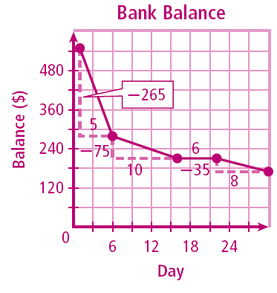
Check It Out! Example 2
Graph the data from Check It Out Example 1 and show the rates of change.
Graph the ordered pairs. The vertical segments show the changes in the dependent variable, and the horizontal segments show the changes in the independent variable.
Notice that the greatest rate of change is represented by the steepest of the red line segments.

Slide 13
Check It Out! Example 2 Continued
Graph the data from Check It Out Problem 1 and show the rates of change.
Also notice that between days 16 to 22, when the balance did not change, the line segment is horizontal.

Slide 14
If all of the connected segments have the same rate of change, then they all have the same steepness and together form a straight line. The constant rate of change of a line is called the slope of the line.

Slide 15
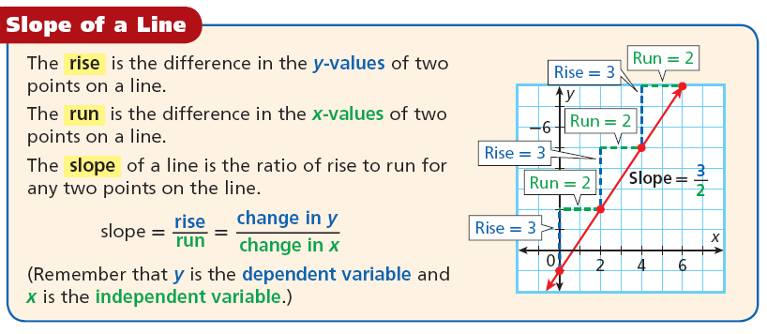

Slide 16
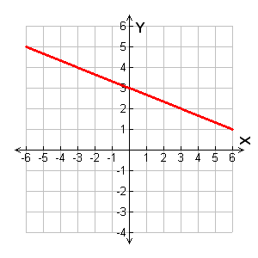


Example 3: Finding Slope
Find the slope of the line.
Run –9
Begin at one point and count vertically to fine the rise.
(–6, 5)
•
Rise 3
Then count horizontally to the second point to find the run.
Rise –3
•
(3, 2)
Run 9
It does not matter which point you start with. The slope is the same.

Slide 17
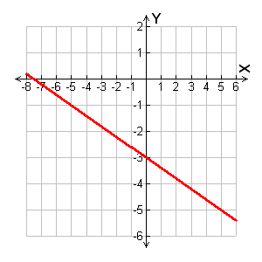


Check It Out! Example 3
Find the slope of the line that contains (0, –3) and (5, –5).
Begin at one point and count vertically to find rise.
Then count horizontally to the second point to find the run.
Run –5
It does not matter which point you start with. The slope is the same.
•
Rise –2
Rise 2
•
Run 5

Slide 18
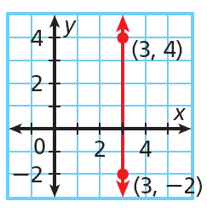
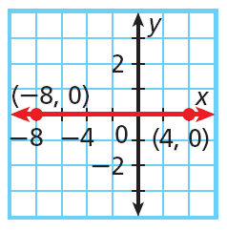


Example 4: Finding Slopes of Horizontal and Vertical Lines
Find the slope of each line.
A.
B.
You cannot divide by 0
The slope is undefined.
The slope is 0.

Slide 19
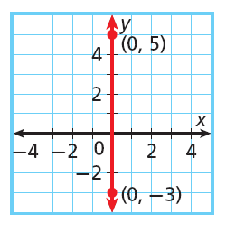
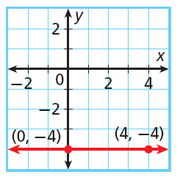


Check It Out! Example 4
Find the slope of each line.
4a.
4b.
You cannot divide by 0.
The slope is undefined.
The slope is 0.

Slide 20
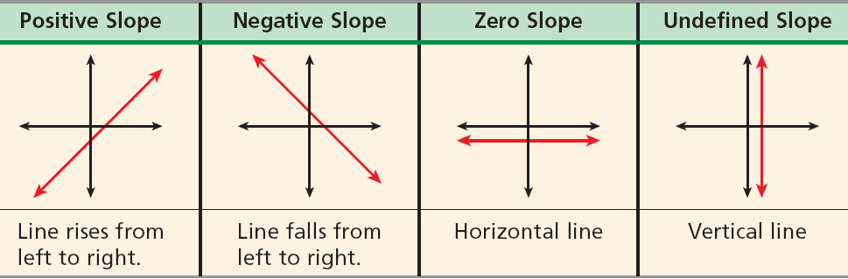
As shown in the previous examples, slope can be positive, negative, zero or undefined. You can tell which of these is the case by looking at a graph of a line–you do not need to calculate the slope.

Slide 21
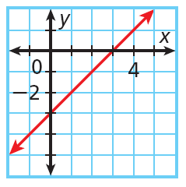
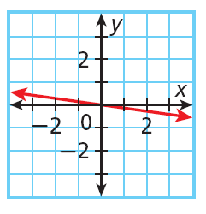
Example 5: Describing Slope
Tell whether the slope of each line is positive, negative, zero or undefined.
A.
B.
The line rises from left to right.
The line falls from left to right.
The slope is positive.
The slope is negative.

Slide 22
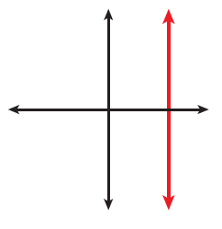
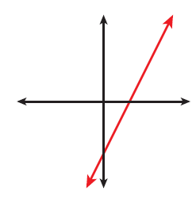
Check It Out! Example 5
Tell whether the slope of each line is positive, negative, zero or undefined.
a.
b.
The line is vertical.
The line rises from left to right.
The slope is undefined.
The slope is positive.

Slide 23
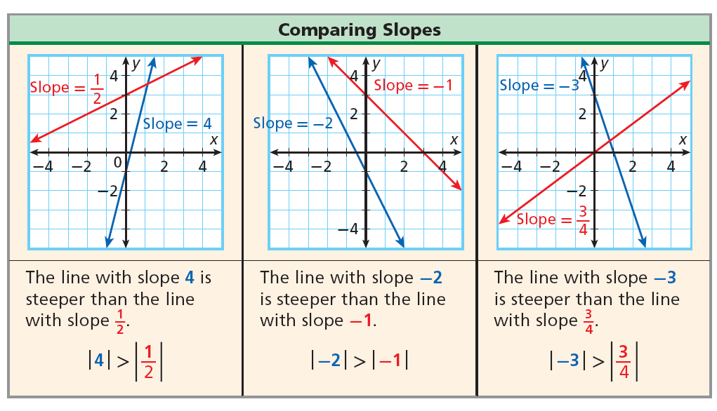

Slide 24
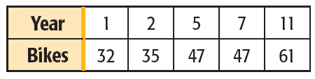
Lesson Quiz: Part I
Name each of the following.
1. The table shows the number of bikes made by a company for certain years. Find the rate of change for each time period. During which time period did the number of bikes increase at the fastest rate?
1 to 2: 3; 2 to 5: 4; 5 to 7: 0; 7 to 11: 3.5;
from years 2 to 5

Slide 25
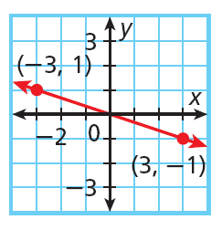
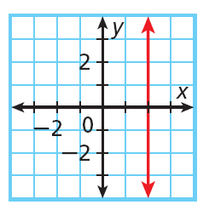

Lesson Quiz: Part II
Find the slope of each line.
2.
3.
undefined

