Slide 1

The Slope Formula
Warm Up
Lesson Presentation
Lesson Quiz
Holt Algebra 1
Holt McDougal Algebra 1

Slide 2
Warm Up
Add or subtract.
1. 4 + (–6) 2. –3 + 5
3. –7 – 7 4. 2 – (–1)
–2
2
–14
3
Find the x- and y-intercepts.
5. x + 2y = 8
6. 3x + 5y = –15
x-intercept: 8; y-intercept: 4
x-intercept: –5; y-intercept: –3

Slide 3
Objective
Find slope by using the slope formula.

Slide 4
In Lesson 5-3, slope was described as the constant rate of change of a line. You saw how to find the slope of a line by using its graph.
There is also a formula you can use to find the slope of a line, which is usually represented by the letter m. To use this formula, you need the coordinates of two different points on the line.

Slide 5
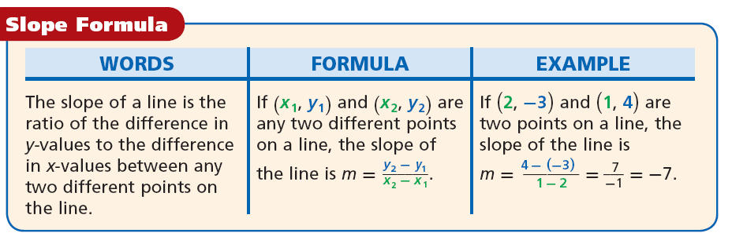

Slide 6





Example 1: Finding Slope by Using the Slope Formula
Find the slope of the line that contains (2, 5) and (8, 1).
Use the slope formula.
Substitute (2, 5) for (x₁, y₁) and (8, 1) for (x₂, y₂).
Simplify.
The slope of the line that contains (2, 5) and (8, 1)
is .

Slide 7


Check It Out! Example 1a
Find the slope of the line that contains (–2, –2) and (7, –2).
Use the slope formula.
Substitute (–2, –2) for (x₁, y₁) and (7, –2) for (x₂, y₂).
Simplify.
= 0
The slope of the line that contains (–2, –2) and (7, –2) is 0.

Slide 8


Check It Out! Example 1b
Find the slope of the line that contains (5, –7) and (6, –4).
Use the slope formula.
Substitute (5, –7) for (x₁, y₁) and (6, –4) for (x₂, y₂).
Simplify.
= 3
The slope of the line that contains (5, –7) and (6, –4) is 3.

Slide 9


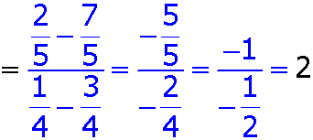


Check It Out! Example 1c
Find the slope of the line that contains and
Use the slope formula.
Substitute for (x₁, y₁) and for (x₂, y₂) and simplify.
The slope of the line that contains and is 2.

Slide 10
Sometimes you are not given two points to use in the formula. You might have to choose two points from a graph or a table.

Slide 11
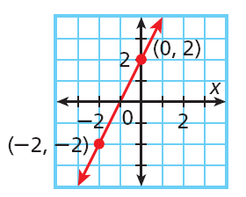


Example 2A: Finding Slope from Graphs and Tables
The graph shows a linear relationship. Find the slope.
Let (0, 2) be (x₁, y₁) and (–2, –2) be (x₂, y₂).
Use the slope formula.
Substitute (0, 2) for (x₁, y₁) and (–2, –2) for (x₂, y₂).
Simplify.

Slide 12
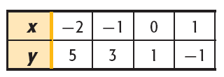



Example 2B: Finding Slope from Graphs and Tables
The table shows a linear relationship. Find the slope.
Step 1 Choose any two points from the table. Let (0, 1) be (x₁, y₁) and (–2, 5) be (x₂, y₂).
Step 2 Use the slope formula.
Use the slope formula.
Substitute (0, 1) for
and (–2, 5) for
.
Simplify.
The slope equals –2

Slide 13


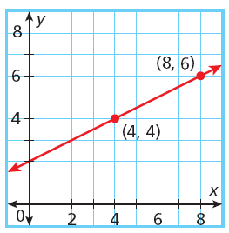
Check It Out! Example 2a
The graph shows a linear relationship. Find the slope.
Let (4, 4) be (x₁, y₁) and (8, 6) be (x₂, y₂).
Use the slope formula.
Substitute (4, 4) for (x₁, y₁) and (8, 6) for (x₂, y₂).
Simplify.

Slide 14
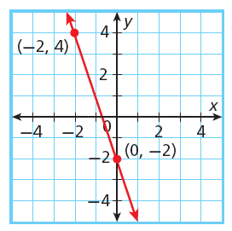


Check It Out! Example 2b
The graph shows a linear relationship. Find the slope.
Let (–2, 4) be (x₁, y₁) and (0, –2) be (x₂, y₂).
Use the slope formula.
Substitute (–2, 4) for (x₁, y₁) and (0, –2) for (x₂, y₂).
Simplify.

Slide 15
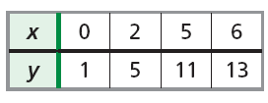

Check It Out! Example 2c
The table shows a linear relationship. Find the slope.
Step 1 Choose any two points from the table. Let (0, 1) be (x₁, y₁) and (2, 5) be (x₂, y₂).
Step 2 Use the slope formula.
Use the slope formula.
Substitute (0, 1) for (x₁, y₁) and (2, 5) for (x₂, y₂).
Simplify.

Slide 16
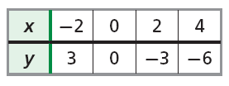

Check It Out! Example 2d
The table shows a linear relationship. Find the slope.
Step 1 Choose any two points from the table. Let (0, 0) be (x₁, y₁) and (–2, 3) be (x₂, y₂).
Step 2 Use the slope formula.
Use the slope formula.
Substitute (0, 0) for (x₁, y₁) and (–2, 3) for (x₂, y₂).
Simplify

Slide 17
Remember that slope is a rate of change. In real-world problems, finding the slope can give you information about how a quantity is changing.

Slide 18
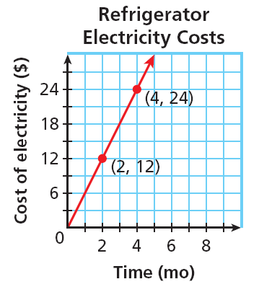


Example 3: Application
The graph shows the average electricity costs (in dollars) for operating a refrigerator for several months. Find the slope of the line. Then tell what the slope represents.
Step 1 Use the slope formula.

Slide 19


Example 3 Continued
Step 2 Tell what the slope represents.
In this situation y represents the cost of electricity and x represents time.
So slope represents in units of
.
A slope of 6 mean the cost of running the refrigerator is a rate of 6 dollars per month.

Slide 20
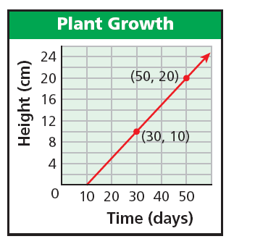


Check It Out! Example 3
The graph shows the height of a plant over a period of days. Find the slope of the line. Then tell what the slope represents.
Step 1 Use the slope formula.

Slide 21


Check It Out! Example 3
Step 2 Tell what the slope represents.
In this situation y represents the height of the plant and x represents time.
So slope represents in units of
.
A slope of mean the plant grows at rate of 1 centimeter every two days.

Slide 22
If you know the equation that describes a line, you can find its slope by using any two ordered-pair solutions. It is often easiest to use the ordered pairs that contain the intercepts.

Slide 23



Example 4: Finding Slope from an Equation
Find the slope of the line described by 4x – 2y = 16.
Step 1 Find the x-intercept.
Step 2 Find the y-intercept.
4x – 2y = 16
4x – 2y = 16
4x – 2(0) = 16
Let y = 0.
4(0) – 2y = 16
Let x = 0.
4x = 16
–2y = 16
x = 4
y = –8
Step 3 The line contains (4, 0) and (0, –8). Use the slope formula.

Slide 24



Check It Out! Example 4
Find the slope of the line described by 2x + 3y = 12.
Step 1 Find the x-intercept.
Step 2 Find the y-intercept.
2x + 3y = 12
2x + 3y = 12
2x + 3(0) = 12
Let y = 0.
2(0) + 3y = 12
Let x = 0.
2x = 12
3y = 12
x = 6
y = 4
Step 3 The line contains (6, 0) and (0, 4). Use the slope formula.

Slide 25

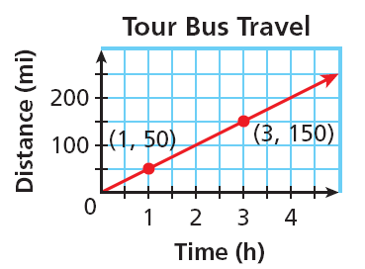

Lesson Quiz
1. Find the slope of the line that contains (5, 3) and (–1, 4).
2. Find the slope of the line. Then tell what the slope represents.
50; speed of bus is 50 mi/h
3. Find the slope of the line described by x + 2y = 8.

