Slide 1

Slopes of Parallel and
Perpendicular Lines
Warm Up
Lesson Presentation
Lesson Quiz
Holt Algebra 1
Holt McDougal Algebra 1

Slide 2
Objectives
Identify and graph parallel and perpendicular lines.
Write equations to describe lines parallel or perpendicular to a given line.

Slide 3
Vocabulary
parallel lines
perpendicular lines

Slide 4
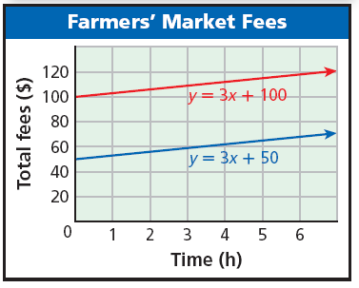
To sell at a particular farmers’ market for a year, there is a $100 membership fee. Then you pay $3 for each hour that you sell at the market. However, if you were a member the previous year, the membership fee is reduced to $50.
The red line shows the total cost if you are a new member.
The blue line shows the total cost if you are a returning member.

Slide 5
These two lines are parallel. Parallel lines are lines in the same plane that have no points in common. In other words, they do not intersect.

Slide 6
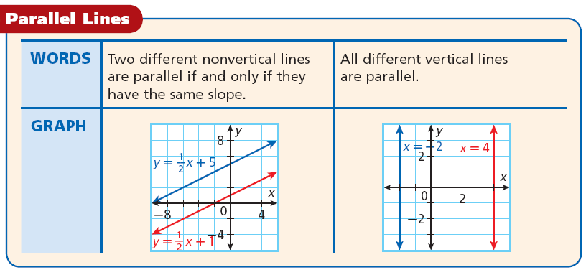

Slide 7


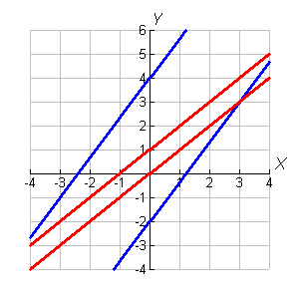



Example 1A: Identifying Parallel Lines
Identify which lines are parallel.
The lines described by
and both have slope . These lines are parallel. The lines described by y = x and y = x + 1 both have slope 1. These lines are parallel.

Slide 8

Example 1B: Identifying Parallel Lines
Identify which lines are parallel.
Write all equations in slope-intercept form to determine the slope.
y = 2x – 3 slope-intercept form
✓
slope-intercept form
✓

Slide 9


Example 1B Continued
Identify which lines are parallel.
Write all equations in slope-intercept form to determine the slope.
2x + 3y = 8
–2x – 2x
y + 1 = 3(x – 3)
3y = –2x + 8
y + 1 = 3x – 9
– 1 – 1
y = 3x – 10

Slide 10

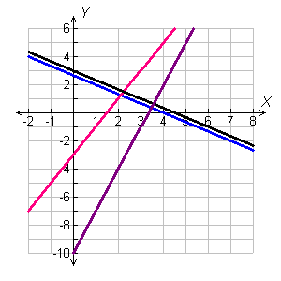

Example 1B Continued
The lines described by y = 2x – 3
and y + 1 = 3(x – 3) are not parallel with any of the lines.
The lines described by
and represent parallel lines. They each have the slope .
y = 2x – 3
y + 1 = 3(x – 3)

Slide 11
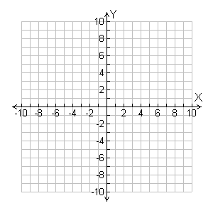
Check It Out! Example 1a
Identify which lines are parallel.
y = 2x + 2; y = 2x + 1; y = –4; x = 1
The lines described by
y = 2x + 2 and y = 2x + 1 represent parallel lines. They each have slope 2.
y = 2x + 2
y = 2x + 1
Equations x = 1 and y = –4 are not parallel.
y = –4
x = 1

Slide 12

Check It Out! Example 1b
Identify which lines are parallel.
Write all equations in slope-intercept form to determine the slope.
y = 3x
✓
✓
Slope-intercept form
Slope-intercept form

Slide 13


Check It Out! Example 1b Continued
Identify which lines are parallel.
Write all equations in slope-intercept form to determine the slope.
–3x + 4y = 32
y – 1 = 3(x + 2)
+3x +3x
y – 1 = 3x + 6
4y = 3x + 32
+ 1 + 1
y = 3x + 7

Slide 14


Check It Out! Example 1b Continued
The lines described by
–3x + 4y = 32 and y = + 8 have the same slope, but they are not parallel lines. They are the same line.
–3x + 4y = 32
y = 3x
The lines described by
y = 3x and y – 1 = 3(x + 2) represent parallel lines. They each have slope 3.
y – 1 = 3(x + 2)

Slide 15
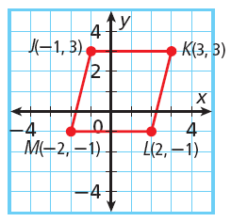


Example 2: Geometry Application
Show that JKLM is a parallelogram.
Use the ordered pairs and the slope formula to find the slopes of MJ and KL.
MJ is parallel to KL because they have the same slope.
JK is parallel to ML because they are both horizontal.
Since opposite sides are parallel, JKLM is a parallelogram.

Slide 16
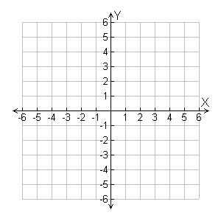


Check It Out! Example 2
Show that the points A(0, 2), B(4, 2), C(1, –3), D(–3, –3) are the vertices of a parallelogram.
Use the ordered pairs and slope formula to find the slopes of AD and BC.
A(0, 2)
•
B(4, 2)
•
•
•
C(1, –3)
D(–3, –3)
AD is parallel to BC because they have the same slope.
AB is parallel to DC because they are both horizontal.
Since opposite sides are parallel, ABCD is a parallelogram.

Slide 17
Perpendicular lines are lines that intersect to form right angles (90°).

Slide 18
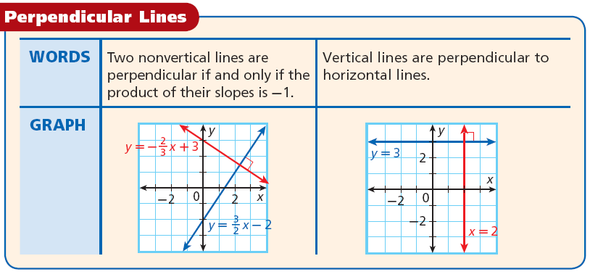

Slide 19

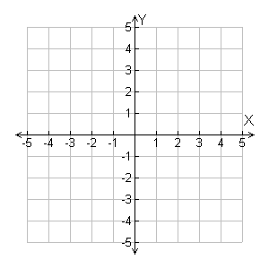



Example 3: Identifying Perpendicular Lines
Identify which lines are perpendicular: y = 3; x = –2; y = 3x; .
The graph described by y = 3 is a horizontal line, and the graph described by x = –2 is a vertical line. These lines are perpendicular.
x = –2
y = 3
The slope of the line described by y = 3x is 3. The slope of the line described by
y =3x
is .

Slide 20

Example 3 Continued
Identify which lines are perpendicular: y = 3; x = –2; y = 3x; .
x = –2
y = 3
These lines are perpendicular because the product of their slopes is –1.
y =3x

Slide 21

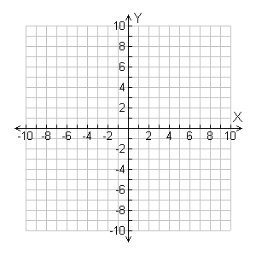



Check It Out! Example 3
Identify which lines are perpendicular: y = –4; y – 6 = 5(x + 4); x = 3; y =
The graph described by x = 3 is a vertical line, and the graph described by y = –4 is a horizontal line. These lines are perpendicular.
x = 3
The slope of the line described by y – 6 = 5(x + 4) is 5. The slope of the line described by
y = is
y = –4
y – 6 = 5(x + 4)

Slide 22

Check It Out! Example 3 Continued
Identify which lines are perpendicular: y = –4; y – 6 = 5(x + 4); x = 3; y =
x = 3
These lines are perpendicular because the product of their slopes is –1.
y = –4
y – 6 = 5(x + 4)

Slide 23
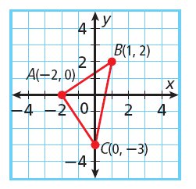



Example 4: Geometry Application
Show that ABC is a right triangle.
If ABC is a right triangle, AB will be perpendicular to AC.
slope of
slope of
AB is perpendicular to AC because
Therefore, ABC is a right triangle because it contains a right angle.

Slide 24
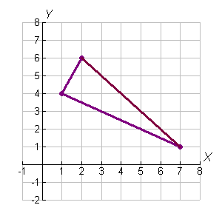


Check It Out! Example 4
Show that P(1, 4), Q(2,6), and R(7, 1) are the vertices of a right triangle.
If PQR is a right triangle, PQ will be perpendicular to PR.
Q(2, 6)
slope of PQ
P(1, 4)
R(7, 1)
slope of PR
PQ is perpendicular to PR because the product of their slopes is –1.
Therefore, PQR is a right triangle because it contains a right angle.

Slide 25
Example 5A: Writing Equations of Parallel and Perpendicular Lines
Write an equation in slope-intercept form for the line that passes through (4, 10) and is parallel to the line described by y = 3x + 8.
Step 1 Find the slope of the line.
y = 3x + 8
The slope is 3.
The parallel line also has a slope of 3.
Step 2 Write the equation in point-slope form.
y – y₁ = m(x – x₁)
Use the point-slope form.
Substitute 3 for m, 4 for x₁, and 10 for y₁.
y – 10 = 3(x – 4)

Slide 26

Example 5A Continued
Write an equation in slope-intercept form for the line that passes through (4, 10) and is parallel to the line described by y = 3x + 8.
Step 3 Write the equation in slope-intercept form.
y – 10 = 3(x – 4)
y – 10 = 3x – 12
Distributive Property
y = 3x – 2
Addition Property of Equality

Slide 27




Example 5B: Writing Equations of Parallel and Perpendicular Lines
Write an equation in slope-intercept form for the line that passes through (2, –1) and is perpendicular to the line described by y = 2x – 5.
Step 1 Find the slope of the line.
y = 2x – 5
The slope is 2.
The perpendicular line has a slope of because
Step 2 Write the equation in point-slope form.
Use the point-slope form.
y – y₁ = m(x – x₁)
Substitute for m, –1 for y₁, and 2 for x₁.

Slide 28



Example 5B Continued
Write an equation in slope-intercept form for the line that passes through (2, –1) and is perpendicular to the line described by y = 2x – 5.
Step 3 Write the equation in slope-intercept form.
Distributive Property
Addition Property of Equality.

Slide 29



Helpful Hint
If you know the slope of a line, the slope of a perpendicular line will be the "opposite reciprocal.”

Slide 30


Check It Out! Example 5a
Write an equation in slope-intercept form for the line that passes through (5, 7) and is parallel to the line described by y = x – 6.
Step 1 Find the slope of the line.
y = x –6
The slope is .
The parallel line also has a slope of .
Step 2 Write the equation in point-slope form.
y – y₁ = m(x – x₁)
Use the point-slope form.

Slide 31



Check It Out! Example 5a Continued
Write an equation in slope-intercept form for the line that passes through (5, 7) and is parallel to the line described by y = x – 6.
Step 3 Write the equation in slope-intercept form.
Distributive Property
Addition Property of Equality

Slide 32




Check It Out! Example 5b
Write an equation in slope-intercept form for the line that passes through (–5, 3) and is perpendicular to the line described by y = 5x.
Step 1 Find the slope of the line.
y = 5x
The slope is 5.
The perpendicular line has a slope of because
.
Step 2 Write the equation in point-slope form.
y – y₁ = m(x – x₁)
Use the point-slope form.

Slide 33




Check It Out! Example 5b Continued
Write an equation in slope-intercept form for the line that passes through (–5, 3) and is perpendicular to the line described by y = 5x.
Step 3 Write the equation in slope-intercept form.
Distributive Property
Addition Property

Slide 34
On pg. 175 in notebook complete
Page 513-515 in notebook#3-17 ODD, and 23,
25, 35, 37, 39, and 53

Slide 35

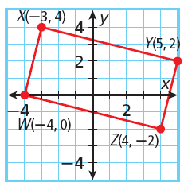
Exit Ticket 21
Write an equation is slope-intercept form for the line described.
1. contains the point (8, –12) and is parallel to
2. contains the point (4, –3) and is perpendicular to y = 4x + 5
3. Show that WXYZ is a rectangle.

Slide 36


Lesson Quiz: Part I
Write an equation is slope-intercept form for the line described.
1. contains the point (8, –12) and is parallel to
2. contains the point (4, –3) and is perpendicular to y = 4x + 5

Slide 37

Lesson Quiz: Part II
3. Show that WXYZ is a rectangle.
slope of =
XY
slope of YZ = 4
slope of =
WZ
slope of XW = 4
The product of the slopes of adjacent sides is –1. Therefore, all angles are right angles, and WXYZ is a rectangle.

