Slide 1

Symmetry
Warm Up
Lesson Presentation
Lesson Quiz
Holt McDougal Geometry
Holt Geometry

Slide 2


Warm Up
Identify each transformation.
1.
2.
Rotation
Reflection
Rotate ∆ABC with the given vertices by the given angle.
3. A(3, –4), B(5, 1), C(–4, 0); 180°
A’(–3, 4), B’(–5, –1), C(4, 0)
4. A(1, –5), B(7, –1), C(3, 6); 90°
A’(5, 1), B’(1, 7), C(–6, 3)

Slide 3
Objective
Identify and describe symmetry in geometric figures.

Slide 4
Vocabulary
symmetry
line symmetry
line of symmetry
rotational symmetry

Slide 5
Diatoms are microscopic algae that are found in aquatic environments. Scientists use a system that was developed in the 1970s to classify diatoms based on their symmetry.
A figure has symmetry if there is a transformation of the figure such that the image coincides with the preimage.

Slide 6
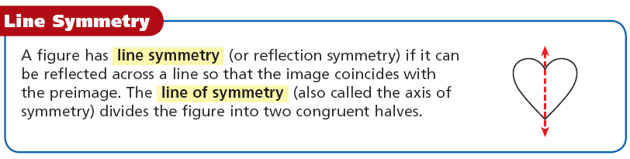

Slide 7


Example 1A: Identifying line of symmetry
Tell whether the figure has line symmetry. If so, copy the shape and draw all lines of symmetry.
yes; eight lines of symmetry

Slide 8
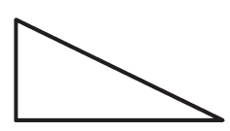
Example 1B: Identifying line of symmetry
Tell whether the figure has line symmetry. If so, copy the shape and draw all lines of symmetry.
no line symmetry

Slide 9


Example 1C: Identifying line of symmetry
Tell whether the figure has line symmetry. If so, copy the shape and draw all lines of symmetry.
Yes; four lines of symmetry

Slide 10
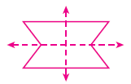





Check It Out! Example 1
Tell whether each figure has line symmetry. If so, copy the shape and draw all lines of symmetry.
a.
yes; two lines of symmetry
yes; one line of symmetry
b.
c.
yes; one line of symmetry

Slide 11
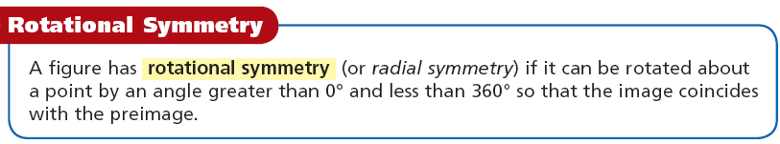

Slide 12
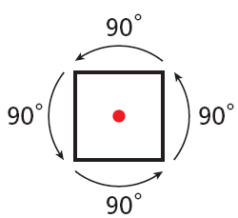
The angle of rotational symmetry is the smallest angle through which a figure can be rotated to coincide with itself. The number of times the figure coincides with itself as it rotates through 360° is called the order of the rotational symmetry.
Angle of rotational symmetry: 90° Order: 4

Slide 13



Example 2: Identifying Rotational Symmetry
Tell whether each figure has rotational symmetry. If so, give the angle of rotational symmetry and the order of the symmetry.
A.
no rotational symmetry
B.
yes; 180°; order: 2
C.
yes; 90°;
order: 4

Slide 14



Check It Out! Example 2
Tell whether each figure has rotational symmetry. If so, give the angle of rotational symmetry and the order of the symmetry.
a.
b.
c.
yes; 120°; order: 3
yes; 180°; order: 2
no rotational symmetry

Slide 15

Example 3A: Design Application
Describe the symmetry of each icon. Copy each shape and draw any lines of symmetry. If there is rotational symmetry, give the angle and order.
No line symmetry; rotational symmetry; angle of rotational symmetry: 180°; order: 2

Slide 16


Example 3B: Design Application
Describe the symmetry of each icon. Copy each shape and draw any lines of symmetry. If there is rotational symmetry, give the angle and order.
Line symmetry and rotational symmetry;
angle of rotational symmetry: 90°; order: 4

Slide 17
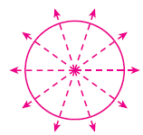



Check It Out! Example 3
Describe the symmetry of each diatom. Copy the shape and draw any lines of symmetry. If there is rotational symmetry, give the angle and order.
a.
b.
line symmetry and rotational symmetry; 72°; order: 5
line symmetry and rotational symmetry; 51.4°; order: 7

Slide 18
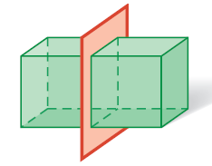
A three-dimensional figure has plane symmetry if a plane can divide the figure into two congruent reflected halves.
Plane symmetry

Slide 19
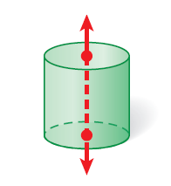
A three-dimensional figure has symmetry about an axis if there is a line about which the figure can be rotated (by an angle greater than 0° and less than 360°) so that the image coincides with the preimage.
Symmetry about an axis

Slide 20
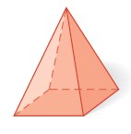

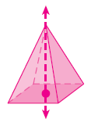

Example 4A: Identifying Symmetry in Three Dimensions
Tell whether the figure has plane symmetry, symmetry about an axis, or neither.
plane symmetry and symmetry about an axis

Slide 21
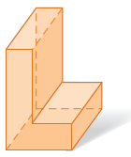
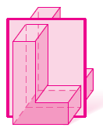
Example 4B: Identifying Symmetry in Three Dimensions
Tell whether the figure has plane symmetry, symmetry about an axis, or neither.
plane symmetry

Slide 22
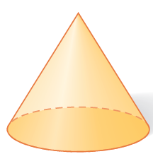
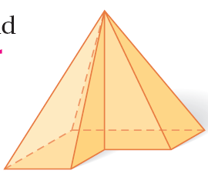
Check It Out! Example 4
Tell whether each figure has plane symmetry, symmetry about an axis, or no symmetry.
a. cone
b. pyramid
plane symmetry and symmetry about an axis
neither

Slide 23
On pg. 165 in interactive notebook
Complete Pg. 487 1-25 ODD

Slide 24
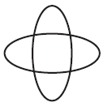


Lesson Quiz: Part I
Describe the symmetry of each figure. Draw any lines of symmetry. Give the angle and the order of any rotational symmetry.
1.
Line symmetry and rotational symmetry; 90°; order: 4
2.
No symmetry

Slide 25
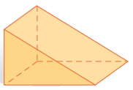
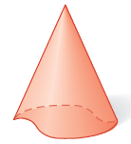
Lesson Quiz: Part II
Tell whether each figure has plane symmetry, symmetry about an axis, or neither.
3.
plane symmetry
4.
symmetry about an axis

