Slide 1

Tessellations
Warm Up
Lesson Presentation
Lesson Quiz
Holt McDougal Geometry
Holt Geometry

Slide 2
Warm Up
Find the sum of the interior angle measures of each polygon.
1. quadrilateral
360°
2. octagon
1080°
Find the interior angle measure of each regular polygon.
3. square
90°
4. pentagon
108°
5. hexagon
120°
6. octagon
135°

Slide 3
Objectives
Use transformations to draw tessellations.
Identify regular and semiregular tessellations and figures that will tessellate.

Slide 4
Vocabulary
translation symmetry
frieze pattern
glide reflection symmetry
regular tessellation
semiregular tessellation

Slide 5
A pattern has translation symmetry if it can be translated along a vector so that the image coincides with the preimage. A frieze pattern is a pattern that has translation symmetry along a line.

Slide 6

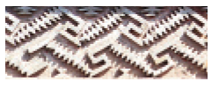
Both of the frieze patterns shown below have translation symmetry. The pattern on the right also has glide reflection symmetry. A pattern with glide reflection symmetry coincides with its image after a glide reflection.

Slide 7
Helpful Hint
When you are given a frieze pattern, you may assume that the pattern continues forever in both directions.

Slide 8


Example 1: Art Application
Identify the symmetry in each wallpaper border pattern.
A.
translation symmetry
B.
translation symmetry and glide reflection symmetry

Slide 9

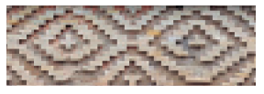
Check It Out! Example 1
Identify the symmetry in each frieze pattern.
a.
b.
translation symmetry and glide reflection symmetry
translation symmetry

Slide 10
A tessellation, or tiling, is a repeating pattern that completely covers a plane with no gaps or overlaps. The measures of the angles that meet at each vertex must add up to 360°.

Slide 11
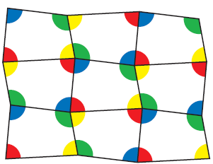
In the tessellation shown, each angle of the quadrilateral occurs once at each vertex. Because the angle measures of any quadrilateral add to 360°, any quadrilateral can be used to tessellate the plane. Four copies of the quadrilateral meet at each vertex.

Slide 12
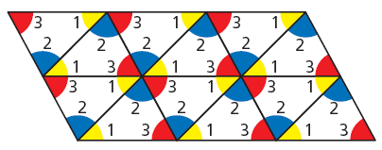

The angle measures of any triangle add up to 180°. This means that any triangle can be used to tessellate a plane. Six copies of the triangle meet at each vertex as shown.

Slide 13


Example 2A: Using Transformations to Create Tessellations
Copy the given figure and use it to create a tessellation.
Step 1 Rotate the triangle 180° about the midpoint of one side.

Slide 14
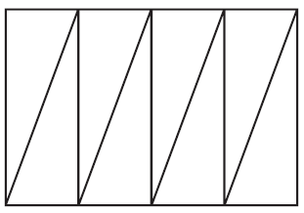
Example 2A Continued
Step 2 Translate the resulting pair of triangles to make a row of triangles.

Slide 15

Example 2A Continued
Step 3 Translate the row of triangles to make a tessellation.

Slide 16
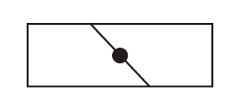

Example 2B: Using Transformations to Create Tessellations
Copy the given figure and use it to create a tessellation.
Step 1 Rotate the quadrilateral 180° about the midpoint of one side.

Slide 17

Example 2B Continued
Step 2 Translate the resulting pair of quadrilaterals to make a row of quadrilateral.

Slide 18

Example 2B Continued
Step 3 Translate the row of quadrilaterals to make a tessellation.

Slide 19
Check It Out! Example 2
Copy the given figure and use it to create a tessellation.
•
Step 1 Rotate the figure 180° about the midpoint of one side.

Slide 20
Check It Out! Example 2 Continued
Step 2 Translate the resulting pair of figures to make a row of figures.

Slide 21
Check It Out! Example 2 Continued
Step 3 Translate the row of quadrilaterals to make a tessellation.

Slide 22
A regular tessellation is formed by congruent regular polygons. A semiregular tessellation is formed by two or more different regular polygons, with the same number of each polygon occurring in the same order at every vertex.

Slide 23
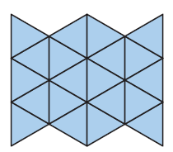
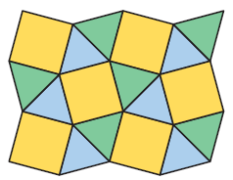
Every vertex has two squares and three triangles in this order: square, triangle, square, triangle, triangle.
Regular
tessellation
Semiregular
tessellation

Slide 24
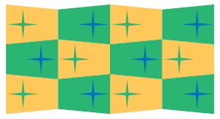
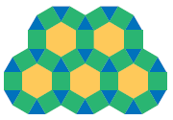

Example 3: Classifying Tessellations
Classify each tessellation as regular, semiregular, or neither.
Irregular polygons are used in the tessellation. It is neither regular nor semiregular.
Only triangles are used. The tessellation is regular.
A hexagon meets two squares and a triangle at each vertex. It is semiregular.

Slide 25
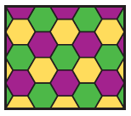
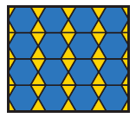
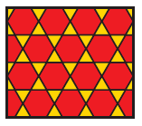
Check It Out! Example 3
Classify each tessellation as regular, semiregular, or neither.
Only hexagons are used. The tessellation is regular.
It is neither regular nor semiregular.
Two hexagons meet two triangles at each vertex. It is semiregular.

Slide 26

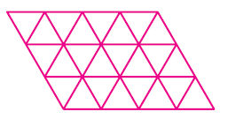
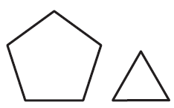
Example 4: Determining Whether Polygons Will Tessellate
Determine whether the given regular polygon(s) can be used to form a tessellation. If so, draw the tessellation.
A.
B.
Yes; six equilateral triangles meet at each vertex. 6(60°) = 360°
No; each angle of the pentagon measures 108°, and the equation
108n + 60m = 360 has no solutions with n and m positive integers.

Slide 27

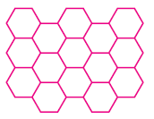

Check It Out! Example 4
Determine whether the given regular polygon(s) can be used to form a tessellation. If so, draw the tessellation.
a.
b.
Yes; three equal hexagons meet at each vertex.
No

Slide 28
Pg 494 #1-31 ODD
In interactive notebook on pg 167

Slide 29


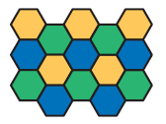

Exit Ticket 20
1. Identify the symmetry in the frieze pattern.
2. Copy the given figure and use it to create a tessellation.
3. Classify the tessellation as regular, semiregular, or neither.
4. Determine whether the given regular polygons can be used to form a tessellation. If so, draw the tessellation.

Slide 30

Lesson Quiz: Part I
1. Identify the symmetry in the frieze pattern.
translation symmetry and glide reflection symmetry
2. Copy the given figure and use it to create a tessellation.

Slide 31

Lesson Quiz: Part II
3. Classify the tessellation as regular, semiregular, or neither.
regular
4. Determine whether the given regular polygons can be used to form a tessellation. If so, draw the tessellation.

