Slide 1

Translations
Warm Up
Lesson Presentation
Lesson Quiz
Holt McDougal Geometry
Holt Geometry

Slide 2
Warm Up
Find the coordinates of the image of ∆ABC with vertices A(3, 4), B(–1, 4), and C(5, –2), after each reflection.
1. across the x-axis
A’(3, –4), B’(–1, –4), C’(5, 2)
2. across the y-axis
A’(–3, 4), B’(1, 4), C’(–5, –2)
3. across the line y = x
A’(4, 3), B’(4, –1), C’(–2, 5)

Slide 3
Pg. 462-463
  1-27 ODD
  On page 157 in Notebook

Slide 4
Objective
Identify and draw translations.

Slide 5
A translation is a transformation where all the points of a figure are moved the same distance in the same direction. A translation is an isometry, so the image of a translated figure is congruent to the preimage.

Slide 6
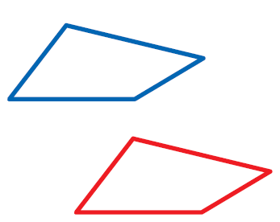

Example 1: Identifying Translations
Tell whether each transformation appears to be a translation. Explain.
A.
B.
No; the figure appears to be flipped.
Yes; the figure appears to slide.

Slide 7
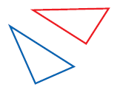

Check It Out! Example 1
Tell whether each transformation appears to be a translation.
a.
b.
Yes; all of the points
have moved the same
distance in the same
direction.
No; not all of the points have moved the same distance.

Slide 8
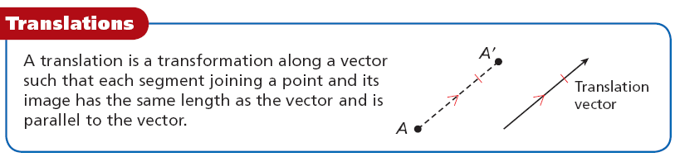

Slide 9
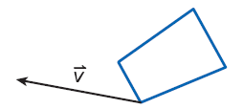
Example 2: Drawing Translations
Copy the quadrilateral and the translation vector. Draw the translation along
Step 1 Draw a line parallel to the vector through each vertex of the triangle.

Slide 10
Example 2 Continued
Step 2 Measure the length of the vector. Then, from each vertex mark off the distance in the same direction as the vector, on each of the parallel lines.
Step 3 Connect the images of
the vertices.

Slide 11
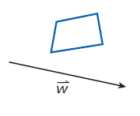
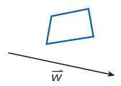
Check It Out! Example 2
Copy the quadrilateral and the translation vector. Draw the translation of the quadrilateral along
Step 1 Draw a line parallel to the vector through each vertex of the quadrangle.

Slide 12

Check It Out! Example 2 Continued
Step 2 Measure the length of the vector. Then, from each vertex mark off this distance in the same direction as the vector, on each of the parallel lines.
•
•
•
•
Step 3 Connect the images
of the vertices.

Slide 13
Recall that a vector in the coordinate plane can be written as <a, b>, where a is the horizontal change and b is the vertical change from the initial point to the terminal point.

Slide 14
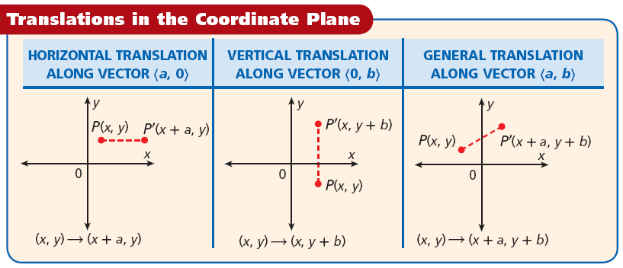

Slide 15
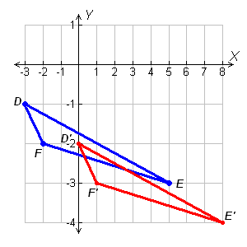
Example 3: Drawing Translations in the Coordinate Plane
Translate the triangle with vertices D(–3, –1), E(5, –3), and F(–2, –2) along the vector <3, –1>.
The image of (x, y) is (x + 3, y – 1).
D(–3, –1) D’(–3 + 3, –1 – 1) = D’(0, –2)
E(5, –3) E’(5 + 3, –3 – 1) = E’(8, –4)
F(–2, –2) F’(–2 + 3, –2 – 1) = F’(1, –3)
Graph the preimage and the image.

Slide 16
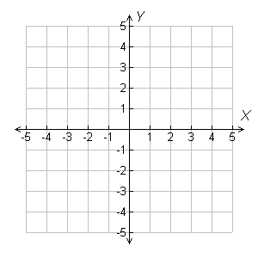
Check It Out! Example 3
Translate the quadrilateral with vertices R(2, 5), S(0, 2), T(1,–1), and U(3, 1) along the vector
<–3, –3>.
The image of (x, y) is (x – 3, y – 3).
R(2, 5) R’(2 – 3, 5 – 3)
= R’(–1, 2)
R
S(0, 2) S’(0 – 3, 2 – 3)
= S’(–3, –1)
R’
S
U
T(1, –1) T’(1 – 3, –1 – 3)
= T’(–2, –4)
S’
U’
T
U(3, 1) U’(3 – 3, 1 – 3)
= U’(0, –2)
T’
Graph the preimage and the image.

Slide 17
Example 3: Recreation Application
A sailboat has coordinates 100° west and 5° south. The boat sails 50° due west. Then the boat sails 10° due south. What is the boat’s final position? What single translation vector moves it from its first position to its final position?

Slide 18
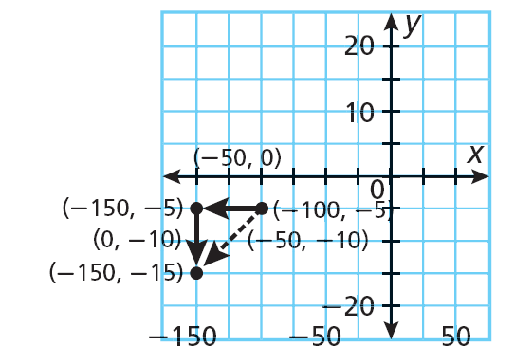
Example 3: Recreation Application
The boat’s starting coordinates are (–100, –5).
The boat’s second position is (–100 – 50, –5) = (–150, –5).
The boat’s final position is
(–150, – 5 – 10) = (–150, –15), or 150° west, 15° south.
The vector that moves the boat directly to its final position is (–50, 0) + (0, –10) = (–50, –10).

Slide 19
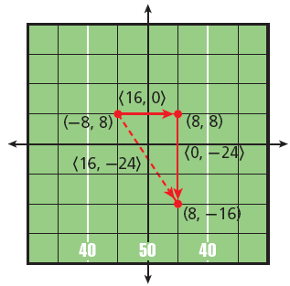
Check It Out! Example 4
What if…? Suppose another drummer started at the center of the field and marched along the same vectors as at right. What would this drummer’s final position be?
The drummer’s starting coordinates are (0, 0).
The vector that moves the drummer directly to her final position is (0, 0) + (16, –24) = (16, –24).

Slide 20

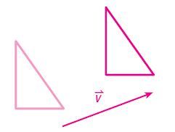
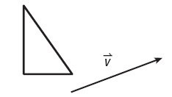
Lesson Quiz: Part I
1. Tell whether the transformation appears to be a translation.
yes
2. Copy the triangle and the translation vector. Draw the translation of the triangle along

Slide 21
& Reflections
Exit Ticket 19
1. Tell whether the transformation appears to be a translation.
Translate the figure with the given vertices along the given vector.
2. S(0, –7), T(–4, 4), U(–5, 2), V(8, 1); <–4, 5>
Reflect the figure with the given vertices across the given line.
3. A(2, 3), B(–1, 5), C(4,–1); y = x
4. U(–8, 2), V(–3, –1), W(3, 3); y-axis
5. E(–3, –2), F(6, –4), G(–2, 1); x-axis

Slide 22
Lesson Quiz: Part II
Translate the figure with the given vertices along the given vector.
3. G(8, 2), H(–4, 5), I(3,–1); <–2, 0>
G’(6, 2), H’(–6, 5), I’(1, –1)
4. S(0, –7), T(–4, 4), U(–5, 2), V(8, 1); <–4, 5>
S’(–4, –2), T’(–8, 9), U’(–9, 7), V’(4, 6)

Slide 23
Lesson Quiz: Part II
Reflect the figure with the given vertices across the given line.
3. A(2, 3), B(–1, 5), C(4,–1); y = x
A’(3, 2), B’(5,–1), C’(–1, 4)
4. U(–8, 2), V(–3, –1), W(3, 3); y-axis
U’(8, 2), V’(3, –1), W’(–3, 3)
5. E(–3, –2), F(6, –4), G(–2, 1); x-axis
E’(–3, 2), F’(6, 4), G’(–2, –1)

Slide 24
Lesson Quiz: Part III
5. A rook on a chessboard has coordinates (3, 4). The rook is moved up two spaces. Then it is moved three spaces to the left. What is the rook’s final position? What single vector moves the rook from its starting position to its final position?
(0, 6); <–3, 2>

