Slide 1
Coordinate Algebra
January 9th, 2014
Goals, College, and Rates

Slide 2
Letter to your future self
Write a FULL 1-page letter to yourself addressing the following:
What do you want accomplish this semester?
What grade will you receive?
How do you want to act?
What will you do each day to assure you meet your goals?
How do you want to perform on the EOCT?
What will you do to meet that goal?
What will do to become a problem solver in math and life?

Slide 3
Before the Bell Rings
Enter quietly
Before sitting down pick-up your packet and folder
Sharpen your pencil
Write down homework
Take out homework
Begin inbox task

Slide 4
Our Big Goals…
Our big number is 100

Slide 5
100% Mastery
Mastery means an higher than an 80%
Master every objective, quiz, and test
If at first you don’t succeed, try again
This means everyone will get an A or B

Slide 6
100% EOCT Meets or Exceeds
Expectations
Everyone will pass their EOCT
Hard work = success

Slide 7
100 Point SAT improvement
This means 10 point improvement on PSAT math section
 | 2010 SAT Math | 2011 SAT Math | 2012 SAT Math
Nation | 516 | 514 | 505
DeKalb County | 442 | 446 | 450
Stephenson | 418 | 428 | 420
Chamblee | 553 | 551 | 543
Lakeside | 542 | 541 | 515
DECA | - | 514 | 494
Parkview | 544 | 550 | 542

Slide 8
Raffle Tickets
Weekly raffle is held on Friday with rewards randomly chosen
Must turn in raffle tickets at the end of each day
Raffle tickets are an privilege not a right
  DO NOT ASK FOR A TICKET
  If I miss you I’ll try to get you a different time

Slide 9
College is Incredible
Why should I go to college?
Let’s see how college is even better than high school.

Slide 10
College is Incredible
I had a great time in college. Best years of my life!
I got to live on my own away from my parents and their rules.

Slide 11
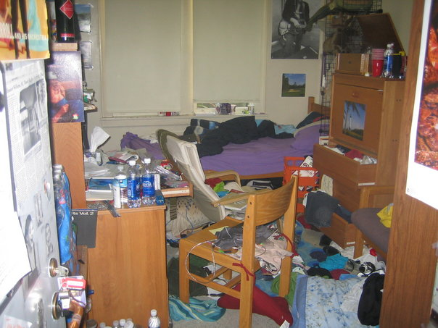

Slide 12
College is Incredible
I went to Brigham Young University in Utah, one of the most beautiful campuses in the country.

Slide 13
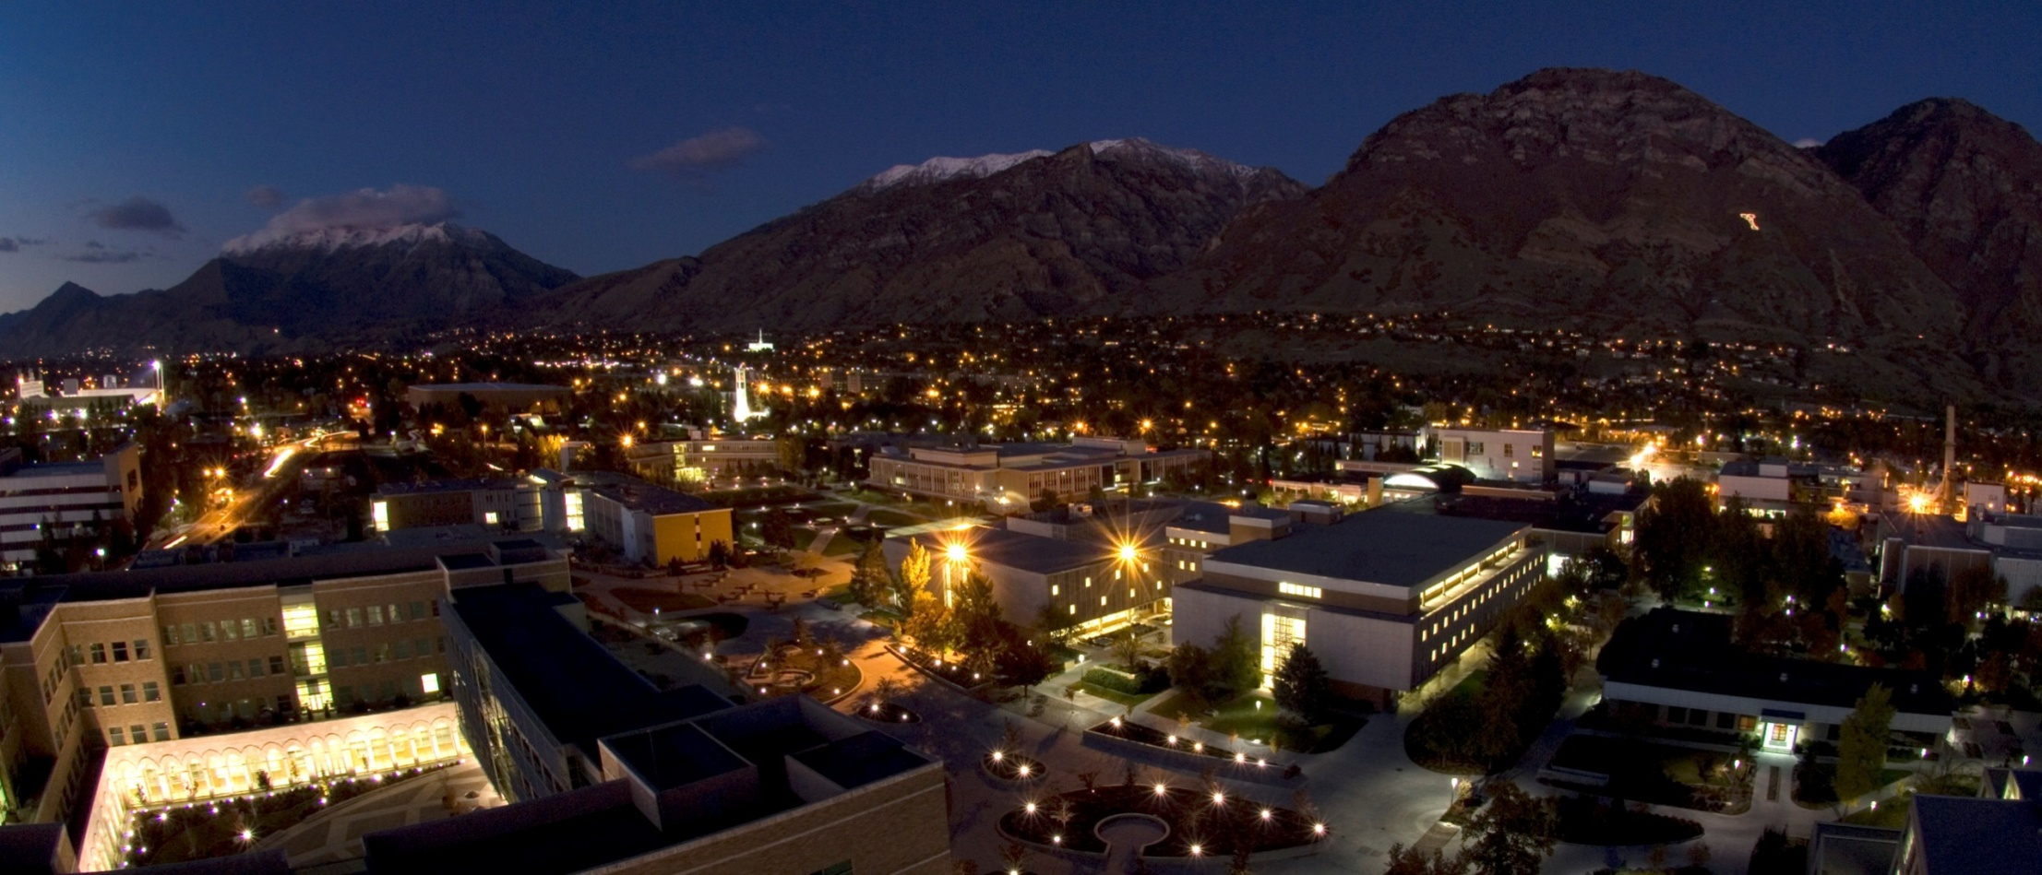


Slide 14
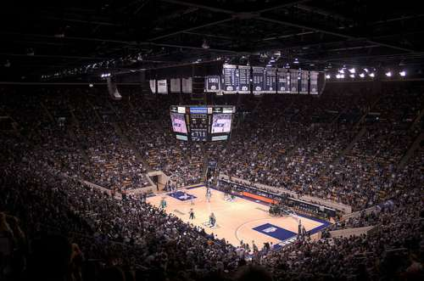



Slide 15
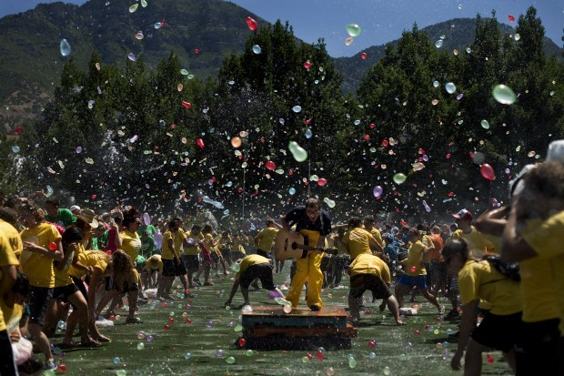
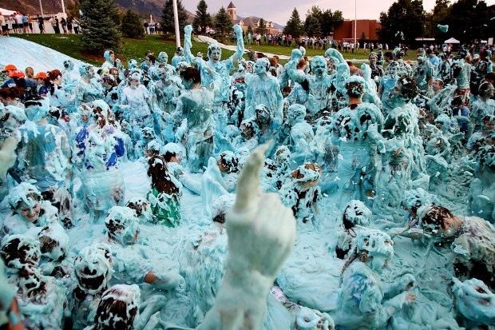

Slide 16


College is Incredible
I got internships and learned about business, and made money in the summer working.

Slide 17
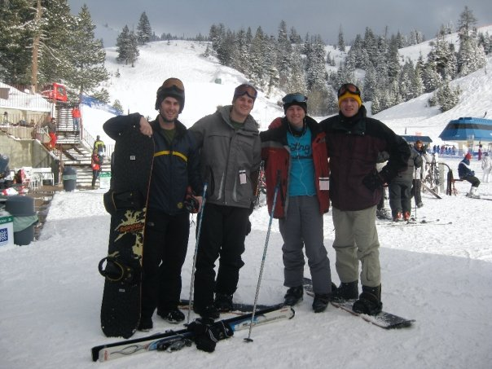
I went snowboading.
I snowboarded in world famous mountains.

Slide 18

I met my wife at college!

Slide 19
College is Better than
High School
Hours of Classes Per Week:
High School: 30
College: 12-16

Slide 20
College is Better than High School
Number of times you meet for class per Week:
High School: 20
College: 6-8

Slide 21
College is Better than High School
Rules in Class:
High School: No eating, drinking, gum, electronics, coats, or hats
College: Generally allow to eat, drink, chew gum, bring electronics (although not use them), and wear a coat or hat

Slide 22
College is Better than High School
Hours of Homework Per Week:
High School: 7-14
College: 20-30

Slide 23
College is Better than High School
Number of Organizations/Clubs That Students Can Join:
High School: 5-15
College: Hundreds!
Examples: Sports, business, fraternities, sororities, “Meat” club, frisbee club, black student union, so many choices!

Slide 24
College is Better than High School
Responsibilities/Staying on Track:
High School: Most classes are picked for you; security guards and teachers make sure you are in class; teachers meet with and call your parents.
College: You choose your classes; you make appointments with your advisor; you choose to come to class on time; grades are usually not sent to your parents.

Slide 25
College is Better than High School
The Bottom Line:
Going to college means more responsibility and harder work …
But with that responsibility comes more fun, freedom and opportunities.

Slide 26
The more you learn, the more you earn!
Statistics show that the more education you receive, the more money you make over your lifetime.
In addition, the more education you receive, the better quality of a job you can get.

Slide 27
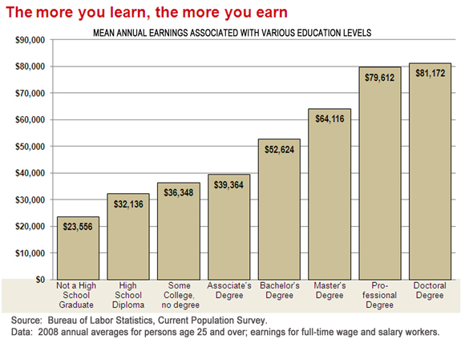
81,172
79,612
64,116
52,624
39,364
36,348
32,130
23,556

Slide 28
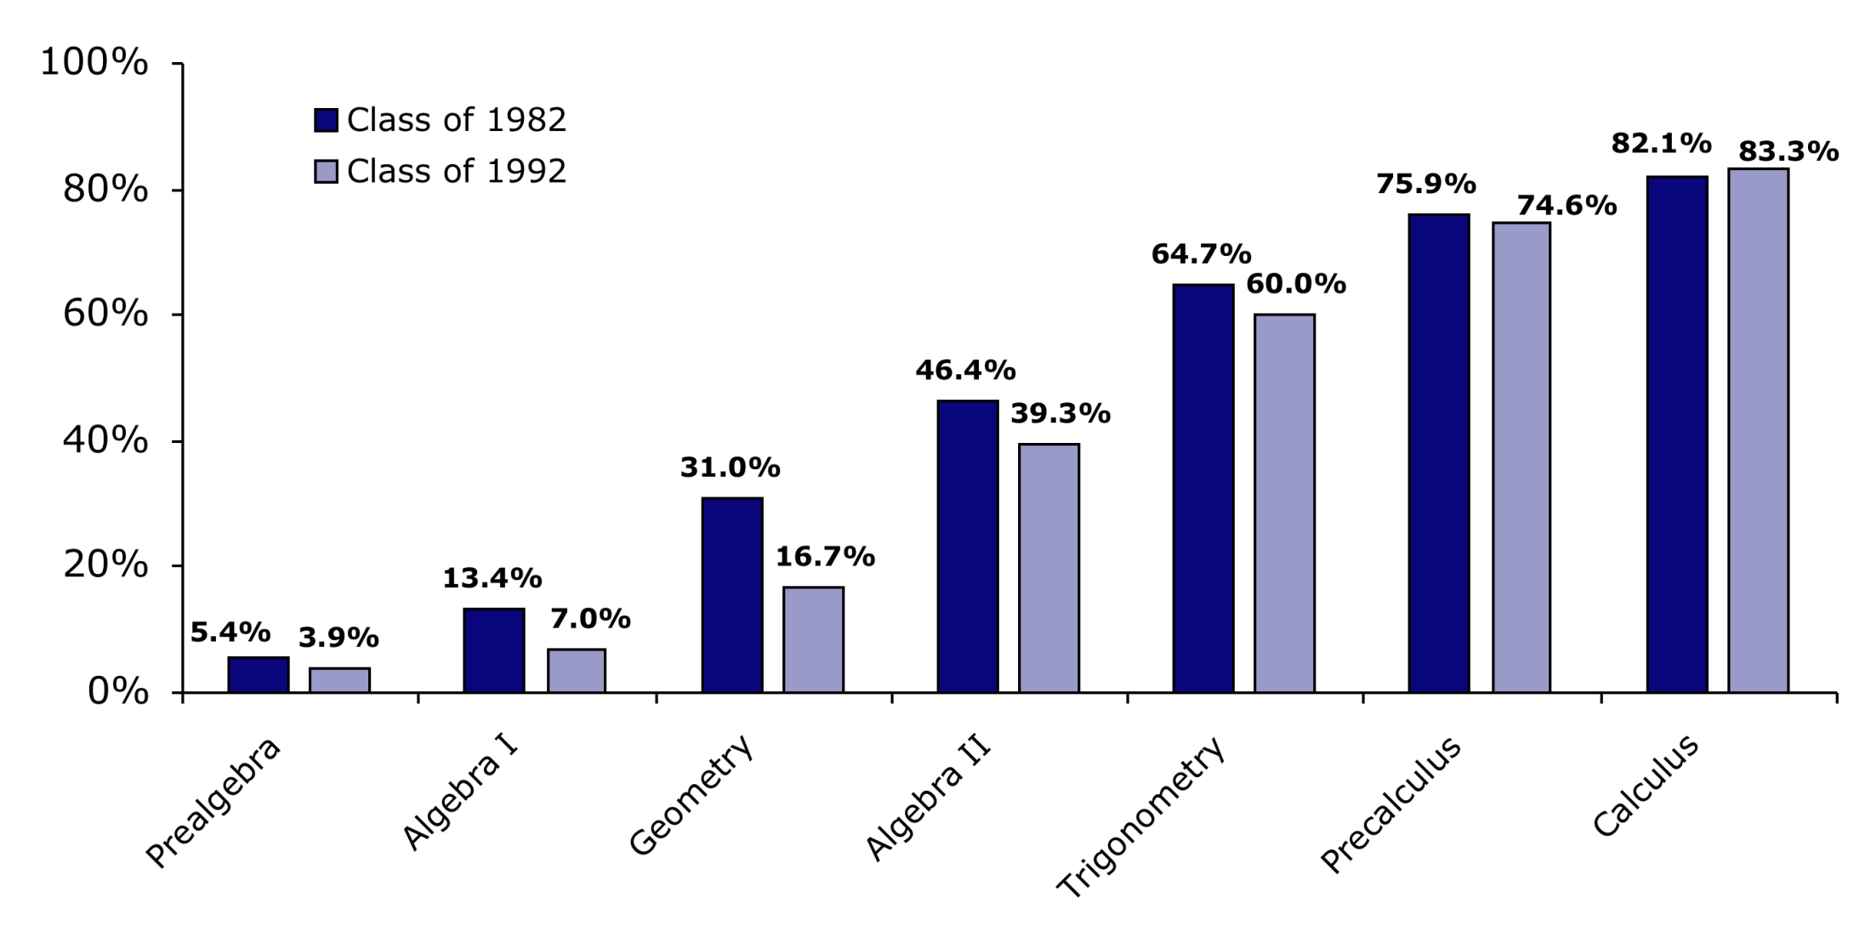
Probability of Graduating College based on
High School Math Courses
83.3%
74.6%
60%
39.3%
16.7%
7.0%
3.9%

Slide 29
How Do I Get to College?
Wanting to go to college is different than being PREPARED to GO!
Why? You get accepted into college primarily based on what you do in the first three years of high school.

Slide 30
How Do I Get to College?
Getting into college is more competitive than ever!
In order to go to a quality college, there are four areas in which a student should excel:

Slide 31
How Do I Get to College?
College To Do List
Grade Point Average (GPA)
ACT/SAT Score (taken during the spring of junior year)
Extracurricular activities (after school jobs, community service, leadership, involvement in school clubs)
Coursework: 4 years of math, science, English, and history; 3 years of a foreign language; AP and honors classes whenever possible

Slide 32
How Do I Get to College?
The Bottom Line:
There is NO time to waste.
Do not wait until your junior or senior year to think about college.

Slide 33
How Do I Get to College?
Getting Into College Is A Challenge
It is difficult to do this alone!
Talking to an intelligent counselor, teacher or parent can be helpful in this process.

Slide 34
How Do I Get to College?
It is OK if no one in your family has gone before!
Every family has a first family member that goes to college … it could be you.

Slide 35
How Do I Get to College?
You start preparing now!
If you get a Proficient or Advanced Profecienct on the EOCT… you’re going to be prepared to succeed in the HARDEST high school math classes.

Slide 36
Examples

Slide 37
Practice

