Slide 1
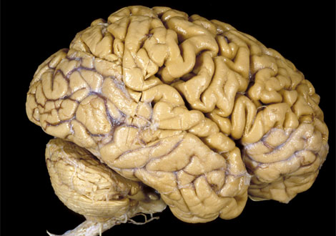
Malleable Intelligence
Intelligence is malleable,
NOT fixed.

Slide 2
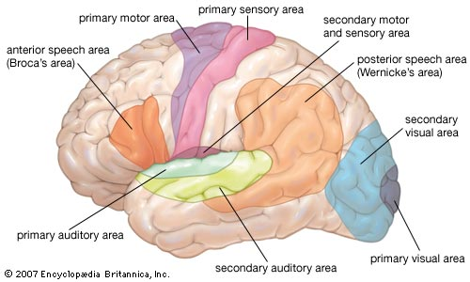
The Human BRAIN

Slide 3
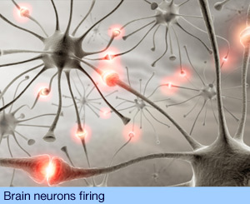
This is what’s happening inside your head right now.

Slide 4
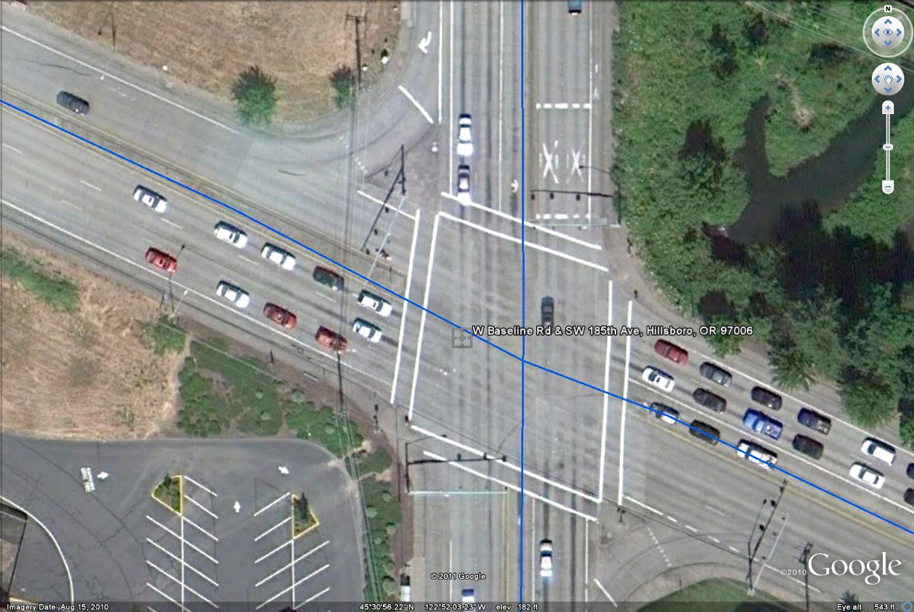
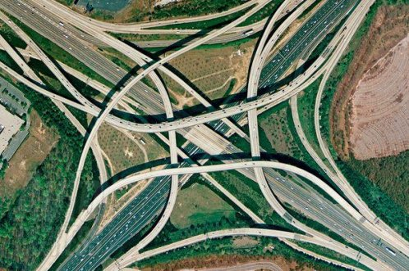
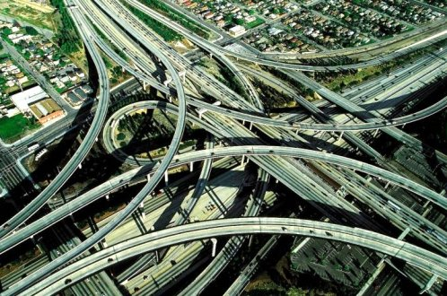
The brain is like a roadway.

Slide 5
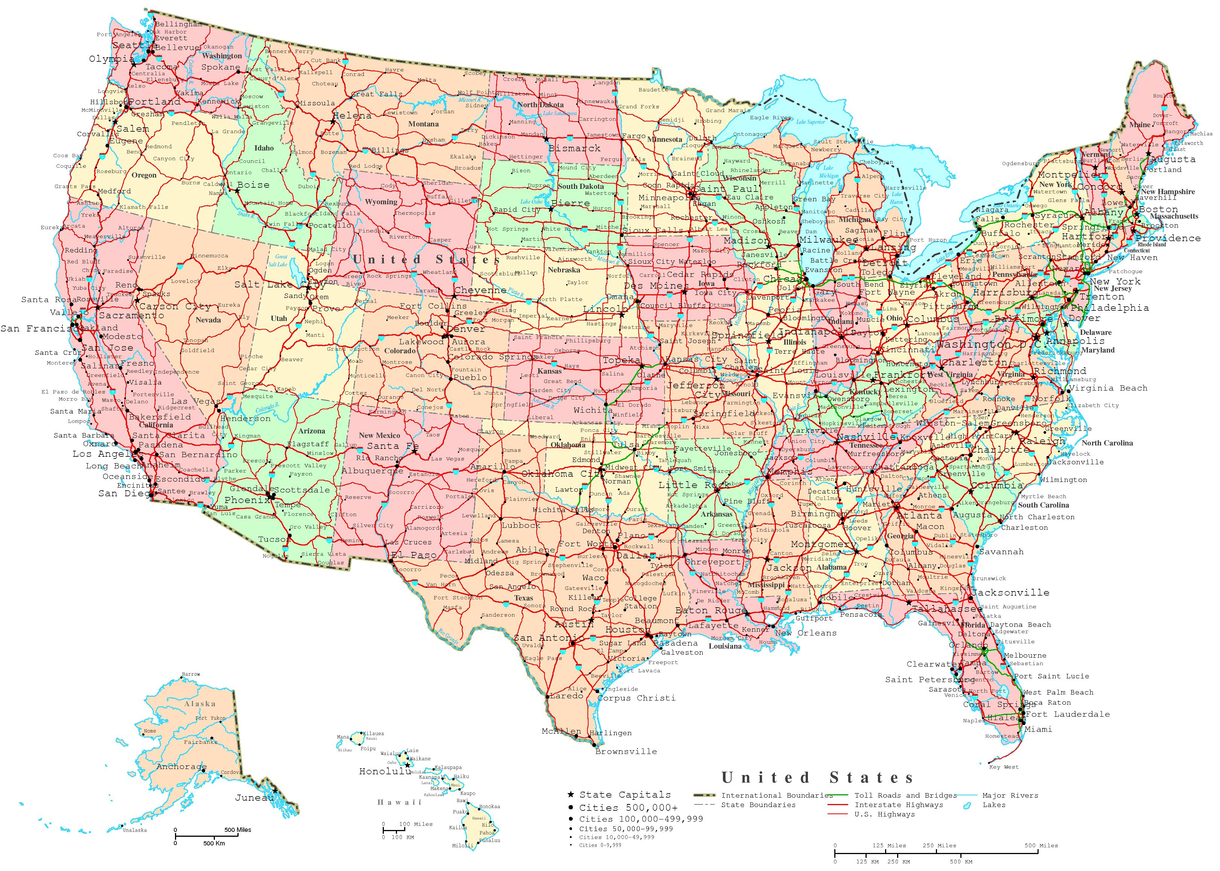

Slide 6
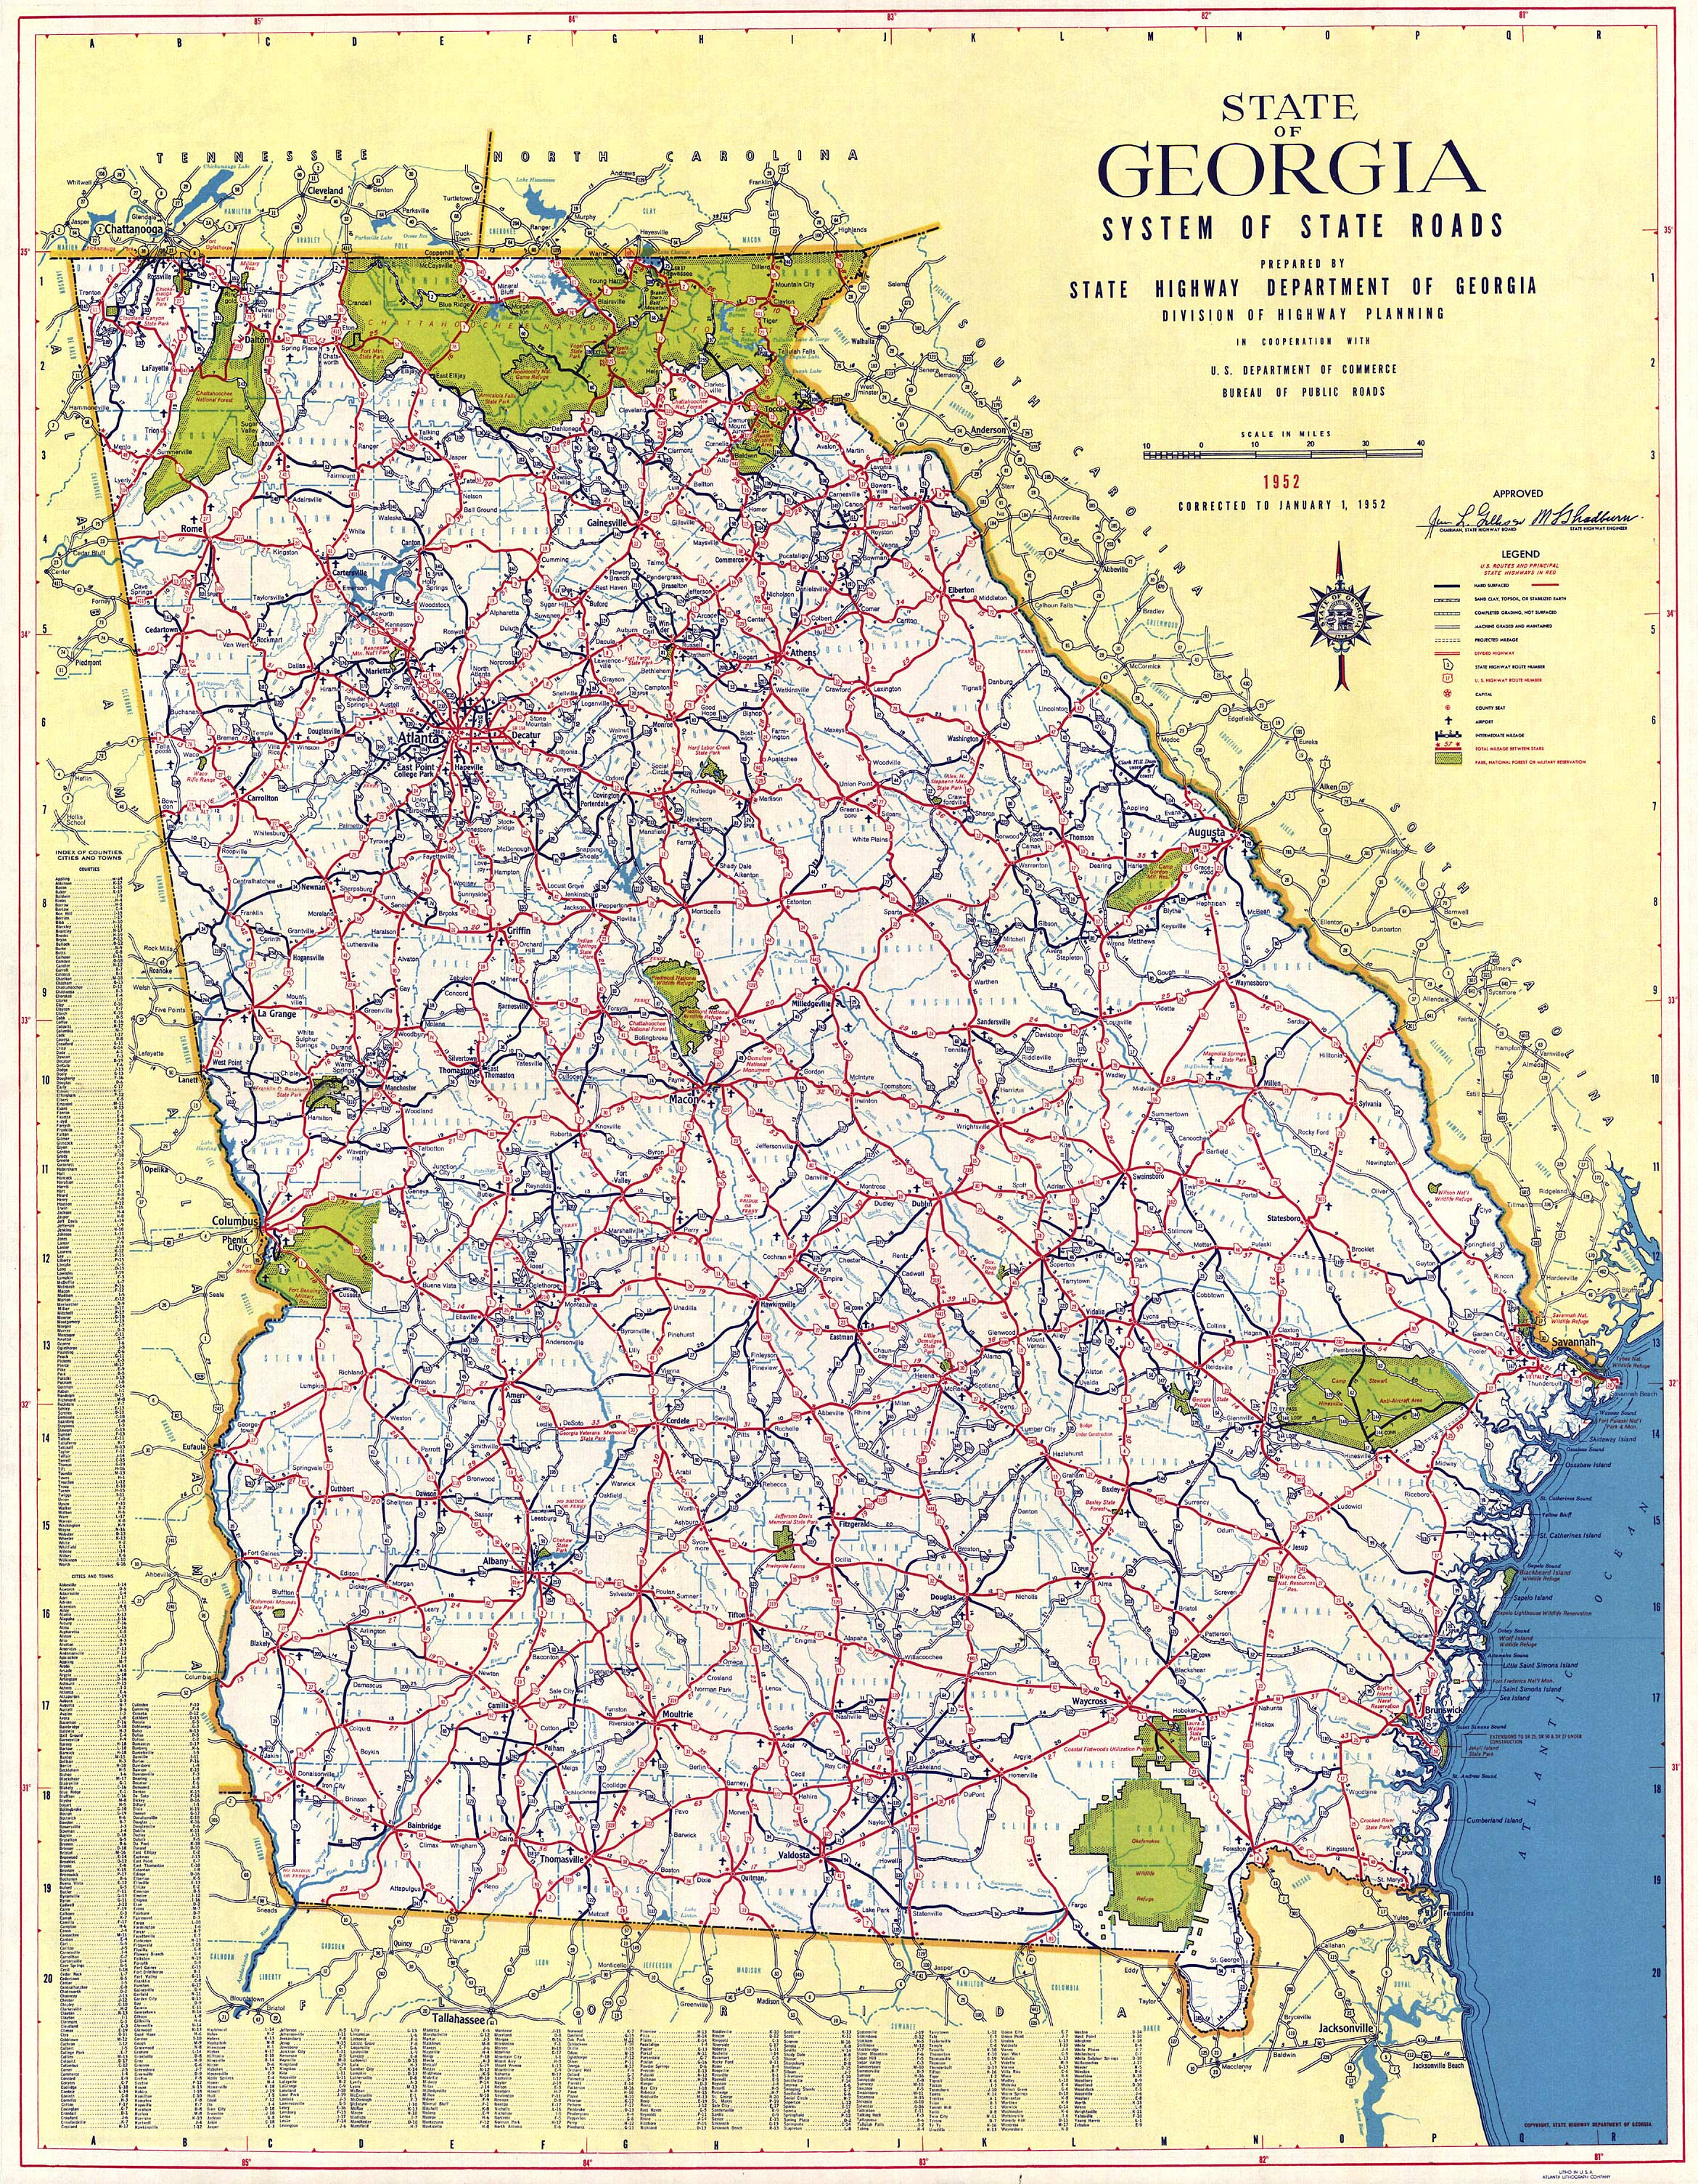

Slide 7
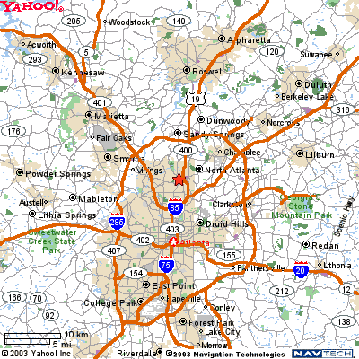

Slide 8
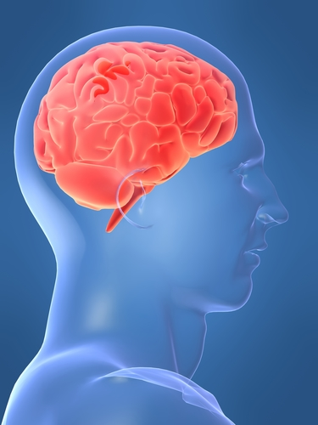
Malleable Intelligence Theory:
Malleable means that you can shape or change something.
Intelligence means your ability to learn, reason and problem solve.
Together this means that if you WORK HARD, you will GET SMART.

Slide 9
Malleable
If you are bad at math, it’s probably because you haven’t been taught math very well
Or that you haven’t worked as hard as your could
It has nothing to do with your brain and its capabilities
Notes:
9

Slide 10
I WILL
is more
important
than IQ.

Slide 11
It takes HOURS and HOURS of work to be good at something.
If you know somebody who is very good at math, they were not born that way, they’re not lucky, they have just worked hard.
Notes:
11
Show me about how big your brain is right now.
Show me how big you want it to be by the end of the year.

Slide 12
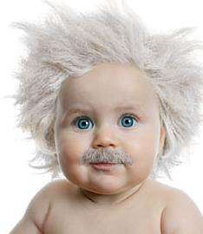
Most people believe that you are born with a certain amount of intelligence.
THIS IS FALSE
and one of our MOST HARMFUL BELIEFS.
Notes:
Most people believe that you are born with a set amount of intelligence. Is this true?
No!

Slide 13
Intelligence
=
How HARD You Work

Slide 14
How hard will you work?

Slide 15
Our Big Goals…
Our big number is 100

Slide 16
100% Mastery
Mastery means an higher than an 80%
Master every objective, quiz, and test
If at first you don’t succeed, try again
This means everyone will get an A or B

Slide 17
100% EOCT Meets or Exceeds
Expectations
Everyone will pass their EOCT
Hard work = success

Slide 18
100 Point SAT improvement
This means 10 point improvement on PSAT math section
 | 2010 SAT Math | 2011 SAT Math | 2012 SAT Math
Nation | 516 | 514 | 505
DeKalb County | 442 | 446 | 450
Stephenson | 418 | 428 | 420
Chamblee | 553 | 551 | 543
Lakeside | 542 | 541 | 515
DECA | - | 514 | 494
Parkview | 544 | 550 | 542

Slide 19
Integers
Listen carefully for the directions regarding the answer sheet.
When you complete your test, come to the front of the class to get your textbook.

Slide 20
Pre Assessment
Listen carefully for the directions regarding the answer sheet.
When you complete your test, come to the front of the class to get your textbook.

Slide 21
Math Review
Find the x and y intercepts: 6x + 3y = 12

Slide 22
Math Review
Make a table of values from -3 to +3 for: y = 3x – 4

Slide 23
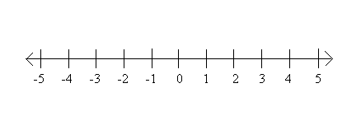
Math Review

Slide 24
Math Review

Slide 25
Math Review

Slide 26
Math Review
Write the equation of a line that passes through (4,2) and (2,4).

Slide 27
Exit Ticket
Complete your exit ticket silently

