Slide 1
College, Careers, Success!

Slide 2
College is Incredible
Why should I go to college?
Let’s see how college is even better than high school.

Slide 3
College is Incredible
I had a great time in college. Best years of my life!
I got to live on my own away from my parents and their rules.

Slide 4


Slide 5
College is Incredible
I went to Brigham Young University in Utah, one of the most beautiful campuses in the country.

Slide 6



Slide 7




Slide 8
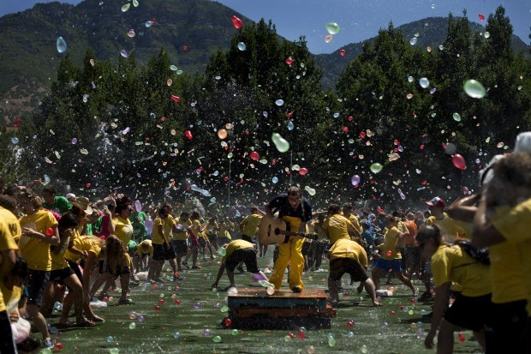
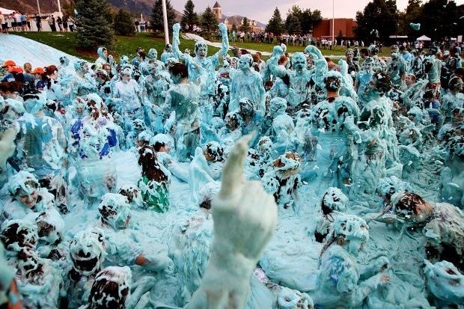

Slide 9


College is Incredible
I got internships and learned about business, and made money in the summer working.

Slide 10

I went snowboading.
I snowboarded in world famous mountains.

Slide 11

I met my wife at college!

Slide 12
College is Better than
High School
Hours of Classes Per Week:
High School: 30
College: 12-16

Slide 13
College is Better than High School
Number of times you meet for class per Week:
High School: 20
College: 6-8

Slide 14
College is Better than High School
Rules in Class:
High School: No eating, drinking, gum, electronics, coats, or hats
College: Generally allow to eat, drink, chew gum, bring electronics (although not use them), and wear a coat or hat

Slide 15
College is Better than High School
Hours of Homework Per Week:
High School: 7-14
College: 20-30

Slide 16
College is Better than High School
Number of Organizations/Clubs That Students Can Join:
High School: 5-15
College: Hundreds!
Examples: Sports, business, fraternities, sororities, “Meat” club, frisbee club, black student union, so many choices!

Slide 17
College is Better than High School
Responsibilities/Staying on Track:
High School: Most classes are picked for you; security guards and teachers make sure you are in class; teachers meet with and call your parents.
College: You choose your classes; you make appointments with your advisor; you choose to come to class on time; grades are usually not sent to your parents.

Slide 18
College is Better than High School
The Bottom Line:
Going to college means more responsibility and harder work …
But with that responsibility comes more fun, freedom and opportunities.

Slide 19
The more you learn, the more you earn!
Statistics show that the more education you receive, the more money you make over your lifetime.
In addition, the more education you receive, the better quality of a job you can get.

Slide 20
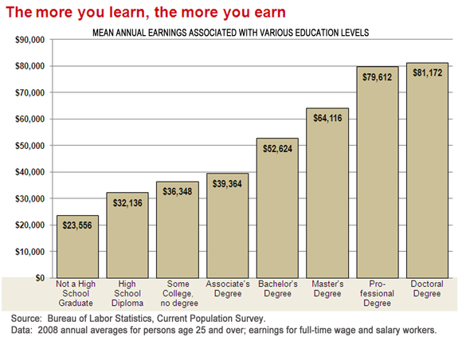
81,172
79,612
64,116
52,624
39,364
36,348
32,130
23,556

Slide 21
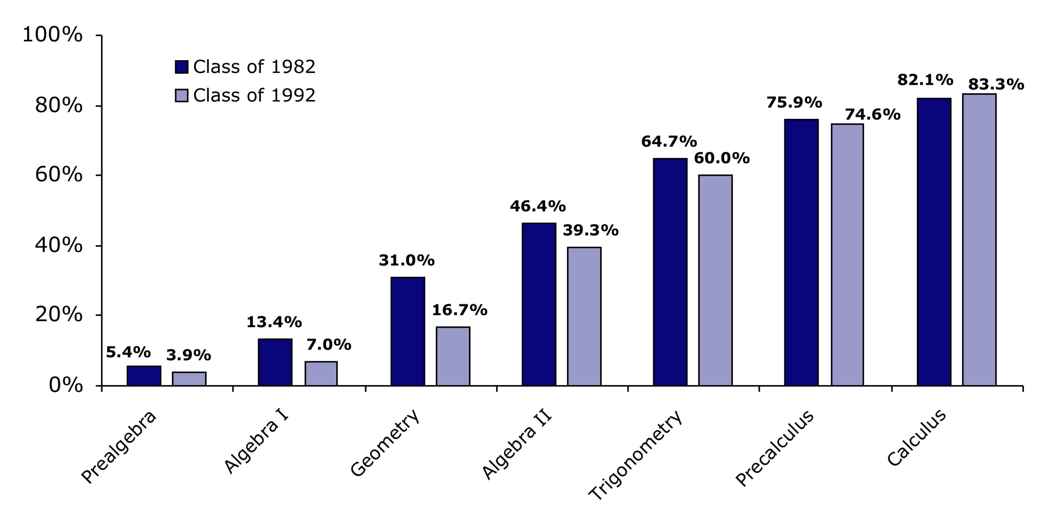
Probability of Graduating College based on
High School Math Courses
83.3%
74.6%
60%
39.3%
16.7%
7.0%
3.9%

Slide 22
How Do I Get to College?
Wanting to go to college is different than being PREPARED to GO!
Why? You get accepted into college primarily based on what you do in the first three years of high school.

Slide 23
How Do I Get to College?
Getting into college is more competitive than ever!
In order to go to a quality college, there are four areas in which a student should excel:

Slide 24
How Do I Get to College?
College To Do List
Grade Point Average (GPA)
ACT/SAT Score (taken during the spring of junior year)
Extracurricular activities (after school jobs, community service, leadership, involvement in school clubs)
Coursework: 4 years of math, science, English, and history; 3 years of a foreign language; AP and honors classes whenever possible

Slide 25
How Do I Get to College?
The Bottom Line:
There is NO time to waste.
Do not wait until your junior or senior year to think about college.

Slide 26
How Do I Get to College?
Getting Into College Is A Challenge
It is difficult to do this alone!
Talking to an intelligent counselor, teacher or parent can be helpful in this process.

Slide 27
How Do I Get to College?
It is OK if no one in your family has gone before!
Every family has a first family member that goes to college … it could be you.

Slide 28
How Do I Get to College?
You start preparing now!
If you get a Proficient or Advanced Profecienct on the EOCT… you’re going to be prepared to succeed in the HARDEST high school math classes.

Slide 29
Order of Operations
Parenthesis
Exponents
Multiplication
Division
Addition
Subtraction

Slide 30
Like Terms
Like terms are terms that contain the same variables with the same exponents. Only the coefficients of like terms are different.

Slide 31

Examples
Student 1 | Student 2
3 + 4 x 2 | 3 + 4 x 2
= 7 x 2 | = 3 + 8
= 14 | = 11

Slide 32
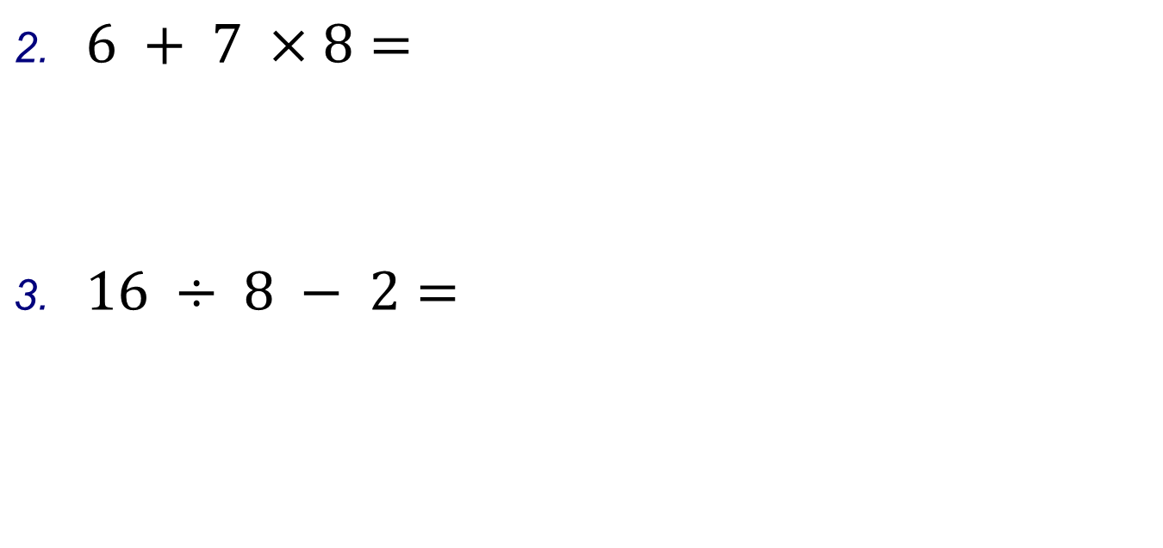

Slide 33
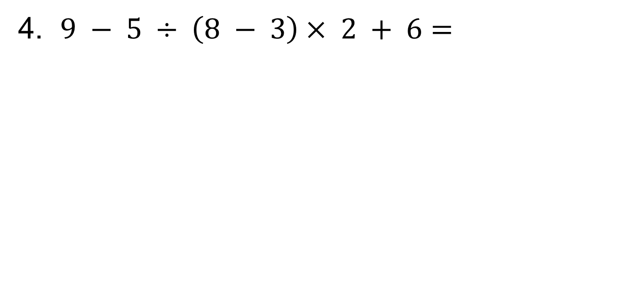
Examples

Slide 34
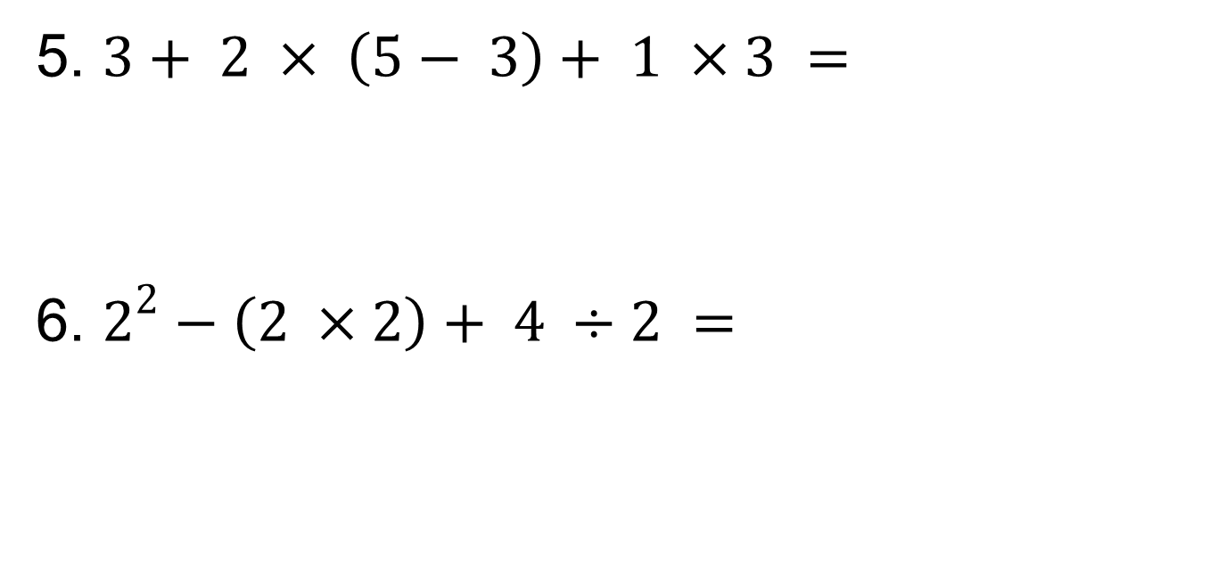
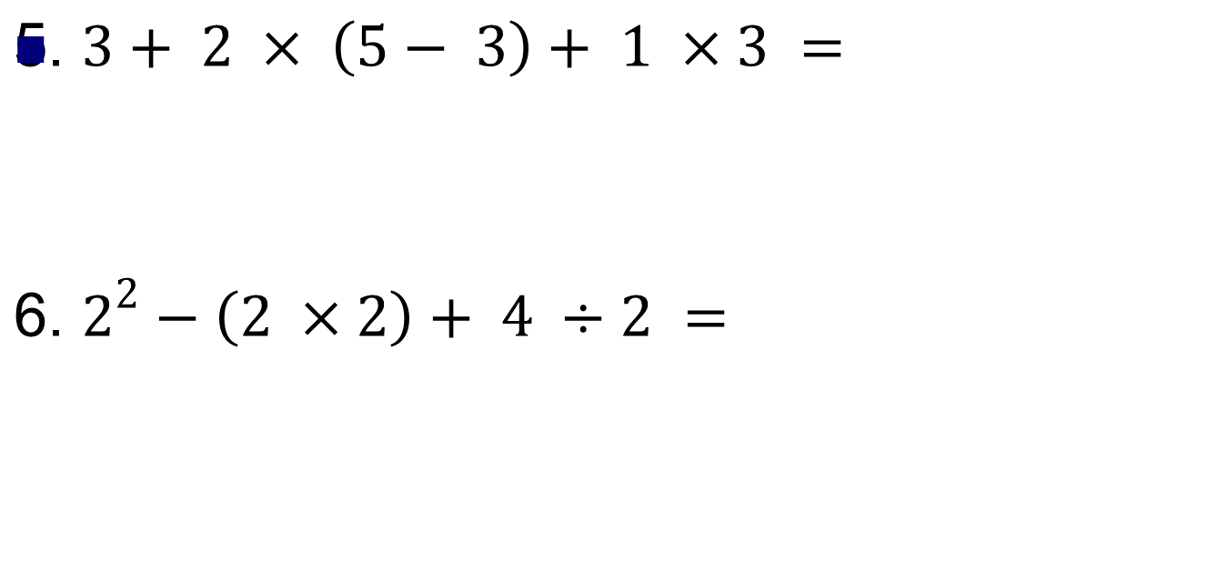

Slide 35
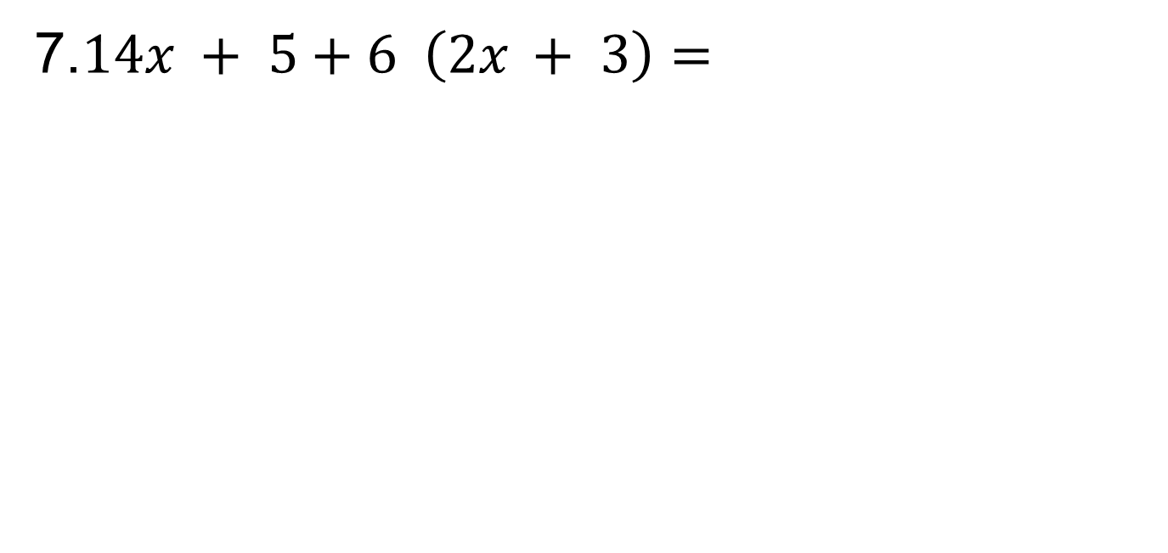
Examples

Slide 36
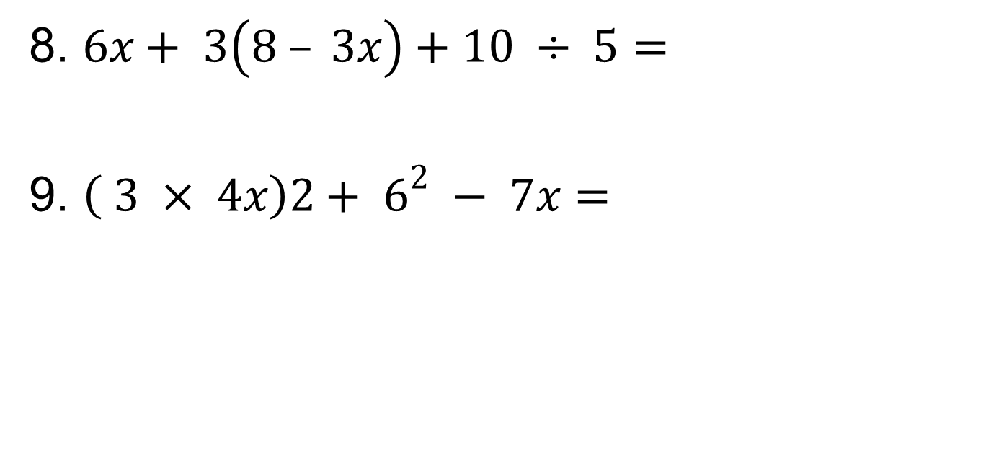

Slide 37
Practice
On your own you will now complete practice problems 1-8
Refer back to the examples if you are unsure how to solve something
Raise your hand if you have a question

Slide 38
Solving Equations
When you solve an equation you are trying to get the variable by itself
Whatever you do to an equation, do the
S A M E thing to B O T H sides of that equation!

Slide 39
Solving Equations
26 = 8 + v
m + 4 = -12

Slide 40
Solving Equations
3. 3 + p = 8
4. 10n = 40

Slide 41
Solving Equations
6. -5= a/2
7. 2d – 4=8

Slide 42
Solving Equations
10.
15. 5(2x-2)=3(x-1)+7

Slide 43

Math Review
Graph y = -2/3 x + 4

Slide 44
Homework
Page 4 of your packet
  “What do you know” 11-20

