Slide 1

Exploring Transformations
Warm Up
Lesson Presentation
Lesson Quiz
Holt McDougal Algebra 2
Holt Algebra 2

Slide 2
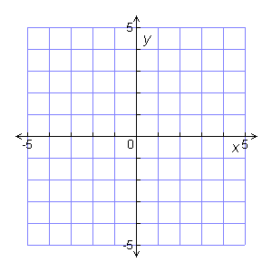
Warm Up
Plot each point.
1. A(0,0)
2. B(5,0)
3. C(–5,0)
4. D(0,5)
5. E(0, –5)
6. F(–5,–5)
• D
•C
• A
• B
• F
• E

Slide 3
Objectives
Apply transformations to points and sets of points.
Interpret transformations of real-world data.

Slide 4
Vocabulary
transformation
translation
reflection
stretch
compression

Slide 5
A transformation is a change in the position, size, or shape of a figure.
A translation, or slide, is a transformation that moves each point in a figure the same distance in the same direction.

Slide 6
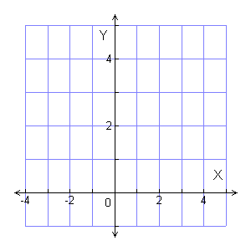
Example 1A: Translating Points
Perform the given translation on the point (–3, 4). Give the coordinates of the translated point.
5 units right
5 units right
•
•
(-3, 4)
(2, 4)
Translating (–3, 4) 5 units
right results in the point
(2, 4).

Slide 7
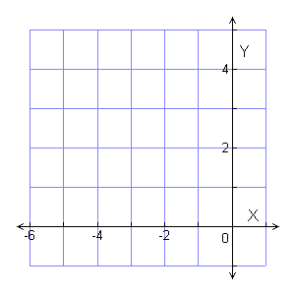
Example 1B: Translating Points
Perform the given translation on the point (–3, 4). Give the coordinates of the translated point.
2 units left and 2 units down
2 units
(–3, 4)
•
Translating (–3, 4) 2 units
left and 2 units down results
in the point (–5, 2).
3 units
•
(–5, 2)

Slide 8
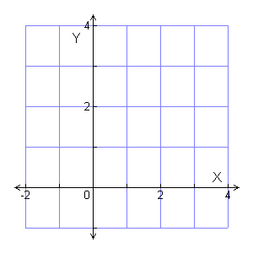
Check It Out! Example 1a
Perform the given translation on the point (–1, 3). Give the coordinates of the translated point.
4 units right
4 units
Translating (–1, 3) 4 units
right results in the point
(3, 3).
•
•
(–1, 3)
(3, 3)

Slide 9
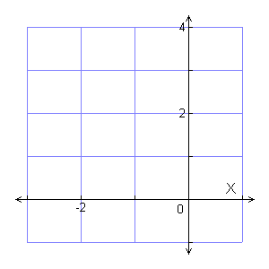
Check It Out! Example 1b
Perform the given translation on the point (–1, 3). Give the coordinates of the translated point.
1 unit left and 2 units down
1 unit
•
(–1, 3)
Translating (–1, 3) 1 unit
left and 2 units down results
in the point (–2, 1).
2 units
•
(–2, 1)

Slide 10
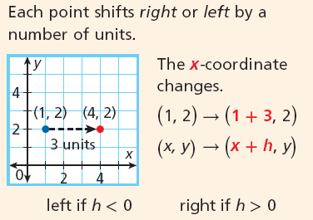
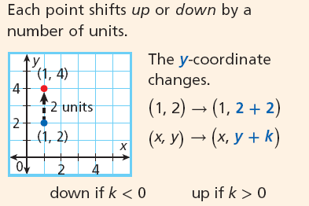
Notice that when you translate left or right, the
x-coordinate changes, and when you translate up
or down, the y-coordinate changes.
Translations
Horizontal Translation | Vertical Translation

Slide 11
A reflection is a transformation that flips a figure across a line called the line of reflection. Each reflected point is the same distance from the line of reflection, but on the opposite side of the line.

Slide 12
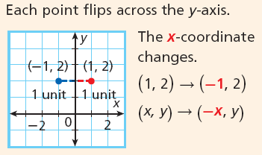
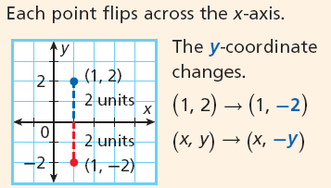
Reflections
Reflection Across y-axis | Reflection Across x-axis

Slide 13
You can transform a function by transforming its ordered pairs. When a function is translated or reflected, the original graph and the graph of the transformation are congruent because the size and shape of the graphs are the same.

Slide 14
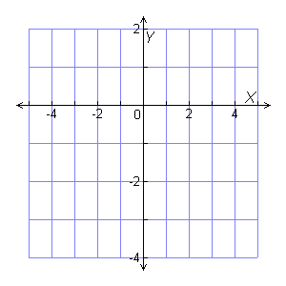
Example 2A: Translating and Reflecting Functions
Use a table to perform each transformation of y=f(x). Use the same coordinate plane as the original function.
translation 2 units up

Slide 15
Example 2A Continued
translation 2 units up
Identify important points from the graph and make a table.
x | y | y + 2
–5 | –3 | –3 + 2 = –1
–2 | 0 | 0 + 2 = 2
0 | –2 | –2 + 2 = 0
2 | 0 | 0 + 2 = 2
5 | –3 | –3 + 2 = –1
Add 2 to each y-coordinate.
The entire graph shifts 2 units up.

Slide 16
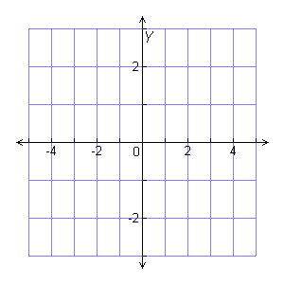
Example 2B: Translating and Reflecting Functions
reflection across x-axis
Identify important points from the graph and make a table.
x | y | –y
–5 | –3 | –1(–3) = 3
–2 | 0 | – 1(0) = 0
0 | –2 | – 1(–2) = 2
2 | 0 | – 1(0) = 0
5 | –3 | – 1(–3) = 3
Multiply each y-coordinate by – 1.
The entire graph flips across the x-axis.

Slide 17
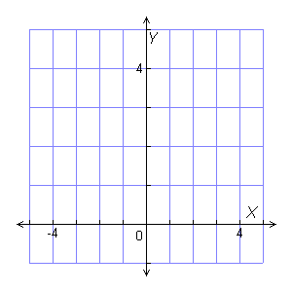
Check It Out! Example 2a
Use a table to perform the transformation of y = f(x). Use the same coordinate plane as the original function.
translation 3 units right
x | y | x + 3
–2 | 4 | –2 + 3 = 1
–1 | 0 | –1 + 3 = 2
0 | 2 | 0 + 3 = 3
2 | 2 | 2 + 3 = 5
Add 3 to each x-coordinate.
The entire graph shifts 3 units right.

Slide 18
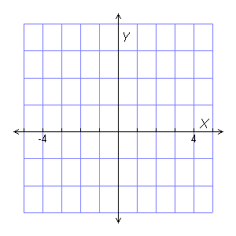
Check It Out! Example 2b
Use a table to perform the transformation of y = f(x). Use the same coordinate plane as the original function.
reflection across x-axis
x | y | –y
–2 | 4 | –4
–1 | 0 | 0
0 | 2 | –2
2 | 2 | –2
f
Multiply each y-coordinate by –1.
The entire graph flips across the x-axis.

Slide 19
Imagine grasping two points on the graph of a function that lie on opposite sides of the y-axis. If you pull the points away from the y-axis, you would create a horizontal stretch of the graph. If you push the points towards the y-axis, you would create a horizontal compression.

Slide 20
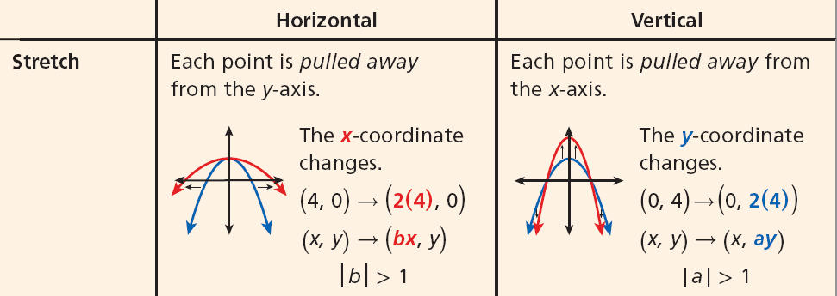
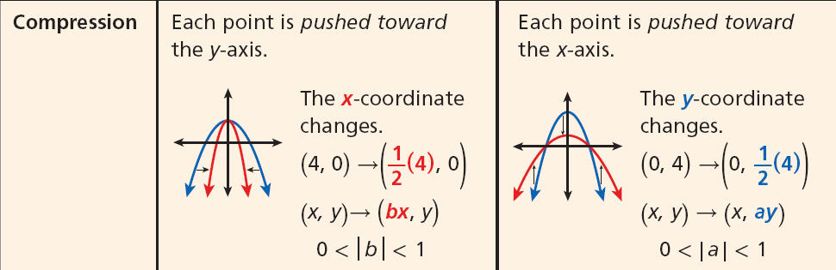
Stretches and compressions are not congruent to the original graph.
Stretches and Compressions

Slide 21
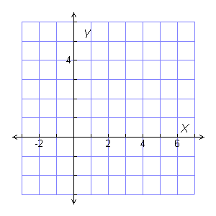
Example 3: Stretching and Compressing Functions
Use a table to perform a horizontal stretch of the function y = f(x) by a factor of 3. Graph the function and the transformation on the same coordinate plane.
Identify important points from the graph and make a table.
3x | x | y
3(–1) = –3 | –1 | 3
3(0) = 0 | 0 | 0
3(2) = 6 | 2 | 2
3(4) = 12 | 4 | 2
Multiply each x-coordinate by 3.

Slide 22
Check It Out! Example 3
Use a table to perform a vertical stretch of y = f(x) by a factor of 2. Graph the transformed function on the same coordinate plane as the original figure.
Identify important points from the graph and make a table.
x | y | 2y
–1 | 3 | 2(3) = 6
0 | 0 | 2(0) = 0
2 | 2 | 2(2) = 4
4 | 2 | 2(2) = 4
Multiply each y-coordinate by 2.

Slide 23
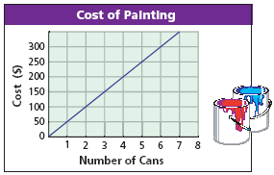
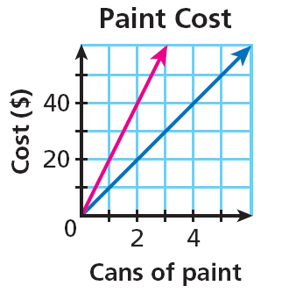
Example 4: Business Application
The graph shows the cost of painting based on the number of cans of paint used. Sketch a graph to represent the cost of a can of paint doubling, and identify the transformation of the original graph that it represents.
If the cost of painting is based on the number of cans of paint used and the cost of a can of paint doubles, the cost of painting also doubles. This represents a vertical stretch by a factor of 2.

Slide 24
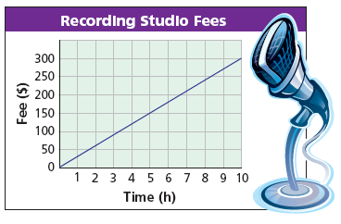
Check It Out! Example 4
Recording studio fees are usually based on an hourly rate, but the rate can be modified due to various options. The graph shows a basic hourly studio rate.

Slide 25
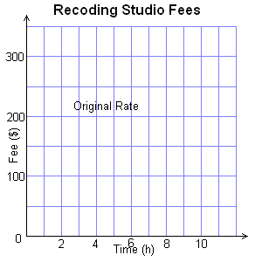
Check It Out! Example 4 Continued
What if…? Suppose that a discounted rate is of the original rate. Sketch a graph to represent the situation and identify the transformation of the original graph that it represents.
If the price is discounted by of the hourly rate, the value of each y-coordinate would be multiplied by .

Slide 26
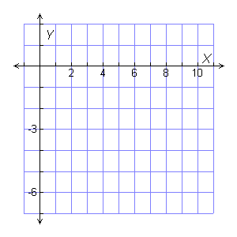
Lesson Quiz: Part I
1. Translate the point (4,–6) 6 units right and 7 units up. Give the coordinates on the translated point.
(10, 1)
•
(10, 1)
0
•
(4,–6)

Slide 27
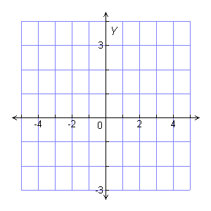
Lesson Quiz: Part II
Use a table to perform the transformation of y = f(x). Graph the function and the transformation on the same coordinate plane.
2. Reflection across y-axis
3. vertical compression by a factor
of .
f

