Slide 1

Arithmetic Sequences
Warm Up
Lesson Presentation
Lesson Quiz
Holt Algebra 1
Holt McDougal Algebra 1

Slide 2




Warm Up
Evaluate.
1. 5 + (–7)
3. 5.3 + 0.8
5. –3(2 – 5)
–2
2.
6.1
4. 6(4 – 1)
18
9
6.
11
7.
where h = –2
8. n – 2.8 where n = 5.1
2.3
9. 6(x – 1) where x = 5
24
10. 10 + (5 – 1)s where s = –4
–6

Slide 3
Objectives
Recognize and extend an arithmetic sequence.
Find a given term of an arithmetic sequence.

Slide 4
Vocabulary
sequence
term
arithmetic sequence
common difference

Slide 5
During a thunderstorm, you can estimate your distance from a lightning strike by counting the number of seconds from the time you see the lightning until you hear the thunder.
When you list the times and distances in order, each list forms a sequence. A sequence is a list of numbers that often forms a pattern. Each number in a sequence is a term.

Slide 6
Time (s)
1
2
3
4
5
6
7
8
Time (s)
Distance (mi)
0.2
0.4
0.6
0.8
1.0
1.2
1.4
1.6
Distance (mi)
+0.2
+0.2
+0.2
+0.2
+0.2
+0.2
+0.2
In the distance sequence, each distance is 0.2 mi greater than the previous distance. When the terms of a sequence differ by the same nonzero number d, the sequence is an arithmetic sequence and d is the common difference. The distances in the table form an arithmetic sequence with d = 0.2.

Slide 7
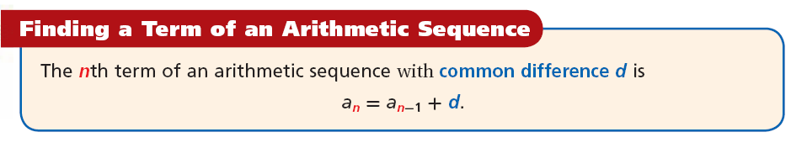
The variable a is often used to represent terms in a sequence. The variable a₉, read “a sub 9,” is the ninth term in a sequence. To designate any term, or the nth term, in a sequence, you write a_{n}, where n can be any number.
To find a term in an arithmetic sequence, add d to the previous term.

Slide 8
Example 1A: Identifying Arithmetic Sequences
Determine whether the sequence appears to be an arithmetic sequence. If so, find the common difference and the next three terms.
9, 13, 17, 21,…
Step 1 Find the difference between successive terms.
9, 13, 17, 21,…
You add 4 to each term to find the next term. The common difference is 4.
+4
+4
+4

Slide 9
Example 1A Continued
Determine whether the sequence appears to be an arithmetic sequence. If so, find the common difference and the next three terms.
9, 13, 17, 21,…
Step 2 Use the common difference to find the next 3 terms.
9, 13, 17, 21,
a_{n} = a_{n-1} + d
25, 29, 33,…
+4
+4
+4
The sequence appears to be an arithmetic sequence with a common difference of 4. The next three terms are 25, 29, 33.

Slide 10
Reading Math
The three dots at the end of a sequence are called an ellipsis. They mean that the sequence continues and can read as “and so on.”

Slide 11
Example 1B: Identifying Arithmetic Sequences
Determine whether the sequence appears to be an arithmetic sequence. If so, find the common difference and the next three terms.
10, 8, 5, 1,…
Find the difference between successive terms.
10, 8, 5, 1,…
The difference between successive terms is not the same.
–2
–3
–4
This sequence is not an arithmetic sequence.

Slide 12



Check It Out! Example 1a
Determine whether the sequence appears to be an arithmetic sequence. If so, find the common difference and the next three terms.
Step 1 Find the difference between successive terms.
You add to each term to find the next term. The common difference is .

Slide 13




Check It Out! Example 1a Continued
Determine whether the sequence appears to be an arithmetic sequence. If so, find the common difference and the next three terms.
Step 2 Use the common difference to find the next 3 terms.
The sequence appears to be an arithmetic sequence with a common difference of . The next three terms are , .

Slide 14
Check It Out! Example 1b
Determine whether the sequence appears to be an arithmetic sequence. If so, find the common difference and the next three terms.
–4, –2, 1, 5,…
Step 1 Find the difference between successive terms.
–4, –2, 1, 5,…
The difference between successive terms is not the same.
+2
+3
+4
This sequence is not an arithmetic sequence.

Slide 15
To find the nth term of an arithmetic sequence when n is a large number, you need an equation or rule. Look for a pattern to find a rule for the sequence below.
1 2 3 4… n Position
3, 5, 7, 9… Term
a₁ a₂ a₃ a₄ a_{n}
The sequence starts with 3. The common difference d is 2. You can use the first term and the common difference to write a rule for finding a_{n}.

Slide 16
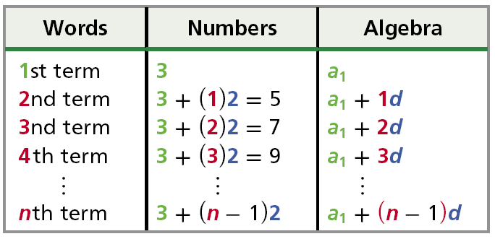
The pattern in the table shows that to find the nth term, add the first term to the product of (n – 1) and the common difference.

Slide 17
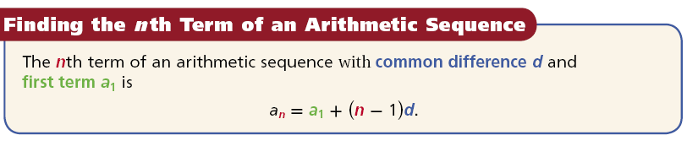

Slide 18
Example 2A: Finding the nth Term of an Arithmetic Sequence
Find the indicated term of the arithmetic sequence.
16th term: 4, 8, 12, 16, …
Step 1 Find the common difference.
4, 8, 12, 16,…
The common difference is 4.
+4 +4 +4
Step 2 Write a rule to find the 16th term.
a_{n} = a₁ + (n – 1)d
Write a rule to find the nth term.
a₁₆ = 4 + (16 – 1)(4)
Substitute 4 for a₁,16 for n, and 4 for d.
= 4 + (15)(4)
Simplify the expression in parentheses.
Multiply.
= 4 + 60
= 64
The 16th term is 64.
Add.

Slide 19
Example 2B: Finding the nth Term of an Arithmetic Sequence
Find the indicated term of the arithmetic sequence.
The 25th term: a₁ = –5; d = –2
a_{n} = a₁ + (n – 1)d
Write a rule to find the nth term.
a₂₅ = –5 + (25 – 1)(–2)
Substitute –5 for a₁, 25 for n, and –2 for d.
= –5 + (24)(–2)
Simplify the expression in parentheses.
= –5 + (–48)
Multiply.
= –53
Add.
The 25th term is –53.

Slide 20
Check It Out! Example 2a
Find the indicated term of the arithmetic sequence.
60th term: 11, 5, –1, –7, …
Step 1 Find the common difference.
11, 5, –1, –7,…
The common difference is –6.
–6 –6 –6
Step 2 Write a rule to find the 60th term.
a_{n} = a₁ + (n – 1)d
Write a rule to find the nth term.
a₆₀ = 11 + (60 – 1)(–6)
Substitute 11 for a₁, 60 for n, and –6 for d.
+2
= 11 + (59)(–6)
Simplify the expression in parentheses.
= 11 + (–354)
Multiply.
= –343
Add.
The 60th term is –343.

Slide 21
Check It Out! Example 2b
Find the indicated term of the arithmetic sequence.
12th term: a₁ = 4.2; d = 1.4
a_{n} = a₁ + (n – 1)d
Write a rule to find the nth term.
a₁₂ = 4.2 + (12 – 1)(1.4)
Substitute 4.2 for a₁,12 for n, and 1.4 for d.
= 4.2 + (11)(1.4)
Simplify the expression in parentheses.
= 4.2 + (15.4)
Multiply.
= 19.6
Add.
The 12th term is 19.6.

Slide 22
Example 3: Application
A bag of cat food weighs 18 pounds at the beginning of day 1. Each day, the cats are fed 0.5 pound of food. How much does the bag of cat food weigh at the beginning of day 30?
Notice that the sequence for the situation is arithmetic with d = –0.5 because the amount of cat food decreases by 0.5 pound each day.
Since the bag weighs 18 pounds to start, a₁ = 18.
Since you want to find the weight of the bag on day 30, you will need to find the 30th term of the sequence, so n = 30.

Slide 23
Example 3 Continued
A bag of cat food weighs 18 pounds at the beginning of day 1. Each day, the cats are fed 0.5 pound of food. How much does the bag of cat food weigh at the beginning of day 30?
a_{n} = a₁ + (n – 1)d
Write the rule to find the nth term.
a₃₁ = 18 + (30 – 1)(–0.5)
Substitute 18 for a₁, –0.5 for d, and 30 for n.
= 18 + (29)(–0.5)
Simplify the expression in parentheses.
= 18 + (–14.5)
Multiply.
= 3.5
Add.
There will be 3.5 pounds of cat food remaining at the beginning of day 30.

Slide 24
Check It Out! Example 3
Each time a truck stops, it drops off 250 pounds of cargo. After stop 1, its cargo weighed 2000 pounds. How much does the load weigh after stop 6?
Notice that the sequence for the situation is arithmetic because the load decreases by 250 pounds at each stop.
Since the load will be decreasing by 250 pounds at each stop, d = –250.
Since the load is 2000 pounds, a₁ = 2000.
Since you want to find the load after the 6th stop, you will
need to find the 6th term of the sequence, so n = 6.

Slide 25
Check It Out! Example 3 Continued
Each time a truck stops, it drops off 250 pounds of cargo. After stop 1, its cargo weighed 2000 pounds. How much does the load weigh after stop 6?
a_{n} = a₁ + (n – 1)d
Write the rule to find the nth term.
a₆ = 2000 + (6 – 1)(–250)
Substitute 2000 for a₁, –250 for d, and 6 for n.
= 2000 + (5)(–250)
Simplify the expression in parentheses.
= 2000 + (–1250)
Multiply.
= 750
Add.
There will be 750 pounds of cargo remaining after stop 6.

Slide 26
Lesson Quiz: Part I
Determine whether each sequence appears to be an arithmetic sequence. If so, find the common difference and the next three terms in the sequence.
1. 3, 9, 27, 81,…
not arithmetic
2. 5, 6.5, 8, 9.5,…
arithmetic;
1.5; 11, 12.5, 14

Slide 27
Lesson Quiz: Part II
Find the indicated term of each arithmetic sequence.
3. 23rd term: –4, –7, –10, –13, …
–70
4. 40th term: 2, 7, 12, 17, …
197
5. 7th term: a₁ = –12, d = 2
0
6. 34th term: a₁ = 3.2, d = 2.6
89
7. On day 1, Zelle has knitted 61 rows of a scarf. Each day she adds 17 more rows. How many rows total has Zelle knitted on day 16?
316 rows

