Slide 1

Using Intercepts
Warm Up
Lesson Presentation
Lesson Quiz
Holt Algebra 1
Holt McDougal Algebra 1

Slide 2


Warm Up
1. 5x + 0 = –10
Solve each equation.
–2
2. 33 = 0 + 3y
11
1
3.
4. 2x + 14 = –3x + 4
–2
5. –5y – 1 = 7y + 5

Slide 3
Objectives
Find x- and y-intercepts and interpret their meanings in real-world situations.
Use x- and y-intercepts to graph lines.

Slide 4
Vocabulary
y-intercept
x-intercept

Slide 5
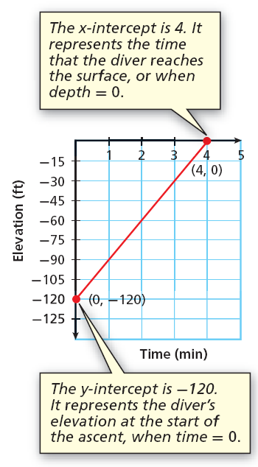
The y-intercept is the y-coordinate of the point where the graph intersects the y-axis. The x-coordinate of this point is always 0.
The x-intercept is the x-coordinate of the point where the graph intersects the x-axis. The y-coordinate of this point is always 0.

Slide 6
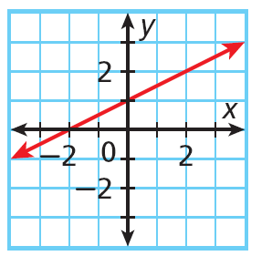
Example 1A: Finding Intercepts
Find the x- and y-intercepts.
The graph intersects the y-axis at (0, 1).
The y-intercept is 1.
The graph intersects the x-axis at (–2, 0).
The x-intercept is –2.

Slide 7


Example 1B: Finding Intercepts
Find the x- and y-intercepts.
5x – 2y = 10
To find the x-intercept, replace y with 0 and solve for x.
To find the y-intercept, replace x with 0 and solve for y.
5x – 2y = 10
5x – 2y = 10
5x – 2(0) = 10
5(0) – 2y = 10
5x – 0 = 10
0 – 2y = 10
5x = 10
– 2y = 10
x = 2
y = –5
The x-intercept is 2.
The y-intercept is –5.

Slide 8
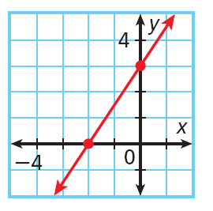
Check It Out! Example 1a
Find the x- and y-intercepts.
The graph intersects the y-axis at (0, 3).
The y-intercept is 3.
The graph intersects the x-axis at (–2, 0).
The x-intercept is –2.

Slide 9


Check It Out! Example 1b
Find the x- and y-intercepts.
–3x + 5y = 30
To find the x-intercept, replace y with 0 and solve for x.
To find the y-intercept, replace x with 0 and solve for y.
–3x + 5y = 30
–3x + 5y = 30
–3x + 5(0) = 30
–3(0) + 5y = 30
–3x – 0 = 30
0 + 5y = 30
–3x = 30
5y = 30
x = –10
y = 6
The x-intercept is –10.
The y-intercept is 6.

Slide 10


Check It Out! Example 1c
Find the x- and y-intercepts.
4x + 2y = 16
To find the x-intercept, replace y with 0 and solve for x.
To find the y-intercept, replace x with 0 and solve for y.
4x + 2y = 16
4x + 2y = 16
4x + 2(0) = 16
4(0) + 2y = 16
4x + 0 = 16
0 + 2y = 16
4x = 16
2y = 16
x = 4
y = 8
The x-intercept is 4.
The y-intercept is 8.

Slide 11
Example 2: Sports Application
Trish can run the 200 m dash in 25 s. The function f(x) = 200 – 8x gives the distance remaining to be run after x seconds. Graph this function and find the intercepts. What does each intercept represent?
Neither time nor distance can be negative, so choose several nonnegative values for x. Use the function to generate ordered pairs.
x
0
5
10
20
25
f(x) = 200 – 8x
200
160
120
40
0

Slide 12
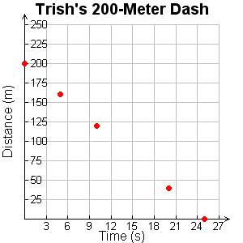
Example 2 Continued
Graph the ordered pairs. Connect the points with a line.
y-intercept: 200. This is the number of meters Trish has to run at the start of the race.
x-intercept: 25. This is the time it takes Trish to finish the race, or when the distance remaining is 0.

Slide 13

Check It Out! Example 2a
The school sells pens for $2.00 and notebooks for $3.00. The equation 2x + 3y = 60 describes the number of pens x and notebooks y that you can buy for $60.
Graph the function and find its intercepts.
Neither pens nor notebooks can be negative, so choose several nonnegative values for x. Use the function to generate ordered pairs.
x | 0 | 15 | 30
 | 20 | 10 | 0

Slide 14
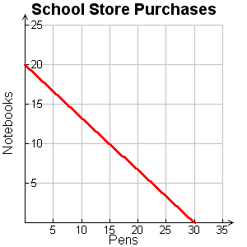
Check It Out! Example 2a Continued
The school sells pens for $2.00 and notebooks for $3.00. The equation 2x + 3y = 60 describes the number of pens x and notebooks y that you can buy for $60.
Graph the function and find its intercepts.
x-intercept: 30; y-intercept: 20

Slide 15
Check It Out! Example 2b
The school sells pens for $2.00 and notebooks for $3.00. The equation 2x + 3y = 60 describes the number of pens x and notebooks y that you can buy for $60.
What does each intercept represent?
x-intercept: 30. This is the number of pens that can be purchased if no notebooks are purchased.
y-intercept: 20. This is the number of notebooks that can be purchased if no pens are purchased.

Slide 16
Remember, to graph a linear function, you need to plot only two ordered pairs. It is often simplest to find the ordered pairs that contain the intercepts.
Helpful Hint
You can use a third point to check your line. Either choose a point from your graph and check it in the equation, or use the equation to generate a point and check that it is on your graph.

Slide 17


Example 3A: Graphing Linear Equations by Using Intercepts
Use intercepts to graph the line described by the equation.
3x – 7y = 21
Step 1 Find the intercepts.
x-intercept:
y-intercept:
3x – 7y = 21
3x – 7y = 21
3x – 7(0) = 21
3(0) – 7y = 21
3x = 21
–7y = 21
x = 7
y = –3

Slide 18
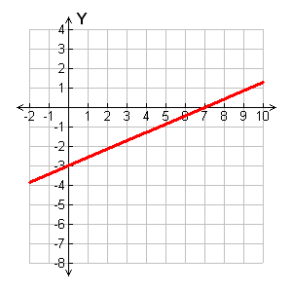
Example 3A Continued
Use intercepts to graph the line described by the equation.
3x – 7y = 21
Step 2 Graph the line.
Plot (7, 0) and (0, –3).
x
Connect with a straight line.

Slide 19
Example 3B: Graphing Linear Equations by Using Intercepts
Use intercepts to graph the line described by the equation.
y = –x + 4
Step 1 Write the equation in standard form.
y = –x + 4
+x +x
Add x to both sides.
x + y = 4

Slide 20
Example 3B Continued
Use intercepts to graph the line described by the equation.
x + y = 4
Step 2 Find the intercepts.
x-intercept:
y-intercept:
x + y = 4
x + y = 4
0 + y = 4
x + 0 = 4
y = 4
x = 4

Slide 21
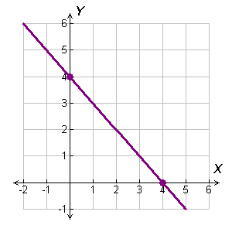
Example 3B Continued
Use intercepts to graph the line described by the equation.
x + y = 4
Step 3 Graph the line.
Plot (4, 0) and (0, 4).
Connect with a straight line.

Slide 22


Check It Out! Example 3a
Use intercepts to graph the line described by the equation.
–3x + 4y = –12
Step 1 Find the intercepts.
x-intercept:
y-intercept:
–3x + 4y = –12
–3x + 4y = –12
–3x + 4(0) = –12
–3(0) + 4y = –12
–3x = –12
4y = –12
x = 4
y = –3

Slide 23
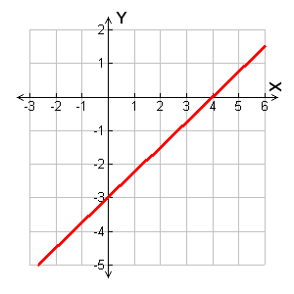
Check It Out! Example 3a Continued
Use intercepts to graph the line described by the equation.
–3x + 4y = –12
Step 2 Graph the line.
Plot (4, 0) and (0, –3).
Connect with a straight line.

Slide 24


Check It Out! Example 3b
Use intercepts to graph the line described by the equation.
Step 1 Write the equation in standard form.
Multiply both sides by 3, to clear the fraction.
3y = x – 6
Write the equation in standard form.
–x + 3y = –6

Slide 25

Check It Out! Example 3b Continued
Use intercepts to graph the line described by the equation.
–x + 3y = –6
Step 2 Find the intercepts.
x-intercept:
y-intercept:
–x + 3y = –6
–x + 3y = –6
–(0) + 3y = –6
–x + 3(0) = –6
3y = –6
–x = –6
x = 6
y = –2

Slide 26
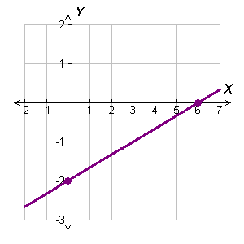
Check It Out! Example 3b Continued
Use intercepts to graph the line described by the equation.
–x + 3y = –6
Step 3 Graph the line.
Plot (6, 0) and (0, –2).
Connect with a straight line.

Slide 27
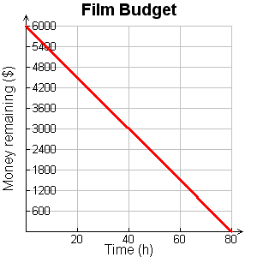
Lesson Quiz: Part I
1. An amateur filmmaker has $6000 to make a film that costs $75/h to produce. The function f(x) = 6000 – 75x gives the amount of money left to make the film after x hours of production. Graph this function and find the intercepts. What does each intercept represent?
x-int.: 80; number of hours it takes to spend all the money
y-int.: 6000; the initial amount of money available.

Slide 28

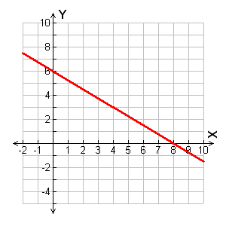
Lesson Quiz: Part II
2. Use intercepts to graph the line described by

