Slide 1

Identifying Linear Functions
Warm Up
Lesson Presentation
Lesson Quiz
Holt Algebra 1
Holt McDougal Algebra 1

Slide 2


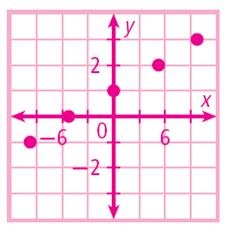
Warm Up
1. Solve 2x – 3y = 12 for y.
2. Graph for D: {–10, –5, 0, 5, 10}.

Slide 3
Objectives
Identify linear functions and linear equations.
Graph linear functions that represent real-world situations and give their domain and range.

Slide 4
Vocabulary
linear function
linear equation

Slide 5
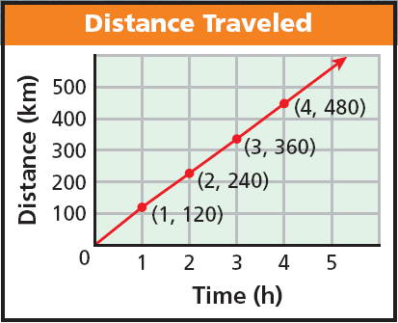
The graph represents a function because each domain value (x-value) is paired with exactly one range value (y-value). Notice that the graph is a straight line. A function whose graph forms a straight line is called a linear function.

Slide 6
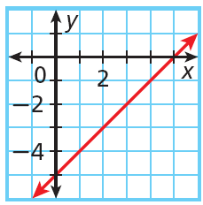
Example 1A: Identifying a Linear Function by Its Graph
Identify whether the graph represents a function. Explain. If the graph does represent a function, is the function linear?
Each domain value is paired with exactly one range value. The graph forms a line.
linear function

Slide 7
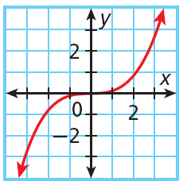
Example 1B: Identifying a Linear Function by Its Graph
Identify whether the graph represents a function. Explain. If the graph does represent a function, is the function linear?
Each domain value is paired with exactly one range value. The graph is not a line.
not a linear function

Slide 8
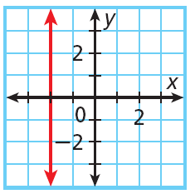
Example 1C: Identifying a Linear Function by Its Graph
Identify whether the graph represents a function. Explain. If the graph does represent a function, is the function linear?
The only domain value,
–2, is paired with many different range values.
not a function

Slide 9
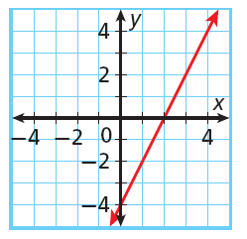
Check It Out! Example 1a
Identify whether the graph represents a function. Explain. If the graph does represent a function, is the function linear?
Each domain value is paired with exactly one range value. The graph forms a line.
linear function

Slide 10
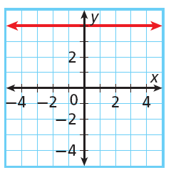
Check It Out! Example 1b
Identify whether the graph represents a function. Explain. If the graph does represent a function, is the function linear?
Each domain value is paired with exactly one range value. The graph forms a line.
linear function

Slide 11
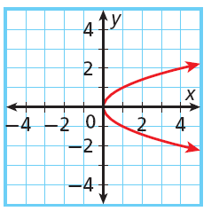
Check It Out! Example 1c
Identify whether the graph represents a function. Explain. If the graph does represent a function, is the function linear?
Each domain value is not paired with exactly one range value.
not a function

Slide 12
You can sometimes identify a linear function by looking at a table or a list of ordered pairs. In a linear function, a constant change in x corresponds to a constant change in y.

Slide 13
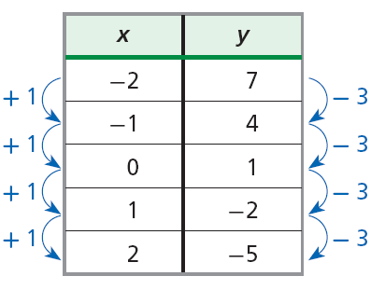
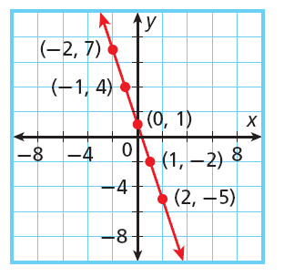
The points from this table lie on a line.
In this table, a constant change of +1 in x corresponds to constant change of –3 in y. These points satisfy a linear function.

Slide 14
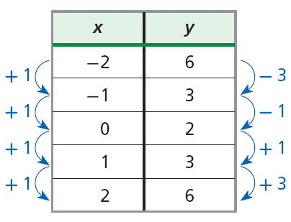
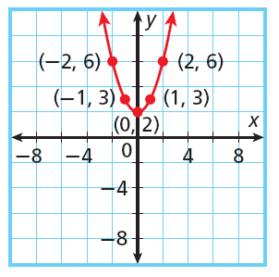
The points from this table do not lie on a line.
In this table, a constant change of +1 in x does not correspond to a constant change in y. These points do not satisfy a linear function.

Slide 15
Example 2A: Identifying a Linear Function by Using Ordered Pairs
Tell whether the set of ordered pairs satisfies a linear function. Explain.
{(0, –3), (4, 0), (8, 3), (12, 6), (16, 9)}
x
y
Write the ordered pairs in a table.
0
4
8
12
16
–3
0
3
6
9
Look for a pattern.
+4
+4
+4
+4
+3
+3
+3
+3
A constant change of +4 in x corresponds to a constant change of +3 in y.
These points satisfy a linear function.

Slide 16
Example 2B: Identifying a Linear Function by Using Ordered Pairs
Tell whether the set of ordered pairs satisfies a linear function. Explain.
{(–4, 13), (–2, 1), (0, –3), (2, 1), (4, 13)}
x
y
Write the ordered pairs in a table.
–4
–2
0
2
4
13
1
–3
1
13
Look for a pattern.
+2
+2
+2
+2
–12
–4
+4
+12
A constant change of 2 in x corresponds to different changes in y.
These points do not satisfy a linear function.

Slide 17
Check It Out! Example 2
Tell whether the set of ordered pairs {(3, 5), (5, 4), (7, 3), (9, 2), (11, 1)} satisfies a linear function. Explain.
x
y
Write the ordered pairs in a table.
3
5
7
9
11
5
4
3
2
1
Look for a pattern.
+2
+2
+2
+2
–1
–1
–1
–1
A constant change of +2 in x corresponds to a constant change of –1 in y.
These points satisfy a linear function.

Slide 18
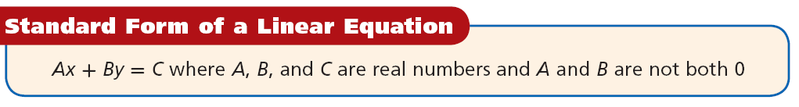
Another way to determine whether a function is linear is to look at its equation. A function is linear if it is described by a linear equation. A linear equation is any equation that can be written in the standard form shown below.

Slide 19
Notice that when a linear equation is written in standard form
x and y both have exponents of 1.
x and y are not multiplied together.
x and y do not appear in denominators,
exponents, or radical signs.

Slide 20
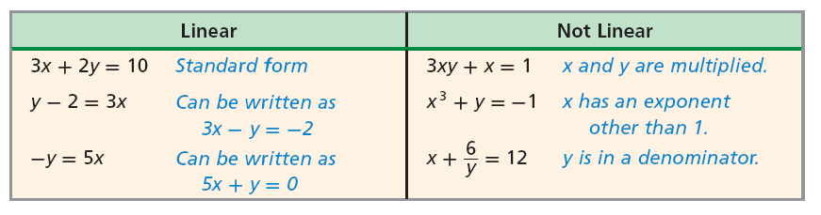

Slide 21
For any two points, there is exactly one line that contains them both. This means you need only two ordered pairs to graph a line.

Slide 22
Example 3A: Graphing Linear Functions
Tell whether the function is linear. If so, graph the function.
x = 2y + 4
Write the equation in standard form. Try to get both variables on the same side. Subtract 2y from both sides.
x = 2y + 4
–2y –2y
The equation is in standard form (A = 1, B = –2, C = 4).
x – 2y = 4
The equation can be written in standard form, so the function is linear.

Slide 23
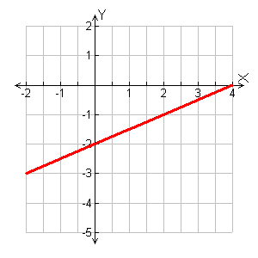
Example 3A Continued
x = 2y + 4
To graph, choose three values of y, and use them to generate ordered pairs. (You only need two, but graphing three points is a good check.)
Plot the points and connect them with a straight line.
•
y | x = 2y + 4 | (x, y)
0 | x = 2(0) + 4 = 4 | (4, 0)
–1 | x = 2(–1) + 4 = 2 | (2, –1)
–2 | x = 2(–2) + 4 = 0 | (0, –2)
•
•

Slide 24
Example 3B: Graphing Linear Functions
Tell whether the function is linear. If so, graph the function.
xy = 4
This is not linear, because x and y are multiplied. It is not in standard form.

Slide 25
Check It Out! Example 3a
Tell whether the function is linear. If so, graph the function.
y = 5x – 9
Write the equation in standard form. Try to get both variables on the same side. Subtract 5x from both sides.
y = 5x – 9
–5x –5x
–5x + y = – 9
The equation is in standard form
(A = –5, B = 1, C = –9).
The equation can be written in standard form, so the function is linear.

Slide 26
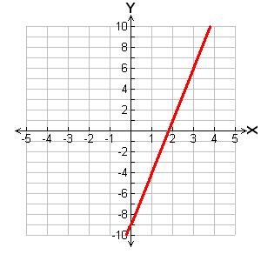
Check It Out! Example 3a Continued
y = 5x – 9
To graph, choose three values of x, and use them to generate ordered pairs. (You only need two, but graphing three points is a good check.)
Plot the points and connect them with a straight line.
x | y = 5x – 9 | (x, y)
0 | y = 5(0) – 9 = –9 | (0, –9)
1 | y = 5(1) – 9 = –4 | (1, –4)
2 | y = 5(2) – 9 = 1 | (2, 1)
•
•
•

Slide 27
Check It Out! Example 3b
Tell whether the function is linear. If so, graph the function.
y = 12
The equation is in standard form
(A = 0, B = 1, C = 12).
The equation can be written in standard form, so the function is linear.

Slide 28
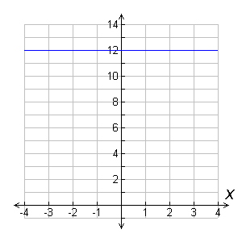
Check It Out! Example 3b Continued
y = 12
y

Slide 29
Check It Out! Example 3c
Tell whether the function is linear. If so, graph the function.
y = 2^{x}
This is not linear, because x is an exponent.

Slide 30
For linear functions whose graphs are not horizontal, the domain and range are all real numbers. However, in many real-world situations, the domain and range must be restricted. For example, some quantities cannot be negative, such as time.

Slide 31
Sometimes domain and range are restricted even further to a set of points. For example, a quantity such as number of people can only be whole numbers. When this happens, the graph is not actually connected because every point on the line is not a solution. However, you may see these graphs shown connected to indicate that the linear pattern, or trend, continues.

Slide 32
Example 4: Application
An approximate relationship between human years and dog years is given by the function y = 7x, where x is the number of human years. Graph this function and give its domain and range.
Choose several values of x and make a table of ordered pairs.
x
f(x) = 7x
The number of human years must be positive, so the domain is {x ≥ 0} and the range is {y ≥ 0}.
1
f(1) = 7(1) = 7
2
f(2) = 7(2) = 14
3
f(3) = 7(3) = 21

Slide 33
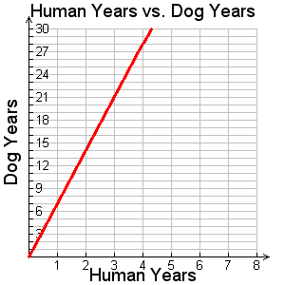
Example 4 Continued
An approximate relationship between human years and dog years is given by the function y = 7x, where x is the number of human years. Graph this function and give its domain and range.
Graph the ordered pairs.
x
f(x) = 7x
(3,21)
•
1
f(1) = 7(1) = 7
•
(2,14)
2
f(2) = 7(2) = 14
•
(1,7)
3
f(3) = 7(3) = 21

Slide 34
Check It Out! Example 4
What if…? At a salon, Sue can rent a station for $10.00 per day plus $3.00 per manicure. The amount she would pay each day is given by f(x) = 3x + 10, where x is the number of manicures. Graph this function and give its domain and range.

Slide 35
Check It Out! Example 4 Continued
Choose several values of x and make a table of ordered pairs.
x
f(x) = 3x + 10
The number of manicures
must be a whole number, so the domain is {0, 1, 2, 3, …}. The range is {10.00, 13.00, 16.00, 19.00, …}.
0
f(0) = 3(0) + 10 = 10
1
f(1) = 3(1) + 10 = 13
2
f(2) = 3(2) + 10 = 16
3
f(3) = 3(3) + 10 = 19
4
f(4) = 3(4) + 10 = 22
5
f(5) = 3(5) + 10 = 25

Slide 36
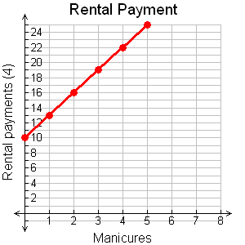
Check It Out! Example 4 Continued
Graph the ordered pairs.
The individual points are solutions in this situation. The line shows that the trend continues.
($)

Slide 37
Lesson Quiz: Part I
Tell whether each set of ordered pairs satisfies a linear function. Explain.
1. {(–3, 10), (–1, 9), (1, 7), (3, 4), (5, 0)}
No; a constant change of +2 in x corresponds to different changes in y.
2. {(3, 4), (5, 7), (7, 10), (9, 13), (11, 16)}
Yes; a constant change of +2 in x corresponds to a constant change of +3 in y.

Slide 38
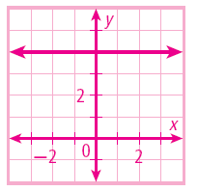
Lesson Quiz: Part II
Tell whether each function is linear. If so, graph the function.
3. y = 3 – 2^{x}
no
4. 3y = 12
yes

Slide 39
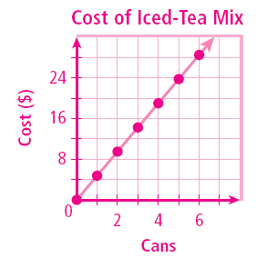
Lesson Quiz: Part III
5. The cost of a can of iced-tea mix at Save More Grocery is $4.75. The function f(x) = 4.75x gives the cost of x cans of iced-tea mix. Graph this function and give its domain and range.
D: {0, 1, 2, 3, …}
R: {0, 4.75, 9.50,
14.25,…}

