Slide 1

Triangle Similarity: AA, SSS, SAS
Warm Up
Lesson Presentation
Lesson Quiz
Holt McDougal Geometry
Holt Geometry

Slide 2





Warm Up
Solve each proportion.
1. 2. 3.
4. If ∆QRS ~ ∆XYZ, identify the pairs of congruent angles and write 3 proportions using pairs of corresponding sides.
z = ±10
x = 8
∠Q ≅ ∠X; ∠R ≅ ∠Y; ∠S ≅ ∠Z;

Slide 3
Objectives
Prove certain triangles are similar by using AA, SSS, and SAS.
Use triangle similarity to solve problems.

Slide 4
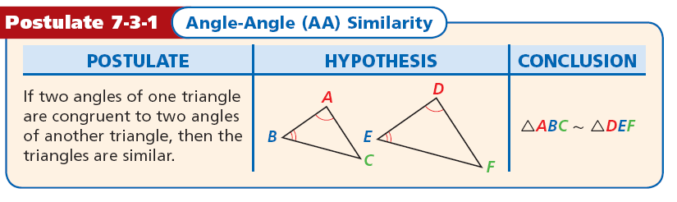
There are several ways to prove certain triangles are similar. The following postulate, as well as the SSS and SAS Similarity Theorems, will be used in proofs just as SSS, SAS, ASA, HL, and AAS were used to prove triangles congruent.

Slide 5
Example 1: Using the AA Similarity Postulate
Explain why the triangles are similar and write a similarity statement.
∠
Since ∠A ≅ ∠D, ∠BCA ≅ ∠ECD by the vertical Angles Theorem. Therefore ∆ABC ~ ∆DEC by AA~.

Slide 6
Check It Out! Example 1
Explain why the triangles
are similar and write a
similarity statement.
By the Triangle Sum Theorem, m∠C = 47°, so ∠C ≅ ∠F. ∠B ≅ ∠E by the Right Angle Congruence Theorem.
Therefore, ∆ABC ~ ∆DEF by AA ~.

Slide 7
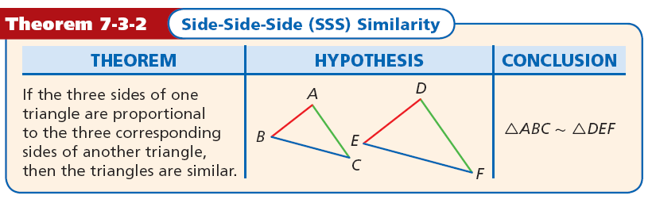

Slide 8
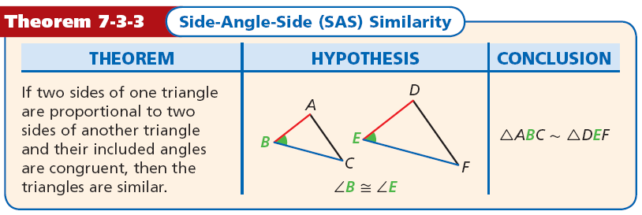

Slide 9



Example 2A: Verifying Triangle Similarity
Verify that the triangles are similar.
∆PQR and ∆STU
Therefore ∆PQR ~ ∆STU by SSS ~.

Slide 10
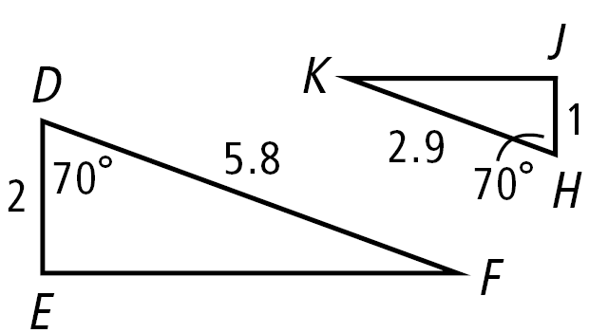


Example 2B: Verifying Triangle Similarity
Verify that the triangles are similar.
∆DEF and ∆HJK
∠D ≅ ∠H by the Definition of Congruent Angles.
Therefore ∆DEF ~ ∆HJK by SAS ~.

Slide 11


Check It Out! Example 2
Verify that ∆TXU ~ ∆VXW.
∠TXU ≅ ∠VXW by the Vertical Angles Theorem.
Therefore ∆TXU ~ ∆VXW by SAS ~.

Slide 12
Example 3: Finding Lengths in Similar Triangles
Explain why ∆ABE ~ ∆ACD, and then find CD.
Step 1 Prove triangles are similar.
∠A ≅ ∠A by Reflexive Property of ≅, and ∠B ≅ ∠C since they are both right angles.
Therefore ∆ABE ~ ∆ACD by AA ~.

Slide 13



Example 3 Continued
Step 2 Find CD.
Corr. sides are proportional. Seg. Add. Postulate.
Substitute x for CD, 5 for BE, 3 for CB, and 9 for BA.
x(9) = 5(3 + 9)
Cross Products Prop.
9x = 60
Simplify.
Divide both sides by 9.

Slide 14
Check It Out! Example 3
Explain why ∆RSV ~ ∆RTU and then find RT.
Step 1 Prove triangles are similar.
It is given that ∠S ≅ ∠T.
∠R ≅ ∠R by Reflexive Property of ≅.
Therefore ∆RSV ~ ∆RTU by AA ~.

Slide 15


Check It Out! Example 3 Continued
Step 2 Find RT.
Corr. sides are proportional.
Substitute RS for 10, 12 for TU, 8 for SV.
RT(8) = 10(12)
Cross Products Prop.
8RT = 120
Simplify.
RT = 15
Divide both sides by 8.

Slide 16
Example 4: Writing Proofs with Similar Triangles
Given: 3UT = 5RT and 3VT = 5ST
Prove: ∆UVT ~ ∆RST

Slide 17


Example 4 Continued
Statements | Reasons
1. 3UT = 5RT
1. Given
2.
2. Divide both sides by 3RT.
3. 3VT = 5ST
3. Given.
4.
4. Divide both sides by3ST.
5. ∠RTS ≅ ∠VTU
5. Vert. ∠s Thm.
6. ∆UVT ~ ∆RST
6. SAS ~ Steps 2, 4, 5

Slide 18
Check It Out! Example 4
Given: M is the midpoint of JK. N is the midpoint of KL, and P is the midpoint of JL.

Slide 19


Check It Out! Example 4 Continued
Statements | Reasons
1. M is the mdpt. of JK,
N is the mdpt. of KL,
and P is the mdpt. of JL.
1. Given
2.
2. ∆ Midsegs. Thm
3.
3. Div. Prop. of =.
4. ∆JKL ~ ∆NPM
4. SSS ~ Step 3

Slide 20
Example 5: Engineering Application
The photo shows a gable roof. AC || FG. ∆ABC ~ ∆FBG. Find BA to the nearest tenth of a foot.
From p. 473, BF ≈ 4.6 ft.
BA = BF + FA
≈ 6.3 + 17
≈ 23.3 ft
Therefore, BA = 23.3 ft.

Slide 21


Check It Out! Example 5
What if…? If AB = 4x, AC = 5x, and BF = 4, find FG.
Corr. sides are proportional.
Substitute given quantities.
4x(FG) = 4(5x)
Cross Prod. Prop.
Simplify.
FG = 5

Slide 22
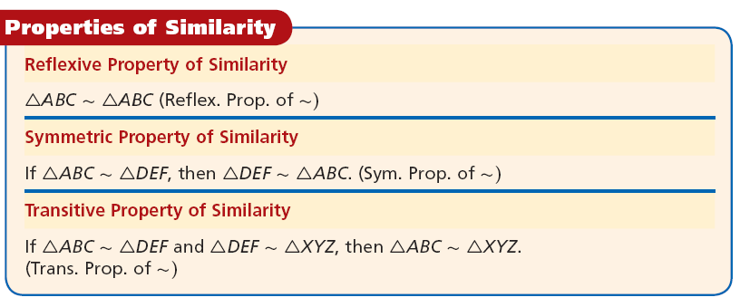
You learned in Chapter 2 that the Reflexive, Symmetric, and Transitive Properties of Equality have corresponding properties of congruence. These properties also hold true for similarity of triangles.

Slide 23
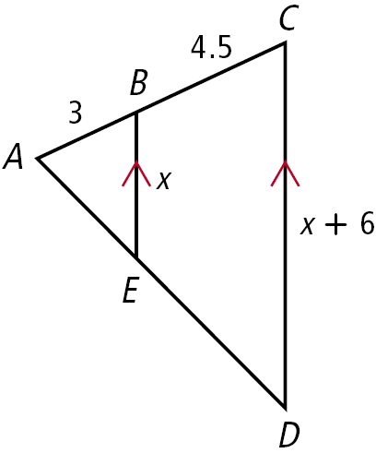
Lesson Quiz
1. Explain why the triangles are similar and write a similarity statement.
2. Explain why the triangles are similar, then find BE and CD.

Slide 24
Lesson Quiz
1. By the Isosc. ∆ Thm., ∠A ≅ ∠C, so by the def.
of ≅, m∠C = m∠A. Thus m∠C = 70° by subst.
By the ∆ Sum Thm., m∠B = 40°. Apply the
Isosc. ∆ Thm. and the ∆ Sum Thm. to ∆PQR.
m∠R = m∠P = 70°. So by the def. of ≅, ∠A ≅ ∠P, and ∠C ≅ ∠R. Therefore ∆ABC ~ ∆PQR by AA ~.
2. ∠A ≅ ∠A by the Reflex. Prop. of ≅. Since BE || CD, ∠ABE ≅ ∠ACD by the Corr. ∠s Post. Therefore ∆ABE ~ ∆ACD by AA ~. BE = 4 and CD = 10.

