Slide 1

Applying Properties
of Similar Triangles
Warm Up
Lesson Presentation
Lesson Quiz
Holt McDougal Geometry
Holt Geometry

Slide 2




Warm Up
Solve each proportion.
1. 2.
3. 4.
AB = 16
QR = 10.5
x = 21
y = 8

Slide 3
Objectives
Use properties of similar triangles to find segment lengths.
Apply proportionality and triangle angle bisector theorems.

Slide 4
Artists use mathematical techniques to make two-dimensional paintings appear three-dimensional. The invention of perspective was based on the observation that far away objects look smaller and
closer objects look larger.
Mathematical theorems like the Triangle Proportionality Theorem are important in making perspective drawings.

Slide 5
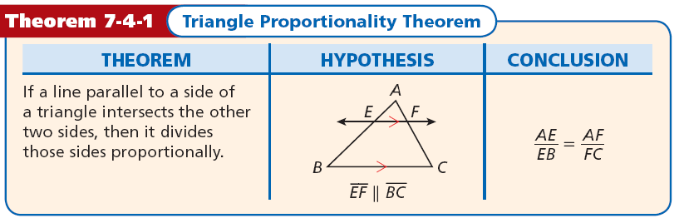

Slide 6




Example 1: Finding the Length of a Segment
Find US.
It is given that , so by the Triangle Proportionality Theorem.
Substitute 14 for RU,
4 for VT, and 10 for RV.
US(10) = 56
Cross Products Prop.
Divide both sides by 10.

Slide 7
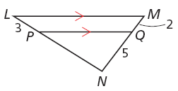


Check It Out! Example 1
Find PN.
Use the Triangle Proportionality Theorem.
Substitute in the given values.
2PN = 15
Cross Products Prop.
PN = 7.5
Divide both sides by 2.

Slide 8
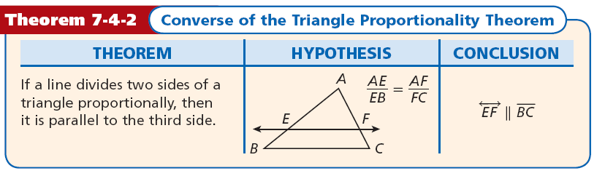

Slide 9

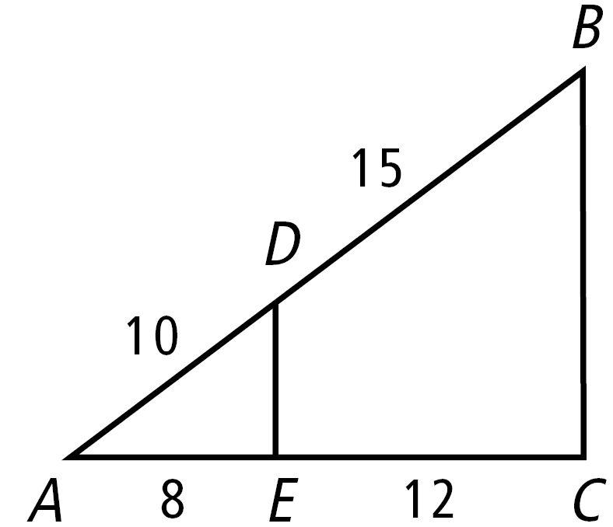



Example 2: Verifying Segments are Parallel
Verify that .
Since , by the Converse of the Triangle Proportionality Theorem.

Slide 10




Check It Out! Example 2
AC = 36 cm, and BC = 27 cm. Verify that .
Since , by the Converse of the
Triangle Proportionality Theorem.

Slide 11
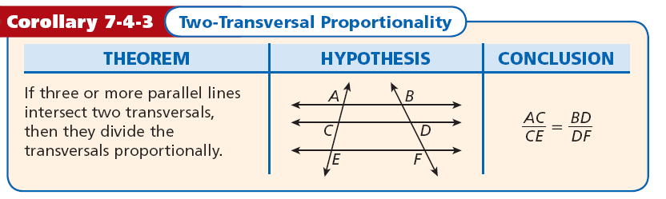

Slide 12
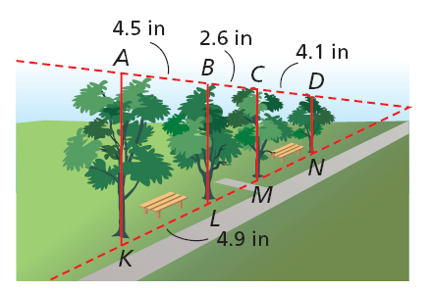
Example 3: Art Application
Suppose that an artist decided to make a larger sketch of the trees. In the figure, if AB = 4.5 in., BC = 2.6 in., CD = 4.1 in., and KL = 4.9 in., find LM and MN to the nearest tenth of an inch.

Slide 13



Example 3 Continued
Given
2-Trans. Proportionality Corollary
Substitute 4.9 for KL, 4.5 for AB, and 2.6 for BC.
4.5(LM) = 4.9(2.6)
Cross Products Prop.
LM ≈ 2.8 in.
Divide both sides by 4.5.

Slide 14


Example 3 Continued
2-Trans. Proportionality Corollary
Substitute 4.9 for KL, 4.5 for AB, and 4.1 for CD.
4.5(MN) = 4.9(4.1)
Cross Products Prop.
MN ≈ 4.5 in.
Divide both sides by 4.5.

Slide 15
Check It Out! Example 3
Use the diagram to find LM and MN to the nearest tenth.

Slide 16

Check It Out! Example 3 Continued
Given
2-Trans. Proportionality Corollary
Substitute 2.6 for KL, 2.4 for AB, and 1.4 for BC.
2.4(LM) = 1.4(2.6)
Cross Products Prop.
LM ≈ 1.5 cm
Divide both sides by 2.4.

Slide 17

Check It Out! Example 3 Continued
2-Trans. Proportionality Corollary
Substitute 2.6 for KL, 2.4 for AB, and 2.2 for CD.
2.4(MN) = 2.2(2.6)
Cross Products Prop.
MN ≈ 2.4 cm
Divide both sides by 2.4.

Slide 18
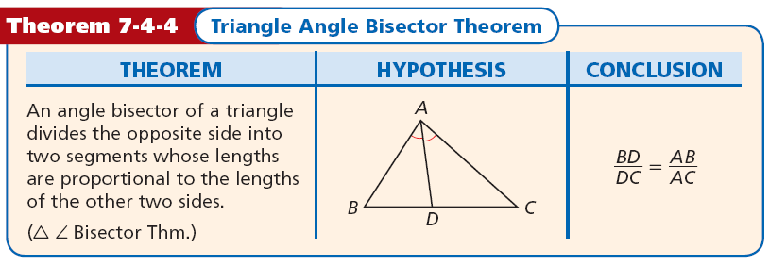
The previous theorems and corollary lead to the following conclusion.

Slide 19
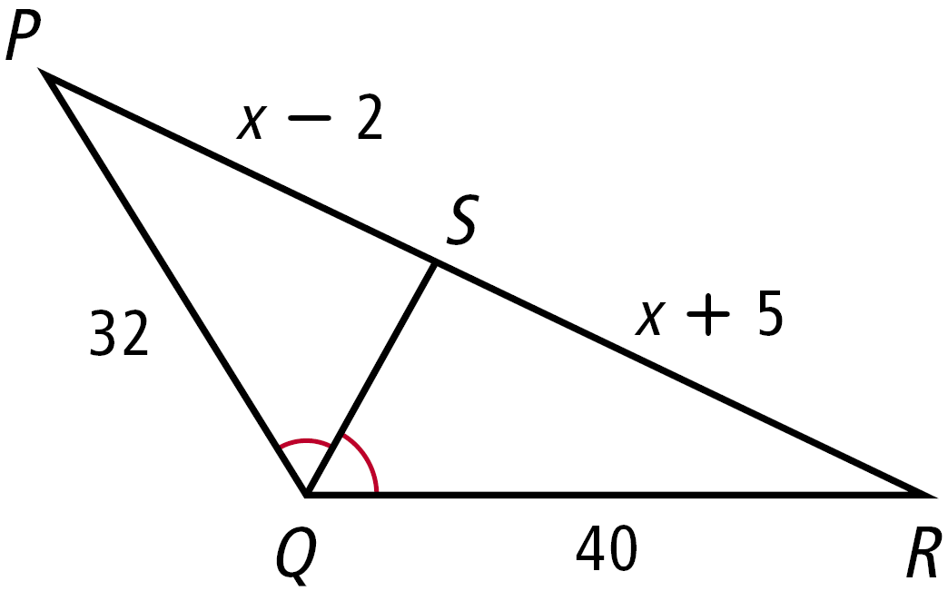


Example 4: Using the Triangle Angle Bisector Theorem
Find PS and SR.
by the ∆ ∠ Bisector Theorem.
Substitute the given values.
40(x – 2) = 32(x + 5)
Cross Products Property
40x – 80 = 32x + 160
Distributive Property

Slide 20
Example 4 Continued
40x – 80 = 32x + 160
8x = 240
Simplify.
x = 30
Divide both sides by 8.
Substitute 30 for x.
PS = x – 2
SR = x + 5
= 30 – 2 = 28
= 30 + 5 = 35

Slide 21

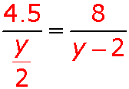
Check It Out! Example 4
Find AC and DC.
by the ∆ ∠ Bisector Theorem.
Substitute in given values.
4y = 4.5y – 9
Cross Products Theorem
–0.5y = –9
Simplify.
y = 18
Divide both sides by –0.5.
So DC = 9 and AC = 16.

Slide 22


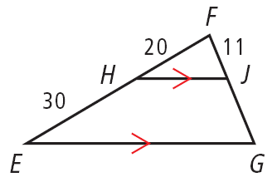
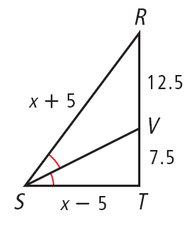

Lesson Quiz: Part I
Find the length of each segment.
1. 2.
SR = 25, ST = 15

Slide 23




Lesson Quiz: Part II
3. Verify that BE and CD are parallel.
Since , by the
Converse of the ∆ Proportionality Thm.

