Slide 1

Dilations and Similarity in the Coordinate Plane
Warm Up
Lesson Presentation
Lesson Quiz
Holt McDougal Geometry
Holt Geometry

Slide 2








Warm Up
Simplify each radical.
1. 2. 3.
Find the distance between each pair of points. Write your answer in simplest radical form.
4. C (1, 6) and D (–2, 0)
5. E(–7, –1) and F(–1, –5)

Slide 3
Objectives
Apply similarity properties in the coordinate plane.
Use coordinate proof to prove figures similar.

Slide 4
Vocabulary
dilation
scale factor

Slide 5
A dilation is a transformation that changes the size of a figure but not its shape. The preimage and the image are always similar. A scale factor describes how much the figure is enlarged or reduced. For a dilation with scale factor k, you can find the image of a point by multiplying each coordinate by k: (a, b) → (ka, kb).

Slide 6
Helpful Hint
If the scale factor of a dilation is greater than 1 (k > 1), it is an enlargement. If the scale factor is less than 1 (k < 1), it is a reduction.

Slide 7


Slide 8

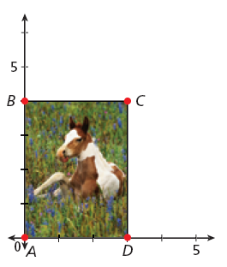
Example 1: Computer Graphics Application
Draw the border of the photo after a dilation with scale factor

Slide 9




Example 1 Continued
Step 1 Multiply the vertices of the photo A(0, 0), B(0, 4), C(3, 4), and D(3, 0) by
Rectangle
ABCD
Rectangle
A’B’C’D’

Slide 10
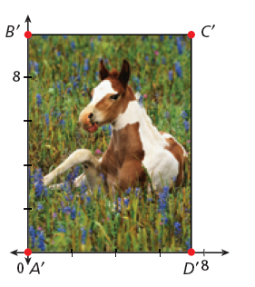
Example 1 Continued
Step 2 Plot points A’(0, 0), B’(0, 10), C’(7.5, 10), and D’(7.5, 0).
Draw the rectangle.

Slide 11

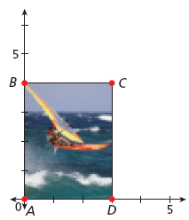
Check It Out! Example 1
What if…? Draw the border of the original photo after a dilation with scale factor

Slide 12




Check It Out! Example 1 Continued
Step 1 Multiply the vertices of the photo A(0, 0), B(0, 4), C(3, 4), and D(3, 0) by
Rectangle
ABCD
Rectangle
A’B’C’D’

Slide 13

Check It Out! Example 1 Continued
Step 2 Plot points A’(0, 0), B’(0, 2), C’(1.5, 2), and D’(1.5, 0).
Draw the rectangle.
B’
C’
2
0
A’
1.5
D’

Slide 14


Example 2: Finding Coordinates of Similar Triangle
Given that ∆TUO ~ ∆RSO, find the coordinates of U and the scale factor.
Since ∆TUO ~ ∆RSO,
Substitute 12 for RO,
9 for TO, and 16 for OY.
12OU = 144
Cross Products Prop.
OU = 12
Divide both sides by 12.

Slide 15


Example 2 Continued
U lies on the y-axis, so its x-coordinate is 0. Since OU = 12, its y-coordinate must be 12. The coordinates of U are (0, 12).
So the scale factor is

Slide 16


Check It Out! Example 2
Given that ∆MON ~ ∆POQ and coordinates P (–15, 0), M(–10, 0), and Q(0, –30), find the coordinates of N and the scale factor.
Since ∆MON ~ ∆POQ,
Substitute 10 for OM,
15 for OP, and 30 for OQ.
15 ON = 300
Cross Products Prop.
ON = 20
Divide both sides by 15.

Slide 17


Check It Out! Example 2 Continued
N lies on the y-axis, so its x-coordinate is 0. Since ON = 20, its y-coordinate must be –20. The coordinates of N are (0, –20).
So the scale factor is

Slide 18
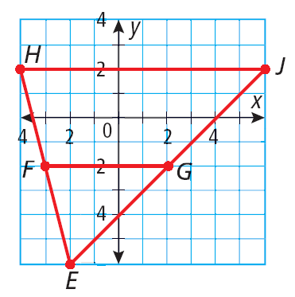
Example 3: Proving Triangles Are Similar
Given: E(–2, –6), F(–3, –2), G(2, –2), H(–4, 2), and J(6, 2).
Prove: ∆EHJ ~ ∆EFG.
Step 1 Plot the points and draw the triangles.

Slide 19
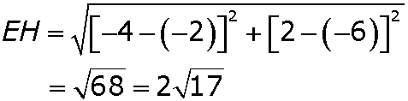
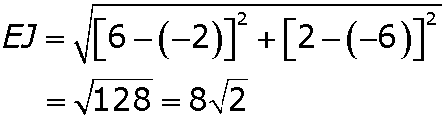
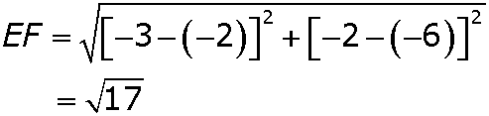
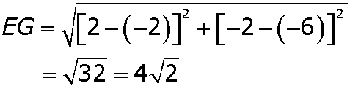
Example 3 Continued
Step 2 Use the Distance Formula to find the side lengths.

Slide 20





Example 3 Continued
Step 3 Find the similarity ratio.
= 2
= 2
Since and ∠E ≅ ∠E, by the Reflexive Property, ∆EHJ ~ ∆EFG by SAS ~ .

Slide 21
Check It Out! Example 3
Given: R(–2, 0), S(–3, 1), T(0, 1), U(–5, 3), and V(4, 3).
Prove: ∆RST ~ ∆RUV

Slide 22
Check It Out! Example 3 Continued
Step 1 Plot the points and draw the triangles.
U
V
S
T
R

Slide 23
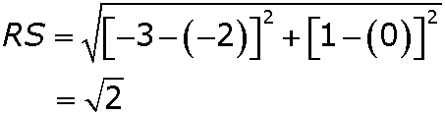
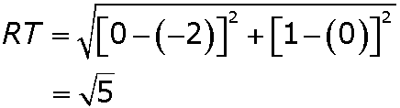
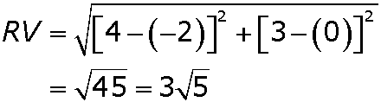
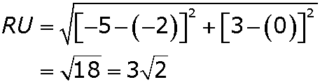
Check It Out! Example 3 Continued
Step 2 Use the Distance Formula to find the side lengths.

Slide 24




Check It Out! Example 3 Continued
Step 3 Find the similarity ratio.
Since and ∠R ≅ ∠R, by the Reflexive Property, ∆RST ~ ∆RUV by SAS ~ .

Slide 25
Example 4: Using the SSS Similarity Theorem
Graph the image of ∆ABC after a dilation with scale factor
Verify that ∆A'B'C' ~ ∆ABC.

Slide 26



Example 4 Continued
Step 1 Multiply each coordinate by to find the coordinates of the vertices of ∆A’B’C’.

Slide 27
Example 4 Continued
Step 2 Graph ∆A’B’C’.
B’ (2, 4)
A’ (0, 2)
C’ (4, 0)

Slide 28
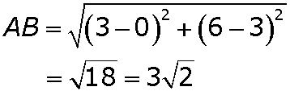
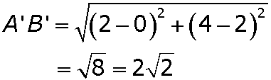
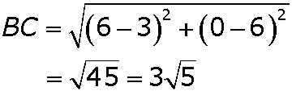
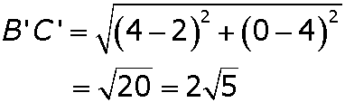
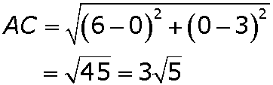
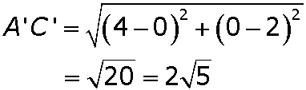
Example 4 Continued
Step 3 Use the Distance Formula to find the side lengths.

Slide 29


Example 4 Continued
Step 4 Find the similarity ratio.
Since , ∆ABC ~ ∆A’B’C’ by SSS ~.

Slide 30
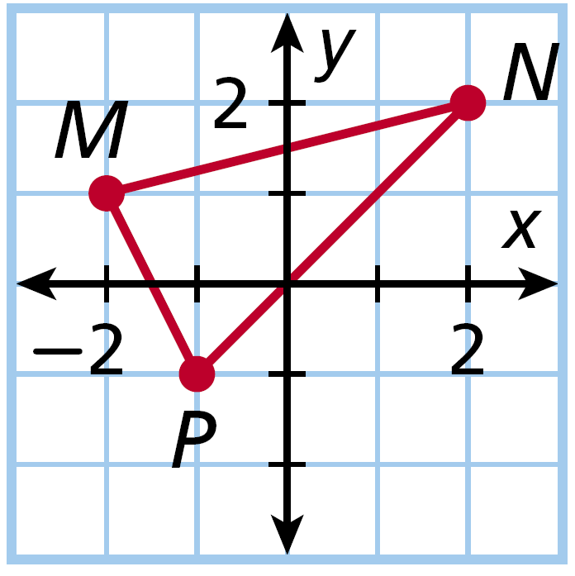
Check It Out! Example 4
Graph the image of ∆MNP after a dilation with scale factor 3.
Verify that ∆M'N'P' ~ ∆MNP.

Slide 31
Check It Out! Example 4 Continued
Step 1 Multiply each coordinate by 3 to find the coordinates of the vertices of ∆M’N’P’.

Slide 32
Check It Out! Example 4 Continued
Step 2 Graph ∆M’N’P’.

Slide 33
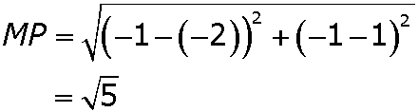
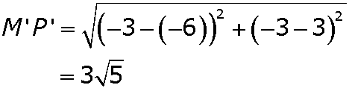
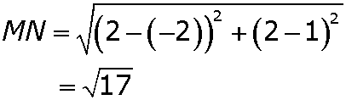
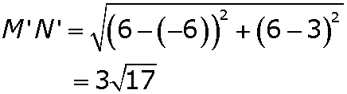
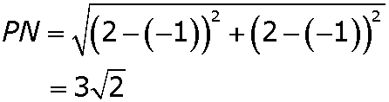
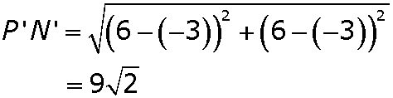
Check It Out! Example 4 Continued
Step 3 Use the Distance Formula to find the side lengths.

Slide 34


Check It Out! Example 4 Continued
Step 4 Find the similarity ratio.
Since , ∆MNP ~ ∆M’N’P’ by SSS ~.

Slide 35

Lesson Quiz: Part I
1. Given X(0, 2), Y(–2, 2), and Z(–2, 0), find the coordinates of X', Y, and Z' after a dilation with scale factor –4.
2. ∆JOK ~ ∆LOM. Find the coordinates of M and the scale factor.
X'(0, –8); Y'(8, –8); Z'(8, 0)

Slide 36
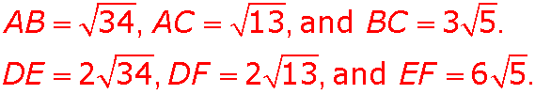

Lesson Quiz: Part II
3. Given: A(–1, 0), B(–4, 5), C(2, 2), D(2, –1), E(–4, 9), and F(8, 3)
Prove: ∆ABC ~ ∆DEF
Therefore, and ∆ABC ~ ∆DEF
by SSS ~.

