Slide 1

Slope-Intercept Form
Warm Up
Lesson Presentation
Lesson Quiz
Holt Algebra 1
Holt McDougal Algebra 1

Slide 2


Warm Up
Find each y-intercept.
1. y = 3x + 2 2. 5x – 3y = 12
2
–4
Find each slope.
4. 6x + 2y = 6
3.
–3
Solve each equation for y.
5. 4x + 2y = 10
6. 3x + 2 = 6y
y = –2x + 5

Slide 3
Objectives
Write a linear equation in slope-intercept form.
Graph a line using slope-intercept form.

Slide 4
You have seen that you can graph a line if you know two points on the line. Another way is to use the slope of the line and the point that contains the y-intercept.

Slide 5
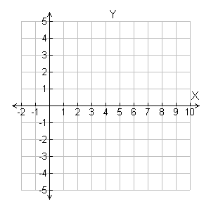

Additional Example 1: Graphing by Using Slope and
y-intercept
Graph the line given the slope and y-intercept.
Slope =-
; y intercept = 4
y
Rise = –2
•
•
Step 1 The y-intercept is 4, so the line contains (0, 4). Plot (0, 4).
•
•
Step 2 Slope = Count 2 units down and 5 units right from (0, 4) and plot another point.
Run = 5
Step 3 Draw the line through the two points.

Slide 6
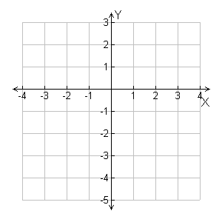

Check It Out! Example 1a
Graph the line given the slope and y-intercept.
slope = 2, y-intercept = –3
Step 1 The y-intercept is –3, so the line contains (0, –3). Plot (0, –3).
Run = 1
Rise = 2
•
Step 2 Slope =
Count 2 units up and 1 unit right from (0, –3) and plot another point.
•
Step 3 Draw the line through the two points.

Slide 7
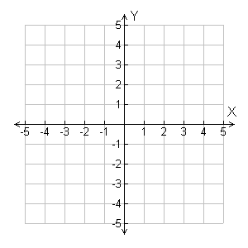

Check It Out! Example 1b
Graph each line given the slope and y-intercept.
slope = , y-intercept = 1
Step 1 The y-intercept is 1, so the line contains (0, 1). Plot (0, 1).
Rise = –2
•
Step 2 Slope = Count 2 units down and 3 units right from (0, 1) and plot another point.
•
Run = 3
Step 3 Draw the line through the two points.

Slide 8

If you know the slope of a line and the y-intercept, you can write an equation that describes the line.
Step 1 If a line has a slope of 2 and the y-intercept is 3, then m = 2 and (0, 3) is on the line. Substitute these values into the slope formula.

Slide 9



Step 2 Solve for y:
Simplify the denominator.
•
•
Multiply both sides by x.
2x = y – 3
Add 3 to both sides.
+3 +3
2x + 3 = y, or y = 2x + 3

Slide 10
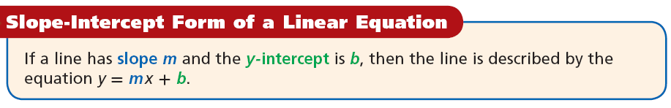
Any linear equation can be written in slope-intercept form by solving for y and simplifying. In this form, you can immediately see the slope and y-intercept. Also, you can quickly graph a line when the equation is written in slope-intercept form.

Slide 11
Additional Example 2A: Writing Linear Equations in Slope-Intercept Form
Write the equation that describes the line in slope-intercept form.
slope = ; y-intercept = 4
y = mx + b
Substitute the given values for m and b.
y = x + 4
Simply if necessary.

Slide 12



Additional Example 2B: Writing Linear Equations in Slope-Intercept Form
Write the equation that describes the line in slope-intercept form.
slope = –9; y-intercept =
y = mx + b
Substitute the given values for m and b.
y = –9x +
Simply if necessary.

Slide 13
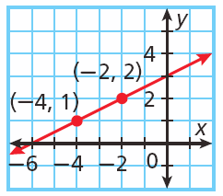
Additional Example 2C: Writing Linear Equations in Slope-Intercept Form
Write the equation that describes the line in slope-intercept form.
Step 1 Find the y-intercept. The graph crosses the y-axis at (0, 3), so b = 3.
Step 2 Find the slope. The line contains the points (–4, 1) and (–2, 2).

Slide 14




Additional Example 2C Continued
Write the equation that describes the line in slope-intercept form.
Use the slope formula.
Substitute (–4,1) for (x₁ , y₁)
and (–2, 2) for (x₂ , y₂) .
Step 3 Write the equation.
y = mx + b
Write the slope-intercept form.

Slide 15
Additional Example 2D: Writing linear Equations in Slope-Intercept Form
Write the equation that describes the line in slope-intercept form.
slope = 2; (3, 4) is on the line.
Step 1 Find the y-intercept.
y = mx + b
Write the slope-intercept form.
4 = 2(3) + b
Substitute 2 for m, 3 for x, and 4 for y.
4 = 6 + b
–6 –6
Solve for b. Since 6 is added to b, subtract 6 from both sides to undo the addition.
–2 = b

Slide 16
Additional Example 2D Continued
Write the equation that describes the line in slope-intercept form.
slope = 2; (3, 4) is on the line.
Step 2 Write the equation.
y = mx + b
Write the slope-intercept form.
y = 2x + (–2)
Substitute 2 for m, and –2 for b.
y = 2x – 2

Slide 17

Check It Out! Example 2a
Write the equation that describes each line in slope-intercept form.
slope = −12, y-intercept =
y = mx + b
Substitute the given values for m and b.
Simplify if necessary.

Slide 18
Check It Out! Example 2b
Write the equation that describes each line in slope-intercept form.
slope = 1, y-intercept = 0
y = mx + b
y = 1x + 0
Substitute the given values for m and b.
y = x

Slide 19
Check It Out! Example 2d
A line has a slope of 8 and (-3, 1) is on the line. Write the equation that describes this line in slope-intercept form.
Step 1 Find the y-intercept.
y = mx + b
Write the slope-intercept form.
1 = 8(−3) + b
Substitute 8 for m, −3 for x, and 1 for y.
1 = −24 + b
+24 +24
Solve for b. Since 24 is subtracted to b, add 24 to both sides to undo the subtraction.
25 = b

Slide 20
Check It Out! Example 2d Continued
A line has a slope of 8 and (3, –1) is on the line. Write the equation that describes this line in slope-intercept form.
Step 2 Write the equation.
y = mx + b
Write the slope-intercept form.
y = 8x + 25
Substitute 8 for m, and 25 for b.
y = 8x + 25

Slide 21
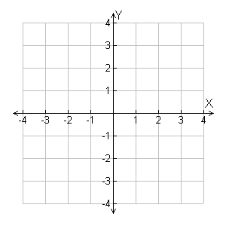
Additional Example 3A: Using Slope-Intercept Form to Graph
Write the equation in slope-intercept form. Then graph the line described by the equation.
y = 3x – 1
y = 3x – 1 is in the form y = mx + b
slope: m = 3 =
•
y-intercept: b = –1
Step 1 Plot (0, –1).
•
Step 2 Count 3 units up and 1 unit right and plot another point.
Step 3 Draw the line connecting the two points.

Slide 22


Additional Example 3B: Using Slope-Intercept Form to Graph
Write the equation in slope-intercept form. Then graph the line described by the equation.
2y + 3x = 6
Step 1 Write the equation in slope-intercept form by solving for y.
2y + 3x = 6
–3x –3x
Subtract 3x from both sides.
2y = –3x + 6
Since y is multiplied by 2, divide both sides by 2.

Slide 23
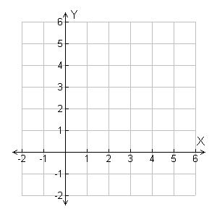


Additional Example 3B Continued
Write the equation in slope-intercept form. Then graph the line described by the equation.
Step 2 Graph the line.
is in the form y = mx + b.
•
slope: m =
•
y-intercept: b = 3
Plot (0, 3).
• Count 3 units down and 2 units right and plot another point.
• Draw the line connecting the two points.

Slide 24

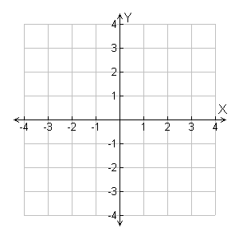


Check It Out! Example 3a
Write the equation in slope-intercept form. Then graph the line described by the equation.
is in the form y = mx + b.
•
•
slope:
y-intercept: b = 0
Step 1 Plot (0, 0).
Step 2 Count 2 units up and 3 units right and plot another point.
Step 3 Draw the line connecting the two points.

Slide 25



Check It Out! Example 3b
Write the equation in slope-intercept form. Then graph the line described by the equation.
6x + 2y = 10
Step 1 Write the equation in slope intercept form by solving for y.
6x + 2y = 10
–6x –6x
Subtract 6x from both sides.
2y = –6x + 10
Since y is multiplied by 2, divide both sides by 2.

Slide 26
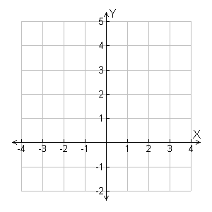

Check It Out! Example 3b Continued
Write the equation in slope-intercept form. Then graph the line described by the equation.
Step 2 Graph the line.
•
y = –3x + 5 is in the form y = mx + b.
•
slope: m =
y-intercept: b = 5
• Plot (0, 5).
• Count 3 units down and 1 unit right and plot another point.
• Draw the line connecting the two points.

Slide 27
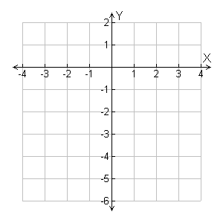
Check It Out! Example 3c
Write the equation in slope-intercept form. Then graph the line described by the equation.
y = –4
y = –4 is in the form y = mx + b.
slope: m = 0 = = 0
y-intercept: b = –4
Step 1 Plot (0, –4).
•
Since the slope is 0, the line will be a horizontal at y = –4.

Slide 28
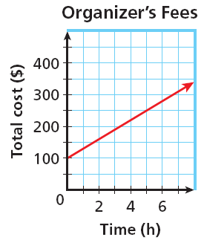
Additional Example 4: Application
A closet organizer charges a $100 initial consultation fee plus $30 per hour. The cost as a function of the number of hours worked is graphed below.

Slide 29
Additional Example 4: Application
A closet organizer charges $100 initial consultation fee plus $30 per hour. The cost as a function of the number of hours worked is graphed below.
a. Write an equation that represents the cost as a function of the number of hours.
for each hour
Cost
is
$30
plus
$100
y
=
30
•x
+
100
An equation is y = 30x + 100.

Slide 30
Additional Example 4 Continued
A closet organizer charges $100 initial consultation fee plus $30 per hour. The cost as a function of the number of hours worked is graphed below.
b. Identify the slope and y-intercept and describe their meanings.
The y-intercept is 100. This is the cost for 0 hours, or the initial fee of $100. The slope is 30. This is the rate of change of the cost: $30 per hour.
c. Find the cost if the organizer works 12 hrs.
y = 30x + 100
Substitute 12 for x in the equation
= 30(12) + 100 = 460
The cost of the organizer for 12 hours is $460.

Slide 31
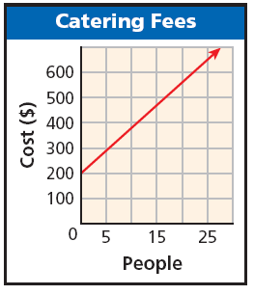
Check It Out! Example 4
A caterer charges a $200 fee plus $18 per person served. The cost as a function of the number of guests is shown in the graph.
a. Write an equation that represents the cost as a function of the number of guests.
for each person
Cost
is
$18
plus
$200
y
=
18
•x
+
200
An equation is y = 18x + 200.

Slide 32
Check It Out! Example 4 Continued
A caterer charges a $200 fee plus $18 per person served. The cost as a function of the number of guests is shown in the graph.
b. Identify the slope and y-intercept and describe their meanings.
The y-intercept is 200. This is the cost for 0 people, or the initial fee of $200. The slope is 18. This is the rate of change of the cost: $18 per person.
c. Find the cost of catering an event for 200 guests.
y = 18x + 200
Substitute 200 for x in the equation
= 18(200) + 200 = 3800
The cost of catering for 200 people is $3800.

Slide 33
Pop Quiz #2
Write the equation that describes each line in the slope-intercept form.
1. slope = 3, y-intercept = –2
2. slope = 0, y-intercept =
3. slope = , (2, 7) is on the line.
Write each equation in slope-intercept form. Then tell the slope and y-intercept
4. 6x + 2y = 10

Slide 34
Pop Quiz #2
Write the equation that describes each line in the slope-intercept form.
1. slope = 3, y-intercept = –2
y = 3x – 2
2. slope = 0, y-intercept =
y =
3. slope = , (2, 7) is on the line.
y = x + 4

Slide 35
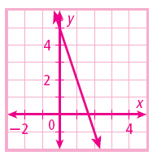
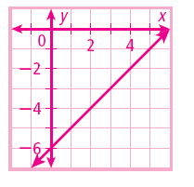
Lesson Quiz: Part II
Write each equation in slope-intercept form. Then tell the slope and y-intercept
4. 6x + 2y = 10
5. x – y = 6
y = –3x + 5
y = x – 6

