Slide 1

The Pythagorean Theorem
Warm Up
Lesson Presentation
Lesson Quiz
Holt McDougal Geometry
Holt Geometry

Slide 2
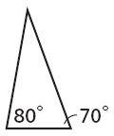
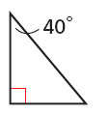

Warm Up
Classify each triangle by its angle measures.
1. 2.
3. Simplify
4. If a = 6, b = 7, and c = 12, find a² + b² and find c². Which value is greater?
acute
right
12
85; 144; c²

Slide 3
Objectives
Use the Pythagorean Theorem and its converse to solve problems.
Use Pythagorean inequalities to classify triangles.

Slide 4
Vocabulary
Pythagorean triple

Slide 5
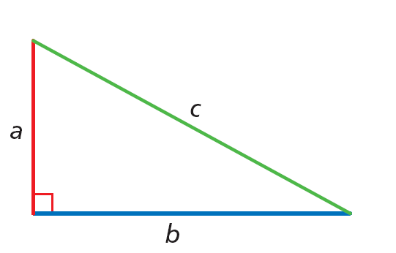
The Pythagorean Theorem is probably the most famous mathematical relationship. As you learned in Lesson 1-6, it states that in a right triangle, the sum of the squares of the lengths of the legs equals the square of the length of the hypotenuse.
a² + b² = c²

Slide 6
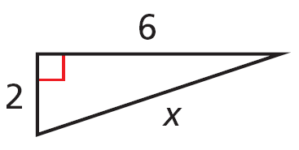


Example 1A: Using the Pythagorean Theorem
Find the value of x. Give your answer in simplest radical form.
a² + b² = c²
Pythagorean Theorem
2² + 6² = x²
Substitute 2 for a, 6 for b, and x for c.
40 = x²
Simplify.
Find the positive square root.
Simplify the radical.

Slide 7
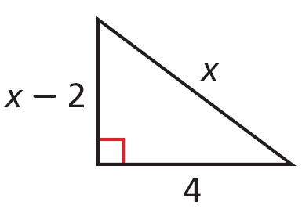
Example 1B: Using the Pythagorean Theorem
Find the value of x. Give your answer in simplest radical form.
a² + b² = c²
Pythagorean Theorem
(x – 2)² + 4² = x²
Substitute x – 2 for a, 4 for b, and x for c.
x² – 4x + 4 + 16 = x²
Multiply.
–4x + 20 = 0
Combine like terms.
20 = 4x
Add 4x to both sides.
5 = x
Divide both sides by 4.

Slide 8
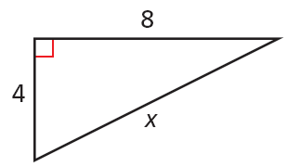


Check It Out! Example 1a
Find the value of x. Give your answer in simplest radical form.
a² + b² = c²
Pythagorean Theorem
4² + 8² = x²
Substitute 4 for a, 8 for b, and x for c.
80 = x²
Simplify.
Find the positive square root.
Simplify the radical.

Slide 9
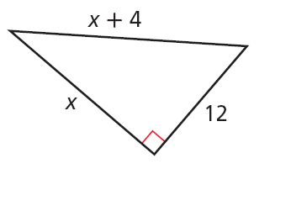
Check It Out! Example 1b
Find the value of x. Give your answer in simplest radical form.
a² + b² = c²
Pythagorean Theorem
Substitute x for a, 12 for b, and x + 4 for c.
x² + 12² = (x + 4)²
x² + 144 = x² + 8x + 16
Multiply.
128 = 8x
Combine like terms.
16 = x
Divide both sides by 8.

Slide 10
Example 2: Crafts Application
Randy is building a rectangular picture frame. He wants the ratio of the length to the width to be 3:1 and the diagonal to be 12 centimeters. How wide should the frame be? Round to the nearest tenth of a centimeter.
Let l and w be the length and width in centimeters of the picture. Then l:w = 3:1, so l = 3w.

Slide 11


Example 2 Continued
a² + b² = c²
Pythagorean Theorem
Substitute 3w for a, w for b, and 12 for c.
(3w)² + w² = 12²
Multiply and combine like terms.
10w² = 144
Divide both sides by 10.
Find the positive square root and round.

Slide 12
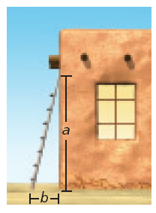
Check It Out! Example 2
What if...? According to the recommended safety ratio of 4:1, how high will a 30-foot ladder reach when placed against a wall? Round to the nearest inch.
Let x be the distance in feet from the foot of the ladder to the base of the wall. Then 4x is the distance in feet from the top of the ladder to the base of the wall.

Slide 13


Check It Out! Example 2 Continued
a² + b² = c²
Pythagorean Theorem
Substitute 4x for a, x for b, and 30 for c.
(4x)² + x² = 30²
Multiply and combine like terms.
17x² = 900
Since 4x is the distance in feet from the top of the ladder to the base of the wall, 4(7.28) ≈ 29 ft 1 in.

Slide 14
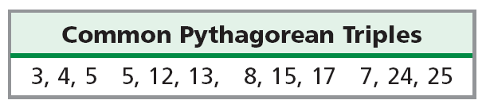
A set of three nonzero whole numbers a, b, and c such that a² + b² = c² is called a Pythagorean triple.

Slide 15
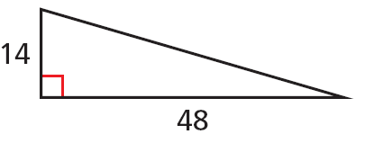
Example 3A: Identifying Pythagorean Triples
Find the missing side length. Tell if the side lengths form a Pythagorean triple. Explain.
a² + b² = c²
Pythagorean Theorem
14² + 48² = c²
Substitute 14 for a and 48 for b.
2500 = c²
Multiply and add.
50 = c
Find the positive square root.
The side lengths are nonzero whole numbers that satisfy the equation a² + b² = c², so they form a Pythagorean triple.

Slide 16
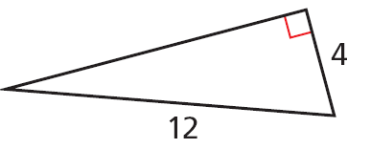


Example 3B: Identifying Pythagorean Triples
Find the missing side length. Tell if the side lengths form a Pythagorean triple. Explain.
a² + b² = c²
Pythagorean Theorem
4² + b² = 12²
Substitute 4 for a and 12 for c.
b² = 128
Multiply and subtract 16 from both sides.
Find the positive square root.
The side lengths do not form a Pythagorean triple because is not a whole number.

Slide 17
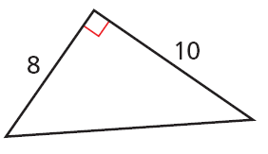


Check It Out! Example 3a
Find the missing side length. Tell if the side lengths form a Pythagorean triple. Explain.
a² + b² = c²
Pythagorean Theorem
8² + 10² = c²
Substitute 8 for a and 10 for b.
164 = c²
Multiply and add.
Find the positive square root.
The side lengths do not form a Pythagorean triple because is not a whole number.

Slide 18
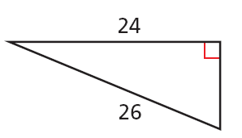
Check It Out! Example 3b
Find the missing side length. Tell if the side lengths form a Pythagorean triple. Explain.
a² + b² = c²
Pythagorean Theorem
24² + b² = 26²
Substitute 24 for a and 26 for c.
b² = 100
Multiply and subtract.
b = 10
Find the positive square root.
The side lengths are nonzero whole numbers that satisfy the equation a² + b² = c², so they form a Pythagorean triple.

Slide 19
Check It Out! Example 3c
Find the missing side length. Tell if the side lengths form a Pythagorean triple. Explain.
No. The side length 2.4 is not a whole number.

Slide 20
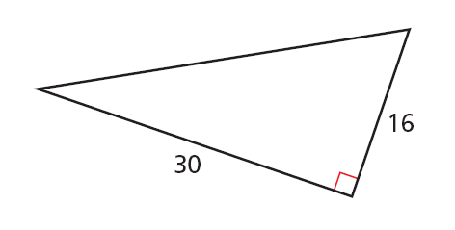
Check It Out! Example 3d
Find the missing side length. Tell if the side lengths form a Pythagorean triple. Explain.
a² + b² = c²
Pythagorean Theorem
30² + 16² = c²
Substitute 30 for a and 16 for b.
c² = 1156
Multiply.
c = 34
Find the positive square root.
Yes. The three side lengths are nonzero whole numbers that satisfy Pythagorean's Theorem.

Slide 21
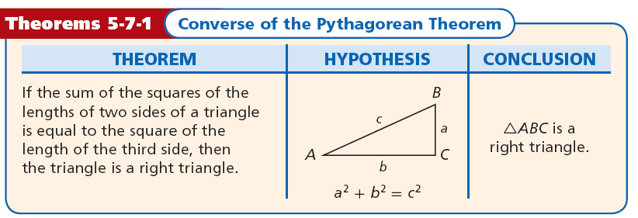
The converse of the Pythagorean Theorem gives you a way to tell if a triangle is a right triangle when you know the side lengths.

Slide 22
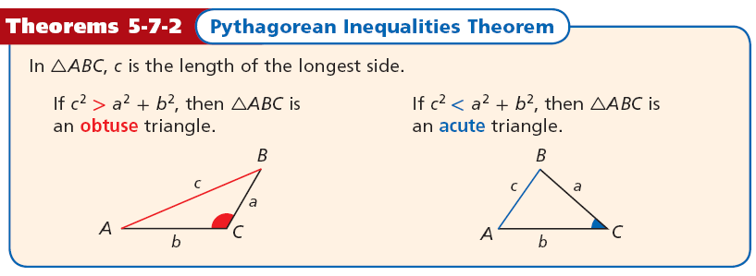
You can also use side lengths to classify a triangle as acute or obtuse.
B
c
a
A
C
b

Slide 23
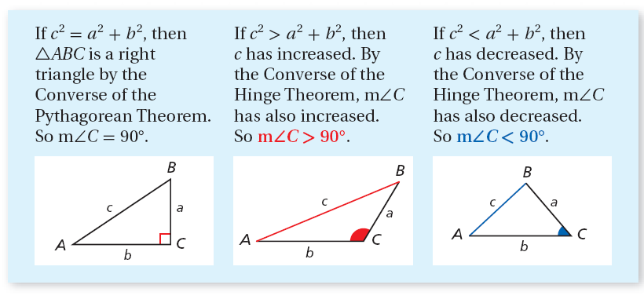
To understand why the Pythagorean inequalities are true, consider ∆ABC.

Slide 24
Remember!
By the Triangle Inequality Theorem, the sum of any two side lengths of a triangle is greater
than the third side length.

Slide 25
Example 4A: Classifying Triangles
Tell if the measures can be the side lengths of a triangle. If so, classify the triangle as acute, obtuse, or right.
5, 7, 10
Step 1 Determine if the measures form a triangle.
By the Triangle Inequality Theorem, 5, 7, and 10 can be the side lengths of a triangle.

Slide 26
Example 4A Continued
Step 2 Classify the triangle.
?
c² = a² + b²
Compare c² to a² + b².
?
10² = 5² + 7²
Substitute the longest side for c.
?
100 = 25 + 49
Multiply.
100 > 74
Add and compare.
Since c² > a² + b², the triangle is obtuse.

Slide 27
Example 4B: Classifying Triangles
Tell if the measures can be the side lengths of a triangle. If so, classify the triangle as acute, obtuse, or right.
5, 8, 17
Step 1 Determine if the measures form a triangle.
Since 5 + 8 = 13 and 13 > 17, these cannot be the side lengths of a triangle.

Slide 28
Check It Out! Example 4a
Tell if the measures can be the side lengths of a triangle. If so, classify the triangle as acute, obtuse, or right.
7, 12, 16
Step 1 Determine if the measures form a triangle.
By the Triangle Inequality Theorem, 7, 12, and 16 can be the side lengths of a triangle.

Slide 29
Check It Out! Example 4a Continued
Step 2 Classify the triangle.
?
c² = a² + b²
Compare c² to a² + b².
?
16² = 12² + 7²
Substitute the longest side for c.
?
256 = 144 + 49
Multiply.
256 > 193
Add and compare.
Since c² > a² + b², the triangle is obtuse.

Slide 30
Check It Out! Example 4b
Tell if the measures can be the side lengths of a triangle. If so, classify the triangle as acute, obtuse, or right.
11, 18, 34
Step 1 Determine if the measures form a triangle.
Since 11 + 18 = 29 and 29 > 34, these cannot be the sides of a triangle.

Slide 31
Check It Out! Example 4c
Tell if the measures can be the side lengths of a triangle. If so, classify the triangle as acute, obtuse, or right.
3.8, 4.1, 5.2
Step 1 Determine if the measures form a triangle.
By the Triangle Inequality Theorem, 3.8, 4.1, and 5.2 can be the side lengths of a triangle.

Slide 32
Check It Out! Example 4c Continued
Step 2 Classify the triangle.
?
c² = a² + b²
Compare c² to a² + b².
?
5.2² = 3.8² + 4.1²
Substitute the longest side for c.
?
27.04 = 14.44 + 16.81
Multiply.
27.04 < 31.25
Add and compare.
Since c² < a² + b², the triangle is acute.

Slide 33
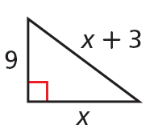

Lesson Quiz: Part I
1. Find the value of x.
2. An entertainment center is 52 in. wide and 40 in. high. Will a TV with a 60 in. diagonal fit in it? Explain.
12

Slide 34
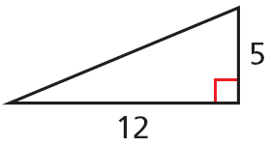
Lesson Quiz: Part II
3. Find the missing side length. Tell if the side lengths form a Pythagorean triple. Explain.
4. Tell if the measures 7, 11, and 15 can be the side lengths of a triangle. If so, classify the
triangle as acute, obtuse, or right.
13; yes; the side lengths are nonzero whole numbers that satisfy Pythagorean’s Theorem.
yes; obtuse

