Slide 1

Transforming Linear Functions
Warm Up
Lesson Presentation
Lesson Quiz
Holt McDougal Algebra 2
Holt Algebra 2

Slide 2
Warm Up
Give the coordinates of each transformation of (2, –3).
1. horizontal translation right of 5
(7, –3)
2. vertical translation of –1
(2, –4)
3. reflection across the x-axis
(2, 3)
4. reflection across the y-axis
(–2, –3)
Evaluate f(–2) and f(1.5).
5. f(x) = 3(x + 5) – 1
8; 18.5
6. f(x) = x² + 4x
–4; 8.25

Slide 3
Objectives
Transform linear functions.
Solve problems involving linear transformations.

Slide 4
In Lesson 1-8, you learned to transform functions by transforming each point. Transformations can also be expressed by using function notation.

Slide 5
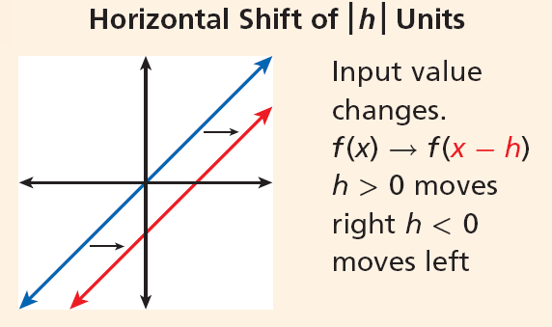

Slide 6
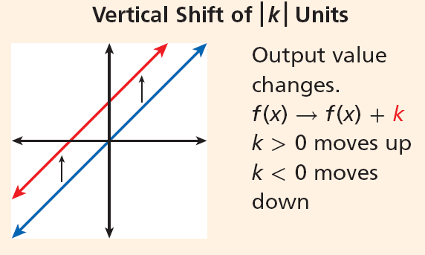

Slide 7
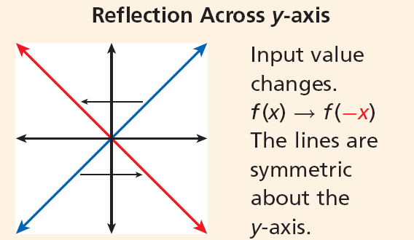

Slide 8
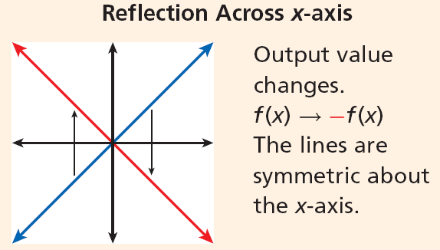

Slide 9
Helpful Hint
To remember the difference between vertical and horizontal translations, think:
“Add to y, go high.”
“Add to x, go left.”

Slide 10
Example 1A: Translating and Reflecting Functions
Let g(x) be the indicated transformation of f(x). Write the rule for g(x).
f(x) = x – 2 , horizontal translation right 3 units
Translating f(x) 3 units right subtracts 3 from each input value.
g(x) = f(x – 3)
Subtract 3 from the input of f(x).
g(x) = (x – 3) – 2
Evaluate f at x – 3.
g(x) = x – 5
Simplify.

Slide 11
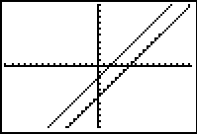
Example 1 Continued
Check Graph f(x) and g(x) on a graphing calculator. The slopes are the same, but the x-intercept has moved 3 units right from 2 to 5.

Slide 12
Example 1B: Translating Reflecting Functions
Let g(x) be the indicated transformation of f(x). Write the rule for g(x).
x | –2 | 0 | 2
f(x) | 0 | 1 | 2
linear function defined in the table; reflection across x-axis

Slide 13
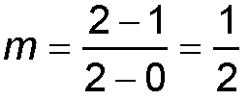
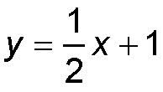

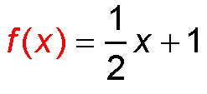
Example 1B Continued
Step 1 Write the rule for f(x) in
slope-intercept form.
x | –2 | 0 | 2
f(x) | 0 | 1 | 2
The y-intercept is 1.
The table contains (0, 1).
Find the slope:
Use (0, 1) and (2, 2).
y = mx + b
Slope-intercept form.
Substitute for m and 1 for b.
Replace y with f(x).

Slide 14
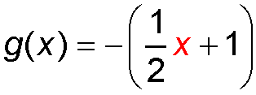
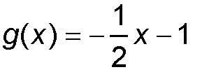
Example 1B Continued
Step 2 Write the rule for g(x). Reflecting f(x) across the
x-axis replaces each y with –y.
g(x) = –f(x)

Slide 15
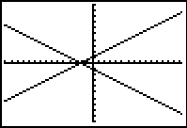
Example 1B Continued
Check Graph f(x) and g(x) on a graphing calculator. The lines are symmetric about the x-axis.

Slide 16
Check It Out! Example 1a
Let g(x) be the indicated transformation of f(x). Write the rule for g(x).
f(x) = 3x + 1; translation 2 units right
Translating f(x) 2 units right subtracts 2 from each input value.
g(x) = f(x – 2)
Subtract 2 from the input of f(x).
g(x) = 3(x – 2) + 1
Evaluate f at x – 2.
g(x) = 3x – 5
Simplify.

Slide 17
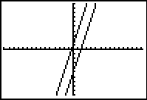
Check It Out! Example 1a Continued
Check Graph f(x) and g(x) on a graphing calculator. The slopes are the same, but the
y-intercept has moved 6 units down from 1 to –5.

Slide 18
Check It Out! Example 1b
Let g(x) be the indicated transformation of f(x). Write the rule for g(x).
x | –1 | 0 | 1
f(x) | 1 | 2 | 3
linear function defined in the table; reflection across the x-axis

Slide 19
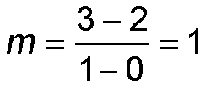
Check It Out! Example 1b Continued
Step 1 Write the rule for
f(x) in slope-intercept form.
x | –1 | 0 | 1
f(x) | 1 | 2 | 3
The y-intercept is 2.
The table contains (0, 2).
Find the slope:
Use (0, 1) and (2, 2).
y = mx + b
Slope-intercept form
y = x + 2
Substitute 1 for m and 2 for b.
f(x) = x + 2
Replace y with f(x).

Slide 20
Check It Out! Example 1b Continued
Step 2 Write the rule for g(x). Reflecting f(x) across the
x-axis replaces each y with –y.
g(x) = –(x – 2)
g(x) = –f(x)
g(x) = –x – 2

Slide 21
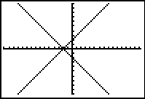
Check It Out! Example 1b Continued
Check Graph f(x) and g(x) on a graphing calculator. The graphs are symmetric about the x-axis.

Slide 22
Stretches and compressions change the slope of a linear function. If the line becomes steeper, the function has been stretched vertically or compressed
horizontally. If the line becomes flatter, the function has been compressed vertically or stretched horizontally.

Slide 23
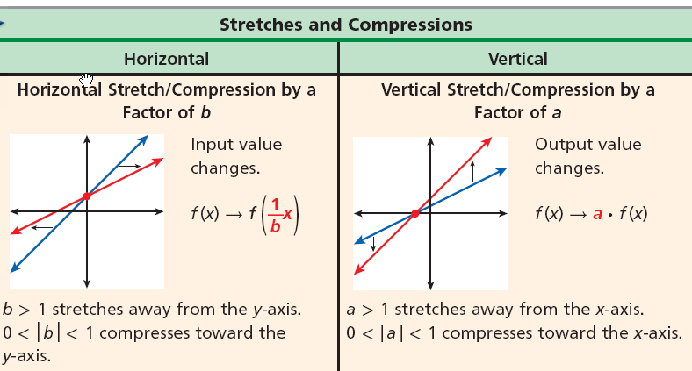

Slide 24
Helpful Hint
These don’t change!
y–intercepts in a horizontal stretch or compression
x–intercepts in a vertical stretch or compression

Slide 25



Example 2: Stretching and Compressing Linear Functions
Let g(x) be a horizontal compression of
f(x) = –x + 4 by a factor of . Write the rule for g(x), and graph the function.
Horizontally compressing f(x) by a factor of replaces each x with where b = .
.

Slide 26
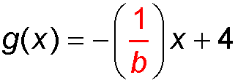

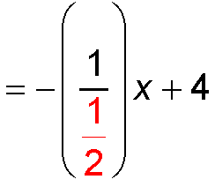

Example 2A Continued
For horizontal compression, use .
Substitute for b.
= –(2x) +4
Replace x with 2x.
g(x) = –2x +4
Simplify.

Slide 27
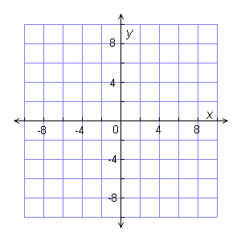
Example 2A Continued
Check Graph both functions on the same coordinate plane. The graph of g(x) is steeper than f(x), which indicates that g(x) has been horizontally compressed from f(x), or pushed toward the y-axis.

Slide 28

Check It Out! Example 2
Let g(x) be a vertical compression of f(x) = 3x + 2 by a factor of . Write the rule for g(x) and graph the function.
Vertically compressing f(x) by a factor of replaces each f(x) with a · f(x) where a = .

Slide 29


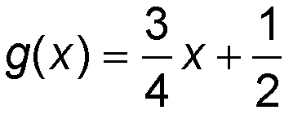
Check It Out! Example 2 Continued
g(x) = a(3x + 2)
For vertical compression, use a.
= (3x + 2)
Substitute for a.
Simplify.

Slide 30
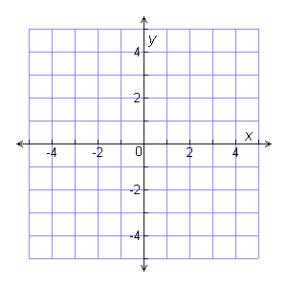
Graph both functions on the same coordinate plane. The graph of g(x) is less steep than f(x), which indicates that g(x) has been vertically compressed from f(x), or compressed towards the x-axis.

Slide 31
Some linear functions involve more than one transformation by applying individual transformations one at a time in the order in which they are given.
For multiple transformations, create a temporary function—such as h(x) in Example 3 below—to represent the first transformation, and then transform it to find the combined transformation.

Slide 32
Example 3: Combining Transformations of Linear Functions
Let g(x) be a horizontal shift of f(x) = 3x left 6 units followed by a horizontal stretch by a factor of 4. Write the rule for g(x).
Step 1 First perform the translation.
Translating f(x) = 3x left 6 units adds 6 to each input value. You can use h(x) to represent the translated function.
h(x) = f(x + 6)
Add 6 to the input value.
h(x) = 3(x + 6)
Evaluate f at x + 6.
h(x) = 3x + 18
Distribute.

Slide 33

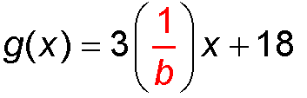

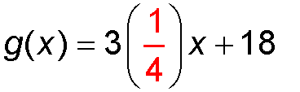
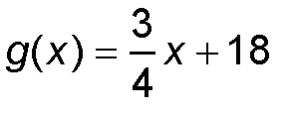
Example 3 Continued
Step 2 Then perform the stretch.
Stretching h(x) horizontally by a factor of 4 replaces each x with where b = 4.
For horizontal compression, use .
Substitute 4 for b.
Simplify.

Slide 34
Check It Out! Example 3
Let g(x) be a vertical compression of f(x) = x by a factor of followed by a horizontal shift 8 left units. Write the rule for g(x).
Step 1 First perform the translation.
h(x) = f(x + 8)
Add 8 to the input value.
Translating f(x) = 3x left 8 units adds 8 to each input value. You can use h(x) to represent the translated function.
h(x) = x + 8
Evaluate f at x + 8.
h(x) = x + 8
Distribute.

Slide 35
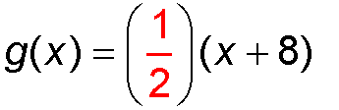

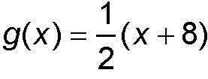
Check It Out! Example 3
Step 2 Then perform the stretch.
Stretching h(x) vertically by a factor of multiplies the function by .
Multiply the function by .
Simplify.

Slide 36
Example 4A: Fund-raising Application
The golf team is selling T-shirts as a fund-raiser. The function R(n) = 7.5n represents the team’s revenue in dollars, and n is the number of t-shirts sold.
The team paid $60 for the T-shirts. Write a new function P(n) for the team’s profit.
The initial costs must be subtracted from the revenue.
R(n) = 7.5n
Original function
P(n) = 7.5n – 60
Subtract the expenses.

Slide 37
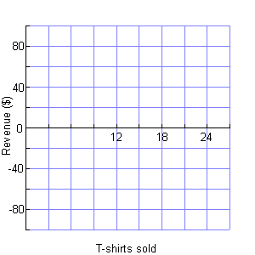
Example 4B: Fund-raising Application
Graph both P(n) and R(n) on the same coordinate plane.
Graph both functions. The lines have the same slope but different y-intercepts.
R
P
Note that the profit can be negative but the number of T-shirts sold cannot be less than 0.

Slide 38
Example 4C: Fund-raising Application
Describe the transformation(s) that have been applied.
The graph indicates that P(n) is a translation of R(n). Because 60 was subtracted, P(n) = R(n) – 60. This indicates a vertical shift 60 units down.

Slide 39
Check It Out! Example 4a
The Dance Club is selling beaded purses as a fund-raiser. The function R(n) = 12.5n represents the club’s revenue in dollars where n is the number of purses sold.
The club paid $75 for the materials needed to make the purses. Write a new function P(n) for the club’s profit.
What if …? The club members decided to double the price of each purse
The initial costs must be subtracted from the revenue.
S(n) = 25n – 75
Subtract the expenses.

Slide 40
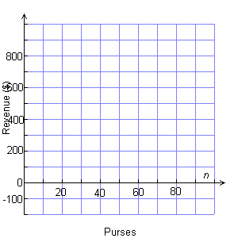
Check It Out! Example 4b
Graph both S(n) and P(n) on the same coordinate plane.
Graph both functions. The lines have the same slope but different y-intercepts.
P
S
Note that the profit can be negative but the number of purses sold cannot be less than 0.

Slide 41

Check It Out! Example 4c
Describe the transformation(s) that have been applied.
The graph indicates that P(n) is a compression of S(n). Because the price was doubled, S(n) = 2R(n) – 75. This indicates a horizontal compression by a factor
of .

Slide 42
Lesson Quiz: Part I
Let g(x) be the indicated transformation of f(x) = 3x + 1. Write the rule for g(x).
1.
horizontal translation 3 units right
g(x) = 3x – 8
2.
reflection across the x-axis
g(x) = –3x – 1
3.
vertical stretch by a factor of 2.
g(x) = 6x + 2
4.
vertical shift up 4 units followed by a horizontal compression of .
g(x) = 9x + 5

Slide 43
Lesson Quiz: Part II
5.
The cost of a classified ad is represented by
C(l) = 1.50l + 4.00 where l is the number of lines in the ad. The cost is increased by $3.00 when color is used.
Write a new function H(l) for the cost of a classified ad in color, and describe the transformation(s) that have been applied.
H(l) = 1.50l + 7.00; shift 3 units up

