Slide 1

Trigonometric Ratios
Warm Up
Lesson Presentation
Lesson Quiz
Holt McDougal Geometry
Holt Geometry

Slide 2



Warm Up
Write each fraction as a decimal rounded to the nearest hundredth.
1. 2.
Solve each equation.
3. 4.
0.67
0.29
x = 7.25
x = 7.99

Slide 3
Objectives
Find the sine, cosine, and tangent of an acute angle.
Use trigonometric ratios to find side lengths in right triangles and to solve real-world problems.

Slide 4
Vocabulary
trigonometric ratio
sine
cosine
tangent

Slide 5

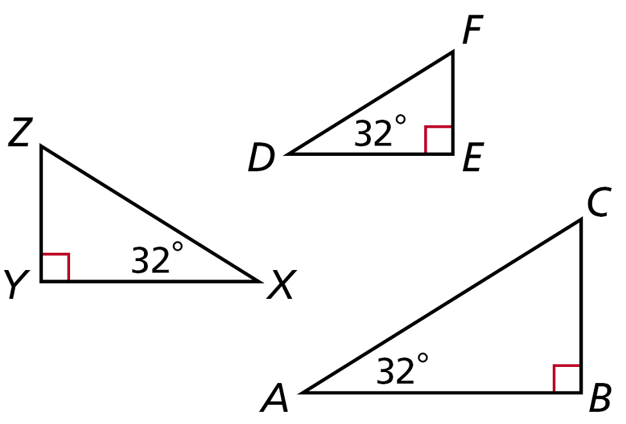
By the AA Similarity Postulate, a right triangle with
a given acute angle is similar to every other right triangle with that same acute angle measure. So ∆ABC ~ ∆DEF ~ ∆XYZ, and . These are trigonometric ratios. A trigonometric ratio is a ratio of two sides of a right triangle.

Slide 6
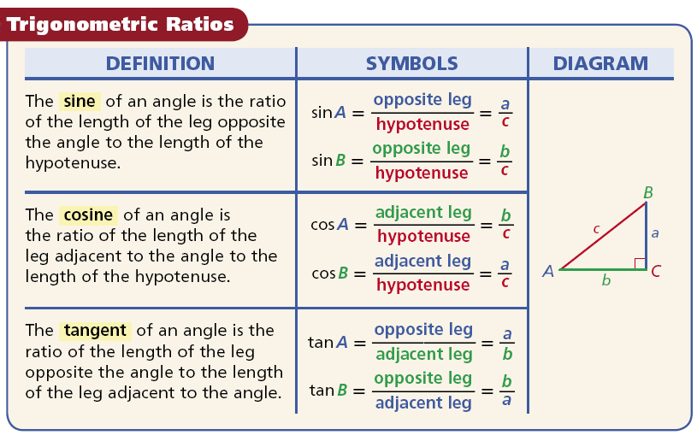

Slide 7
Writing Math
In trigonometry, the letter of the vertex of the angle is often used to represent the measure of that angle. For example, the sine of ∠A is written as sin A.

Slide 8
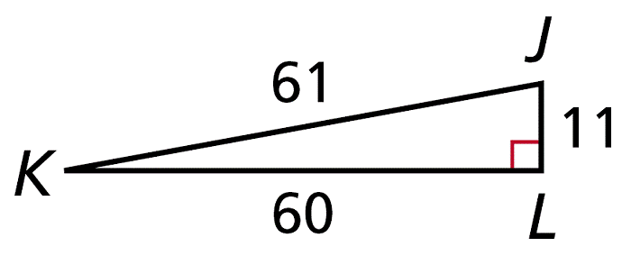


Example 1A: Finding Trigonometric Ratios
Write the trigonometric ratio as a fraction and as a decimal rounded to the nearest hundredth.
sin J

Slide 9


Example 1B: Finding Trigonometric Ratios
Write the trigonometric ratio as a fraction and as a decimal rounded to the nearest hundredth.
cos J

Slide 10


Example 1C: Finding Trigonometric Ratios
Write the trigonometric ratio as a fraction and as a decimal rounded to the nearest hundredth.
tan K

Slide 11
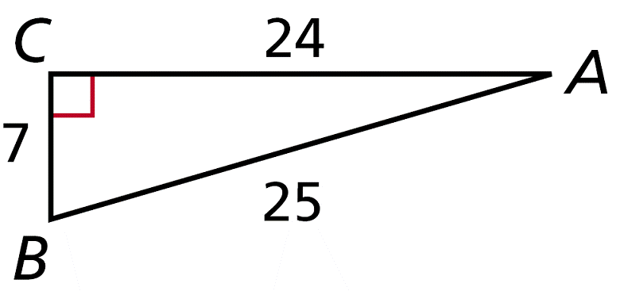

Check It Out! Example 1a
Write the trigonometric ratio as a fraction and as a decimal rounded to
the nearest hundredth.
cos A

Slide 12

Check It Out! Example 1b
Write the trigonometric ratio as a fraction and as a decimal rounded to
the nearest hundredth.
tan B

Slide 13

Check It Out! Example 1c
Write the trigonometric ratio as a fraction and as a decimal rounded to
the nearest hundredth.
sin B

Slide 14
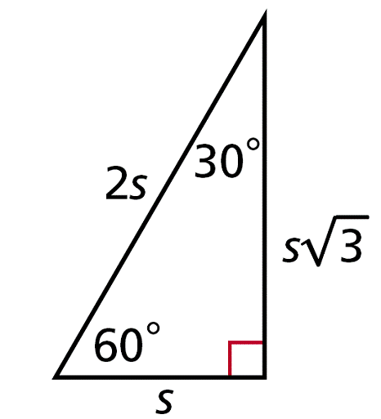

Example 2: Finding Trigonometric Ratios in Special Right Triangles
Use a special right triangle to write cos 30° as a fraction.
Draw and label a 30º-60º-90º ∆.

Slide 15
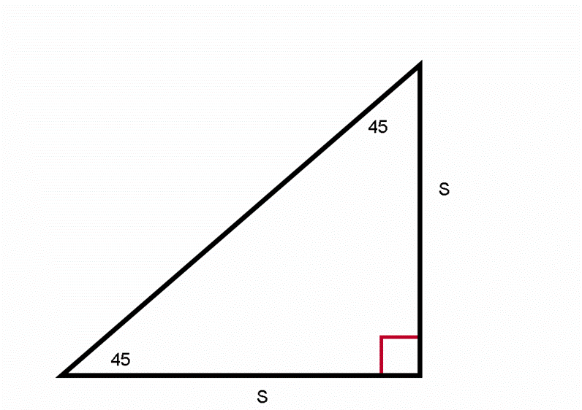

Check It Out! Example 2
Use a special right triangle to write tan 45° as a fraction.
45°
s
Draw and label a 45º-45º-90º ∆.
45°
s

Slide 16
Example 3A: Calculating Trigonometric Ratios
Use your calculator to find the trigonometric ratio. Round to the nearest hundredth.
sin 52°
Caution!
Be sure your calculator is in degree mode, not radian mode.
sin 52° ≈ 0.79

Slide 17
Example 3B: Calculating Trigonometric Ratios
Use your calculator to find the trigonometric ratio. Round to the nearest hundredth.
cos 19°
cos 19° ≈ 0.95

Slide 18
Example 3C: Calculating Trigonometric Ratios
Use your calculator to find the trigonometric ratio. Round to the nearest hundredth.
tan 65°
tan 65° ≈ 2.14

Slide 19
Check It Out! Example 3a
Use your calculator to find the trigonometric ratio. Round to the nearest hundredth.
tan 11°
tan 11° ≈ 0.19

Slide 20
Check It Out! Example 3b
Use your calculator to find the trigonometric ratio. Round to the nearest hundredth.
sin 62°
sin 62° ≈ 0.88

Slide 21
Check It Out! Example 3c
Use your calculator to find the trigonometric ratio. Round to the nearest hundredth.
cos 30°
cos 30° ≈ 0.87

Slide 22
The hypotenuse is always the longest side of a right triangle. So the denominator of a sine or cosine ratio is always greater than the numerator. Therefore the sine and cosine of an acute angle are always positive numbers less than 1. Since the tangent of an acute angle is the ratio of the lengths of the legs, it can have any value greater than 0.

Slide 23
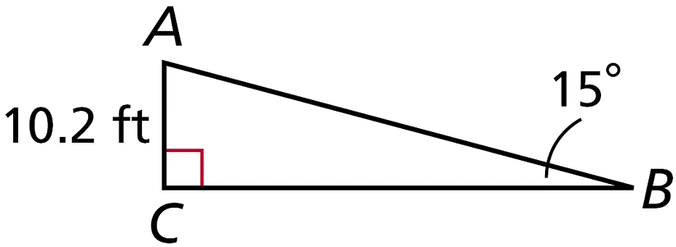

Example 4A: Using Trigonometric Ratios to Find Lengths
Find the length. Round to the nearest hundredth.
BC
is adjacent to the given angle, ∠B. You are given AC, which is opposite ∠B. Since the adjacent and opposite legs are involved, use a tangent ratio.

Slide 24



Example 4A Continued
Write a trigonometric ratio.
Substitute the given values.
Multiply both sides by BC and divide by tan 15°.
BC ≈ 38.07 ft
Simplify the expression.

Slide 25
Caution!
Do not round until the final step of your answer. Use the values of the trigonometric ratios provided by your calculator.

Slide 26
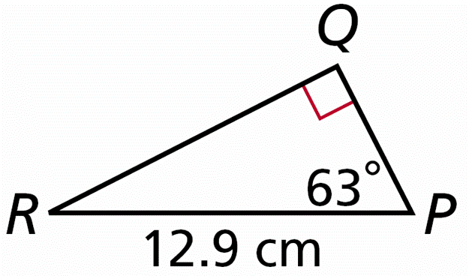

Example 4B: Using Trigonometric Ratios to Find Lengths
Find the length. Round to the nearest hundredth.
QR
is opposite to the given angle, ∠P. You are given PR, which is the hypotenuse. Since the opposite side and hypotenuse are involved, use a sine ratio.

Slide 27


Example 4B Continued
Write a trigonometric ratio.
Substitute the given values.
12.9(sin 63°) = QR
Multiply both sides by 12.9.
11.49 cm ≈ QR
Simplify the expression.

Slide 28
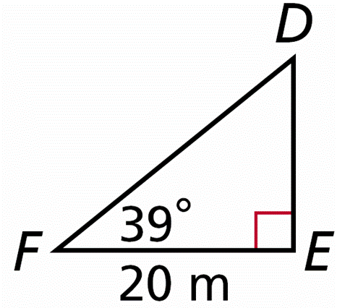

Example 4C: Using Trigonometric Ratios to Find Lengths
Find the length. Round to the nearest hundredth.
FD
is the hypotenuse. You are given EF, which is adjacent to the given angle, ∠F. Since the adjacent side and hypotenuse are involved, use a cosine ratio.

Slide 29



Example 4C Continued
Write a trigonometric ratio.
Substitute the given values.
Multiply both sides by FD and divide by cos 39°.
FD ≈ 25.74 m
Simplify the expression.

Slide 30
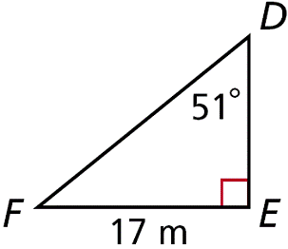

Check It Out! Example 4a
Find the length. Round to the nearest hundredth.
DF
is the hypotenuse. You are given EF, which is opposite to the given angle, ∠D. Since the opposite side and hypotenuse are involved, use a sine ratio.

Slide 31



Check It Out! Example 4a Continued
Write a trigonometric ratio.
Substitute the given values.
Multiply both sides by DF and divide by sin 51°.
DF ≈ 21.87 cm
Simplify the expression.

Slide 32
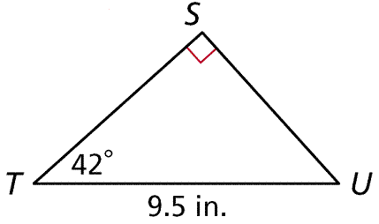

Check It Out! Example 4b
Find the length. Round to the nearest hundredth.
ST
is a leg. You are given TU, which is the hypotenuse. Since the adjacent side and hypotenuse are involved, use a cosine ratio.

Slide 33


Check It Out! Example 4b Continued
Write a trigonometric ratio.
Substitute the given values.
ST = 9.5(cos 42°)
Multiply both sides by 9.5.
ST ≈ 7.06 in.
Simplify the expression.

Slide 34
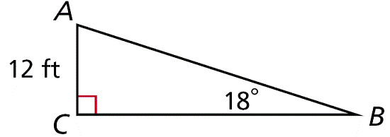
Check It Out! Example 4c
Find the length. Round to the nearest hundredth.
BC
is a leg. You are given AC, which is the opposite side to given angle, ∠B. Since the opposite side and adjacent side are involved, use a tangent ratio.

Slide 35


Check It Out! Example 4c Continued
Write a trigonometric ratio.
Substitute the given values.
Multiply both sides by BC and divide by tan 18°.
BC ≈ 36.93 ft
Simplify the expression.

Slide 36
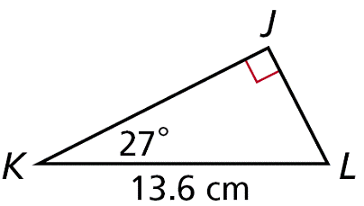

Check It Out! Example 4d
Find the length. Round to the nearest hundredth.
JL
is the opposite side to the given angle, ∠K. You are given KL, which is the hypotenuse. Since the opposite side and hypotenuse are involved, use a sine ratio.

Slide 37


Check It Out! Example 4d Continued
Write a trigonometric ratio.
Substitute the given values.
JL = 13.6(sin 27°)
Multiply both sides by 13.6.
JL ≈ 6.17 cm
Simplify the expression.

Slide 38

Example 5: Problem-Solving Application
The Pilatusbahn in Switzerland is the world’s steepest cog railway. Its steepest section makes an angle of about 25.6º with the horizontal and rises about 0.9 km. To the nearest hundredth of a kilometer, how long is this section of the railway track?

Slide 39

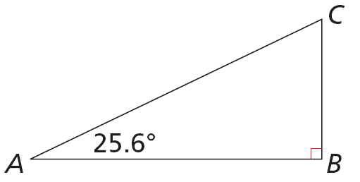
Example 5 Continued
1
Understand the Problem
Make a sketch. The answer is AC.
0.9 km

Slide 40


Example 5 Continued
2
Make a Plan
is the hypotenuse. You are given BC, which is the leg opposite ∠A. Since the opposite and hypotenuse are involved, write an equation using the sine ratio.

Slide 41




Example 5 Continued
3
Solve
Write a trigonometric ratio.
Substitute the given values.
Multiply both sides by CA and divide by sin 25.6°.
CA ≈ 2.0829 km
Simplify the expression.

Slide 42

Example 5 Continued
4
Look Back
The problem asks for CA rounded to the nearest hundredth, so round the length to 2.08. The section of track is 2.08 km.

Slide 43
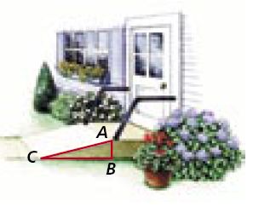
Check It Out! Example 5
Find AC, the length of the ramp, to the nearest hundredth of a foot.

Slide 44
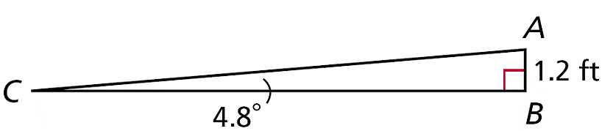
Check It Out! Example 5 Continued
1
Understand the Problem
Make a sketch. The answer is AC.

Slide 45

Check It Out! Example 5 Continued
2
Make a Plan
is the hypotenuse to ∠C. You are given AB, which is the leg opposite ∠C. Since the opposite leg and hypotenuse are involved, write an equation using the sine ratio.

Slide 46



Check It Out! Example 5 Continued
3
Solve
Write a trigonometric ratio.
Substitute the given values.
Multiply both sides by AC and divide by sin 4.8°.
AC ≈ 14.3407 ft
Simplify the expression.

Slide 47
Check It Out! Example 5 Continued
4
Look Back
The problem asks for AC rounded to the nearest hundredth, so round the length to 14.34. The length of ramp covers a distance of 14.34 ft.

Slide 48


Lesson Quiz: Part I
Use a special right triangle to write each trigonometric ratio as a fraction.
1. sin 60° 2. cos 45°
Use your calculator to find each trigonometric ratio. Round to the nearest hundredth.
3. tan 84° 4. cos 13°
9.51
0.97

Slide 49
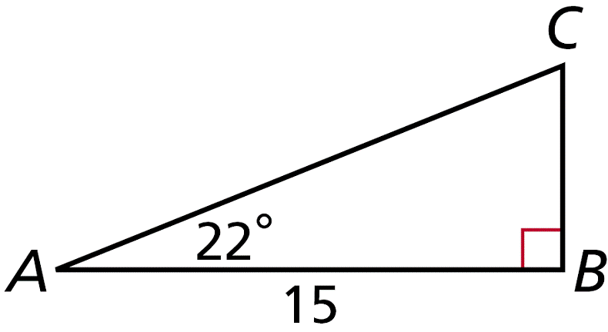



Lesson Quiz: Part II
Find each length. Round to the nearest tenth.
5. CB
6. AC
6.1
16.2
Use your answers from Items 5 and 6 to write each trigonometric ratio as a fraction and as a decimal rounded to the nearest hundredth.
7. sin A 8. cos A 9. tan A

