Slide 1

Solving Right Triangles
Warm Up
Lesson Presentation
Lesson Quiz
Holt McDougal Geometry
Holt Geometry

Slide 2
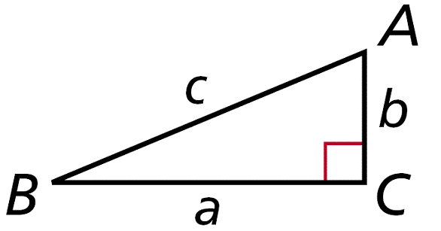



Warm Up
Use ∆ABC for Exercises 1–3.
1. If a = 8 and b = 5, find c.
2. If a = 60 and c = 61, find b.
3. If b = 6 and c = 10, find sin B.
Find AB.
4. A(8, 10), B(3, 0)
5. A(1, –2), B(2, 6)
11
0.6

Slide 3
Objective
Use trigonometric ratios to find angle measures in right triangles and to solve real-world problems.

Slide 4
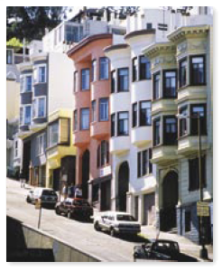
San Francisco, California, is famous for its steep streets. The steepness of a road is often expressed as a percent grade. Filbert Street, the steepest street in San Francisco, has a 31.5% grade. This means the road rises 31.5 ft over a horizontal distance of 100 ft, which is equivalent to a 17.5° angle. You can use trigonometric ratios to change a percent grade to an angle measure.

Slide 5

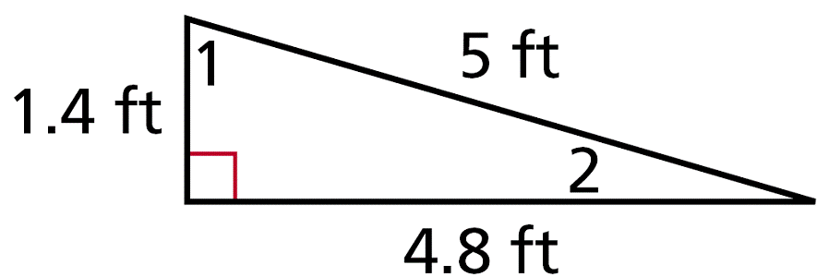



Example 1: Identifying Angles from Trigonometric Ratios
Use the trigonometric ratio to determine which angle of the triangle is ∠A.
Cosine is the ratio of the adjacent leg to the hypotenuse.
The leg adjacent to ∠1 is 1.4. The hypotenuse is 5.
The leg adjacent to ∠2 is 4.8. The hypotenuse is 5.
Since cos A = cos∠2, ∠2 is ∠A.

Slide 6
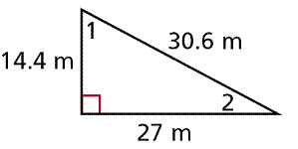




Check It Out! Example 1a
Use the given trigonometric ratio to determine which angle of the triangle is ∠A.
Sine is the ratio of the opposite leg to the hypotenuse.
The leg adjacent to ∠1 is 27. The hypotenuse is 30.6.
The leg adjacent to ∠2 is 14.4. The hypotenuse is 30.6.
Since sin∠A = sin∠2, ∠2 is ∠A.

Slide 7



Check It Out! Example 1b
Use the given trigonometric ratio to determine which angle of the triangle is ∠A.
tan A = 1.875
Tangent is the ratio of the opposite leg to the adjacent leg.
The leg opposite to ∠1 is 27. The leg adjacent is 14.4.
The leg opposite to ∠2 is 14.4. The leg adjacent is 27.
Since tan∠A = tan∠1, ∠1 is ∠A.

Slide 8
In Lesson 8-2, you learned that sin 30° = 0.5. Conversely, if you know that the sine of an acute angle is 0.5, you can conclude that the angle measures 30°. This is written as sin⁻¹(0.5) = 30°.

Slide 9
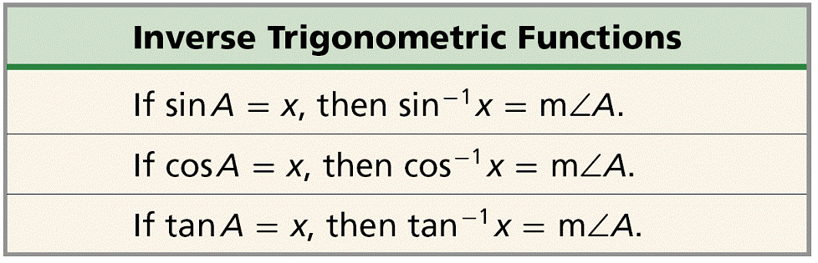
If you know the sine, cosine, or tangent of an acute angle measure, you can use the inverse trigonometric functions to find the measure of the angle.

Slide 10
Example 2: Calculating Angle Measures from Trigonometric Ratios
Use your calculator to find each angle measure to the nearest degree.
A. cos⁻¹(0.87)
B. sin⁻¹(0.85)
C. tan⁻¹(0.71)
cos⁻¹(0.87) ≈ 30°
sin⁻¹(0.85) ≈ 58°
tan⁻¹(0.71) ≈ 35°

Slide 11
Check It Out! Example 2
Use your calculator to find each angle measure to the nearest degree.
a. tan⁻¹(0.75)
b. cos⁻¹(0.05)
c. sin⁻¹(0.67)
tan⁻¹(0.75) ≈ 35°
cos⁻¹(0.05) ≈ 87°
sin⁻¹(0.67) ≈ 42°

Slide 12
Using given measures to find the unknown angle measures or side lengths of a triangle is known as solving a triangle. To solve a right triangle, you need to know two side lengths or one side length and an acute angle measure.

Slide 13
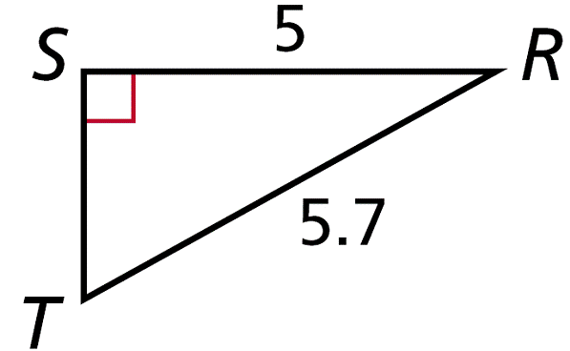


Example 3: Solving Right Triangles
Find the unknown measures. Round lengths to the nearest hundredth and angle measures to the nearest degree.
Method 1: By the Pythagorean Theorem,
RT² = RS² + ST²
(5.7)² = 5² + ST²
Since the acute angles of a right triangle are complementary, m∠T ≈ 90° – 29° ≈ 61°.

Slide 14


Example 3 Continued
Method 2:
Since the acute angles of a right triangle are complementary, m∠T ≈ 90° – 29° ≈ 61°.
, so ST = 5.7 sinR.

Slide 15
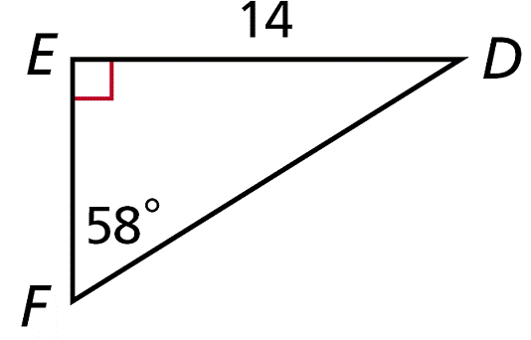

Check It Out! Example 3
Find the unknown measures. Round lengths to the nearest hundredth and angle measures to the nearest degree.
Since the acute angles of a right triangle are complementary, m∠D = 90° – 58° = 32°.
, so EF = 14 tan 32°. EF ≈ 8.75
DF² = ED² + EF²
DF² = 14² + 8.75²
DF ≈ 16.51

Slide 16
Example 4: Solving a Right Triangle in the Coordinate Plane
The coordinates of the vertices of ∆PQR are P(–3, 3), Q(2, 3), and R(–3, –4). Find the side lengths to the nearest hundredth and the angle measures to the nearest degree.

Slide 17
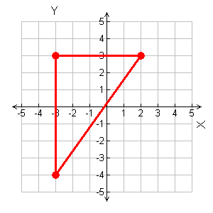



Example 4 Continued
Step 1 Find the side lengths. Plot points P, Q, and R.
PR = 7 PQ = 5
Y
By the Distance Formula,
P
Q
X
R

Slide 18



Example 4 Continued
Step 2 Find the angle measures.
Y
m∠P = 90°
P
Q
X
The acute ∠s of a rt. ∆ are comp.
R
m∠R ≈ 90° – 54° ≈ 36°

Slide 19
Check It Out! Example 4
The coordinates of the vertices of ∆RST are R(–3, 5), S(4, 5), and T(4, –2). Find the side lengths to the nearest hundredth and the angle measures to the nearest degree.

Slide 20
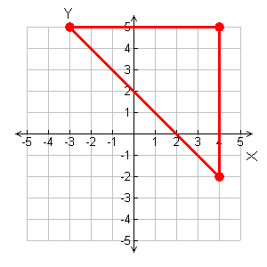



Check It Out! Example 4 Continued
Step 1 Find the side lengths. Plot points R, S, and T.
Y
R
S
RS = ST = 7
By the Distance Formula,
X
T

Slide 21



Check It Out! Example 4 Continued
Step 2 Find the angle measures.
m∠S = 90°
m∠R ≈ 90° – 45° ≈ 45°
The acute ∠s of a rt. ∆ are comp.

Slide 22

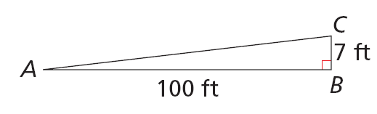

Example 5: Travel Application
A highway sign warns that a section of road ahead has a 7% grade. To the nearest degree, what angle does the road make with a horizontal line?
Change the percent grade to a fraction.
A 7% grade means the road rises (or falls) 7 ft for every 100 ft of horizontal distance.
Draw a right triangle to represent the road.
∠A is the angle the road makes with a horizontal line.

Slide 23


Check It Out! Example 5
Baldwin St. in Dunedin, New Zealand, is the steepest street in the world. It has a grade of 38%. To the nearest degree, what angle does Baldwin St. make with a horizontal line?
Change the percent grade to a fraction.
A 38% grade means the road rises (or falls) 38 ft for every 100 ft of horizontal distance.
C
Draw a right triangle to represent the road.
38 ft
A
B
100 ft
∠A is the angle the road makes with a horizontal line.

Slide 24
Lesson Quiz: Part I
Use your calculator to find each angle measure to the nearest degree.
1. cos⁻¹ (0.97)
2. tan⁻¹ (2)
3. sin⁻¹ (0.59)
14°
63°
36°

Slide 25
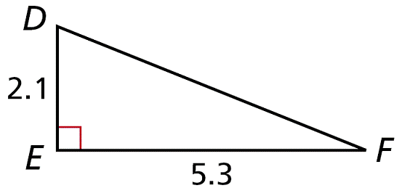
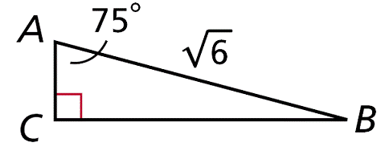
Lesson Quiz: Part II
Find the unknown measures. Round lengths to the nearest hundredth and angle measures to the nearest degree.
4. 5.
DF ≈ 5.7; m∠D ≈ 68°; m∠F ≈ 22°
AC ≈ 0.63; BC ≈ 2.37; m ∠B = 15°

Slide 26
Lesson Quiz: Part III
6. The coordinates of the vertices of ∆MNP are M (–3, –2), N(–3, 5), and P(6, 5). Find the side lengths to the nearest hundredth and the angle measures to the nearest degree.
MN = 7; NP = 9; MP ≈ 11.40; m∠N = 90°; m∠M ≈ 52°; m∠P ≈ 38°

