Slide 1

Angles of Elevation
and Depression
Warm Up
Lesson Presentation
Lesson Quiz
Holt McDougal Geometry
Holt Geometry

Slide 2
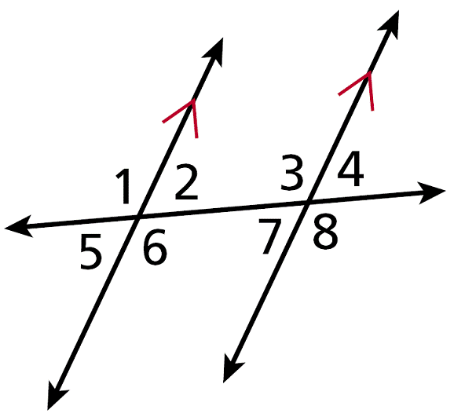

Warm Up
1. Identify the pairs of alternate
interior angles.
2. Use your calculator to find tan 30° to the nearest hundredth.
3. Solve . Round to the nearest hundredth.
∠2 and ∠7; ∠3 and ∠6
0.58
1816.36

Slide 3
Objective
Solve problems involving angles of elevation and angles of depression.

Slide 4
Vocabulary
angle of elevation
angle of depression

Slide 5
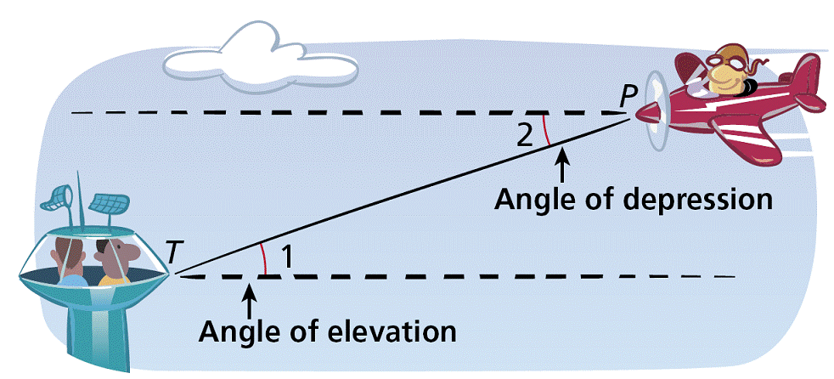
An angle of elevation is the angle formed by a horizontal line and a line of sight to a point above the line. In the diagram, ∠1 is the angle of elevation from the tower T to the plane P.
An angle of depression is the angle formed by a horizontal line and a line of sight to a point below the line. ∠2 is the angle of depression from the plane to the tower.

Slide 6
Since horizontal lines are parallel, ∠1 ≅ ∠2 by the Alternate Interior Angles Theorem. Therefore the angle of elevation from one point is congruent
to the angle of depression from the other point.

Slide 7
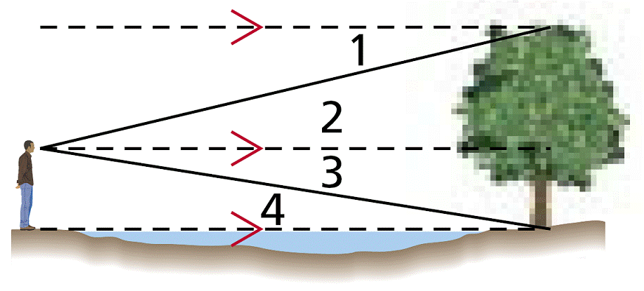
Example 1A: Classifying Angles of Elevation and Depression
Classify each angle as an angle of elevation or an angle of depression.
∠1
∠1 is formed by a horizontal line and a line of sight to a point below the line. It is an angle of depression.

Slide 8
Example 1B: Classifying Angles of Elevation and Depression
Classify each angle as an angle of elevation or an angle of depression.
∠4
∠4 is formed by a horizontal line and a line of sight to a point above the line. It is an angle of elevation.

Slide 9
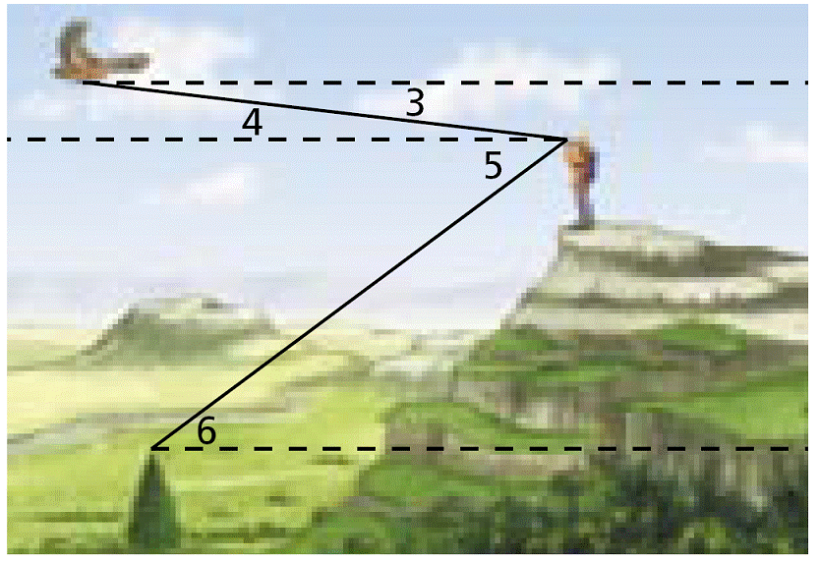
Check It Out! Example 1
Use the diagram above to classify each angle as an angle of elevation or angle of depression.
1a. ∠5
∠5 is formed by a horizontal line and a line of sight to a point below the line. It is an angle of depression.
1b. ∠6
∠6 is formed by a horizontal line and a line of sight to a point above the line. It is an angle of elevation.

Slide 10
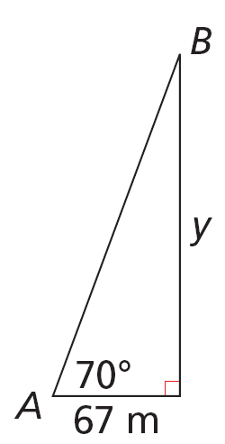
Example 2: Finding Distance by Using Angle of Elevation
The Seattle Space Needle casts a 67-meter shadow. If the angle of elevation from the tip of the shadow to the top of the Space Needle is 70º, how tall is the Space Needle? Round to the nearest meter.
Draw a sketch to represent the given information. Let A represent the tip of the shadow, and let B represent the top of the Space Needle. Let y be the height of the Space Needle.

Slide 11

Example 2 Continued
You are given the side adjacent to ∠A, and y is the side opposite ∠A. So write a tangent ratio.
y = 67 tan 70°
Multiply both sides by 67.
y ≈ 184 m
Simplify the expression.

Slide 12


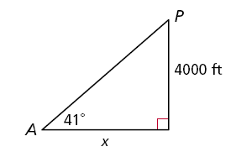
Check It Out! Example 2
What if…? Suppose the plane is at an altitude of 3500 ft and the angle of elevation from the airport to the plane is 29°. What is the horizontal distance between the plane and the airport? Round to the nearest foot.
You are given the side opposite ∠A, and x is the side adjacent to ∠A. So write a tangent ratio.
Multiply both sides by x and divide by tan 29°.
x ≈ 6314 ft
Simplify the expression.
3500 ft
29°

Slide 13
Example 3: Finding Distance by Using Angle of Depression
An ice climber stands at the edge of a crevasse that is 115 ft wide. The angle of depression from the edge where she stands to the bottom of the opposite side is 52º. How deep is the crevasse at this point? Round to the nearest foot.

Slide 14
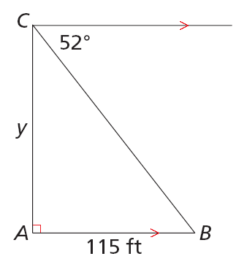
Example 3 Continued
Draw a sketch to represent the given information. Let C represent the ice climber and let B represent the bottom of the opposite side of the crevasse. Let y be the depth of the crevasse.

Slide 15

Example 3 Continued
By the Alternate Interior Angles Theorem, m∠B = 52°.
Write a tangent ratio.
y = 115 tan 52°
Multiply both sides by 115.
y ≈ 147 ft
Simplify the expression.

Slide 16
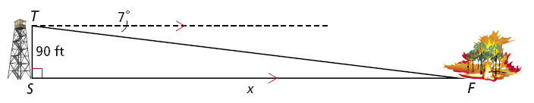


Check It Out! Example 3
What if…? Suppose the ranger sees another fire and the angle of depression to the fire is 3°. What is the horizontal distance to this fire? Round to the nearest foot.
3°
By the Alternate Interior Angles Theorem, m∠F = 3°.
Write a tangent ratio.
Multiply both sides by x and divide by tan 3°.
x ≈ 1717 ft
Simplify the expression.

Slide 17
Example 4: Shipping Application
An observer in a lighthouse is 69 ft above the water. He sights two boats in the water directly in front of him. The angle of depression to the nearest boat is 48º. The angle of depression to the other boat is 22º. What is the distance between the two boats? Round to the nearest foot.

Slide 18
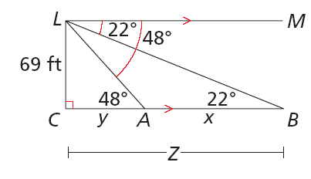
Example 4 Application
Step 1 Draw a sketch. Let L represent the observer in the lighthouse and let A and B represent the two boats. Let x be the distance between the two boats.

Slide 19


Example 4 Continued
Step 2 Find y.
By the Alternate Interior Angles Theorem, m∠CAL = 58°.
In ∆ALC,
So
.

Slide 20


Example 4 Continued
Step 3 Find z.
By the Alternate Interior Angles Theorem, m∠CBL = 22°.
In ∆BLC,
So

Slide 21
Example 4 Continued
Step 4 Find x.
x = z – y
x ≈ 170.8 – 62.1 ≈ 109 ft
So the two boats are about 109 ft apart.

Slide 22
Check It Out! Example 4
A pilot flying at an altitude of 12,000 ft sights two airports directly in front of him. The angle of depression to one airport is 78°, and the angle of depression to the second airport is 19°. What is the distance between the two airports? Round to the nearest foot.

Slide 23
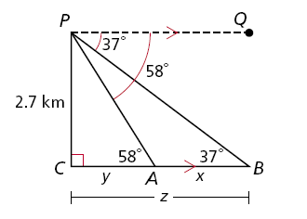
Check It Out! Example 4 Continued
Step 1 Draw a sketch. Let P represent the pilot and let A and B represent the two airports. Let x be the distance between the two airports.
19°
78°
12,000 ft
78°
19°

Slide 24


Check It Out! Example 4 Continued
Step 2 Find y.
By the Alternate Interior Angles Theorem, m∠CAP = 78°.
In ∆APC,
So

Slide 25


Check It Out! Example 4 Continued
Step 3 Find z.
By the Alternate Interior Angles Theorem, m∠CBP = 19°.
In ∆BPC,
So

Slide 26
Check It Out! Example 4 Continued
Step 4 Find x.
x = z – y
x ≈ 34,851 – 2551 ≈ 32,300 ft
So the two airports are about 32,300 ft apart.

Slide 27
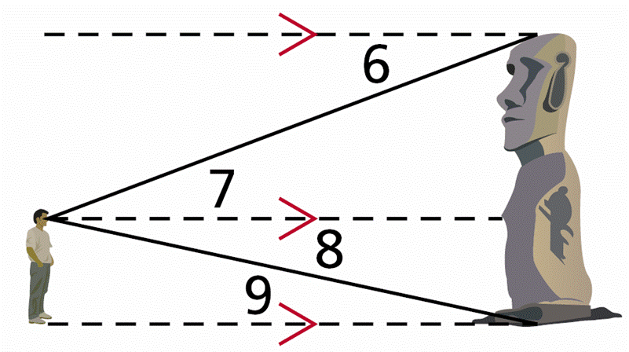
Lesson Quiz: Part I
Classify each angle as an angle of elevation or angle of depression.
1. ∠6
2. ∠9
angle of depression
angle of elevation

Slide 28
Lesson Quiz: Part II
3. A plane is flying at an altitude of 14,500 ft. The angle of depression from the plane to a control tower is 15°. What is the horizontal distance from the plane to the tower? Round to the nearest foot.
4. A woman is standing 12 ft from a sculpture. The angle of elevation from her eye to the top of the sculpture is 30°, and the angle of depression to its base is 22°. How tall is the sculpture to the nearest foot?
54,115 ft
12 ft

