Slide 1

Exponential Growth and Decay
Warm Up
Lesson Presentation
Lesson Quiz
Holt McDougal Algebra 1
Holt Algebra 1

Slide 2

Warm Up
Simplify each expression.
1. (4 + 0.05)²
3.
4. The first term of a geometric sequence is 3 and the common ratio is 2. What is the 5th term of the sequence?
5. The function f(x) = 2(4)^{x} models an insect population after x days. What is the population after 3 days?
16.4025
2. 25(1 + 0.02)³
26.5302
1.0075
48
128 insects

Slide 3
Objective
Solve problems involving exponential growth and decay.

Slide 4
Vocabulary
exponential growth
compound interest
exponential decay
half-life

Slide 5
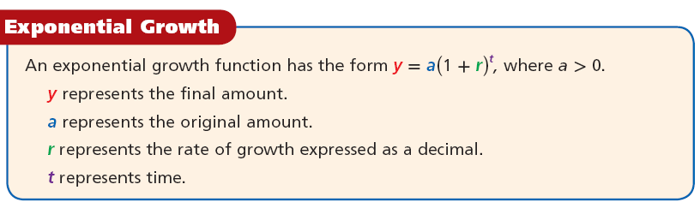
Exponential growth occurs when an quantity increases by the same rate r in each period t. When this happens, the value of the quantity at any given time can be calculated as a function of the rate and the original amount.

Slide 6
Example 1: Exponential Growth
The original value of a painting is $9,000 and the value increases by 7% each year. Write an exponential growth function to model this situation. Then find the painting’s value in 15 years.
Step 1 Write the exponential growth function for this situation.
y = a(1 + r)^{t}
Write the formula.
= 9000(1 + 0.07)^{t}
Substitute 9000 for a and 0.07 for r.
= 9000(1.07)^{t}
Simplify.

Slide 7
Example 1 Continued
The original value of a painting is $9,000 and the value increases by 7% each year. Write an exponential growth function to model this situation. Then find the painting’s value in 15 years.
Step 2 Find the value in 15 years.
y = 9000(1.07)^{t}
= 9000(1 + 0.07)¹⁵
Substitute 15 for t.
Use a calculator and round to the nearest hundredth.
≈ 24,831.28
The value of the painting in 15 years is $24,831.28.

Slide 8
Check It Out! Example 1
A sculpture is increasing in value at a rate of 8% per year, and its value in 2000 was $1200. Write an exponential growth function to model this situation. Then find the sculpture’s value in 2006.
Step 1 Write the exponential growth function for this situation.
y = a(1 + r)^{t}
Write the formula
= 1200(1 + 0.08)⁶
Substitute 1200 for a and 0.08 for r.
= 1200(1.08)^{t}
Simplify.

Slide 9
Check It Out! Example 1 Continued
A sculpture is increasing in value at a rate of 8% per year, and its value in 2000 was $1200. Write an exponential growth function to model this situation. Then find the sculpture’s value in 2006.
Step 2 Find the value in 6 years.
y = 1200(1.08)^{t}
= 1200(1 + 0.08)⁶
Substitute 6 for t.
≈ 1,904.25
Use a calculator and round to the nearest hundredth.
The value of the painting in 6 years is $1,904.25.

Slide 10
A common application of exponential growth is compound interest. Recall that simple interest is earned or paid only on the principal. Compound interest is interest earned or paid on both the principal and previously earned interest.

Slide 11
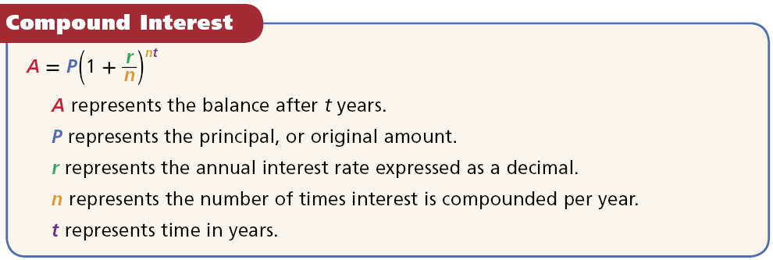

Slide 12
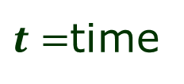
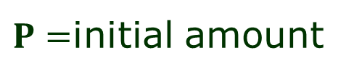
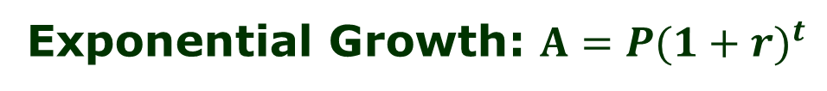
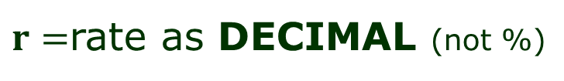
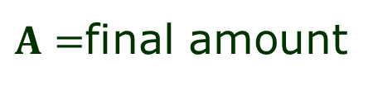

Notes on pg. 114
Exponential Growth: $A=P{(1+r)}^{t}$
$A=$final amount
$r=$rate as DECIMAL (not %)
$P=$initial amount
$t=$time
Exponential Decay: $A=P{(1−r)}^{t}$
Compound Interest: $A=P{(1+\frac{r}{n})}^{nt}$
$r=$annual interest rate as DECIMAL (not %)
$n=$ number of times interest is compounded per year

Slide 13
Reading Math
For compound interest
annually means “once per year” (n = 1).
quarterly means “4 times per year” (n =4).
monthly means “12 times per year” (n = 12).

Slide 14


Example 2A: Finance Application
Write a compound interest function to model each situation. Then find the balance after the given number of years.
$1200 invested at a rate of 2% compounded quarterly; 3 years.
Step 1 Write the compound interest function for this situation.
Write the formula.
Substitute 1200 for P, 0.02 for r, and 4 for n.
= 1200(1.005)^{4t}
Simplify.

Slide 15
Example 2A Continued
Write a compound interest function to model each situation. Then find the balance after the given number of years.
$1200 invested at a rate of 2% compounded quarterly; 3 years.
Step 2 Find the balance after 3 years.
A = 1200(1.005)⁴⁽³⁾
Substitute 3 for t.
= 1200(1.005)¹²
Use a calculator and round to the nearest hundredth.
≈ 1274.01
The balance after 3 years is $1,274.01.

Slide 16


Example 2B: Finance Application
Write a compound interest function to model each situation. Then find the balance after the given number of years.
$15,000 invested at a rate of 4.8% compounded monthly; 2 years.
Step 1 Write the compound interest function for this situation.
Write the formula.
Substitute 15,000 for P, 0.048 for r, and 12 for n.
= 15,000(1.004)^{12t}
Simplify.

Slide 17
Example 2B Continued
Write a compound interest function to model each situation. Then find the balance after the given number of years.
$15,000 invested at a rate of 4.8% compounded monthly; 2 years.
Step 2 Find the balance after 2 years.
A = 15,000(1.004)¹²⁽²⁾
Substitute 2 for t.
= 15,000(1.004)²⁴
Use a calculator and round to the nearest hundredth.
≈ 16,508.22
The balance after 2 years is $16,508.22.

Slide 18

Check It Out! Example 2a
Write a compound interest function to model each situation. Then find the balance after the given number of years.
$1200 invested at a rate of 3.5% compounded quarterly; 4 years
Step 1 Write the compound interest function for this situation.
Write the formula.
Substitute 1,200 for P, 0.035 for r, and 4 for n.
= 1,200(1.00875)^{4t}
Simplify.

Slide 19
Check It Out! Example 2a Continued
Write a compound interest function to model each situation. Then find the balance after the given number of years.
$1200 invested at a rate of 3.5% compounded quarterly; 4 years
Step 2 Find the balance after 4 years.
A = 1200(1.00875)⁴⁽⁴⁾
Substitute 4 for t.
= 1200(1.00875)¹⁶
Use a calculator and round to the nearest hundredth.
≈ 1379.49
The balance after 4 years is $1,379.49.

Slide 20

Check It Out! Example 2b
Write a compound interest function to model each situation. Then find the balance after the given number of years.
$4000 invested at a rate of 3% compounded monthly; 8 years
Step 1 Write the compound interest function for this situation.
Write the formula.
Substitute 4,000 for P, 0.03 for r, and 12 for n.
= 4,000(1.0025)^{12t}
Simplify.

Slide 21
Check It Out! Example 2b Continued
Write a compound interest function to model each situation. Then find the balance after the given number of years.
$4000 invested at a rate of 3% compounded monthly; 8 years
Step 2 Find the balance after 8 years.
A = 4,000(1.0025)¹²⁽⁸⁾
Substitute 8 for t.
= 4,000(1.0025)⁹⁶
Use a calculator and round to the nearest hundredth.
≈ 5083.47
The balance after 4 years is $5,083.47.

Slide 22
Exponential decay occurs when a quantity decreases by the same rate r in each time period t. Just like exponential growth, the value of the quantity at any given time can be calculated by using the rate and the original amount.

Slide 23
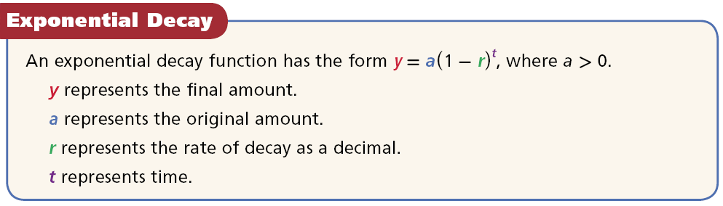

Slide 24
Notice an important difference between exponential growth functions and exponential decay functions. For exponential growth, the value inside the parentheses will be greater than 1 because r is added to 1. For exponential decay, the value inside the parentheses will be less than 1 because r is subtracted from 1.

Slide 25
Example 3: Exponential Decay
The population of a town is decreasing at a rate of 3% per year. In 2000 there were 1700 people. Write an exponential decay function to model this situation. Then find the population in 2012.
Step 1 Write the exponential decay function for this situation.
y = a(1 – r)^{t}
Write the formula.
Substitute 1700 for a and 0.03 for r.
= 1700(1 – 0.03)^{t}
= 1700(0.97)^{t}
Simplify.

Slide 26
Example 3: Exponential Decay
The population of a town is decreasing at a rate of 3% per year. In 2000 there were 1700 people. Write an exponential decay function to model this situation. Then find the population in 2012.
Step 2 Find the population in 2012.
y = 1,700(0.97)¹²
Substitute 12 for t.
Use a calculator and round to the nearest whole number.
≈ 1180
The population in 2012 will be approximately 1180 people.

Slide 27
Check It Out! Example 3
The fish population in a local stream is decreasing at a rate of 3% per year. The original population was 48,000. Write an exponential decay function to model this situation. Then find the population after 7 years.
Step 1 Write the exponential decay function for this situation.
y = a(1 – r)^{t}
Write the formula.
= 48,000(1 – 0.03)^{t}
Substitute 48,000 for a and 0.03 for r.
= 48,000(0.97)^{t}
Simplify.

Slide 28
Check It Out! Example 3 Continued
The fish population in a local stream is decreasing at a rate of 3% per year. The original population was 48,000. Write an exponential decay function to model this situation. Then find the population after 7 years.
Step 2 Find the population in 7 years.
y = 48,000(0.97)⁷
Substitute 7 for t.
Use a calculator and round to the nearest whole number.
≈ 38,783
The population after 7 years will be approximately 38,783 people.

Slide 29
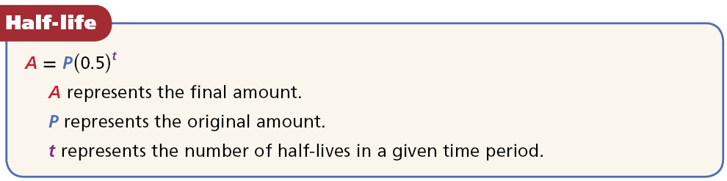
A common application of exponential decay is half-life. The half-life of a substance is the time it takes for one-half of the substance to decay into another substance.

Slide 30

Example 4A: Science Application
Astatine-218 has a half-life of 2 seconds.
Find the amount left from a 500 gram sample of astatine-218 after 10 seconds.
Step 1 Find t, the number of half-lives in the given time period.
Divide the time period by the half-life. The value of t is 5.
Step 2 A = P(0.5)^{t}
Write the formula.
= 500(0.5)⁵
Substitute 500 for P and 5 for t.
= 15.625
Use a calculator.
There are 15.625 grams of Astatine-218 remaining after 10 seconds.

Slide 31

Example 4B: Science Application
Astatine-218 has a half-life of 2 seconds.
Find the amount left from a 500-gram sample of astatine-218 after 1 minute.
Step 1 Find t, the number of half-lives in the given time period.
Find the number of seconds in 1 minute.
1(60) = 60
Divide the time period by the half-life. The value of t is 30.

Slide 32
Example 4B Continued
Astatine-218 has a half-life of 2 seconds.
Find the amount left from a 500-gram sample of astatine-218 after 1 minute.
Step 2 A = P(0.5)^{t}
Write the formula.
= 500(0.5)³⁰
Substitute 500 for P and 30 for t.
= 0.00000047
Use a calculator.
There are 0.00000047 grams of Astatine-218 remaining after 60 seconds.

Slide 33

Check It Out! Example 4a
Cesium-137 has a half-life of 30 years. Find the amount of cesium-137 left from a 100 milligram sample after 180 years.
Step 1 Find t, the number of half-lives in the given time period.
Divide the time period by the half-life. The value of t is 6.

Slide 34
Check It Out! Example 4a Continued
Cesium-137 has a half-life of 30 years. Find the amount of cesium-137 left from a 100 milligram sample after 180 years.
Step 2 A = P(0.5)^{t}
Write the formula.
Substitute 100 for P and 6 for t.
= 100(0.5)⁶
= 1.5625
Use a calculator.
There are 1.5625 milligrams of Cesium-137 remaining after 180 years.

Slide 35

Check It Out! Example 4b
Bismuth-210 has a half-life of 5 days.
Find the amount of bismuth-210 left from a 100-gram sample after 5 weeks. (Hint: Change 5 weeks to days.)
Step 1 Find t, the number of half-lives in the given time period.
5 weeks = 35 days
Find the number of days in 5 weeks.
Divide the time period by the half-life. The value of t is 7.

Slide 36
Check It Out! Example 4b Continued
Bismuth-210 has a half-life of 5 days.
Find the amount of bismuth-210 left from a 100-gram sample after 5 weeks. (Hint: Change 5 weeks to days.)
Step 2 A = P(0.5)^{t}
Write the formula.
= 100(0.5)⁷
Substitute 100 for P and 7 for t.
= 0.78125
Use a calculator.
There are 0.78125 grams of Bismuth-210 remaining after 5 weeks.

Slide 37
Lesson Quiz: Part I
Write a compound interest function to model each situation. Then find the balance after the given number of years.
1. The number of employees at a certain company is 1440 and is increasing at a rate of 1.5% per year. Write an exponential growth function to model this situation. Then find the number of employees in the company after 9 years.
y = 1440(1.015)^{t}; 1646
2. $12,000 invested at a rate of 6% compounded quarterly; 15 years
A = 12,000(1.015)^{4t}, $29,318.64

Slide 38
Lesson Quiz: Part II
3. $500 invested at a rate of 2.5% compounded annually; 10 years
A = 500(1.025)^{t}; $640.04
4. The deer population of a game preserve is decreasing by 2% per year. The original population was 1850. Write an exponential decay function to model the situation. Then find the population after 4 years.
y = 1850(0.98)^{t}; 1706
5. Iodine-131 has a half-life of about 8 days. Find the amount left from a 30-gram sample of iodine-131 after 40 days.
0.9375 g

