Slide 1

Linear, Quadratic, and Exponential Models
Warm Up
Lesson Presentation
Lesson Quiz
Holt McDougal Algebra 1
Holt Algebra 1

Slide 2

Warm Up
1. Find the slope and y-intercept of the line that passes through (4, 20) and (20, 24).
The population of a town is decreasing at a rate of 1.8% per year. In 1990, there were 4600 people.
2. Write an exponential decay function to model this situation.
3. Find the population in 2010.
y = 4600(0.982)^{t}
3199

Slide 3
Objectives
Compare linear, quadratic, and exponential models.
Given a set of data, decide which type of function models the data and write an equation to describe the function.

Slide 4
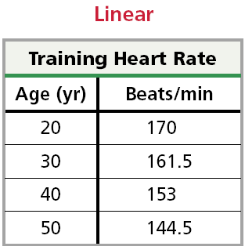
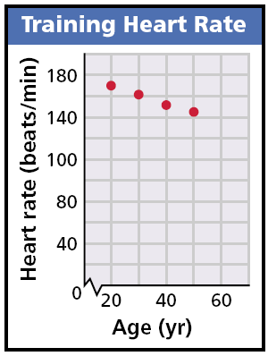
Look at the tables and graphs below. The data show three ways you have learned that variable quantities can be related. The relationship shown is linear.

Slide 5
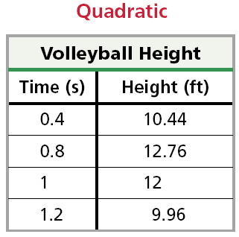
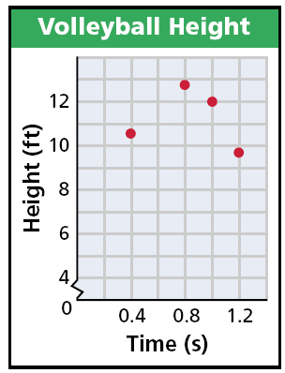
Look at the tables and graphs below. The data show three ways you have learned that variable quantities can be related. The relationship shown is quadratic.

Slide 6
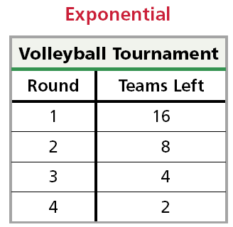
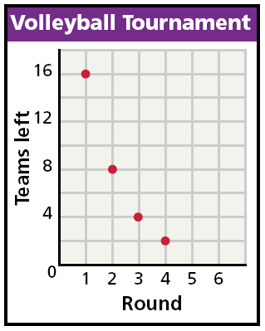
Look at the tables and graphs below. The data show three ways you have learned that variable quantities can be related. The relationship shown is exponential.

Slide 7
In the real world, people often gather data and then must decide what kind of relationship (if any) they think best describes their data.

Slide 8
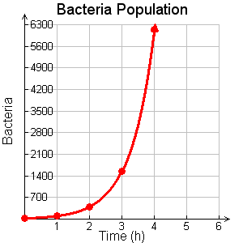
Example 1A: Graphing Data to Choose a Model
Graph each data set. Which kind of model best describes the data?
Time(h) | Bacteria
0 | 24
1 | 96
2 | 384
3 | 1536
4 | 6144
Plot the data points and connect them.
The data appear to be exponential.

Slide 9
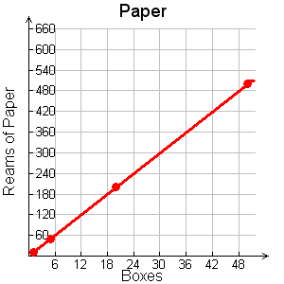
Example 1B: Graphing Data to Choose a Model
Graph each data set. Which kind of model best describes the data?
Boxes | Reams of paper
1 | 10
5 | 50
20 | 200
50 | 500
Plot the data points and connect them.
The data appears to be linear.

Slide 10
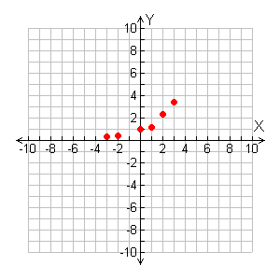
Check It Out! Example 1a
Graph each set of data. Which kind of model best describes the data?
x | y
–3 | 0.30
–2 | 0.44
0 | 1
1 | 1.5
2 | 2.25
3 | 3.38
Plot the data points.
The data appears to be exponential.

Slide 11
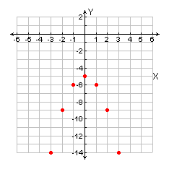
Check It Out! Example 1b
Graph each set of data. Which kind of model best describes the data?
x | y
–3 | –14
–2 | –9
–1 | –6
0 | –5
1 | –6
2 | –9
3 | –14
Plot the data points.
The data appears to be quadratic.

Slide 12
Another way to decide which kind of relationship (if any) best describes a data set is to use patterns.

Slide 13

Example 2A: Using Patterns to Choose a Model
Look for a pattern in each data set to determine which kind of model best describes the data.
Height of golf ball
Time (s) | Height (ft)
0 | 4
1 | 68
2 | 100
3 | 100
4 | 68
For every constant change in time of +1 second, there is a constant second difference of –32.
+ 1
+ 64
–32
+ 1
+ 32
–32
+ 1
0
–32
+ 1
–32
The data appear to be quadratic.

Slide 14
Example 2B: Using Patterns to Choose a Model
Look for a pattern in each data set to determine which kind of model best describes the data.
Money in CD
Time (yr) | Amount ($)
0 | 1000.00
1 | 1169.86
2 | 1368.67
3 | 1601.04
For every constant change in time of + 1 year there is an approximate constant ratio of 1.17.
+ 1
× 1.17
+ 1
× 1.17
+ 1
× 1.17
The data appears to be exponential.

Slide 15
Check It Out! Example 2
Look for a pattern in the data set {(–2, 10), (–1, 1), (0, –2), (1, 1), (2, 10)} to determine which kind of model best describes the data.
Data (1) | Data (2)
–2 | 10
–1 | 1
0 | –2
1 | 1
2 | 10
For every constant change of +1 there is a constant ratio of 6.
+ 1
– 9
+ 6
+ 1
– 3
+ 6
+ 1
+ 3
+ 1
+ 6
+ 9
The data appear to be quadratic.

Slide 16
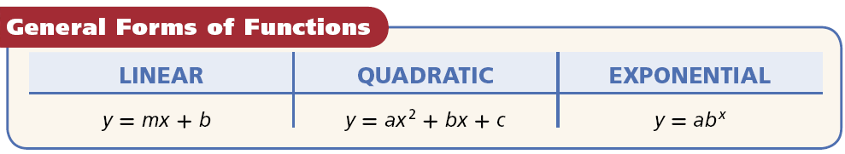
After deciding which model best fits the data, you can write a function. Recall the general forms of linear, quadratic, and exponential functions.

Slide 17

Example 3: Problem-Solving Application
Use the data in the table to describe how the number of people changes. Then write a function that models the data. Use your function to predict the number of people who received the e-mail after one week.
E-mail forwarding
Time (Days) | Number of People Who Received the E-mail
0 | 8
1 | 56
2 | 392
3 | 2744

Slide 18


1
Understand the Problem
The answer will have three parts–a description, a function, and a prediction.
2
Make a Plan
Determine whether the data is linear, quadratic, or exponential. Use the general form to write a function. Then use the function to find the number of people after one week.

Slide 19

3
Solve
Step 1 Describe the situation in words.
E-mail forwarding
Time (Days)
Number of People Who Received the E-mail
0
8
+ 1
× 7
1
56
× 7
+ 1
2
392
× 7
+ 1
3
2744
Each day, the number of e-mails is multiplied by 7.

Slide 20
Step 2 Write the function.
There is a constant ratio of 7. The data appear to be exponential.
y = ab^{x}
Write the general form of an exponential function.
y = a(7)^{x}
8 = a(7)⁰
Choose an ordered pair from the table, such as (0, 8). Substitute for x and y.
8 = a(1)
Simplify 7⁰ = 1
8 = a
The value of a is 8.
y = 8(7)^{x}
Substitute 8 for a in y = a(7)^{x}.

Slide 21
Step 3 Predict the e-mails after 1 week.
y = 8(7)^{x}
Write the function.
= 8(7)⁷
Substitute 7 for x (1 week = 7 days).
= 6,588,344
Use a calculator.
There will be 6,588,344 e-mails after one week.

Slide 22

4
Look Back
You chose the ordered pair (0, 8) to write the function. Check that every other ordered pair in the table satisfies your function.
y = 8(7)^{x}
y = 8(7)^{x}
y = 8(7)^{x}
56 8(7)¹
392 8(7)²
2744 8(7)³
56 8(7)
392 8(49)
2744 8(343)
✓
✓
✓
56 56
392 392
2744 2744

Slide 23
Remember!
When the independent variable changes by a constant amount,
linear functions have constant first differences.
quadratic functions have constant second differences.
exponential functions have a constant ratio.

Slide 24
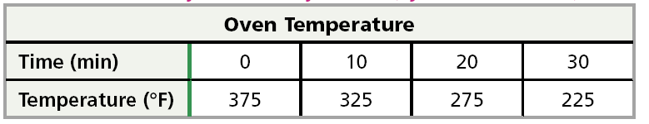
Check It Out! Example 3
Use the data in the table to describe how the oven temperature is changing. Then write a function that models the data. Use your function to predict the temperature after 1 hour.

Slide 25
1
Understand the Problem
The answer will have three parts–a description, a function, and a prediction.
2
Make a Plan
Determine whether the data is linear, quadratic, or exponential. Use the general form to write a function. Then use the function to find the temperature after one hour.

Slide 26
3
Solve
Step 1 Describe the situation in words.
Oven Temperature
Time (min)
Temperature (°F)
0
375
+ 10
– 50
10
325
+ 10
– 50
20
275
+ 10
– 50
30
225
Each 10 minutes, the temperature is reduced by 50 degrees.

Slide 27
Step 2 Write the function.
There is a constant reduction of 50° each 10 minutes. The data appear to be linear.
y = mx + b
Write the general form of a linear function.
y = –5(x) + b
The slope m is –50 divided by 10.
y = –5(0) + b
Choose an x value from the table, such as 0.
y = 0 + 375
The starting point is b which is 375.
y = 375

Slide 28
Step 3 Predict the temperature after 1 hour.
y = –5x + 375
Write the function.
= –5(60) + 375
Substitute 60 for x.
= 75° F
Simplify.
The temperature will be 75°F after 1 hour.

Slide 29
4
Look Back
You chose the ordered pair (0, 375) to write the function. Check that every other ordered pair in the table satisfies your function.
y = –5(x) + 375
y = –5(x) + 375
375 –5(0) + 375
325 –5(10) +375
375 0 + 375
325 –50 + 375
✓
✓
375 375
325 325

Slide 30
4
Look Back
You chose the ordered pair (0, 375) to write the function. Check that every other ordered pair in the table satisfies your function.
y = –5(x) + 375
y = –5(x) + 375
275 –5(20) +375
225 –5(30) +375
275 –100 + 375
225 –150 + 375
✓
✓
275 275
225 225

Slide 31
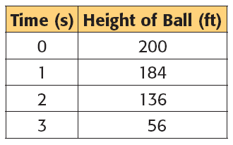
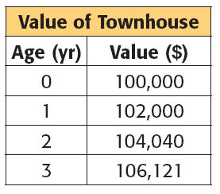
Lesson Quiz: Part I
Which kind of model best describes each set of data?
1.
2.
quadratic
exponential

Slide 32
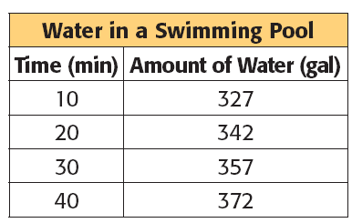
Lesson Quiz: Part II
3. Use the data in the table to describe how the amount of water is changing. Then write a function that models the data. Use your function to predict the amount of water in the pool after 3 hours.
Increasing by 15 gal every 10 min; y = 1.5x + 312; 582 gal

