Slide 1
Inbox Task and Classwork
On pages 124-127 in notebook
Complete the following
  Pg. 210 #2-14 EVENS
  Pg. 236 #2-14 EVENS
  Pg. 270 #2-10 EVENS
  Pg. 304 #2-14 EVENS
  Pg. 336 #2-16 EVENS
  Pg. 360 #2-8 EVENS

Slide 2
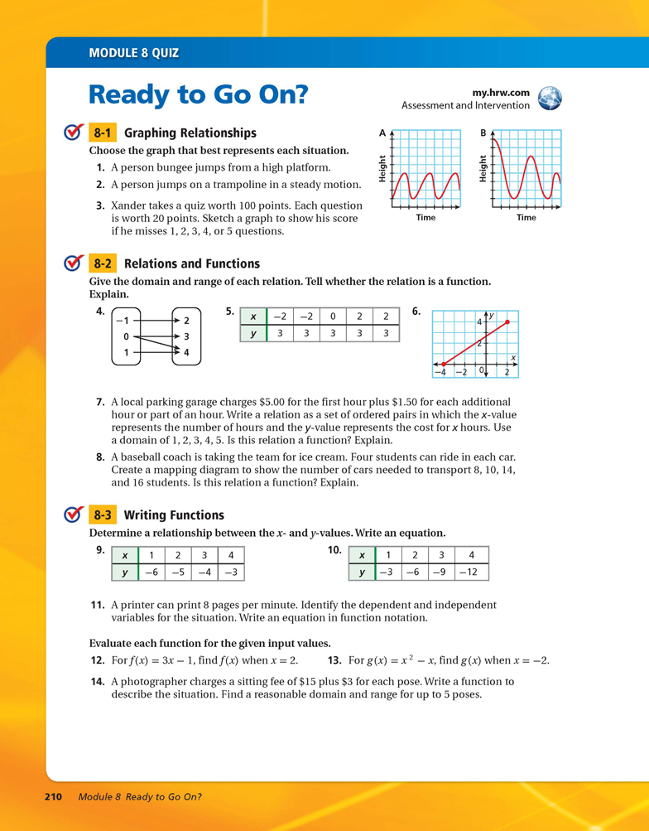

Slide 3
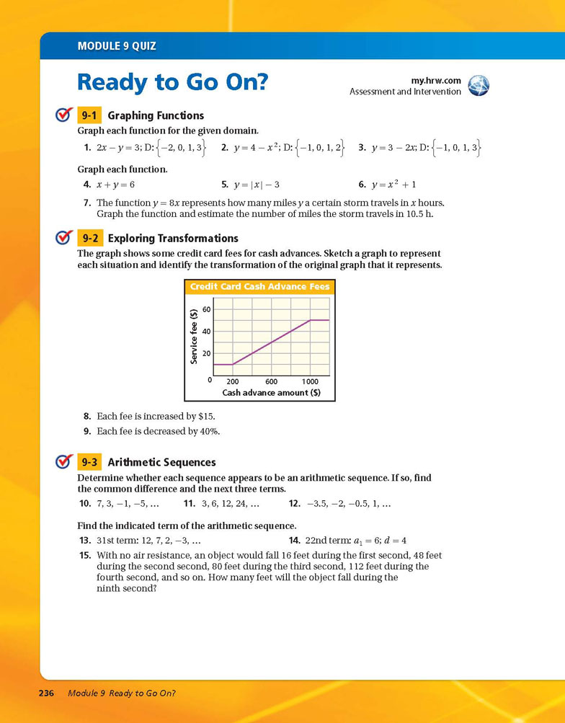

Slide 4
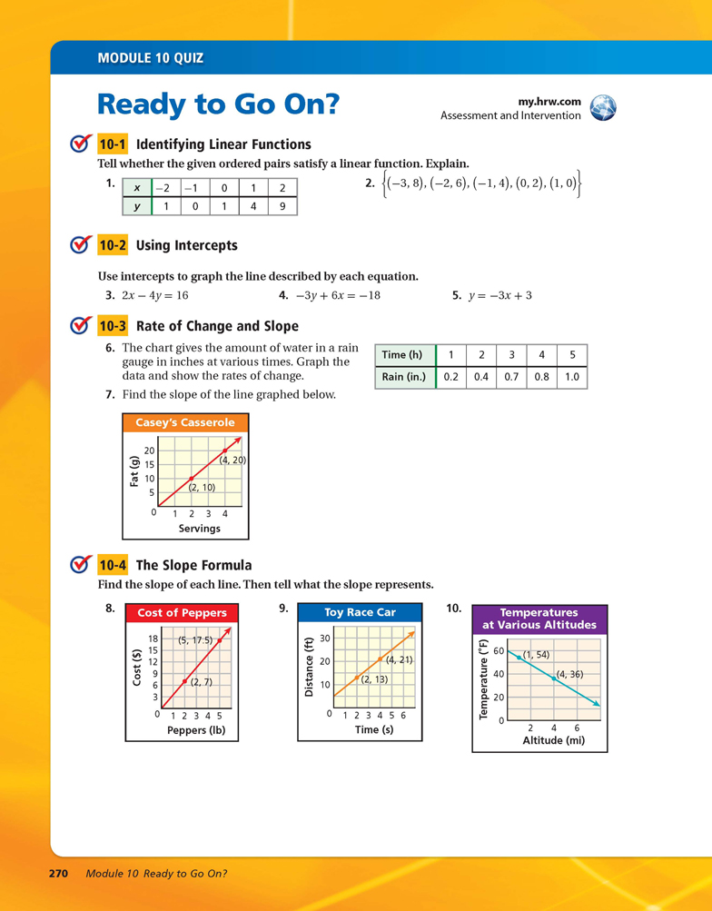

Slide 5
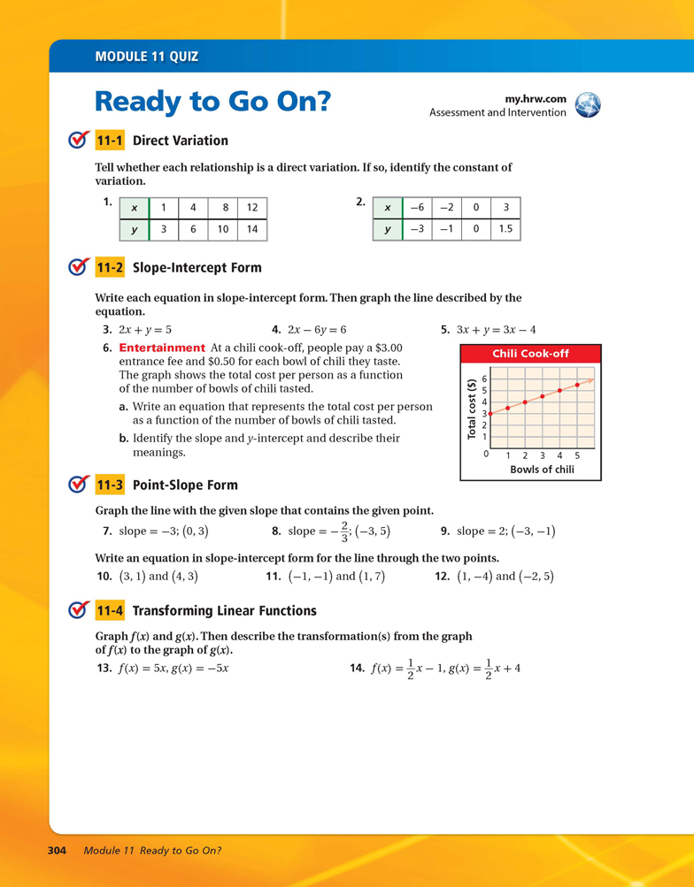

Slide 6
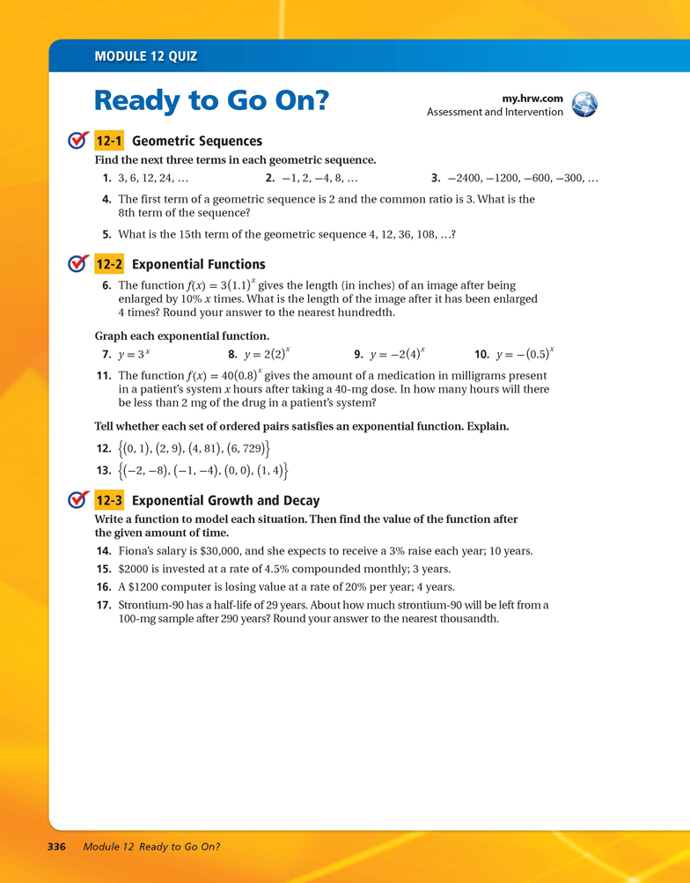

Slide 8
