Slide 1

Frequency and Histograms
Warm Up
Lesson Presentation
Lesson Quiz
Holt McDougal Algebra 1
Holt Algebra 1

Slide 2
Warm Up
Identify the least and greatest value in each data set.
1. 34, 62, 45, 35, 75, 23, 35, 65, 23
2. 1.6, 3.4, 2.6, 4.8, 1.3, 3.5, 4.0
Order the data from least to greatest.
3. 2.4, 5.1, 3.7, 2.1, 3.6, 4.0, 2.9
4. 5, 5, 6, 8, 7, 4, 6, 5, 9, 3, 6, 6, 9
23, 75
1.3, 4.8
2.1, 2.4, 2.9, 3.6, 3.7, 4.0, 5.1
3, 4, 5, 5, 5, 6, 6, 6, 6, 7, 8, 9, 9

Slide 3
Objectives
Create stem-and-leaf plots.
Create frequency tables and histograms.

Slide 4
Vocabulary
stem-and-leaf plot
frequency
frequency table
histogram
cumulative frequency

Slide 5

A stem-and-leaf plot arranges data by dividing each data value into two parts. This allows you to see each data value.
The digits other than the last digit of each value are called a stem.
The last digit of a
value is called a leaf.
Key: 2|3 means 23
The key tells you how to read each value.

Slide 6
Example 1A: Making a Stem-and-Leaf Plot
The numbers of defective widgets in batches of 1000 are given below. Use the data to make a stem-and-leaf plot.
14, 12, 8, 9, 13, 20, 15, 9, 21, 8, 13, 19
Number of Defective
Widgets per Batch
The tens digits are the stems.
The ones digits are the leaves. List the leaves from least to greatest within each row.
Stem Leaves
0 8 8 9 9
1 2 3 3 4 5 9
2 0 1
Title the graph and add a key.
Key: 1|9 means 19

Slide 7
Example 1B: Making a Stem-and-Leaf Plot
The season’s scores for the football teams going to the state championship are given below. Use the data to make a back-to-back stem-and-leaf plot.
Team A: 65, 42, 56, 49, 58, 42, 61, 55, 45, 72
Team B: 57, 60, 48, 49, 52, 61, 58, 37, 63, 48

Slide 8
Example 1B Continued
Team A: 65, 42, 56, 49, 58, 42, 61, 55, 45, 72
Team B: 57, 60, 48, 49, 52, 61, 58, 37, 63, 48
Football State
Championship Scores
The tens digits are the stems.
Team A Team B
The ones digits are the leaves.
3 7
9 5 2 2 4 8 8 9
Put Team A’s scores on the left side and Team B’s scores on the right.
8 6 5 5 2 7 8
5 1 6 0 1 3
2 7
Title the graph and add a key.
Key: |4|8 means 48
2|4| means 42

Slide 9
Check It Out! Example 1
The temperature in degrees Celsius for two weeks are given below. Use the data to make a stem-and-leaf plot.
7, 32, 34, 31, 26, 27, 23, 19, 22, 29, 30, 36, 35, 31
Temperature in Degrees Celsius
The tens digits are the stems.
Stem Leaves
0 7
The ones digits are the leaves. List the leaves from least to greatest within each row.
1 9
2 2 3 6 7 9
3 0 1 1 2 4 5 6
Key: 1|9 means 19
Title the graph and add a key.

Slide 10
The frequency of a data value is the number of times it occurs. A frequency table shows the frequency of each data value. If the data is divided into intervals, the table shows the frequency of each interval.

Slide 11
Example 2: Making a Frequency Table
The numbers of students enrolled in Western Civilization classes at a university are given below. Use the data to make a frequency table with intervals.
12, 22, 18, 9, 25, 31, 28, 19, 22, 27, 32, 14
Step 1 Identify the least and greatest values.
The least value is 9. The greatest value is 32.

Slide 12
Example 2 Continued
Step 2 Divide the data into equal intervals.
For this data set, use an interval of 10.
Enrollment in Western
Civilization Classes
Step 3 List the intervals in the first column of the table. Count the number of data values in each interval and list the count in the last column. Give the table a title.
Number Enrolled | Frequency
1 – 10 | 1
11 – 20 | 4
21 – 30 | 5
31 – 40 | 2

Slide 13
Check It Out! Example 2
The number of days of Maria’s last 15 vacations are listed below. Use the data to make a frequency table with intervals.
4, 8, 6, 7, 5, 4, 10, 6, 7, 14, 12, 8, 10, 15, 12
Step 1 Identify the least and greatest values.
The least value is 4. The greatest value is 15.
Step 2 Divide the data into equal intervals.
For this data set use an interval of 3.

Slide 14
Check It Out! Example 2 Continued
Step 3 List the intervals in the first column of the table. Count the number of data values in each interval and list the count in the last column. Give the table a title.
Number of Vacation Days
Interval | Frequency
4 – 6 | 5
7 – 9 | 4
10 – 12 | 4
13 – 15 | 2

Slide 15
A histogram is a bar graph used to display the frequency of data divided into equal intervals. The bars must be of equal width and should touch, but not overlap.

Slide 16
Example 3: Making a Histogram
Use the frequency table in Example 2 to make a histogram.
Step 1 Use the scale and interval from the frequency table.
Enrollment in Western
Civilization Classes
Number Enrolled | Frequency
1 – 10 | 1
11 – 20 | 4
21 – 30 | 5
31 – 40 | 2
Step 2 Draw a bar for the number of classes in each interval.
All bars should be the same width. The bars should touch, but not overlap.

Slide 17
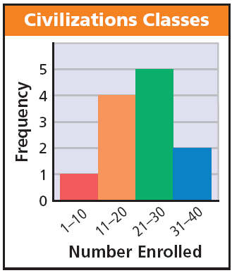
Example 3 Continued
Step 3 Title the graph
and label the horizontal and vertical scales.

Slide 18
Check It Out! Example 3
Make a histogram for the number of days of Maria’s last 15 vacations.
4, 8, 6, 7, 5, 4, 10, 6, 7, 14, 12, 8, 10, 15, 12
Step 1 Use the scale and interval from the frequency table.
Number of Vacation Days
Interval | Frequency
4 – 6 | 5
7 – 9 | 4
10 – 12 | 4
13 – 15 | 2

Slide 19
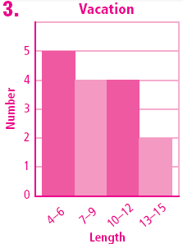
Check It Out! Example 3 Continued
Step 2 Draw a bar for the number of scores in each interval.
All bars should be the same width. The bars should touch, but not overlap.
Vacations
Step 3 Title the graph
and label the horizontal and vertical scales.

Slide 20
Cumulative frequency shows the frequency of all data values less than or equal to a given value. You could just count the number of values, but if the data set has many values, you might lose track. Recording the data in a cumulative frequency table can help you keep track of the data values as you count.

Slide 21
Example 4: Making a Cumulative Frequency Table
The weights (in ounces) of packages of cheddar cheese are given below.
19, 20, 26, 18, 25, 29, 18, 18, 22, 24, 27, 26, 24, 21, 29, 19
a. Use the data to make a cumulative frequency table.
Step 1 Choose intervals for the first column of the table.
Step 2 Record the frequency values in each interval for the second column.

Slide 22
Example 4 Continued
Step 3 Add the frequency of each interval to the frequencies of all the intervals before it. Put that number in the third column of the table.
Step 4 Title the table.
Cheddar Cheese
Weight (oz) | Frequency | Cumulative Frequency
18-20 | 6 | 6
21-23 | 2 | 8
24-26 | 5 | 13
27-29 | 3 | 16

Slide 23
Example 4 Continued
b. How many packages weigh less than 24 ounces.
All packages less than 24 oz are displayed in the first two rows of the table, so look at the cumulative frequency shown in the second row.
Cheddar Cheese
Weight (oz) | Frequency | Cumulative Frequency
18-20 | 6 | 6
21-23 | 2 | 8
24-26 | 5 | 13
27-29 | 3 | 16
There are 8 packages with weights under
24 oz?

Slide 24
Check It Out! Example 4
The number of vowels in each sentence of a short essay are listed below.
33, 36, 39, 37, 34, 35, 43, 35, 28, 32, 36, 35, 29, 40, 33, 41, 37
a. Use the data to make a cumulative frequency table.
Step 1 Choose intervals for the first column of the table.
Step 2 Record the frequency values in each interval for the second column.

Slide 25
Check It Out! Example 4 Continued
Step 3 Add the frequency of each interval to the frequencies of all the intervals before it. Put that number in the third column of the table.
Vowels in Sentences
Step 4 Title the table.
Number | Frequency | Cumulative Frequency
28-31 | 2 | 2
32-35 | 7 | 9
36-39 | 5 | 14
40-43 | 3 | 17

Slide 26
Check It Out! Example 4 Continued
b. How many sentences contain 35 vowels or fewer?
All sentences with less than 35 vowels. are displayed in the first two rows of the table, so look at the cumulative frequency shown in the second row.
Vowels in Sentences
Number | Frequency | Cumulative Frequency
28-31 | 2 | 2
32-35 | 7 | 9
36-39 | 5 | 14
40-43 | 3 | 17
There are 9 sentences with fewer than 35 vowels.

Slide 27
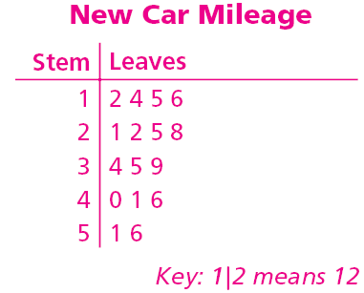
Lesson Quiz: Part I
1. The number of miles on the new cars in a car lot are given below. Use the data to make a stem-and-leaf plot.
35, 21, 15, 51, 39, 41, 46, 22, 28, 16, 12, 40, 34, 56, 25, 14

Slide 28
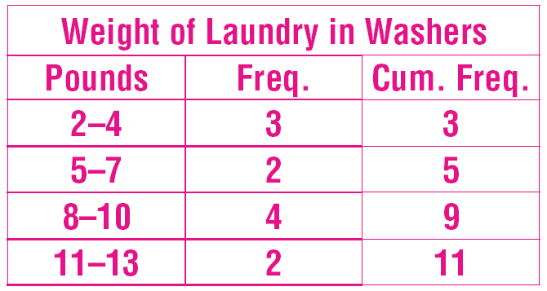
Lesson Quiz: Part II
2. The numbers of pounds of laundry in the washers at a laundromat are given below. Use the data to make a cumulative frequency table.
2, 12, 4, 8, 5, 8, 11, 3, 6, 9, 8

Slide 29
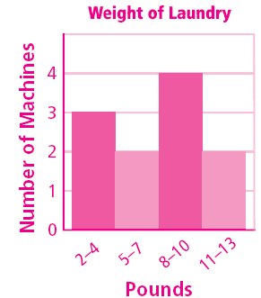
Lesson Quiz: Part III
3. Use the frequency table from Problem 2 to make a histogram.

