Slide 1

Two – Way Tables
Warm Up
Lesson Presentation
Lesson Quiz
Holt McDougal Algebra 2
Holt Algebra 2

Slide 2
Warm Up
A bag contains 4 red and 2 yellow marbles. A marble is selected, kept out of the bag, and another marble is selected. Find each conditional probability of selecting the second marble.
1. P(red | red)
0.6
2. P(red | yellow)
0.8
3. P(yellow | yellow)
0.2
4. P(yellow | red)
0.4

Slide 3
5. A bag contains 4 red and 2 yellow marbles. A marble is selected, kept out of the bag, and another marble is selected. Find P(two red marbles).
Continued : Warm Up
0.4

Slide 4
Objectives
Construct and interpret two-way frequency
tables of data when two categories are
associated with each object being classified.

Slide 5
Vocabulary
joint relative frequency
marginal relative frequency
conditional relative frequency

Slide 6
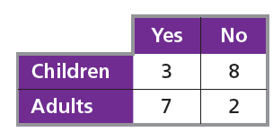
A two-way table is a useful way to organize data that can be categorized by two variables. Suppose you asked 20 children and adults whether they
liked broccoli. The table shows one way to arrange the data.
The joint relative frequencies are the values in each category divided by the total number of values, shown by the shaded cells in the table. Each value is divided by 20, the total number of individuals.

Slide 7
The marginal relative frequencies are found by adding the joint relative frequencies in each row and column.

Slide 8
To find a conditional relative frequency , divide the joint relative frequency by the marginal relative frequency. Conditional relative frequencies can be used to find conditional probabilities.

Slide 9
Example 1: Finding Joint and Marginal Relative Frequencies
The table shows the results of randomly selected car insurance quotes for 125 cars made by an insurance company in one week. Make a table of the joint and marginal relative frequencies.

Slide 10
Example 1: Continued
Divide each value by the total of 125 to find the joint relative frequencies, and add each row and column to find the marginal relative frequencies.
Teen
Adult
Total
0 acc.
0.12
0.424
0.544
1 acc.
0.032
0.256
0.288
2 + acc.
0.072
0.096
0.168
Total
0.224
0.776
1

Slide 11
Check It Out! Example 1
The table shows the number of books sold at a library sale. Make a table of the joint and marginal relative frequencies.

Slide 12
Check It Out! Example 1 Continued
Divide each value by the total of 210 to find the joint relative frequencies, and add each row and column to find the marginal relative frequencies.
Fiction
Nonfiction
Total
Hardcover
0.133
0.248
0.381
Paperback
0.448
0.171
0.619
Total
0.581
0.419
1

Slide 13
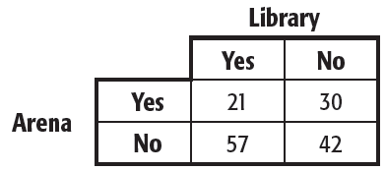
Example 2: Using Conditional Relative Frequency to Find Probability
A reporter asked 150 voters if they plan to vote in favor of a new library and a new arena. The table shows the results.

Slide 14
Example 2A Continued
A. Make a table of the joint and marginal relative frequencies.
Library
Yes
No
Total
Yes
0.14
0.2
0.34
Arena
No
0.38
0.28
0.66
Total
0.52
0.48
1

Slide 15
B. If you are given that a voter plans to vote no to the new library, what is the probability the voter also plans to say no to the new arena?
Example 2B Continued
0.28 _{≈ 0.58}
0.48

Slide 16
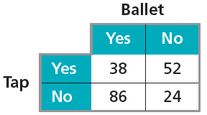
Check It Out! Example 2
The classes at a dance academy include ballet and tap dancing. Enrollment in these classes is shown in the table.
2a. Copy and complete the table of the joint relative frequencies and marginal relative frequencies.

Slide 17
Check It Out! Example 2 continued
Ballet
Yes
No
Total
Yes
0.19
0.26
0.45
Tap
No
0.43
0.12
0.55
Total
0.62
0.38
1
2b. If you are given that a student is taking ballet, what is the probability that the student is not taking tap?
0.43
≈ 0.69 or 69%
0.62

Slide 18
A company sells items in a store, online, and through a catalog. A manager recorded whether or not the 50 sales made one day were paid for with a gift card.
Example 3: Comparing Conditional Probabilities
Use conditional probabilities to determine for which method a customer is most likely to pay with a gift card.

Slide 19
Example 3 Continued
 | Gift Card | Another Method | TOTAL
Store | 0.12 | 0.18 | 0.30
Online | 0.18 | 0.26 | 0.44
Catalog | 0.10 | 0.16 | 0.26
TOTAL | 0.40 | 0.60 | 1
P(gift card if in store) = 0.4
P(gift card if online) ≈ 0.41
P(gift card if by catalog) ≈ 0.38
so most likely if buying online.
A customer is most likely to pay with a gift card if buying online.

Slide 20
Check It Out! Example 3
Francine is evaluating three driving schools. She asked 50 people who attended the schools whether they passed their driving tests on the first try. Use conditional probabilities to determine which is the best school.
Use conditional probabilities to determine which is the best school.

Slide 21
Check It Out! Example 3 Continued
 | Pass | Fail | TOTAL
Al’s Driving | 0.28 | 0.16 | 0.44
Drive Time | 0.22 | 0.14 | 0.36
Crash Course | 0.10 | 0.10 | 0.20
TOTAL | 0.60 | 0.40 | 1
Al’s Driving has the best pass rate, about 64%, versus 61% for Drive Time and 50% for Crash Course.

Slide 22
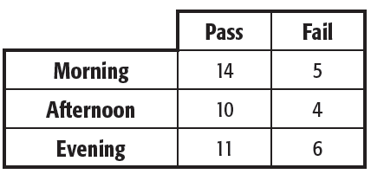
Lesson Quiz: Part I
At a juice-bottling factory, quality-control technicians randomly select bottles and mark them pass or fail. The manager randomly selects the results of 50 tests and organizes the data by shift and result. The table below shows these results.

Slide 23
1. Make a table of the joint and marginal relative frequencies.
Lesson Quiz: Part I continued
Pass
Fail
Total
Morn.
0.28
0.1
0.38
After.
0.2
0.08
0.28
Eve.
0.22
0.12
0.34
Total
0.7
0.3
1

Slide 24
Lesson Quiz: Part 2
2. Find the probability that a bottle was inspected in the afternoon given that it failed the inspection.
0.08
≈
0.27
0.3

Slide 25
3. Use conditional probabilities to determine on which shift a bottle is most likely to pass inspection.
Lesson Quiz: Part 3
P(pass if in morning) ≈ 0.74,
P(pass if in afternoon) ≈ 0.71,
P(pass if in evening) ≈ 0.65,
so most likely to pass in the
morning

