Slide 1
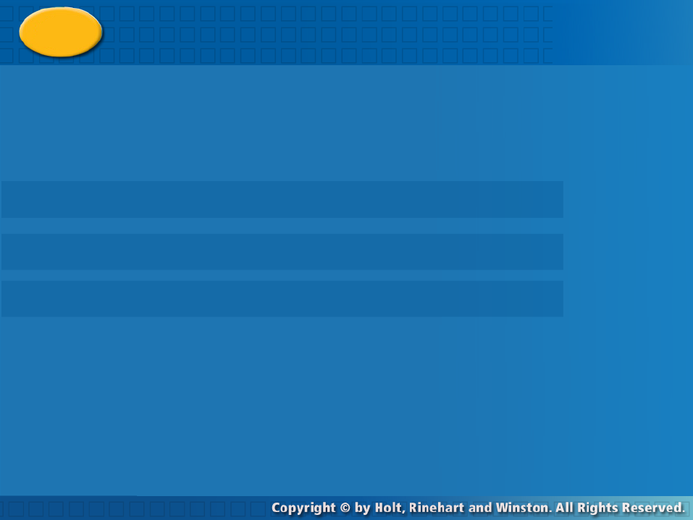
Data Distributions
Warm Up
Lesson Presentation
Lesson Quiz
Holt McDougal Algebra 1
Holt Algebra 1

Slide 2
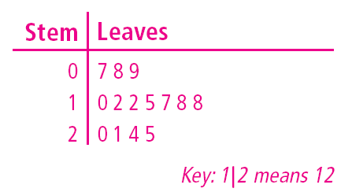
Warm Up
Identify the least and greatest value in each set.
1.
2.
3. Use the data below to make a stem-and-leaf plot.
7, 8, 10, 18, 24, 15,
17, 9, 12, 20, 25,
18, 21, 12
34, 62, 45, 35, 75, 23, 35, 65
23, 75
1.6, 3.4, 2.6, 4.8, 1.3, 3.5, 4.0
1.3, 4.8

Slide 3
Objectives
Describe the central tendency of a data set.
Create and interpret box-and-whisker plots.

Slide 4
Vocabulary
mean first quartile
median third quartile
mode interquartile range (IQR)
range box-and-whisker plot
outlier

Slide 5
A measure of central tendency describes the center of a set of data. Measures of central tendency include the mean, median, and mode.
The mean is the average of the data values, or the sum of the values in the set divided by the number of values in the set.
The median the middle value when the values are in numerical order, or the mean of the two middle numbers if there are an even number of values.

Slide 6
The mode is the value or values that occur most often. A data set may have one mode or more than one mode. If no value occurs more often than another, we say the data set has no mode.
The range of a set of data is the difference between the least and greatest values in the set. The range describes the spread of the data.

Slide 7

Additional Example 1: Finding Mean, Median, Mode, and Range of a Data Set
The weights in pounds of six members of a basketball team are 161, 156, 150, 156, 150, and 163. Find the mean, median, mode, and range of the data set.
Write the data in numerical order.
Add all the values and divide by the number of values.
mean:
median: 150, 150, 156, 156, 161, 163
The median is 156.
There are an even number of values. Find the mean of the two middle values.

Slide 8
Additional Example 1 Continued
150, 150, 156, 156, 161, 163
modes: 150 and 156
150 and 156 both occur more often than any other value.
range: 163 – 150 = 13

Slide 9


Check It Out! Example 1
The weights in pounds of five cats are 12, 14, 12, 16, and 16. Find the mean, median, mode, and range of the data set.
12, 12, 14, 16, 16
Write the data in numerical order.
Add all the values and divide by the number of values.
median: 12, 12, 14, 16, 16
There are an odd number of values. Find the middle value.
The median is 14.

Slide 10
Check It Out! Example 1 Continued
The weights in pounds of five cats are 12, 14, 12, 16, and 16.Find the mean, median, mode, and range of the data set.
mode: 12 and 16
The data set is bi-modal as 12 and 14 both occur twice.
range: 12 – 16 = 4

Slide 11
A value that is very different from the other values in a data set is called an outlier. In the data set below one value is much greater than the other values.
Most of data
Mean
Much different value

Slide 12

Additional Example 2: Determining the Effect of Outliers
Identify the outlier in the data set {16, 23, 21, 18, 75, 21}, and determine how the outlier affects the mean, median, mode, and range of the data.
16, 18, 21, 21, 23, 75
Write the data in numerical order.
The outlier is 75.
Look for a value much greater or less than the rest.
With the outlier:
median:
16, 18, 21, 21, 23, 75
The median is 21.
mode: 21 occurs twice. It is the mode.
range: 75 – 16 = 59

Slide 13

Additional Example 2 Continued
Without the outlier:
median:
16, 18, 21, 21, 23
The median is 21.
mode: 21 occurs twice. It is the mode.
range: 23 – 16 = 7
The outlier is 75; the outlier increases the mean by 9.2 and increases the range by 52. It has no effect on the median and the mode.

Slide 14
Check It Out! Example 2
Identify the outlier in the data set {21, 24, 3, 27, 30, 24} and determine how the outlier affects the mean, median, mode and the range of the data.
3, 21, 24, 24, 27, 30
Write the data in numerical order.
The outlier is 3.
Look for a value much greater or less than the rest.
With the outlier:
3+21+24+24+27+30
mean:
= 21.5
6
median:
3, 21, 24, 24, 27, 30
The median is 24.
mode: 24 occurs twice. It is the mode.
range: 30 – 3 = 27

Slide 15
Check It Out! Example 2 Continued
Without the outlier:
21+24+24+27+30
mean:
= 25.2
5
median:
21, 24, 24, 27, 30
The median is 24.
mode: 24 occurs twice. It is the mode.
range: 30 – 21 = 9
The outlier is 3; the outlier decreases the mean by 3.7 and increases the range by 18. It has no effect on the median and the mode.

Slide 16
As you can see in Example 2, an outlier can strongly affect the mean of a data set, having little or no impact on the median and mode. Therefore, the mean may not be the best measure to describe a data set that contains an outlier. In such cases, the median or mode may better describe the center of the data set.

Slide 17
Additional Example 3: Choosing a Measure of Central Tendency
Rico scored 74, 73, 80, 75, 67, and 54 on six history tests. Use the mean, median, and mode of his scores to answer each question.
mean ≈ 70.7 median = 73.5 mode = none
A. Which measure best describes Rico’s scores?
Median: 73.5; the outlier of 54 lowers the mean, and there is no mode.
B. Which measure should Rico use to describe his test scores to his parents? Explain.
Median: 73.5; the median is greater than the mean, and there is no mode.

Slide 18
Check It Out! Example 3
Josh scored 75, 75, 81, 84, and 85 on five tests. Use the mean, median, and mode of his scores to answer each question.
mean = 80 median = 81 mode = 75
a. Which measure describes the score Josh received most often?
Josh has two scores of 75 which is the mode.
b. Which measure best describes Josh’s scores? Explain.
Median: 81; the median is greater than either the mean or the mode.

Slide 19
Measures of central tendency describe how data cluster around one value. Another way to describe a data set is by its spread—how the data values are spread out from the center.
Quartiles divide a data set into four equal parts. Each quartile contains one-fourth of the values in the set. The first quartile is the median of the lower half of the data set. The second quartile is the median of the data set, and the third quartile is the median of the upper half of the data set.

Slide 20
Reading Math
The first quartile is sometimes called the lower quartile, and the third quartile is sometimes called the upper quartile.

Slide 21
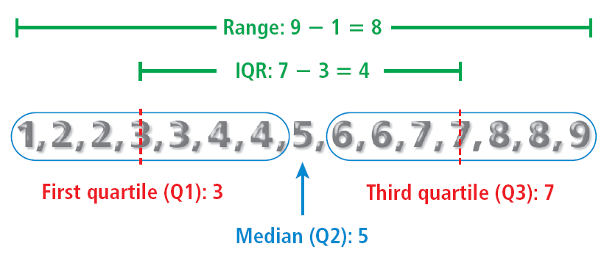
The interquartile range (IQR) of a data set is the difference between the third and first quartiles. It represents the range of the middle half of the data.

Slide 22
A box-and-whisker plot can be used to show how the values in a data set are distributed. You need five values to make a box and whisker plot; the minimum (or least value), first quartile, median, third quartile, and maximum (or greatest value).

Slide 23
Additional Example 4: Application
The number of runs scored by a softball team in 19 games is given. Use the data to make a box-and-whisker plot.
3, 8, 10, 12, 4, 9, 13, 20, 12, 15, 10, 5, 11, 5, 10, 6, 7, 6, 11
Step 1 Order the data from least to greatest.
3, 4, 5, 5, 6, 6, 7, 8, 9, 10, 10, 10, 11, 11, 12, 12, 13, 15, 20

Slide 24
Additional Example 4 Continued
Step 2 Identify the five needed values.
3, 4, 5, 5, 6, 6, 7, 8, 9, 10, 10, 10, 11, 11, 12, 12, 13, 15, 20
Minimum
Q1
Q2
Q3
Maximum
3
6
10
12
20

Slide 25
Additional Example 4 Continued
Step 3 Draw a number line and plot a point above each of the five needed values. Draw a box through the first and third quartiles and a vertical line through the median. Draw lines from the box to the minimum and maximum.
First quartile
Third quartile
Minimum
Median
Maximum
•
•
•
•
•
0
8
16
24
Half of the scores are between 6 and 12 runs per game. One-fourth of the scores are between 3 and 6. The greatest score earned by this team is 20.

Slide 26
Check It Out! Example 4
Use the data to make a box-and-whisker plot.
13, 14, 18, 13, 12, 17, 15, 12, 13, 19, 11, 14, 14, 18, 22, 23
Step 1 Order the data from least to greatest.
11, 12, 12, 13, 13, 13, 14, 14, 14, 15, 17, 18, 18, 19, 22, 23
Step 2 Identify the five needed values.

Slide 27
Check It Out! Example 4 Continued
11, 12, 12, 13, 13, 13, 14, 14, 14, 15, 17, 18, 18, 19, 22, 23
Minimum
Q1
Q2
Q3
Maximum
11
13
14
18
23

Slide 28
Check It Out! Example 4 Continued
Step 3
First quartile
Third quartile
Minimum
Maximum
Median
•
•
•
•
•
8
16
24
Half of the data are between 13 and 18. One-fourth of the data are between 11 and 13. The greatest value is 23.

Slide 29
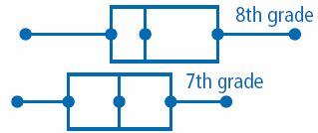

Additional Example 5: Reading and Interpreting Box-and-Whisker Plots
The box-and-whisker plots show the number of mugs sold per student in two different grades.
A. About how much greater was the median number of mugs sold by the 8th grade than the median number of mugs sold by the 7th grade?
about 6

Slide 30
Additional Example 5: Reading and Interpreting Box-and-Whisker Plots
B. Which data set has a greater maximum? Explain.
The data set for the 8th grade; the point representing the maximum is farther to the right for the 8th grade than for the 7th grade.

Slide 31
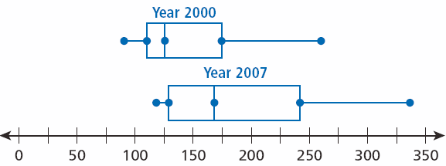
Check It Out! Example 5
Use the box-and-whisker plots to answer each question.
A. Which data set has a smaller range? Explain.
The data set for 2000; the distance between the points for the least and greatest values is less for 2000 than for 2007.

Slide 32
Check It Out! Example 5
Use the box-and-whisker plots to answer each question.
B. About how much more was the median ticket sales for the top 25 movies in 2007 than in 2000?
about $40 million

Slide 33
Lesson Quiz: Part I
1. Find the mean, median, mode, and range of the data set.
{7, 3, 5, 4, 5}
mean: 4.8; median: 5; mode: 5; range: 4
2. Identify the outlier in the data set {12, 15, 20, 44, 18, 20}, and determine how the outlier affects the mean, median, mode, and range of the data.
the outlier is 44; the mean increases by 4.5, median by 1, and range by 24; no effect on mode.

Slide 34
Lesson Quiz: Part II
3. The data set {12, 23, 13, 14, 13} gives the times of Tara’s one-way ride to school (in minutes) for one week. For each question, choose the mean, median, or mode, and give its value.
mean = 15 median = 13 mode = 13
A. Which value describes the time that occurred most often?
mode, 13
B. Which value best describes Tara’s ride time? Explain.
Median, 13 or mode, 13; there is an outlier, so the mean is strongly affected .

Slide 35
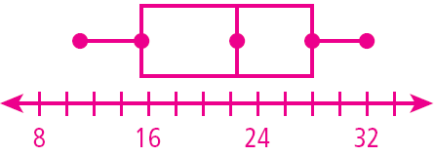
Lesson Quiz: Part III
4. The amounts of snow (in inches) that fell during the last 8 winters in one city are given. Use the data to make a box-and-whisker plot.
25, 17, 14, 27, 20, 11, 29, 32
15.5
22.5
28
11
32

