Slide 1

Inscribed Angles
Warm Up
Lesson Presentation
Lesson Quiz
Holt McDougal Geometry
Holt Geometry

Slide 2
Warm Up
Find each value.
1. m∠BCA
2. t
Solve for x.
3. 58 – x = 4 (x + 7)
4. 2 (x – 8) = 8
63.5°
116.5°
6
12

Slide 3
Objectives
Find the measure of an inscribed angle.
Use inscribed angles and their properties to solve problems.

Slide 4
Vocabulary
inscribed angle
intercepted arc
subtend

Slide 5
String art often begins with pins or nails that are placed around the circumference of a circle. A long piece of string is then wound from one nail to another. The resulting pattern may include hundreds of inscribed angles.

Slide 6
An inscribed angle is an angle whose vertex is on a circle and whose sides contain chords of the circle. An intercepted arc consists of endpoints that lie on the sides of an inscribed angle and all the points of the circle between them. A chord or arc subtends an angle if its endpoints lie on the sides of the angle.

Slide 7
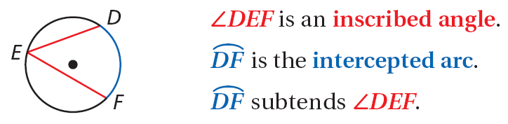
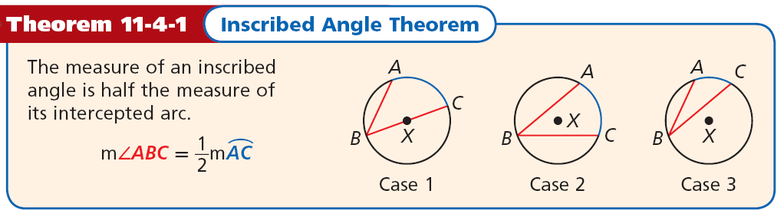

Slide 8


Example 1A: Finding Measures of Arcs and Inscribed Angles
Find each measure.
m∠PRU
Inscribed ∠ Thm.
Substitute 118 for mPU.

Slide 9



Example 1B: Finding Measures of Arcs and Inscribed Angles
Find each measure.
mSP
Inscribed ∠ Thm.
Substitute 27 for m∠ SRP.
Multiply both sides by 2.

Slide 10




Check It Out! Example 1a
Find each measure.
Inscribed ∠ Thm.
Substitute 135 for m∠ ABC.
Multiply both sides by 2.

Slide 11


Check It Out! Example 1b
Find each measure.
m∠DAE
Inscribed ∠ Thm.
Substitute 76 for mDE.

Slide 12
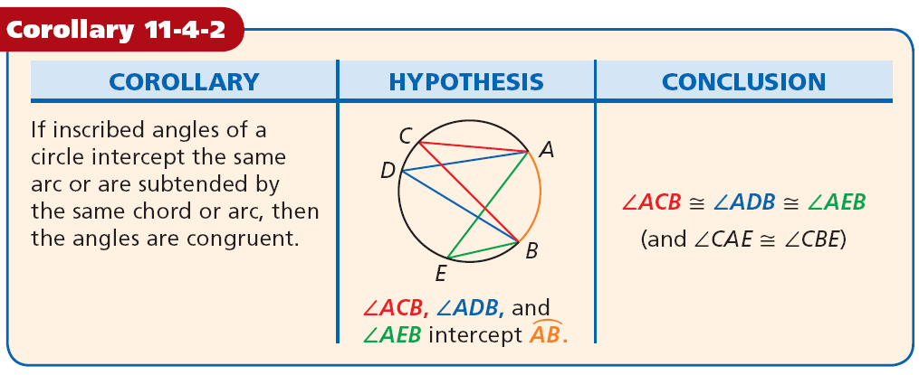

Slide 13
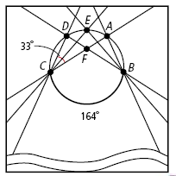


Example 2: Hobby Application
An art student turns in an abstract design for his art project.
Find m∠DFA.
m∠DFA = m∠DCF + m∠CDF
Ext ∠ Thm.
Inscribed ∠ Thm.
Substitute.
= 115°
Simplify.

Slide 14





Check It Out! Example 2
Find m∠ABD and mBC in the string art.
Inscribed ∠ Thm.
Substitute.
= 43°
Inscribed ∠ Thm.
Substitute.

Slide 15
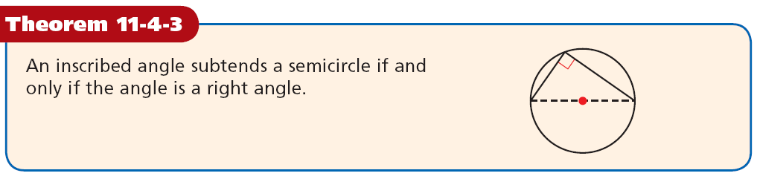

Slide 16
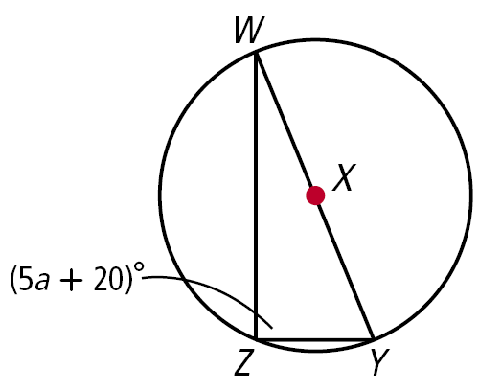
Example 3A: Finding Angle Measures in Inscribed Triangles
Find a.
∠WZY is a right angle | ∠WZY is inscribed in a semicircle.
m∠WZY = 90° | Def of rt. ∠
5a + 20 = 90 Substitute 5a + 20 for m∠WZY.
5a = 70 Subtract 20 from both sides.
a = 14 Divide both sides by 5.

Slide 17
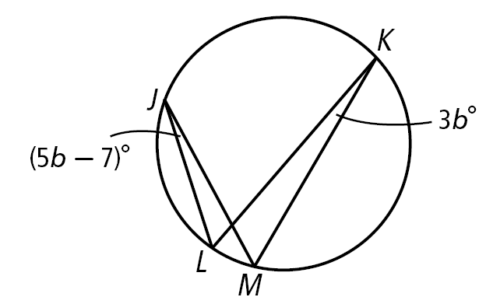
Example 3B: Finding Angle Measures in Inscribed Triangles
Find m∠LJM.
m∠LJM = m∠LKM m∠LJM and m∠LKM
both intercept LM.
5b – 7 = 3b Substitute the given values.
2b – 7 = 0 Subtract 3b from both sides.
2b = 7 Add 7 to both sides.
b = 3.5 Divide both sides by 2.
m∠LJM = 5(3.5) – 7 = 10.5° | Substitute 3.5 for b.

Slide 18
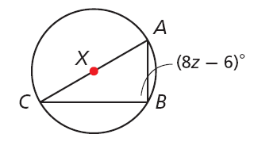
Check It Out! Example 3a
Find z.
∠ABC is a right angle | ∠ABC is inscribed in a semicircle.
m∠ABC = 90° | Def of rt. ∠
8z – 6 = 90 Substitute.
8z = 96 Add 6 to both sides.
z = 12 Divide both sides by 8.

Slide 19
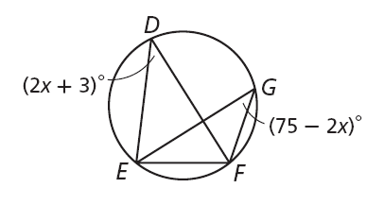
Check It Out! Example 3b
Find m∠EDF.
m∠EDF = m∠EGF m∠EGF and m∠EDF
both intercept EF.
2x + 3 = 75 – 2x Substitute the given values.
4x = 72 Add 2x and subtract 3 from both sides.
x = 18 Divide both sides by 4.
m∠EDF = 2(18) + 3 = 39°

Slide 20
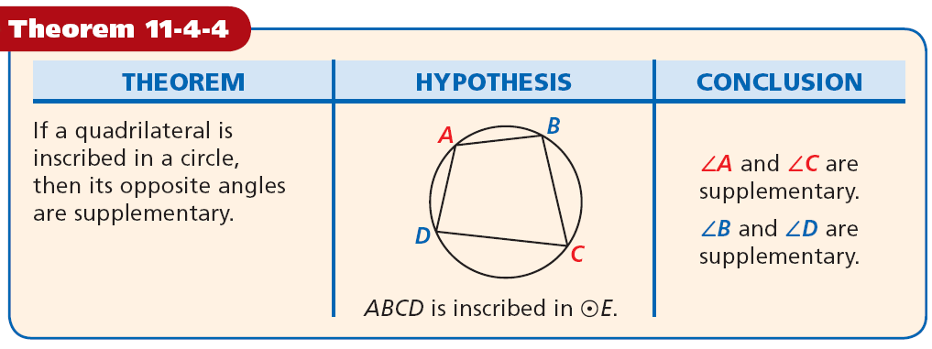

Slide 21
Example 4: Finding Angle Measures in Inscribed Quadrilaterals
Find the angle measures of GHJK.
Step 1 Find the value of b.
m∠G + m∠J = 180° | GHJK is inscribed in a .
3b + 25 + 6b + 20 = 180 | Substitute the given values.
9b + 45 = 180 | Simplify.
9b = 135 | Subtract 45 from both sides.
b = 15 | Divide both sides by 9.

Slide 22
Example 4 Continued
Step 2 Find the measure of each angle.
m∠G = 3(15) + 25 = 70° | Substitute 15 for b
m∠J = 6(15) + 20 = 110° | in each expression.
m∠K = 10(15) – 69 = 81°
m∠H + m∠K = 180° | ∠H and ∠K are supp.
m∠H + 81° = 180° | Substitute 81 for m∠K.
m∠H = 99° | Subtract 81 from both sides

Slide 23
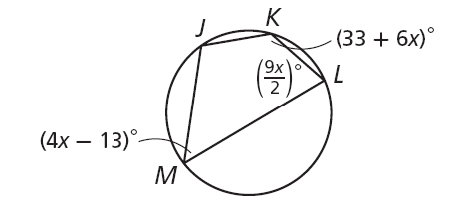
Check It Out! Example 4
Find the angle measures of JKLM.
Step 1 Find the value of b.
m∠M + m∠K = 180°
JKLM is inscribed in a .
4x – 13 + 33 + 6x = 180
Substitute the given values.
10x + 20 = 180
Simplify.
10x = 160
Subtract 20 from both sides.
x = 16
Divide both sides by 10.

Slide 24

Check It Out! Example 4 Continued
Find the angle measures of JKLM.
Step 2 Find the measure of each angle.
m∠M = 4(16) – 13 = 51°
m∠K = 33 + 6(16) = 129°
m∠J = 360° – 252° = 108°

Slide 25
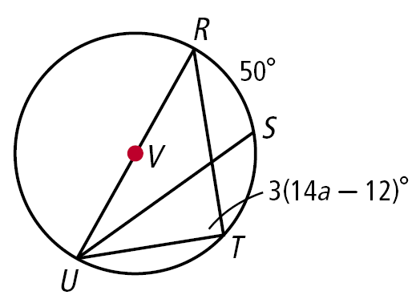
Lesson Quiz: Part I
Find each measure.
1. ∠RUS
2. a
25°
3

Slide 26
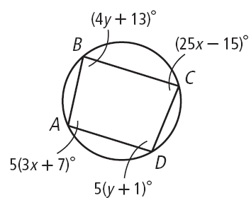
Lesson Quiz: Part II
3. A manufacturer designs a circular ornament with lines of glitter as shown. Find m∠KJN.
130°
4. Find the angle measures of ABCD.
m∠ A = 95°
m∠ B = 85°
m∠ C = 85°
m∠ D = 95°

