Slide 1

Reflections
Warm Up
Lesson Presentation
Lesson Quiz
Holt McDougal Geometry
Holt Geometry

Slide 2






Warm Up
Given that ∆ABC ≅ ∆DEF, identify a segment or angle congruent to each of the following.
1.
2.
3.
4.
5.
6.

Slide 3
Warm Up
Find the coordinates of the image of ∆ABC with vertices A(3, 4), B(–1, 4), and C(5, –2), after each reflection.
7. across the x-axis
A’(3, –4), B’(–1, –4), C’(5, 2)
8. across the y-axis
A’(–3, 4), B’(1, 4), C’(–5, –2)
9. across the line y = x
A’(4, 3), B’(4, –1), C’(–2, 5)

Slide 4
Objective
Identify and draw reflections.

Slide 5
Vocabulary
isometry

Slide 6
An isometry is a transformation that does not change the shape or size of a figure. Reflections, translations, and rotations are all isometries. Isometries are also called congruence transformations or rigid motions.
Recall that a reflection is a transformation that moves a figure (the preimage) by flipping it across a line. The reflected figure is called the image. A reflection is an isometry, so the image is always congruent to the preimage.

Slide 7


Example 1: Identifying Reflections
Tell whether each transformation appears to be a reflection. Explain.
A.
B.
No; the image does not
Appear to be flipped.
Yes; the image appears to be flipped across a line..

Slide 8
Remember!
To review basic transformations, see Lesson 1-7, pages 50–55.

Slide 9


Check It Out! Example 1
Tell whether each transformation appears to be a reflection.
a.
b.
No; the figure does not appear to be flipped.
Yes; the image appears to be flipped across a line.

Slide 10
Draw a segment from each vertex of the preimage to the corresponding vertex of the image. Your construction should show that the line of reflection is the perpendicular bisector of every segment connecting a point and its image.

Slide 11
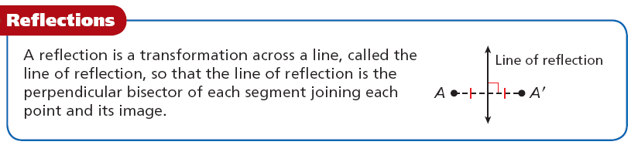

Slide 12
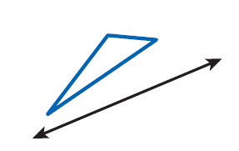
Example 2: Drawing Reflections
Copy the triangle and the line of reflection. Draw the reflection of the triangle across the line.
Step 1 Through each vertex draw a line perpendicular to the line of reflection.

Slide 13
Example 2 Continued
Step 2 Measure the distance from each vertex to the line of reflection. Locate the image of each vertex on the opposite side of the line of reflection and the same distance from it.

Slide 14
Example 2 Continued
Step 3 Connect the images of the vertices.

Slide 15
Check It Out! Example 2
Copy the quadrilateral and the line of reflection. Draw the reflection of the quadrilateral across the line.

Slide 16
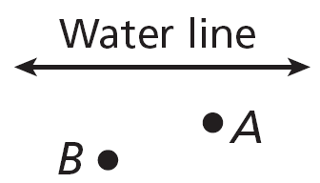


Example 3: Problem-Solving Application
Two buildings located at A and B are to be connected to the same point on the water line. Where should they connect so that the least amount of pipe will be used?
1
Understand the Problem
The problem asks you to locate point X on the water line so that AX + XB has the least value possible.

Slide 17


Example 3 Continued
2
Make a Plan
Let B’ be the reflection of point B across the water line. For any point X on the water line, so AX + XB = AX + XB’.
AX + XB’ is least when A, X, and B’ are collinear.

Slide 18


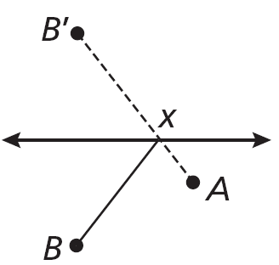
Example 3 Continued
3
Solve
Reflect B across the water line to locate B’.
Draw and locate X at the intersection of
and the water line.

Slide 19

Example 3 Continued
4
Look Back
To verify your answer, choose several possible locations for X and measure the total length of pipe for each location.

Slide 20


Check It Out! Example 3
What if…? If A and B were the same
distance from the river, what would be true about and ?
A
B
River
X
and
would be congruent.

Slide 21
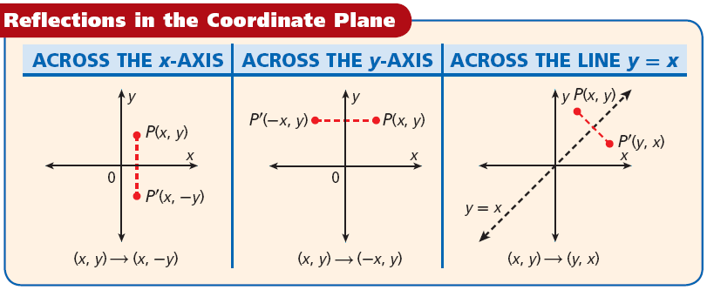

Slide 22
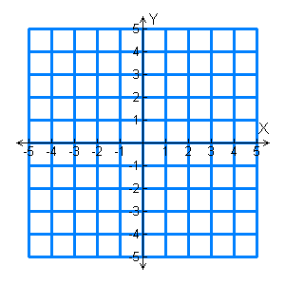
Example 4A: Drawing Reflections in the Coordinate Plane
Reflect the figure with the given vertices across the given line.
X(2, –1), Y(–4, –3), Z(3, 2); x-axis
The reflection of (x, y) is (x,–y).
Y’
X(2,–1) X’(2, 1)
Z
X’
Y(–4,–3) Y’(–4, 3)
X
Z(3, 2) Z’(3, –2)
Z’
Y
Graph the image and preimage.

Slide 23
Example 4B: Drawing Reflections in the Coordinate Plane
Reflect the figure with the given vertices across the given line.
R(–2, 2), S(5, 0), T(3, –1); y = x
S’
The reflection of (x, y) is (y, x).
R(–2, 2) R’(2, –2)
T’
R
S(5, 0) S’(0, 5)
T(3, –1) T’(–1, 3)
S
T
Graph the image and preimage.
R’

Slide 24
Check It Out! Example 4
Reflect the rectangle with vertices S(3, 4),
T(3, 1), U(–2, 1) and V(–2, 4) across the x-axis.
The reflection of (x, y) is (x,–y).
S(3, 4) S’(3, –4)
V
S
T(3, 1) T’(3, –1)
U(–2, 1) U’(–2, –1)
U
T
U’
T’
V(–2, 4) V’(–2, –4)
Graph the image and preimage.
V’
S’

Slide 25
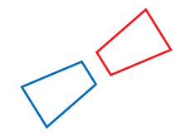
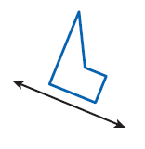
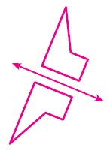
Lesson Quiz: Part I
1. Tell whether the transformation appears to be a reflection.
yes
2. Copy the figure and the line of reflection. Draw the reflection of the figure across the line.

Slide 26
Lesson Quiz: Part II
Reflect the figure with the given vertices across the given line.
3. A(2, 3), B(–1, 5), C(4,–1); y = x
A’(3, 2), B’(5,–1), C’(–1, 4)
4. U(–8, 2), V(–3, –1), W(3, 3); y-axis
U’(8, 2), V’(3, –1), W’(–3, 3)
5. E(–3, –2), F(6, –4), G(–2, 1); x-axis
E’(–3, 2), F’(6, 4), G’(–2, –1)

