Slide 1

Rotations
Warm Up
Lesson Presentation
Lesson Quiz
Holt McDougal Geometry
Holt Geometry

Slide 2

Warm Up
1. The translation image of P(–3, –1) is
P’(1, 3). Find the translation image of Q(2, –4).
Q’(6, 0)
Solve for x. Round to the nearest tenth.
2. cos 30°=
x ≈ 43.3
3. sin 30°=
x = 25

Slide 3
Objective
Identify and draw rotations.

Slide 4
Remember that a rotation is a transformation that turns a figure around a fixed point, called the center of rotation. A rotation is an isometry, so the image of a rotated figure is congruent to the preimage.

Slide 5
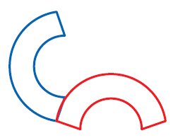

Example 1: Identifying Rotations
Tell whether each transformation appears to be a rotation. Explain.
A.
B.
No; the figure appears
to be flipped.
Yes; the figure appears
to be turned around a point.

Slide 6
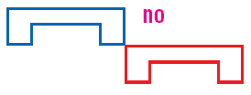

Check It Out! Example 1
Tell whether each transformation appears to be a rotation.
a.
b.
No, the figure appears to be a translation.
Yes, the figure appears to be turned around a point.

Slide 7
Draw a segment from each vertex to the center of rotation. Your construction should show that a point’s distance to the center of rotation is equal to its image’s distance to the center of rotation. The angle formed by a point, the center of rotation, and the point’s image is the angle by which the figure was rotated.

Slide 8
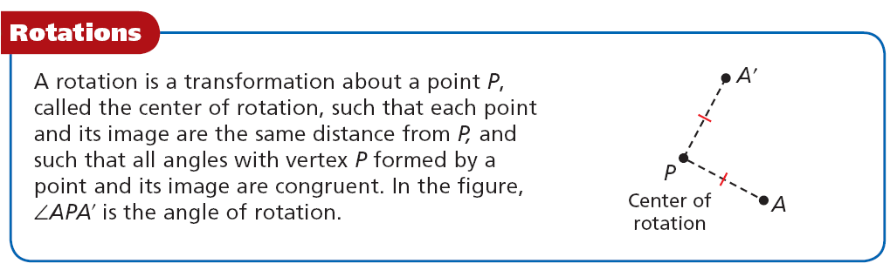

Slide 9
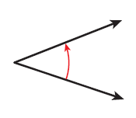
Example 2: Drawing Rotations
Copy the figure and the angle of rotation. Draw the rotation of the triangle about point Q by m∠A.
Q
A
Q
Step 1 Draw a segment from each vertex to point Q.

Slide 10
Example 2 Continued
Step 2 Construct an angle congruent to ∠A onto each segment. Measure the distance from each vertex to point Q and mark off this distance on the corresponding ray to locate the image of each vertex.
Q
Step 3 Connect the images of the vertices.
Q

Slide 11
Helpful Hint
Unless otherwise stated, all rotations in this book are counterclockwise.

Slide 12
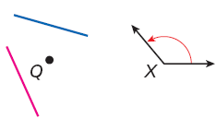

Check It Out! Example 2
Copy the figure and the angle of rotation. Draw the rotation of the segment about point Q by m∠X.
Step 1 Draw a line from each end of the segment to point Q.

Slide 13
Check It Out! Example 2 Continued
Step 2 Construct an angle congruent to ∠X on each segment. Measure the distance from each segment to point P and mark off this distance on the corresponding ray to locate the image of the new segment.
Step 3 Connect the image of the segment.

Slide 14
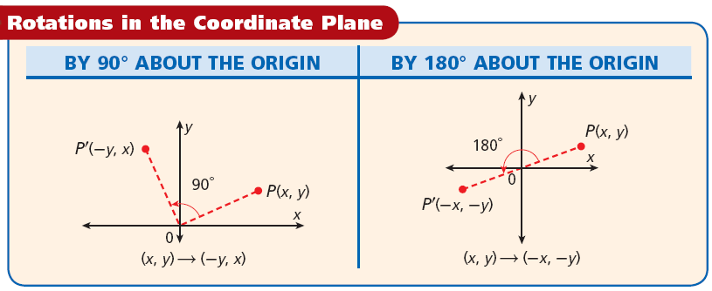
If the angle of a rotation in the coordinate plane is not a multiple of 90°, you can use sine and cosine ratios to find the coordinates of the image.

Slide 15
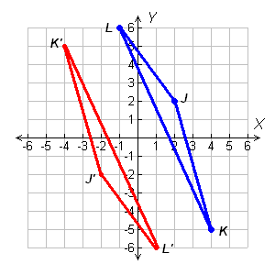
Example 3: Drawing Rotations in the Coordinate Plane
Rotate ΔJKL with vertices J(2, 2), K(4, –5), and L(–1, 6) by 180° about the origin.
The rotation of (x, y) is (–x, –y).
J(2, 2) J’(–2, –2)
K(4, –5) K’(–4, 5)
L(–1, 6) L’(1, –6)
Graph the preimage and image.

Slide 16
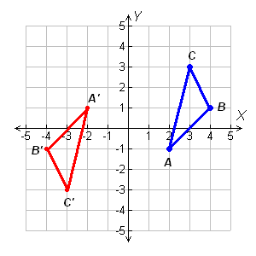
Check It Out! Example 3
Rotate ∆ABC by 180° about the origin.
The rotation of (x, y) is (–x, –y).
A(2, –1) A’(–2, 1)
B(4, 1) B’(–4, –1)
C(3, 3) C’(–3, –3)
Graph the preimage and image.

Slide 17


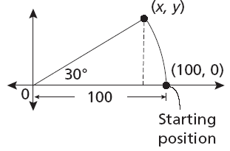
Example 4: Engineering Application
A Ferris wheel has a 100 ft diameter and takes 60 s to make a complete rotation. A chair starts at (100, 0). After 5 s, what are the coordinates of its location to the nearest tenth?
Step 1 Find the angle of rotation. Five seconds is
of a complete rotation, or 360° = 30°.
Step 2 Draw a right triangle to represent the car’s location (x, y) after a rotation of 30° about the origin.

Slide 18




Example 4 Continued
Step 3 Use the cosine ratio to find the x-coordinate.
cos 30° =
x = 100 cos 30° ≈ 86.6
Solve for x.
Step 4 Use the sine ratio to find the y-coordinate.
sin 30° =
y = 100 sin 30° = 50
Solve for y.
The chair’s location after 5 s is approximately (86.6, 50).

Slide 19


Check It Out! Example 4
The London Eye observation wheel has a radius of 67.5 m and takes 30 minutes to make a complete rotation. Find the coordinates of the observation car after 6 minutes. Round to the nearest tenth.
Step 1 find the angle of rotation. six minutes is
of a complete rotation, or 360° = 36°.
(x, y)
Step 2 Draw a right triangle to represent the car’s location (x, y) after a rotation of 36° about the origin.
•
67.5
36°
(67.5, 0)
•
0
67.5
Starting
position

Slide 20


Check It Out! Example 4
Step 3 Use the cosine ratio to find the x-coordinate.
cos 36° =
x = 67.5 cos 36° ≈ 20.9
Solve for x.
Step 4 Use the sine ratio to find the y-coordinate.
sin 36° =
y = 67.5 sin 36° = 64.2
Solve for y.
The chair’s location after 6 m is approximately (20.9, 64.2).

Slide 21

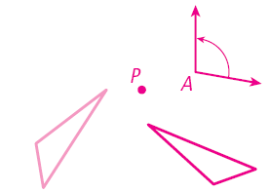
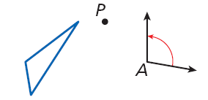
Lesson Quiz: Part I
1. Tell whether the transformation appears to be a rotation.
yes
2. Copy the figure and the angle of rotation. Draw the rotation of the triangle about P by ∠A.

Slide 22
Lesson Quiz: Part II
Rotate ∆RST with vertices R(–1, 4), S(2, 1), and T(3, –3) about the origin by the given angle.
3. 90°
R’(–4, –1), S’(–1, 2), T’(3, 3)
4. 180°
R’(1, –4), S’(–2, –1), T’(–3, 3)

