Slide 1

Transformations in the Coordinate Plane
Warm Up
Lesson Presentation
Lesson Quiz
Holt McDougal Geometry
Holt Geometry

Slide 2
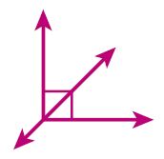
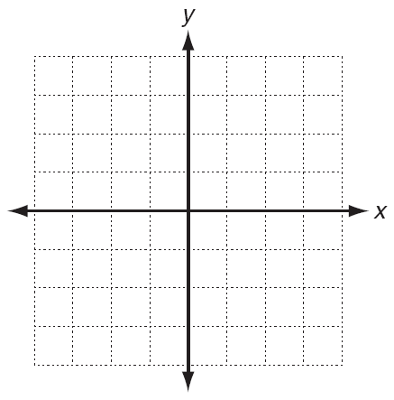
Warm Up
1. Draw a line that divides a right angle in half.
2. Draw three different squares with (3, 2) as one vertex.
3. Find the values of x and y if (3, –2) = (x + 1, y – 3)
x = 2; y = 1

Slide 3
Objectives
Identify reflections, rotations, and translations.
Graph transformations in the coordinate plane.

Slide 4
Vocabulary
transformation reflection
preimage rotation
image translation

Slide 5
The Alhambra, a 13th-century palace in Grenada, Spain, is famous for the geometric patterns that cover its walls and floors. To create a variety of designs, the builders based the patterns on several different transformations.
A transformation is a change in the position, size, or shape of a figure. The original figure is called the preimage. The resulting figure is called the image. A transformation maps the preimage to the image. Arrow notation (→) is used to describe a transformation, and primes (’) are used to label the image.

Slide 6
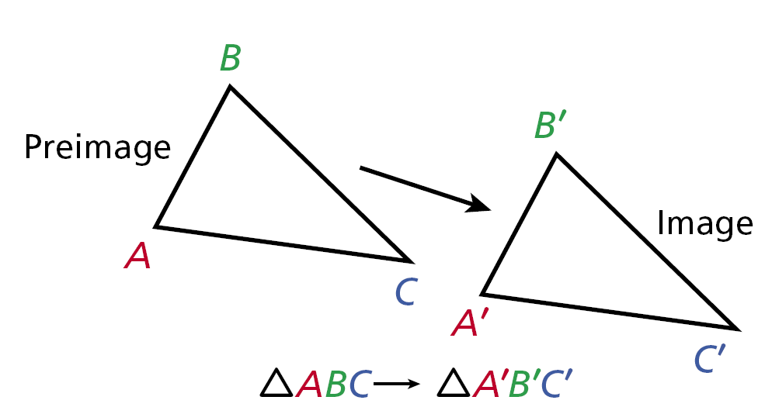

Slide 8
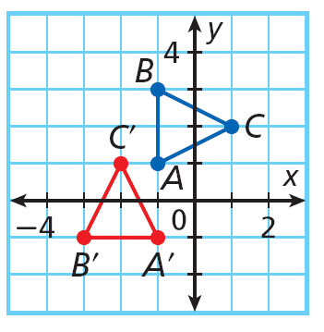
Example 1A: Identifying Transformation
Identify the transformation. Then use arrow notation to describe the transformation.
The transformation cannot
be a reflection because each
point and its image are not the same distance from a line of reflection.
90° rotation, ∆ABC → ∆A’B’C’

Slide 9
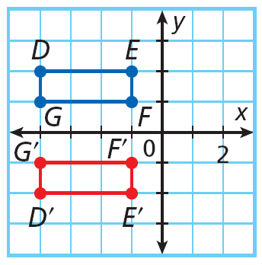
Example 1B: Identifying Transformation
Identify the transformation. Then use arrow notation to describe the transformation.
The transformation cannot be
a translation because each
point and its image are not in
the same relative position.
reflection, DEFG → D’E’F’G’

Slide 10
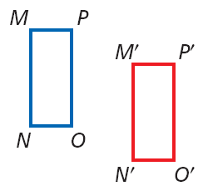
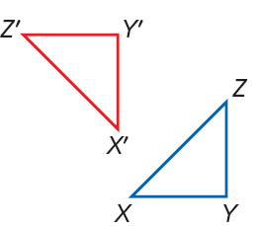
Check It Out! Example 1
Identify each transformation. Then use arrow notation to describe the transformation.
a.
b.
translation; MNOP → M’N’O’P’
rotation; ∆XYZ → ∆X’Y’Z’

Slide 11
Example 2: Drawing and Identifying Transformations
A figure has vertices at A(1, –1), B(2, 3), and C(4, –2). After a transformation, the image of the figure has vertices at A'(–1, –1), B'(–2, 3), and C'(–4, –2). Draw the preimage and image. Then identify the transformation.
Plot the points. Then use a straightedge to connect the vertices.
The transformation is a reflection across the y-axis because each point and its image are the same distance from the y-axis.

Slide 12
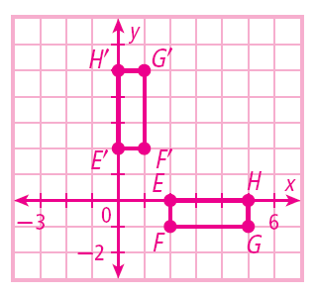
Check It Out! Example 2
A figure has vertices at E(2, 0), F(2, -1), G(5, -1), and H(5, 0). After a transformation, the image of the figure has vertices at E’(0, 2), F’(1, 2), G’(1, 5), and H’(0, 5). Draw the preimage and image. Then identify the transformation.
Plot the points. Then use a straightedge to connect the vertices.
The transformation is a 90° counterclockwise rotation.

Slide 13
To find coordinates for the image of a figure in a translation, add a to the
x-coordinates of the preimage and add b to the y-coordinates of the preimage.
Translations can also be described by a rule such as (x, y) → (x + a, y + b).

Slide 14
Example 3: Translations in the Coordinate Plane
Find the coordinates for the image of ∆ABC after the translation (x, y) → (x + 2, y - 1). Draw the image.
Step 1 Find the coordinates of
∆ABC.
The vertices of ∆ABC are A(–4, 2), B(–3, 4), C(–1, 1).

Slide 15
Example 3 Continued
Step 2 Apply the rule to find the vertices of the image.
A’(–4 + 2, 2 – 1) = A’(–2, 1)
B’(–3 + 2, 4 – 1) = B’(–1, 3)
C’(–1 + 2, 1 – 1) = C’(1, 0)
Step 3 Plot the points. Then finish drawing the image by using a straightedge to connect the vertices.

Slide 16
Check It Out! Example 3
Find the coordinates for the image of JKLM after the translation (x, y) → (x – 2, y + 4). Draw the image.
Step 1 Find the coordinates of
JKLM.
The vertices of JKLM are J(1, 1), K(3, 1), L(3, –4), M(1, –4), .

Slide 17
Check It Out! Example 3 Continued
Step 2 Apply the rule to find the vertices of the image.
J’(1 – 2, 1 + 4) = J’(–1, 5)
K’(3 – 2, 1 + 4) = K’(1, 5)
L’(3 – 2, –4 + 4) = L’(1, 0)
M’(1 – 2, –4 + 4) = M’(–1, 0)
J’
K’
M’
L’
Step 3 Plot the points. Then finish drawing the image by using a straightedge to connect the vertices.

Slide 18

Example 4: Art History Application
The figure shows part of a tile floor. Write a rule for the translation of hexagon 1 to hexagon 2.
Step 1 Choose two points.
Choose a Point A on the preimage and a corresponding Point A’ on the image. A has coordinate (2, –1) and A’ has
coordinates
A’
A

Slide 19
Example 4 Continued
The figure shows part of a tile floor. Write a rule for the translation of hexagon 1 to hexagon 2.
Step 2 Translate.
To translate A to A’, 2 units are subtracted from the x-coordinate and 1 units are added to the y-coordinate. Therefore, the translation rule is (x, y) → (x – 3, y + 1 ).
A’
A

Slide 20
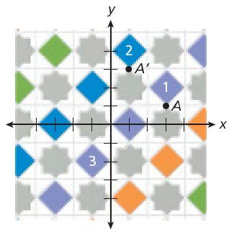
Check It Out! Example 4
Use the diagram to write a rule for the translation of square 1 to square 3.
Step 1 Choose two points.
Choose a Point A on the preimage and a corresponding Point A’ on the image. A has coordinate (3, 1) and A’ has coordinates (–1, –3).
A’

Slide 21
Check It Out! Example 4 Continued
Use the diagram to write a rule for the translation of square 1 to square 3.
Step 2 Translate.
To translate A to A’, 4 units are subtracted from the x-coordinate and 4 units are subtracted from the y-coordinate. Therefore, the translation rule is (x, y) → (x – 4, y – 4).
A’

Slide 22
Lesson Quiz: Part I
1. A figure has vertices at X(–1, 1), Y(1, 4), and
Z(2, 2). After a transformation, the image of the figure has vertices at X'(–3, 2), Y'(–1, 5), and Z'(0, 3). Draw the preimage and the image. Identify the transformation.
translation
2. What transformation is suggested by the wings of an airplane?
reflection

Slide 23
Lesson Quiz: Part II
3. Given points P(-2, -1) and Q(-1, 3), draw PQ and its reflection across the y-axis.
4. Find the coordinates of the image of F(2, 7) after the translation (x, y) → (x + 5, y – 6).
(7, 1)

