Slide 1

Operations with Complex Numbers
Warm Up
Lesson Presentation
Lesson Quiz
Holt McDougal Algebra 2
Holt Algebra 2

Slide 2











Warm Up
Express each number in terms of i.
1.
9i
2.
Find each complex conjugate.
3.
4.
Find each product.
5.
6.

Slide 3
Objective
Perform operations with complex numbers.

Slide 4
Vocabulary
complex plane
absolute value of a complex number

Slide 5

Just as you can represent real numbers graphically as points on a number line, you can represent complex numbers in a special coordinate plane.
The complex plane is a set of coordinate axes in which the horizontal axis represents real numbers and the vertical axis represents imaginary numbers.

Slide 6
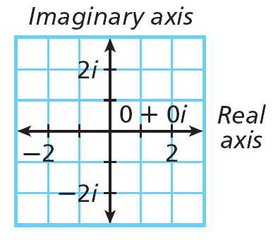
Helpful Hint
The real axis corresponds to the x-axis, and the imaginary axis corresponds to the y-axis. Think of a + bi as x + yi.

Slide 7
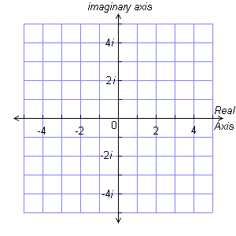
Example 1: Graphing Complex Numbers
Graph each complex number.
A. 2 – 3i
•
–1+ 4i
B. –1 + 4i
4 + i
•
C. 4 + i
•
–i
•
2 – 3i
D. –i

Slide 8
Check It Out! Example 1
Graph each complex number.
a. 3 + 0i
b. 2i
•
3 + 2i
2i
•
c. –2 – i
•
•
3 + 0i
–2 – i
d. 3 + 2i

Slide 9
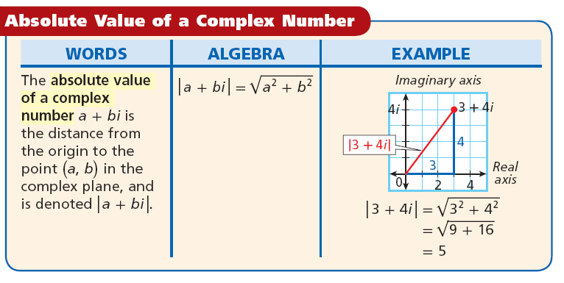
Recall that absolute value of a real number is its distance from 0 on the real axis, which is also a number line. Similarly, the absolute value of an imaginary number is its distance from 0 along the imaginary axis.

Slide 10







Example 2: Determining the Absolute Value of Complex Numbers
Find each absolute value.
A. |3 + 5i|
B. |–13|
C. |–7i|
|–13 + 0i|
|0 +(–7)i|
13
7

Slide 11









Check It Out! Example 2
Find each absolute value.
a. |1 – 2i|
b.
c. |23i|
|0 + 23i|
23

Slide 12
Adding and subtracting complex numbers is similar to adding and subtracting variable expressions with like terms. Simply combine the real parts, and combine the imaginary parts.
The set of complex numbers has all the properties of the set of real numbers. So you can use the Commutative, Associative, and Distributive Properties to simplify complex number expressions.

Slide 13
Helpful Hint
Complex numbers also have additive inverses. The additive inverse of a + bi is –(a + bi), or
–a – bi.

Slide 14
Example 3A: Adding and Subtracting Complex Numbers
Add or subtract. Write the result in the form a + bi.
(4 + 2i) + (–6 – 7i)
(4 – 6) + (2i – 7i)
Add real parts and imaginary parts.
–2 – 5i

Slide 15
Example 3B: Adding and Subtracting Complex Numbers
Add or subtract. Write the result in the form a + bi.
(5 –2i) – (–2 –3i)
(5 – 2i) + 2 + 3i
Distribute.
(5 + 2) + (–2i + 3i)
Add real parts and imaginary parts.
7 + i

Slide 16
Example 3C: Adding and Subtracting Complex Numbers
Add or subtract. Write the result in the form a + bi.
(1 – 3i) + (–1 + 3i)
(1 – 1) + (–3i + 3i)
Add real parts and imaginary parts.
0

Slide 17
Check It Out! Example 3a
Add or subtract. Write the result in the form a + bi.
(–3 + 5i) + (–6i)
(–3) + (5i – 6i)
Add real parts and imaginary parts.
–3 – i

Slide 18
Check It Out! Example 3b
Add or subtract. Write the result in the form a + bi.
2i – (3 + 5i)
(2i) – 3 – 5i
Distribute.
(–3) + (2i – 5i)
Add real parts and imaginary parts.
–3 – 3i

Slide 19
Check It Out! Example 3c
Add or subtract. Write the result in the form a + bi.
(4 + 3i) + (4 – 3i)
(4 + 4) + (3i – 3i)
Add real parts and imaginary parts.
8

Slide 20
You can also add complex numbers by using coordinate geometry.

Slide 21
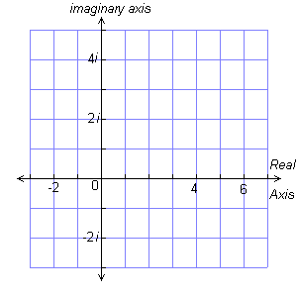
Example 4: Adding Complex Numbers on the Complex Plane
Find (3 – i) + (2 + 3i) by graphing.
Step 1 Graph 3 – i and
2 + 3i on the complex plane. Connect each of these numbers to the origin with a line segment.
2 + 3i
•
•
3 –i

Slide 22
Example 4 Continued
Find (3 – i) + (2 + 3i) by graphing.
Step 2 Draw a parallelogram that has these two line segments as sides. The vertex that is opposite the origin represents the sum of the two complex numbers, 5 + 2i. Therefore, (3 – i) + (2 + 3i) = 5 + 2i.
2 + 3i
•
•
5 +2i
•
3 –i

Slide 23
Example 4 Continued
Find (3 – i) + (2 + 3i) by graphing.
Check Add by combining the real parts and combining the imaginary parts.
(3 – i) + (2 + 3i) = (3 + 2) + (–i + 3i) = 5 + 2i

Slide 24
Check It Out! Example 4a
Find (3 + 4i) + (1 – 3i) by graphing.
3 + 4i
Step 1 Graph 3 + 4i and 1 – 3i on the complex plane. Connect each of these numbers to the origin with a line segment.
•
•
1 – 3i

Slide 25
Check It Out! Example 4a Continued
Find (3 + 4i) + (1 – 3i) by graphing.
Step 2 Draw a parallelogram that has these two line segments as sides. The vertex that is opposite the origin represents the sum of the two complex numbers,
4 + i. Therefore,(3 + 4i) + (1 – 3i) = 4 + i.
3 + 4i
•
•
4 + i
•
1 – 3i

Slide 26
Check It Out! Example 4a Continued
Find (3 + 4i) + (1 – 3i) by graphing.
Check Add by combining the real parts and combining the imaginary parts.
(3 + 4i) + (1 – 3i) = (3 + 1) + (4i – 3i) = 4 + i

Slide 27
Check It Out! Example 4b
Find (–4 – i) + (2 – 2i) by graphing.
Step 1 Graph –4 – i and 2 – 2i on the complex plane. Connect each of these numbers to the origin with a line segment.
•
–4 – i
2 – 2i
●
•
2 – 2i

Slide 28
Check It Out! Example 4b
Find (–4 – i) + (2 – 2i) by graphing.
Step 2 Draw a parallelogram that has these two line segments as sides. The vertex that is opposite represents the sum of the two complex numbers, –2 –3i. Therefore,(–4 – i) + (2 – 2i) = –2 – 3i.
•
–4 – i
•
2 – 2i
•
–2 – 3i

Slide 29
Check It Out! Example 4b
Find (–4 – i) + (2 – 2i) by graphing.
Check Add by combining the real parts and combining the imaginary parts.
(–4 – i) + (2 – 2i) = (–4 + 2) + (–i – 2i) = –2 – 3i

Slide 30
You can multiply complex numbers by using the Distributive Property and treating the imaginary parts as like terms. Simplify by using the fact i² = –1.

Slide 31
Example 5A: Multiplying Complex Numbers
Multiply. Write the result in the form a + bi.
–2i(2 – 4i)
–4i + 8i²
Distribute.
–4i + 8(–1)
Use i² = –1.
–8 – 4i
Write in a + bi form.

Slide 32
Example 5B: Multiplying Complex Numbers
Multiply. Write the result in the form a + bi.
(3 + 6i)(4 – i)
12 + 24i – 3i – 6i²
Multiply.
12 + 21i – 6(–1)
Use i² = –1.
18 + 21i
Write in a + bi form.

Slide 33
Example 5C: Multiplying Complex Numbers
Multiply. Write the result in the form a + bi.
(2 + 9i)(2 – 9i)
4 – 18i + 18i – 81i²
Multiply.
4 – 81(–1)
Use i² = –1.
85
Write in a + bi form.

Slide 34
Example 5D: Multiplying Complex Numbers
Multiply. Write the result in the form a + bi.
(–5i)(6i)
–30i²
Multiply.
–30(–1)
Use i² = –1
30
Write in a + bi form.

Slide 35
Check It Out! Example 5a
Multiply. Write the result in the form a + bi.
2i(3 – 5i)
6i – 10i²
Distribute.
6i – 10(–1)
Use i² = –1.
10 + 6i
Write in a + bi form.

Slide 36
Check It Out! Example 5b
Multiply. Write the result in the form a + bi.
(4 – 4i)(6 – i)
24 – 4i – 24i + 4i²
Distribute.
24 – 28i + 4(–1)
Use i² = –1.
20 – 28i
Write in a + bi form.

Slide 37
Check It Out! Example 5c
Multiply. Write the result in the form a + bi.
(3 + 2i)(3 – 2i)
9 + 6i – 6i – 4i²
Distribute.
9 – 4(–1)
Use i² = –1.
13
Write in a + bi form.

Slide 38
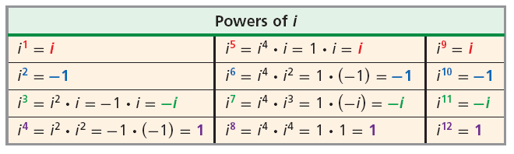
The imaginary unit i can be raised to higher powers as shown below.
Helpful Hint
Notice the repeating pattern in each row of the table. The pattern allows you to express any power of i as one of four possible values: i, –1,
–i, or 1.

Slide 39
Example 6A: Evaluating Powers of i
Simplify –6i¹⁴.
–6i¹⁴ = –6(i²)⁷
Rewrite i¹⁴ as a power of i².
= –6(–1)⁷
= –6(–1) = 6
Simplify.

Slide 40
Example 6B: Evaluating Powers of i
Simplify i⁶³.
i⁶³ = i • i⁶²
Rewrite as a product of i and an even power of i.
= i • (i²)³¹
Rewrite i⁶² as a power of i².
= i • (–1)³¹ = i • –1 = –i
Simplify.

Slide 41




Check It Out! Example 6a
Simplify .
Rewrite as a product of i and an even power of i.
Rewrite i⁶ as a power of i².
Simplify.

Slide 42
Check It Out! Example 6b
Simplify i⁴².
i⁴² = ( i²)²¹
Rewrite i⁴² as a power of i².
= (–1)²¹ = –1
Simplify.

Slide 43
Recall that expressions in simplest form cannot have square roots in the denominator (Lesson 1-3). Because the imaginary unit represents a square root, you must rationalize any denominator that contains an imaginary unit. To do this, multiply the numerator and denominator by the complex conjugate of the denominator.
Helpful Hint
The complex conjugate of a complex number
a + bi is a – bi. (Lesson 5-5)

Slide 44





Example 7A: Dividing Complex Numbers
Simplify.
Multiply by the conjugate.
Distribute.
Use i² = –1.
Simplify.

Slide 45





Example 7B: Dividing Complex Numbers
Simplify.
Multiply by the conjugate.
Distribute.
Use i² = –1.
Simplify.

Slide 46





Check It Out! Example 7a
Simplify.
Multiply by the conjugate.
Distribute.
Use i² = –1.
Simplify.

Slide 47





Check It Out! Example 7b
Simplify.
Multiply by the conjugate.
Distribute.
Use i² = –1.
Simplify.

Slide 48
Lesson Quiz: Part I
Graph each complex number.
1. –3 + 2i
2. 4 – 2i
–3 + 2i
•
4 – 2i
•

Slide 49


Lesson Quiz: Part II
3. Find |7 + 3i|.
Perform the indicated operation. Write the result in the form a + bi.
4. (2 + 4i) + (–6 – 4i)
–4
5. (5 – i) – (8 – 2i)
–3 + i
6. (2 + 5i)(3 – 2i)
7.
3 + i
16 + 11i
8. Simplify i³¹.
–i

