Slide 1

Compositions of Transformations
Warm Up
Lesson Presentation
Lesson Quiz
Holt McDougal Geometry
Holt Geometry

Slide 2
Warm Up
Determine the coordinates of the image of P(4, –7) under each transformation.
1. a translation 3 units left and 1 unit up
(1, –6)
2. a rotation of 90° about the origin
(7, 4)
3. a reflection across the y-axis
(–4, –7)

Slide 3
Objectives
Apply theorems about isometries.
Identify and draw compositions of transformations, such as glide reflections.

Slide 4
Vocabulary
composition of transformations
glide reflection

Slide 5
A composition of transformations is one transformation followed by another. For example, a glide reflection is the composition of a translation and a reflection across a line parallel to the translation vector.

Slide 6
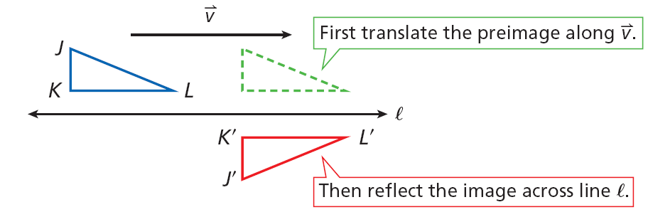
The glide reflection that maps ∆JKL to ∆J’K’L’ is the composition of a translation along followed by a reflection across line l.

Slide 7
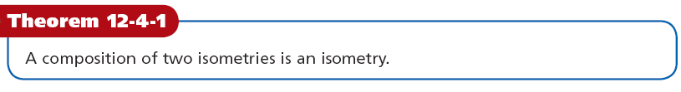
The image after each transformation is congruent to the previous image. By the Transitive Property of Congruence, the final image is congruent to the preimage. This leads to the following theorem.

Slide 8
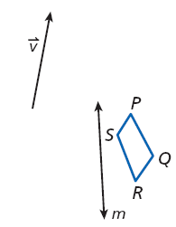
Example 1A: Drawing Compositions of Isometries
Draw the result of the composition of isometries.
Reflect PQRS across line m and then translate it along
Step 1 Draw P’Q’R’S’, the reflection image of PQRS.
P’
P
S’
S
Q’
Q
R’
R
m

Slide 9
Example 1A Continued
Step 2 Translate P’Q’R’S’ along to find the final image, P”Q”R”S”.
P’’
S’’
Q’’
R’’
P’
P
S’
S
Q’
Q
R’
R
m

Slide 10
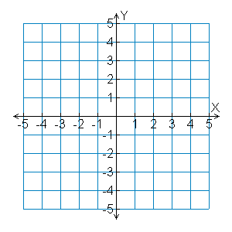
Example 1B: Drawing Compositions of Isometries
Draw the result of the composition of isometries.
∆KLM has vertices K(4, –1), L(5, –2), and M(1, –4). Rotate ∆KLM 180° about the origin and then reflect it across the y-axis.
K
L
M

Slide 11
Example 1B Continued
Step 1 The rotational image of (x, y) is (–x, –y).
M’
M”
K(4, –1) → K’(–4, 1),
L(5, –2) → L’(–5, 2), and
M(1, –4) → M’(–1, 4).
L’
L”
K’
K”
Step 2 The reflection image of (x, y) is (–x, y).
K
L
K’(–4, 1) → K”(4, 1),
L’(–5, 2) → L”(5, 2), and M’(–1, 4) → M”(1, 4).
M
Step 3 Graph the image and preimages.

Slide 12
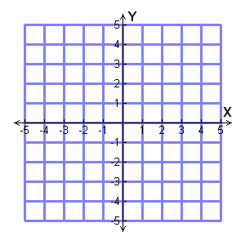
Check It Out! Example 1
∆JKL has vertices J(1,–2), K(4, –2), and L(3, 0). Reflect ∆JKL across the x-axis and then rotate it 180° about the origin.
L
J
K

Slide 13
Check It Out! Example 1 Continued
Step 1 The reflection image of (x, y) is (–x, y).
J(1, –2) J’(–1, –2), K(4, –2) K’(–4, –2), and L(3, 0) L’(–3, 0).
K”
J”
Step 2 The rotational image of (x, y) is (–x, –y).
L'’
L
L'
J’(–1, –2) J”(1, 2), K’(–4, –2) K”(4, 2), and L’(–3, 0) L”(3, 0).
J’
K’
J
K
Step 3 Graph the image and preimages.

Slide 14
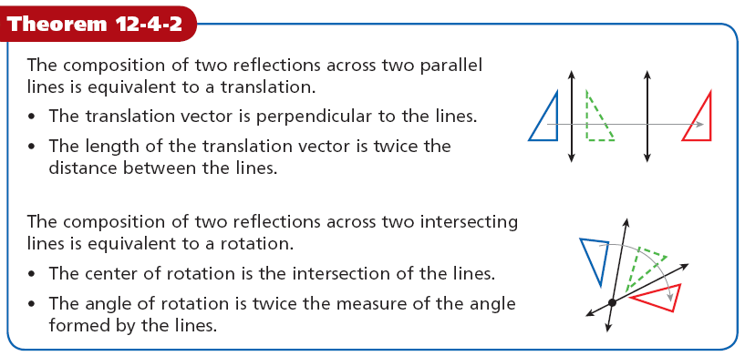

Slide 15
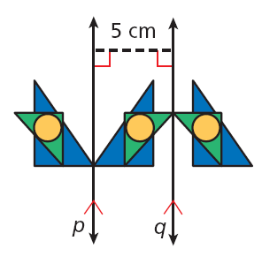
Example 2: Art Application
Sean reflects a design across line p and then reflects the image across line q. Describe a single transformation that moves the design from the original position to the final position.
By Theorem 12-4-2, the composition of two reflections across parallel lines is equivalent to a translation perpendicular to the lines. By Theorem 12-4-2, the translation vector is 2(5 cm) = 10 cm to the right.

Slide 16
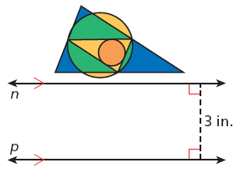
Check It Out! Example 2
What if…? Suppose Tabitha reflects the figure across line n and then the image across line p. Describe a single transformation that is equivalent to the two reflections.
A translation in direction to n and p, by distance of 6 in.

Slide 17
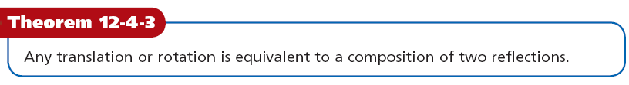

Slide 18
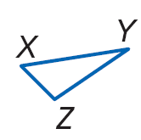
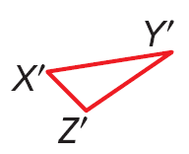
Example 3A: Describing Transformations in Terms of Reflections
Copy each figure and draw two lines of reflection that produce an equivalent transformation.
translation: ∆XYZ→ ∆X’Y’Z’.
Step 1 Draw YY’ and locate the midpoint M of YY’
M
Step 2 Draw the perpendicular bisectors of YM and Y’M.

Slide 19
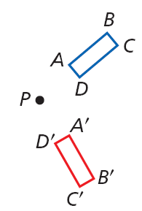
Example 3B: Describing Transformations in Terms of Reflections
Copy the figure and draw two lines of reflection that produce an equivalent transformation.
Rotation with center P;
ABCD → A’B’C’D’
Step 1 Draw ∠APA'. Draw the angle bisector PX
X
Step 2 Draw the bisectors of ∠APX and ∠A'PX.

Slide 20
Remember!
To draw the perpendicular bisector of a segment, use a ruler to locate the midpoint, and then use a right angle to draw a perpendicular line.

Slide 21
Check It Out! Example 3
Copy the figure showing the translation that maps LMNP → L’M’N’P’. Draw the lines of reflection that produce an equivalent transformation.
translation:
LMNP → L’M’N’P’
Step 1 Draw MM’ and locate the midpoint X of MM’
L
M
X
•
L’
M’
Step 2 Draw the perpendicular bisectors of MX and M’X.
P
N
P’
N’

Slide 22
Lesson Quiz: Part I
PQR has vertices P(5, –2), Q(1, –4), and P(–3, 3).
1. Translate ∆PQR along the vector <–2, 1> and then reflect it across the x-axis.
P”(3, 1), Q”(–1, –5), R”(–5, –4)
2. Reflect ∆PQR across the line y = x and then rotate it 90° about the origin.
P”(–5, –2), Q”(–1, 4), R”(3, 3)

Slide 23
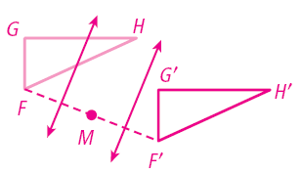
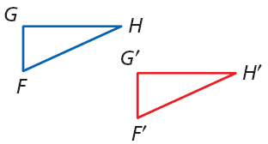
Lesson Quiz: Part II
3. Copy the figure and draw two lines of reflection that produce an equivalent transformation of the translation ∆FGH → ∆F’G’H’.

