Slide 1

Midpoint and Distance
in the Coordinate Plane
Warm Up
Lesson Presentation
Lesson Quiz
Holt McDougal Geometry
Holt Geometry

Slide 2

Warm Up
1. Graph A (–2, 3) and B (1, 0).
2. Find CD.
8
3. Find the coordinate of the midpoint of CD.
–2
4. Simplify.
4

Slide 3
Objectives
Develop and apply the formula for midpoint.
Use the Distance Formula and the Pythagorean Theorem to find the distance between two points.

Slide 4
Vocabulary
coordinate plane
leg
hypotenuse

Slide 5
A coordinate plane is a plane that is divided into four regions by a horizontal line (x-axis) and a vertical line (y-axis) . The location, or coordinates, of a point are given by an ordered pair (x, y).

Slide 6
You can find the midpoint of a segment by using the coordinates of its endpoints.
Calculate the average of the x-coordinates and the average of the y-coordinates of the endpoints.

Slide 7
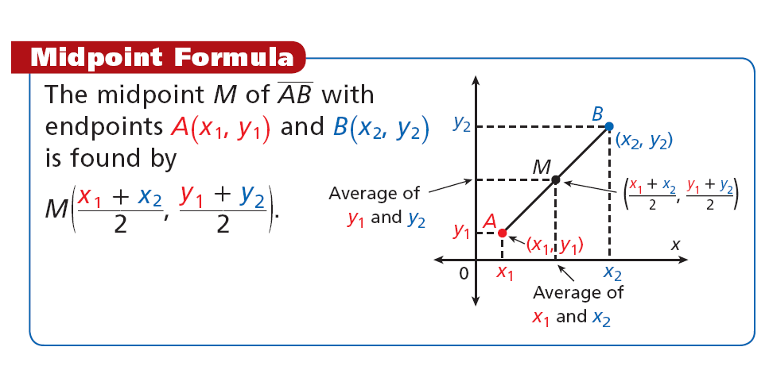

Slide 8
Helpful Hint
To make it easier to picture the problem, plot the segment’s endpoints on a coordinate plane.

Slide 9

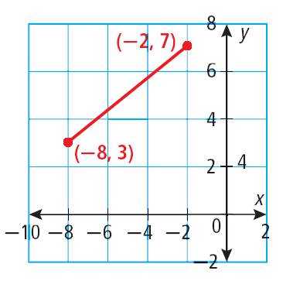

Example 1: Finding the Coordinates of a Midpoint
Find the coordinates of the midpoint of PQ with endpoints P(–8, 3) and Q(–2, 7).
= (–5, 5)

Slide 10
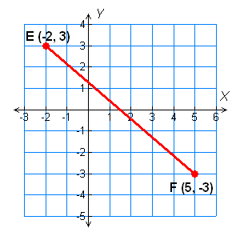

Check It Out! Example 1
Find the coordinates of the midpoint of EF with endpoints E(–2, 3) and F(5, –3).

Slide 11

Example 2: Finding the Coordinates of an Endpoint
M is the midpoint of XY. X has coordinates (2, 7) and M has coordinates (6, 1). Find the coordinates of Y.
Step 1 Let the coordinates of Y equal (x, y).
Step 2 Use the Midpoint Formula:

Slide 12




Example 2 Continued
Step 3 Find the x-coordinate.
Set the coordinates equal.
Multiply both sides by 2.
12 = 2 + x
Simplify.
2 = 7 + y
– 2
–2
Subtract.
– 7
–7
–5 = y
10 = x
Simplify.
The coordinates of Y are (10, –5).

Slide 13

Check It Out! Example 2
S is the midpoint of RT. R has coordinates (–6, –1), and S has coordinates (–1, 1). Find the coordinates of T.
Step 1 Let the coordinates of T equal (x, y).
Step 2 Use the Midpoint Formula:

Slide 14




Check It Out! Example 2 Continued
Step 3 Find the x-coordinate.
Set the coordinates equal.
Multiply both sides by 2.
–2 = –6 + x
Simplify.
2 = –1 + y
+ 6
+6
Add.
+ 1
+ 1
4 = x
Simplify.
3 = y
The coordinates of T are (4, 3).

Slide 15
The Ruler Postulate can be used to find the distance between two points on a number line. The Distance Formula is used to calculate the distance between two points in a coordinate plane.

Slide 16
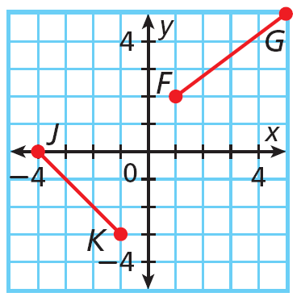
Example 3: Using the Distance Formula
Find FG and JK.
Then determine whether FG ≅ JK.
Step 1 Find the coordinates of each point.
F(1, 2), G(5, 5), J(–4, 0), K(–1, –3)

Slide 17








Example 3 Continued
Step 2 Use the Distance Formula.

Slide 18
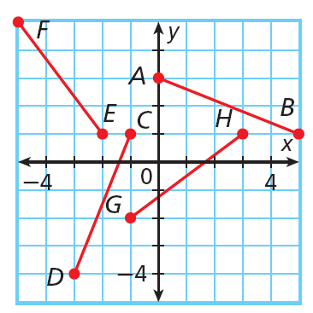
Check It Out! Example 3
Find EF and GH. Then determine if EF ≅ GH.
Step 1 Find the coordinates of each point.
E(–2, 1), F(–5, 5), G(–1, –2), H(3, 1)

Slide 19




Check It Out! Example 3 Continued
Step 2 Use the Distance Formula.

Slide 20
You can also use the Pythagorean Theorem to find the distance between two points in a coordinate plane. You will learn more about the Pythagorean Theorem in Chapter 5.
In a right triangle, the two sides that form the right angle are the legs. The side across from the right angle that stretches from one leg to the other is the hypotenuse. In the diagram, a and b are the lengths of the shorter sides, or legs, of the right triangle. The longest side is called the hypotenuse and has length c.

Slide 21
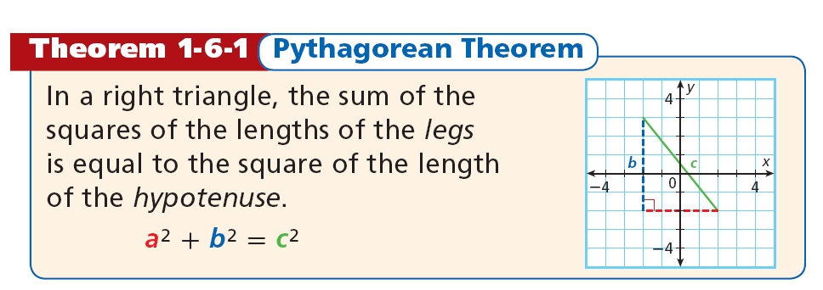

Slide 22
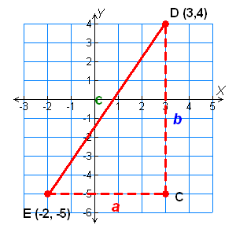
Example 4: Finding Distances in the Coordinate Plane
Use the Distance Formula and the Pythagorean Theorem to find the distance, to the nearest tenth, from D(3, 4) to E(–2, –5).

Slide 23






Example 4 Continued
Method 1
Use the Distance Formula. Substitute the
values for the coordinates of D and E into the
Distance Formula.

Slide 24

Example 4 Continued
Method 2
Use the Pythagorean Theorem. Count the units for sides a and b.
a = 5 and b = 9.
c² = a² + b²
= 5² + 9²
= 25 + 81
= 106
c = 10.3

Slide 25
Check It Out! Example 4a
Use the Distance Formula and the Pythagorean Theorem to find the distance, to the nearest tenth, from R to S.
R(3, 2) and S(–3, –1)
Method 1
Use the Distance Formula. Substitute the
values for the coordinates of R and S into the
Distance Formula.

Slide 26
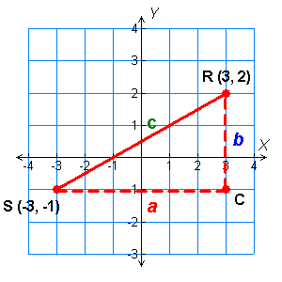



Check It Out! Example 4a Continued
Use the Distance Formula and the Pythagorean Theorem to find the distance, to the nearest tenth, from R to S.
R(3, 2) and S(–3, –1)

Slide 27

Check It Out! Example 4a Continued
Method 2
Use the Pythagorean Theorem. Count the units for sides a and b.
a = 6 and b = 3.
c² = a² + b²
= 6² + 3²
= 36 + 9
= 45

Slide 28
Check It Out! Example 4b
Use the Distance Formula and the Pythagorean Theorem to find the distance, to the nearest tenth, from R to S.
R(–4, 5) and S(2, –1)
Method 1
Use the Distance Formula. Substitute the
values for the coordinates of R and S into the
Distance Formula.

Slide 29
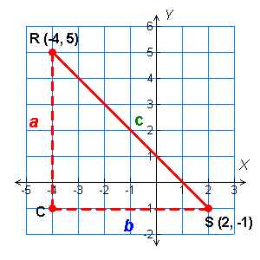



Check It Out! Example 4b Continued
Use the Distance Formula and the Pythagorean Theorem to find the distance, to the nearest tenth, from R to S.
R(–4, 5) and S(2, –1)

Slide 30

Check It Out! Example 4b Continued
Method 2
Use the Pythagorean Theorem. Count the units for sides a and b.
a = 6 and b = 6.
c² = a² + b²
= 6² + 6²
= 36 + 36
= 72

Slide 31
Example 5: Sports Application
A player throws the ball from first base to a point located between third base and home plate and 10 feet from third base.
What is the distance of the throw, to the nearest tenth?

Slide 32






Example 5 Continued
Set up the field on a coordinate plane so that home plate H is at the origin, first base F has coordinates
(90, 0), second base S has coordinates (90, 90), and third base T has coordinates (0, 90).
The target point P of the throw has coordinates (0, 80). The distance of the throw is FP.

Slide 33



Check It Out! Example 5
The center of the pitching mound has coordinates (42.8, 42.8). When a pitcher throws the ball from the center of the mound to home plate, what is the distance of the throw, to the nearest tenth?
≈ 60.5 ft

Slide 34
Lesson Quiz: Part I
1. Find the coordinates of the midpoint of MN with endpoints M(-2, 6) and N(8, 0).
(3, 3)
2. K is the midpoint of HL. H has coordinates (1, –7), and K has coordinates (9, 3). Find the coordinates of L.
(17, 13)
3. Find the distance, to the nearest tenth, between S(6, 5) and T(–3, –4).
12.7
4. The coordinates of the vertices of ∆ABC are A(2, 5), B(6, –1), and C(–4, –2). Find the perimeter of ∆ABC, to the nearest tenth.
26.5

Slide 35

Lesson Quiz: Part II
5. Find the lengths of AB and CD and determine whether they are congruent.

