Slide 1

Properties of Quadratic Functions in Standard Form
Warm Up
Lesson Presentation
Lesson Quiz
Holt McDougal Algebra 2
Holt Algebra 2

Slide 2
Warm Up
Give the coordinate of the vertex of each function.
1. f(x) = (x – 2)² + 3
(2, 3)
2. f(x) = 2(x + 1)² – 4
(–1,–4)
3. Give the domain and range of the following function.
{(–2, 4), (0, 6), (2, 8), (4, 10)}
D:{–2, 0, 2, 4}; R:{4, 6, 8, 10}

Slide 3
Objectives
Define, identify, and graph quadratic functions.
Identify and use maximums and minimums of quadratic functions to solve problems.

Slide 4
Vocabulary
axis of symmetry
standard form
minimum value
maximum value

Slide 5
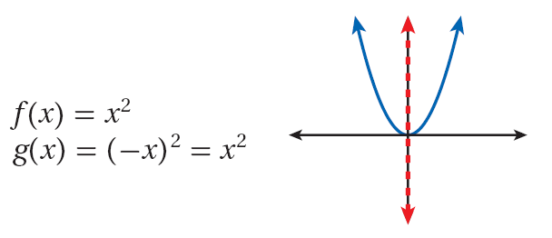
When you transformed quadratic functions in the previous lesson, you saw that reflecting the parent function across the y-axis results in the same function.

Slide 6
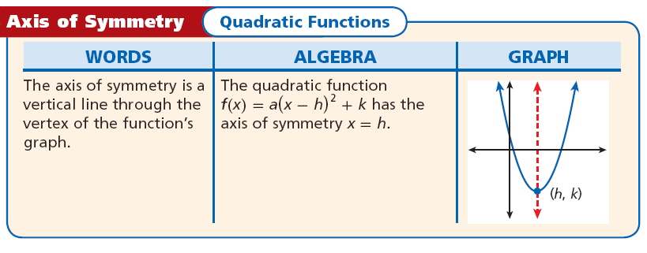
This shows that parabolas are symmetric curves. The axis of symmetry is the line through the vertex of a parabola that divides the parabola into two congruent halves.

Slide 7


Example 1: Identifying the Axis of Symmetry
Identify the axis of symmetry for the graph of
.
Rewrite the function to find the value of h.
Because h = –5, the axis of symmetry is the vertical line x = –5.

Slide 8
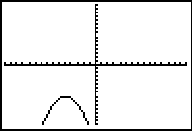
Example 1 Continued
Check
Analyze the graph on a graphing calculator. The parabola is symmetric about the vertical line x = –5.

Slide 9
Check It Out! Example1
Identify the axis of symmetry for the graph of
Rewrite the function to find the value of h.
f(x) = [x - (3)]² + 1
Because h = 3, the axis of symmetry is the vertical line x = 3.

Slide 10
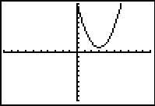
Check It Out! Example1 Continued
Check Analyze the graph on a graphing calculator. The parabola is symmetric about the vertical line x = 3.

Slide 11
Another useful form of writing quadratic functions is the standard form. The standard form of a quadratic function is f(x)= ax² + bx + c, where a ≠ 0.
The coefficients a, b, and c can show properties of the graph of the function. You can determine these properties by expanding the vertex form.
f(x)= a(x – h)² + k
f(x)= a(x² – 2xh +h²) + k
Multiply to expand (x – h)².
f(x)= a(x²) – a(2hx) + a(h²) + k
Distribute a.
f(x)= ax² + (–2ah)x + (ah² + k)
Simplify and group terms.

Slide 12
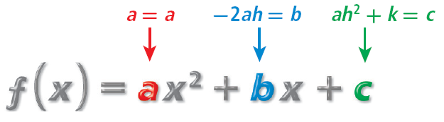
a in standard form is the same as in vertex form. It indicates whether a reflection and/or vertical stretch or compression has been applied.
a = a

Slide 13


Solving for h gives . Therefore, the axis of symmetry, x = h, for a quadratic function in standard form is .
b =–2ah

Slide 14
Notice that the value of c is the same value given by the vertex form of f when x = 0: f(0) = a(0 – h)² + k = ah² + k. So c is the y-intercept.
c = ah² + k

Slide 15
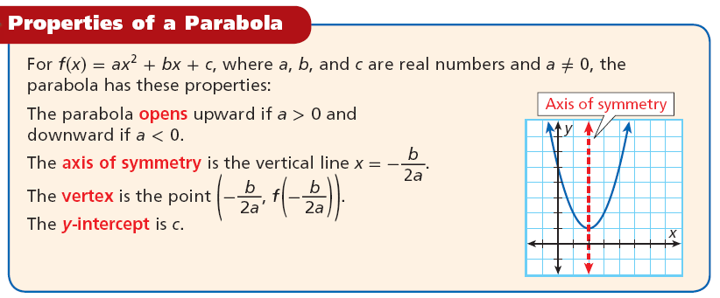
These properties can be generalized to help you graph quadratic functions.

Slide 16
Helpful Hint
When a is positive, the parabola is happy (U). When the a negative, the parabola is sad ( ).
U

Slide 17


Example 2A: Graphing Quadratic Functions in Standard Form
Consider the function f(x) = 2x² – 4x + 5.
a. Determine whether the graph opens upward or downward.
Because a is positive, the parabola opens upward.
b. Find the axis of symmetry.
The axis of symmetry is given by .
Substitute –4 for b and 2 for a.
The axis of symmetry is the line x = 1.

Slide 18
Example 2A: Graphing Quadratic Functions in Standard Form
Consider the function f(x) = 2x² – 4x + 5.
c. Find the vertex.
The vertex lies on the axis of symmetry, so the
x-coordinate is 1. The y-coordinate is the value of the function at this x-value, or f(1).
f(1) = 2(1)² – 4(1) + 5 = 3
The vertex is (1, 3).
d. Find the y-intercept.
Because c = 5, the intercept is 5.

Slide 19
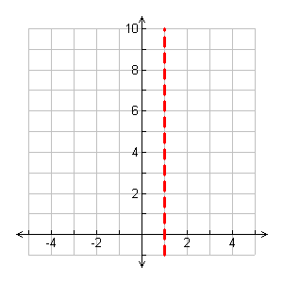
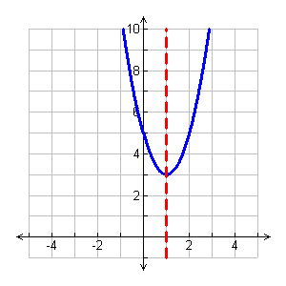
Example 2A: Graphing Quadratic Functions in Standard Form
Consider the function f(x) = 2x² – 4x + 5.
e. Graph the function.
Graph by sketching the axis of symmetry and then plotting the vertex and the intercept point
(0, 5). Use the axis of symmetry to find another point on the parabola. Notice that (0, 5) is 1 unit left of the axis of symmetry. The point on the parabola symmetrical to (0, 5) is 1 unit to the right of the axis at (2, 5).

Slide 20

Example 2B: Graphing Quadratic Functions in Standard Form
Consider the function f(x) = –x² – 2x + 3.
a. Determine whether the graph opens upward or downward.
Because a is negative, the parabola opens downward.
b. Find the axis of symmetry.
The axis of symmetry is given by .
Substitute –2 for b and –1 for a.
The axis of symmetry is the line x = –1.

Slide 21
Example 2B: Graphing Quadratic Functions in Standard Form
Consider the function f(x) = –x² – 2x + 3.
c. Find the vertex.
The vertex lies on the axis of symmetry, so the x-coordinate is –1. The y-coordinate is the value of the function at this x-value, or f(–1).
f(–1) = –(–1)² – 2(–1) + 3 = 4
The vertex is (–1, 4).
d. Find the y-intercept.
Because c = 3, the y-intercept is 3.

Slide 22
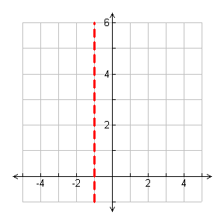
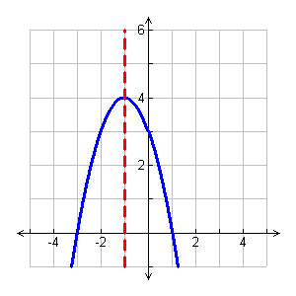
Example 2B: Graphing Quadratic Functions in Standard Form
Consider the function f(x) = –x² – 2x + 3.
e. Graph the function.
Graph by sketching the axis of symmetry and then plotting the vertex and the intercept point
(0, 3). Use the axis of symmetry to find another point on the parabola. Notice that (0, 3) is 1 unit right of the axis of symmetry. The point on the parabola symmetrical to (0, 3) is 1 unit to the left of the axis at (–2, 3).

Slide 23

Check It Out! Example 2a
For the function, (a) determine whether the graph opens upward or downward, (b) find the axis of symmetry, (c) find the vertex, (d) find the y-intercept, and (e) graph the function.
f(x)= –2x² – 4x
a. Because a is negative, the parabola opens downward.
b. The axis of symmetry is given by .
Substitute –4 for b and –2 for a.
The axis of symmetry is the line x = –1.

Slide 24
Check It Out! Example 2a
f(x)= –2x² – 4x
c. The vertex lies on the axis of symmetry, so the
x-coordinate is –1. The y-coordinate is the value
of the function at this x-value, or f(–1).
f(–1) = –2(–1)² – 4(–1) = 2
The vertex is (–1, 2).
d. Because c is 0, the y-intercept is 0.

Slide 25
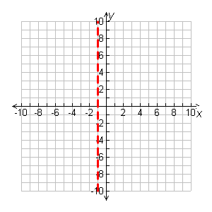
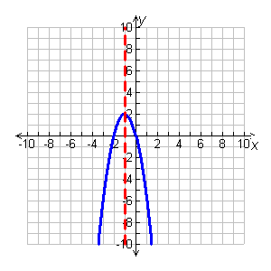
Check It Out! Example 2a
f(x)= –2x² – 4x
e. Graph the function.
Graph by sketching the axis of symmetry and then plotting the vertex and the intercept point
(0, 0). Use the axis of symmetry to find another point on the parabola. Notice that (0, 0) is 1 unit right of the axis of symmetry. The point on the parabola symmetrical to (0,0) is
1 unit to the left of the axis at
(0, –2).

Slide 26


Check It Out! Example 2b
For the function, (a) determine whether the graph opens upward or downward, (b) find the axis of symmetry, (c) find the vertex, (d) find the y-intercept, and (e) graph the function.
g(x)= x² + 3x – 1.
a. Because a is positive, the parabola opens upward.
b. The axis of symmetry is given by .
Substitute 3 for b and 1 for a.
The axis of symmetry is the line .

Slide 27



Check It Out! Example 2b
g(x)= x² + 3x – 1
c. The vertex lies on the axis of symmetry, so the
x-coordinate is . The y-coordinate is the value
of the function at this x-value, or f( ).
f( ) = ( )² + 3( ) – 1 =
The vertex is ( , ).
d. Because c = –1, the intercept is –1.

Slide 28
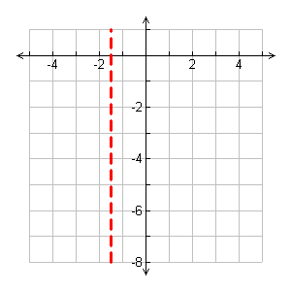
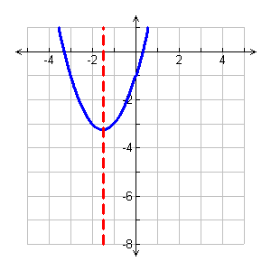
Check It Out! Example2
e. Graph the function.
Graph by sketching the axis of symmetry and then plotting the vertex and the intercept point
(0, –1). Use the axis of symmetry
to find another point on the parabola. Notice that (0, –1) is 1.5 units right of the axis of symmetry. The point on the parabola symmetrical to (0, –1) is 1.5 units to the left of the axis at (–3, –1).

Slide 29
Substituting any real value of x into a quadratic equation results in a real number. Therefore, the domain of any quadratic function is all real numbers. The range of a quadratic function depends on its vertex and the direction that the parabola opens.

Slide 30
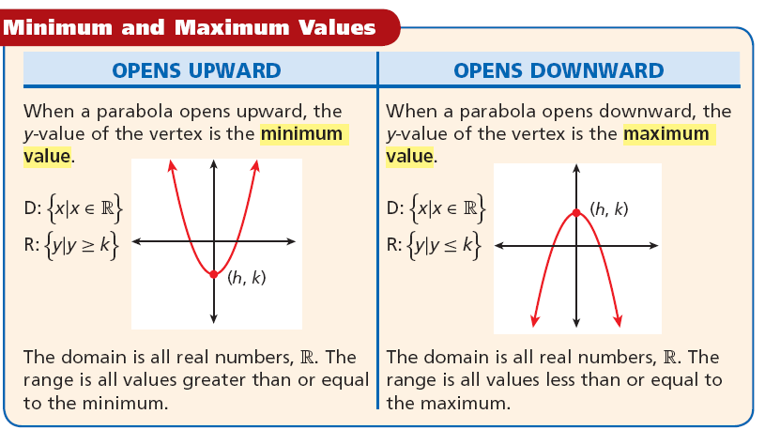

Slide 31
Caution!
The minimum (or maximum) value is the y-value at the vertex. It is not the ordered pair that represents the vertex.

Slide 32

Example 3: Finding Minimum or Maximum Values
Find the minimum or maximum value of
f(x) = –3x² + 2x – 4. Then state the domain and range of the function.
Step 1 Determine whether the function has minimum
or maximum value.
Because a is negative, the graph opens downward and has a maximum value.
Step 2 Find the x-value of the vertex.
Substitute 2 for b and –3 for a.

Slide 33




Example 3 Continued
Find the minimum or maximum value of
f(x) = –3x² + 2x – 4. Then state the domain and range of the function.
Step 3 Then find the y-value of the vertex,
The maximum value is . The domain is all real numbers, R. The range is all real numbers less than or equal to

Slide 34
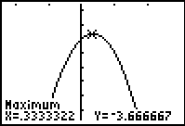
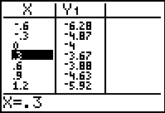
Example 3 Continued
Check
Graph f(x)=–3x² + 2x – 4 on a graphing calculator. The graph and table support the answer.

Slide 35

Check It Out! Example 3a
Find the minimum or maximum value of
f(x) = x² – 6x + 3. Then state the domain and range of the function.
Step 1 Determine whether the function has minimum
or maximum value.
Because a is positive, the graph opens upward and has a minimum value.
Step 2 Find the x-value of the vertex.

Slide 36
Check It Out! Example 3a Continued
Find the minimum or maximum value of
f(x) = x² – 6x + 3. Then state the domain and range of the function.
Step 3 Then find the y-value of the vertex,
f(3) = (3)² – 6(3) + 3 = –6
The minimum value is –6. The domain is all real numbers, R. The range is all real numbers greater than or equal to –6, or {y|y ≥ –6}.

Slide 37
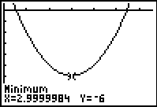
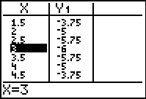
Check It Out! Example 3a Continued
Check
Graph f(x)=x² – 6x + 3 on a graphing calculator. The graph and table support the answer.

Slide 38

Check It Out! Example 3b
Find the minimum or maximum value of
g(x) = –2x² – 4. Then state the domain and range of the function.
Step 1 Determine whether the function has minimum
or maximum value.
Because a is negative, the graph opens downward and has a maximum value.
Step 2 Find the x-value of the vertex.

Slide 39
Check It Out! Example 3b Continued
Find the minimum or maximum value of
g(x) = –2x² – 4. Then state the domain and range of the function.
Step 3 Then find the y-value of the vertex,
f(0) = –2(0)² – 4 = –4
The maximum value is –4. The domain is all real numbers, R. The range is all real numbers less than or equal to –4, or
{y|y ≤ –4}.

Slide 40
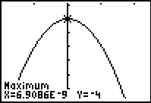
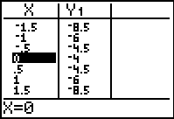
Check It Out! Example 3b Continued
Check
Graph f(x)=–2x² – 4 on a graphing calculator. The graph and table support the answer.

Slide 41
Example 4: Agricultural Application
The average height h in centimeters of a certain type of grain can be modeled by the function h(r) = 0.024r² – 1.28r + 33.6, where r is the distance in centimeters between the rows in which the grain is planted. Based on this model, what is the minimum average height of the grain, and what is the row spacing that results in this height?

Slide 42
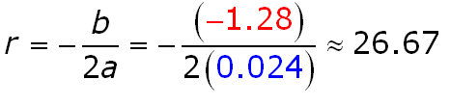
Example 4 Continued
The minimum value will be at the vertex (r, h(r)).
Step 1 Find the r-value of the vertex using
a = 0.024 and b = –1.28.

Slide 43
Example 4 Continued
Step 2 Substitute this r-value into h to find the
corresponding minimum, h(r).
h(r) = 0.024r² – 1.28r + 33.6
Substitute 26.67 for r.
h(26.67) = 0.024(26.67)² – 1.28(26.67) + 33.6
h(26.67) ≈ 16.5
Use a calculator.
The minimum height of the grain is about 16.5 cm planted at 26.7 cm apart.

Slide 44
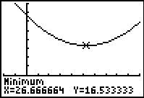
Check Graph the function on a graphing calculator. Use the MINIMUM feature under the CALCULATE menu to approximate the minimum. The graph supports the answer.

Slide 45
Check It Out! Example 4
The highway mileage m in miles per gallon for a compact car is approximately by
m(s) = –0.025s² + 2.45s – 30, where s is the speed in miles per hour. What is the maximum mileage for this compact car to the nearest tenth of a mile per gallon? What speed results in this mileage?

Slide 46
Check It Out! Example 4 Continued
The maximum value will be at the vertex (s, m(s)).
Step 1 Find the s-value of the vertex using
a = –0.025 and b = 2.45.
b
(
2.45
)
s
= −
= −
(
)
=
49
2
a
2
−
0.02
5

Slide 47
Check It Out! Example 4 Continued
Step 2 Substitute this s-value into m to find the corresponding maximum, m(s).
m(s) = –0.025s² + 2.45s – 30
Substitute 49 for r.
m(49) = –0.025(49)² + 2.45(49) – 30
m(49) ≈ 30
Use a calculator.
The maximum mileage is 30 mi/gal at 49 mi/h.

Slide 48
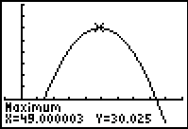
Check It Out! Example 4 Continued
Check Graph the function on a graphing calculator. Use the MAXIMUM feature under the CALCULATE menu to approximate the MAXIMUM. The graph supports the answer.

Slide 49
Lesson Quiz: Part I
Consider the function f(x)= 2x² + 6x – 7.
1. Determine whether the graph opens upward or
downward.
2. Find the axis of symmetry.
3. Find the vertex.
4. Identify the maximum or minimum value of the
function.
5. Find the y-intercept.
upward
x = –1.5
(–1.5, –11.5)
min.: –11.5
–7

Slide 50
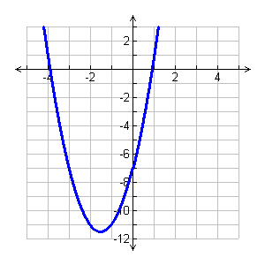
Lesson Quiz: Part II
Consider the function f(x)= 2x² + 6x – 7.
6. Graph the function.
7. Find the domain and
range of the function.
D: All real numbers; R {y|y ≥ –11.5}

