Slide 1

Circles in the Coordinate Plane
Warm Up
Lesson Presentation
Lesson Quiz
Holt McDougal Geometry
Holt Geometry

Slide 2
Warm Up
Use the Distance Formula to find the distance, to the nearest tenth, between each pair of points.
1. A(6, 2) and D(–3, –2)
2. C(4, 5) and D(0, 2)
3. V(8, 1) and W(3, 6)
9.8
5
7.1
4. Fill in the table of values for the equation
y = x – 14.

Slide 3
Objectives
Write equations and graph circles in the coordinate plane.
Use the equation and graph of a circle to solve problems.

Slide 4
The equation of a circle is based on the Distance Formula and the fact that all points on a circle are equidistant from the center.

Slide 5
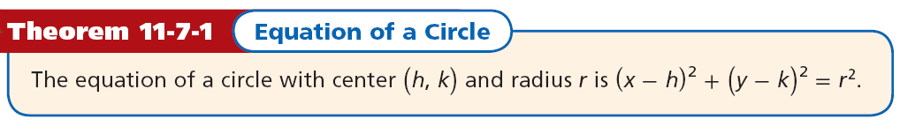

Slide 6
Example 1A: Writing the Equation of a Circle
Write the equation of each circle.
J with center J (2, 2) and radius 4
(x – h)² + (y – k)² = r²
Equation of a circle
(x – 2)² + (y – 2)² = 4²
Substitute 2 for h, 2 for k, and 4 for r.
(x – 2)² + (y – 2)² = 16
Simplify.

Slide 7


Example 1B: Writing the Equation of a Circle
Write the equation of each circle.
K that passes through J(6, 4) and has center K(1, –8)
Distance formula.
Simplify.
Substitute 1 for h, –8 for k, and 13 for r.
(x – 1)² + (y – (–8))² = 13²
(x – 1)² + (y + 8)² = 169
Simplify.

Slide 8
Check It Out! Example 1a
Write the equation of each circle.
P with center P(0, –3) and radius 8
(x – h)² + (y – k)² = r²
Equation of a circle
(x – 0)² + (y – (–3))² = 8²
Substitute 0 for h, –3 for k, and 8 for r.
x² + (y + 3)² = 64
Simplify.

Slide 9


Check It Out! Example 1b
Write the equation of each circle.
Q that passes through (2, 3) and has center Q(2, –1)
Distance formula.
Simplify.
Substitute 2 for h, –1 for k, and 4 for r.
(x – 2)² + (y – (–1))² = 4²
(x – 2)² + (y + 1)² = 16
Simplify.

Slide 10
If you are given the equation of a circle, you can graph the circle by making a table or by identifying its center and radius.

Slide 11

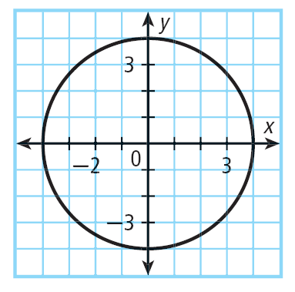
Example 2A: Graphing a Circle
Graph x² + y² = 16.
Step 1 Make a table of values.
Since the radius is , or 4, use ±4 and use the values between for x-values.
Step 2 Plot the points and connect them to form a circle.

Slide 12
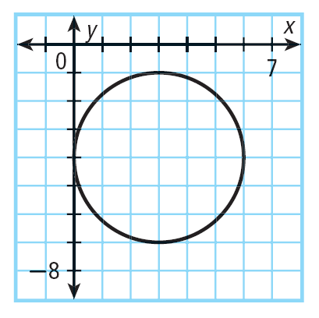
Example 2B: Graphing a Circle
Graph (x – 3)² + (y + 4)² = 9.
The equation of the given circle can be written as
(x – 3)² + (y – (– 4))² = 3².
(3, –4)
So h = 3, k = –4, and r = 3.
The center is (3, –4) and the radius is 3. Plot the point (3, –4). Then graph a circle having this center and radius 3.

Slide 13

Check It Out! Example 2a
Graph x² + y² = 9.
Since the radius is , or 3, use ±3 and use the values between for x-values.
x | 3 | 2 | 1 | 0 | –1 | –2 | –3
y | 0 | ±2.2 | ± 2.8 | ± 3 | ± 2.8 | ± 2.2 | 0
Step 2 Plot the points and connect them to form a circle.

Slide 14
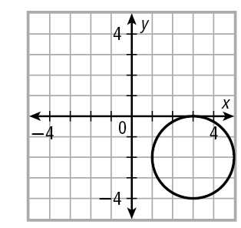
Check It Out! Example 2b
Graph (x – 3)² + (y + 2)² = 4.
The equation of the given circle can be written as
(x – 3)² + (y – (– 2))² = 2².
So h = 3, k = –2, and r = 2.
The center is (3, –2) and the radius is 2. Plot the point (3, –2). Then graph a circle having this center and radius 2.
(3, –2)

Slide 15
Example 3: Radio Application
An amateur radio operator wants to build a radio antenna near his home without using his house as a bracing point. He uses three poles to brace the antenna. The poles are to be inserted in the ground at three points equidistant from the antenna located at J(4, 4), K(–3, –1), and L(2, –8). What are the coordinates of the base of the antenna?
Step 1 Plot the three given points.
Step 2 Connect J, K, and L to form a triangle.

Slide 16
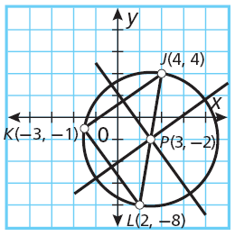
Example 3 Continued
Step 3 Find a point that is equidistant from the three points by constructing the perpendicular
bisectors of two of the sides of ∆JKL.
The perpendicular bisectors of the sides of ∆JKL intersect at a point that is equidistant from J, K, and L.
The intersection of the perpendicular bisectors is P (3, –2). P is the center
of the circle that passes through J, K, and L.
The base of the antenna is at P (3, –2).

Slide 17
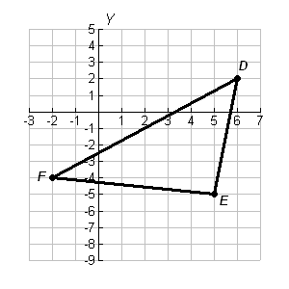
Check It Out! Example 3
What if…? Suppose the coordinates of the three cities in Example 3 (p. 801) are D(6, 2) , E(5, –5), and F(-2, -4). What would be the location of the weather station?
Step 1 Plot the three given points.
Step 2 Connect D, E, and F to form a triangle.

Slide 18
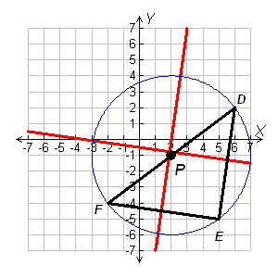
Check It Out! Example 3 Continued
Step 3 Find a point that is equidistant from the three points by constructing the perpendicular
bisectors of two of the sides of ∆DEF.
The perpendicular bisectors of the sides of ∆DEF intersect at a point that is equidistant from D, E, and F.
The intersection of the perpendicular bisectors is P(2, –1). P is the center
of the circle that passes through D, E, and F.
The base of the antenna is at P(2, –1).

Slide 19
Lesson Quiz: Part I
Write the equation of each circle.
1. L with center L (–5, –6) and radius 9
(x + 5)² + (y + 6)² = 81
2. D that passes through (–2, –1) and has center D(2, –4)
(x – 2)² + (y + 4)² = 25

Slide 20
Lesson Quiz: Part II
Graph each equation.
3. x² + y² = 4
4. (x – 2)² + (y + 4)² = 16

Slide 21
Lesson Quiz: Part III
5. A carpenter is planning to build a circular gazebo that requires the center of the structure to be equidistant from three support columns located at E(–2, –4), F(–2, 6), and G(10, 2).
What are the coordinates for the location of the center of the gazebo?
(3, 1)

