Slide 1

Permutations and Combinations
Warm Up
Lesson Presentation
Lesson Quiz
Holt McDougal Algebra 2
Holt Algebra 2

Slide 2




Warm Up
Evaluate.
1. 5 • 4 • 3 • 2 • 1
2. 7 • 6 • 5 • 4 • 3 • 2 • 1
3. 4.
5. 6.
120
5040
4
210
10
70

Slide 3
Objectives
Solve problems involving the Fundamental Counting Principle.
Solve problems involving permutations and combinations.

Slide 4
Vocabulary
Fundamental Counting Principle
permutation
factorial
combination

Slide 5

You have previously used tree diagrams to find
the number of possible combinations of a group of objects. In this lesson, you will learn to use the Fundamental Counting Principle.

Slide 6
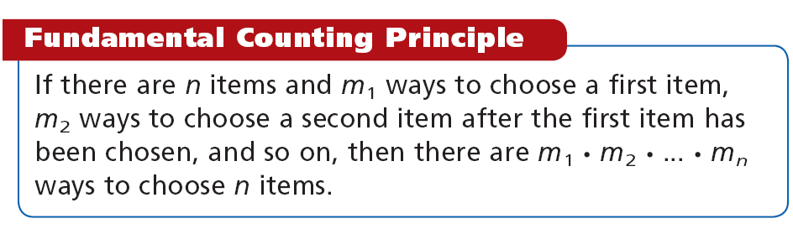

Slide 7
Example 1A: Using the Fundamental Counting Principle
To make a yogurt parfait, you choose one flavor of yogurt, one fruit topping, and one nut topping. How many parfait choices are there?
Yogurt Parfait (choose 1 of each)
Flavor Plain Vanilla | Fruit Peaches Strawberries Bananas Raspberries Blueberries | Nuts Almonds Peanuts Walnuts

Slide 8
Example 1A Continued
number
of flavors
number
of fruits
number
of nuts
number
of choices
times
times
equals
2 × 5 × 3 = 30
There are 30 parfait choices.

Slide 9
Example 1B: Using the Fundamental Counting Principle
A password for a site consists of 4 digits followed by 2 letters. The letters A and Z are not used, and each digit or letter many be used more than once. How many unique passwords are possible?
digit digit digit digit letter letter
10 × 10 × 10 × 10 × 24 × 24 = 5,760,000
There are 5,760,000 possible passwords.

Slide 10
Check It Out! Example 1a
A “make-your-own-adventure” story lets you choose 6 starting points, gives 4 plot choices, and then has 5 possible endings. How many adventures are there?
number of starting points
number
of possible endings
number
of plot choices
number
of adventures
×
×
=
6 × 4 × 5 = 120
There are 120 adventures.

Slide 11
Check It Out! Example 1b
A password is 4 letters followed by 1 digit. Uppercase letters (A) and lowercase letters (a) may be used and are considered different. How many passwords are possible?
Since both upper and lower case letters can be used, there are 52 possible letter choices.
letter letter letter letter number
52 × 52 × 52 × 52 × 10 = 73,116,160
There are 73,116,160 possible passwords.

Slide 12
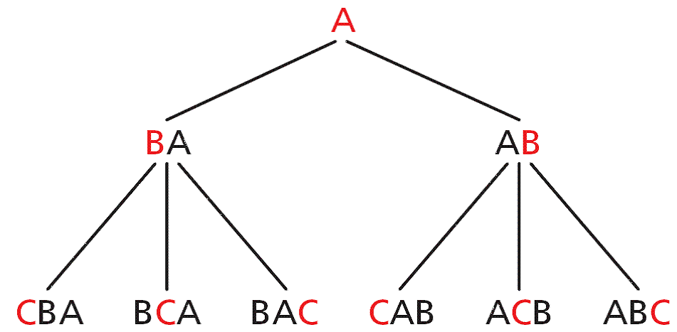
A permutation is a selection of a group of objects in which order is important.
There is one way to
arrange one item A.
1 permutation
A second item B can
be placed first or
second.
2 · 1 permutations
A third item C can be first, second, or third for each order
above.
3 · 2 · 1
permutations

Slide 13
You can see that the number of permutations of 3 items is 3 · 2 · 1. You can extend this to permutations of n items, which is n · (n – 1) · (n – 2) · (n – 3) · ... · 1. This expression is called n factorial, and is written as n!.

Slide 14
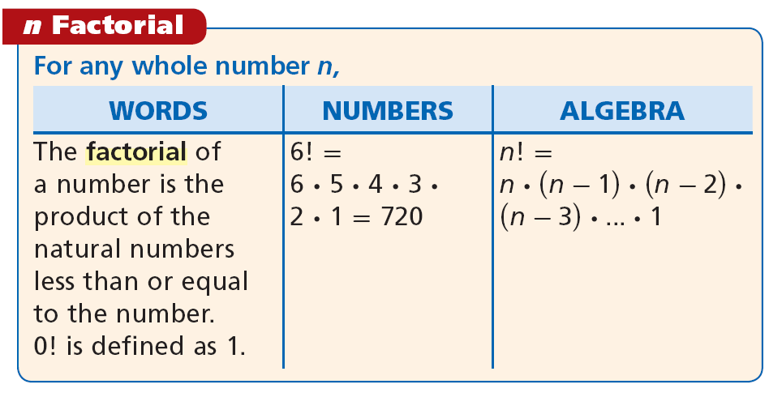

Slide 15
Sometimes you may not want to order an entire set of items. Suppose that you want to select and order 3 people from a group of 7. One way to find possible
permutations is to use the Fundamental Counting Principle.
There are 7 people. You are choosing 3 of them in order.
First Person
Second Person
Third Person
7 choices
6 choices
5 choices
210 permutations
•
•
=

Slide 16
Another way to find the possible permutations is to use factorials. You can divide the total number of arrangements by the number of arrangements that are not used. In the previous slide, there are 7 total people and 4 whose arrangements do not matter.
arrangements of 7 = 7! = 7 · 6 · 5 · 4 · 3 · 2 · 1 = 210
arrangements of 4 4! 4 · 3 · 2 · 1
This can be generalized as a formula, which is useful for large numbers of items.

Slide 17
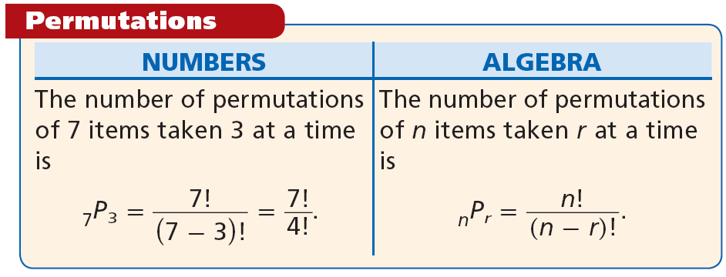

Slide 18



Example 2A: Finding Permutations
How many ways can a student government select a president, vice president, secretary, and treasurer from a group of 6 people?
This is the equivalent of selecting and arranging 4 items from 6.
Substitute 6 for n and 4 for r in
Divide out common factors.
= 6 • 5 • 4 • 3 = 360
There are 360 ways to select the 4 people.

Slide 19


Example 2B: Finding Permutations
How many ways can a stylist arrange 5 of 8 vases from left to right in a store display?
Divide out common factors.
= 8 • 7 • 6 • 5 • 4
= 6720
There are 6720 ways that the vases can be arranged.

Slide 20


Check It Out! Example 2a
Awards are given out at a costume party. How many ways can “most creative,” “silliest,” and “best” costume be awarded to 8 contestants if no one gets more than one award?
= 8 • 7 • 6
= 336
There are 336 ways to arrange the awards.

Slide 21

Check It Out! Example 2b
How many ways can a 2-digit number be formed by using only the digits 5–9 and by each digit being used only once?
= 5 • 4
= 20
There are 20 ways for the numbers to be formed.

Slide 22
A combination is a grouping of items in which order does not matter. There are generally fewer ways to select items when order does not matter. For example, there are 6 ways to order 3 items, but they are all the same combination:
6 permutations → {ABC, ACB, BAC, BCA, CAB, CBA}
1 combination → {ABC}

Slide 23

To find the number of combinations, the formula for permutations can be modified.
Because order does not matter, divide the number of permutations by the number of ways to arrange the selected items.

Slide 24
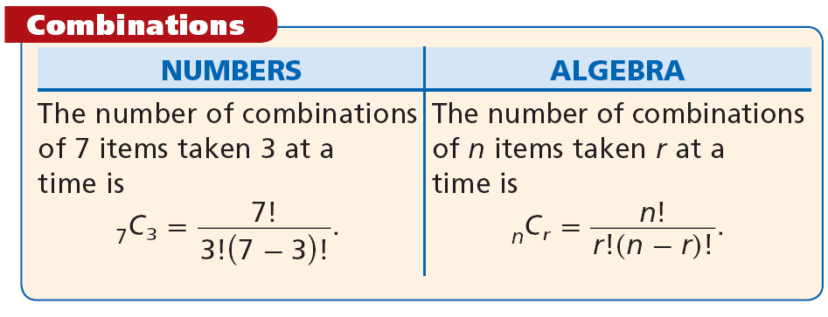

Slide 25
When deciding whether to use permutations or combinations, first decide whether order is important. Use a permutation if order matters and a combination if order does not matter.

Slide 26
Helpful Hint
You can find permutations and combinations by
using nPr and nCr, respectively, on scientific and graphing calculators.

Slide 27
Example 3: Application
There are 12 different-colored cubes in a bag. How many ways can Randall draw a set of 4 cubes from the bag?
Step 1 Determine whether the problem represents a permutation of combination.
The order does not matter. The cubes may be drawn in any order. It is a combination.

Slide 28

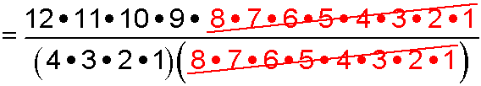


Example 3 Continued
Step 2 Use the formula for combinations.
n = 12 and r = 4
Divide out
common
factors.
5
= 495
There are 495 ways to draw 4 cubes from 12.

Slide 29

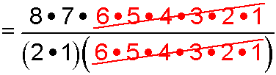

Check It Out! Example 3
The swim team has 8 swimmers. Two swimmers will be selected to swim in the first heat. How many ways can the swimmers be selected?
n = 8 and r = 2
Divide out
common
factors.
4
= 28
The swimmers can be selected in 28 ways.

Slide 30
Lesson Quiz
1. Six different books will be displayed in the library window. How many different arrangements are there?
2. The code for a lock consists of 5 digits. The last number cannot be 0 or 1. How many different codes are possible?
720
80,000
3. The three best essays in a contest will receive gold, silver, and bronze stars. There are 10 essays. In how many ways can the prizes be awarded?
4. In a talent show, the top 3 performers of 15 will advance to the next round. In how many ways can this be done?
720
455

