Slide 1
Inbox Task
Page 474 #1-13
On pg. 168 in Interactive Notebook

Slide 2
Classwork
Page 498 #1-15
On pg. 169 in Interactive Notbook

Slide 3
Translate the figure with the given vertices along the given vector.
G(8, 2), H(–4, 5), I(3,–1); <–2, 0>

Slide 4
Translate the figure with the given vertices along the given vector.
S(0, –7), T(–4, 4), U(–5, 2), V(8, 1); <–4, 5>

Slide 5
Find the coordinates of the image of F(2, 7) after the translation (x, y) → (x + 5, y – 6).

Slide 6
Reflect the figure with the given vertices across the given line.
A(2, 3), B(–1, 5), C(4,–1); y = x

Slide 7
Reflect the figure with the given vertices across the given line.
U(–8, 2), V(–3, –1), W(3, 3); y-axis

Slide 8
Reflect the figure with the given vertices across the given line.
E(–3, –2), F(6, –4), G(–2, 1); x-axis

Slide 9
Rotate ∆RST with vertices R(–1, 4), S(2, 1), and T(3, –3) about the origin by the given angle.
90°

Slide 10
Rotate ∆RST with vertices R(–1, 4), S(2, 1), and T(3, –3) about the origin by the given angle.
180°

Slide 11
PQR has vertices P(5, –2), Q(1, –4), and R(–3, 3).
Translate ∆PQR along the vector <–2, 1> and then reflect it across the x-axis.

Slide 12
PQR has vertices P(5, –2), Q(1, –4), and P(–3, 3).
Reflect ∆PQR across the line y = x and then rotate it 90° about the origin.

Slide 13
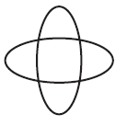
Describe the symmetry of each figure. Draw any lines of symmetry. Give the angle and the order of any rotational symmetry.

Slide 14
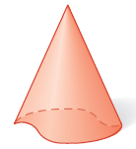
Tell whether each figure has plane symmetry, symmetry about an axis, or neither.

Slide 15

Copy the given figure and use it to create a tessellation.

Slide 16
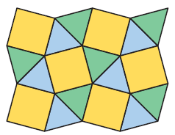
Classify the tessellation as regular, semiregular, or neither.

