Slide 1

Applications of Proportions
Warm Up
Lesson Presentation
Lesson Quiz
Holt Algebra 1
Holt McDougal Algebra 1

Slide 2


Warm Up
Evaluate each expression for a = 3, b = –2,
c = 5.
1. 4a – b 2. 3b² – 5
3. ab – 2c
Solve each proportion.
4. 5.
14
7
−16
9
6.4

Slide 3
Objectives
Use proportions to solve problems involving geometric figures.
Use proportions and similar figures to measure objects indirectly.

Slide 4
Vocabulary
similar
corresponding sides
corresponding angles
indirect measurement
scale factor

Slide 5
Similar figures have exactly the same shape but not necessarily the same size.
Corresponding sides of two figures are in the same relative position, and corresponding angles are in the same relative position. Two figures are similar if and only if the lengths of corresponding sides are proportional and all pairs of corresponding angles have equal measures.

Slide 6

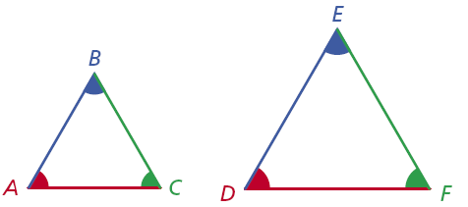
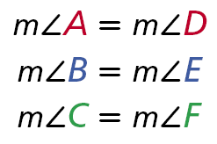
When stating that two figures are similar, use the symbol ~. For the triangles above, you can write ∆ABC ~ ∆DEF. Make sure corresponding vertices are in the same order. It would be incorrect to write ∆ABC ~ ∆EFD.
You can use proportions to find missing lengths in similar figures.

Slide 7
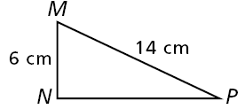
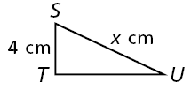





Example 1A: Finding Missing Measures in Similar Figures
Find the value of x the diagram.
∆MNP ~ ∆STU
M corresponds to S, N corresponds to T, and P corresponds to U.
6x = 56
Use cross products.
Since x is multiplied by 6, divide both sides by 6 to undo the multiplication.
The length of SU is cm.

Slide 8
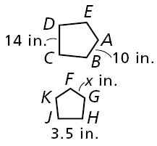



Example 1B: Finding Missing Measures in Similar Figures
Find the value of x the diagram.
ABCDE ~ FGHJK
14x = 35
Use cross products.
Since x is multiplied by 14, divide both sides by 14 to undo the multiplication.
x = 2.5
The length of FG is 2.5 in.

Slide 9
Reading Math
AB means segment AB. AB means the length of AB.
∠A means angle A. m∠A the measure of angle A.

Slide 10
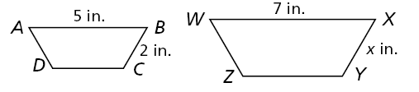



Check It Out! Example 1
Find the value of x in the diagram if ABCD ~ WXYZ.
ABCD ~ WXYZ
Use cross products.
Since x is multiplied by 5, divide both sides by 5 to undo the multiplication.
x = 2.8
The length of XY is 2.8 in.

Slide 11
You can solve a proportion involving similar triangles to find a length that is not easily measured. This method of measurement is called indirect measurement. If two objects form right angles with the ground, you can apply indirect measurement using their shadows.

Slide 12






Example 2: Measurement Application
A flagpole casts a shadow that is 75 ft long at the same time a 6-foot-tall man casts a shadow that is 9 ft long. Write and solve a proportion to find the height of the flag pole.
Since h is multiplied by 9, divide both sides by 9 to undo the multiplication.
The flagpole is 50 feet tall.

Slide 13
Helpful Hint
A height of 50 ft seems reasonable for a flag pole. If you got 500 or 5000 ft, that would not be reasonable, and you should check your work.

Slide 14



Check It Out! Example 2a
A forest ranger who is 150 cm tall casts a shadow 45 cm long. At the same time, a nearby tree casts a shadow 195 cm long. Write and solve a proportion to find the height of the tree.
45x = 29250
Since x is multiplied by 45, divide both sides by 45 to undo the multiplication.
x = 650
The tree is 650 centimeters tall.

Slide 15



Check It Out! Example 2b
A woman who is 5.5 feet tall casts a shadow 3.5 feet long. At the same time, a building casts a shadow 28 feet long. Write and solve a proportion to find the height of the building.
3.5x = 154
Since x is multiplied by 3.5, divide both sides by 3.5 to undo the multiplication.
x = 44
The building is 44 feet tall.

Slide 16
If every dimension of a figure is multiplied by the same number, the result is a similar figure. The multiplier is called a scale factor.

Slide 17








Example 3A: Changing Dimensions
The radius of a circle with radius 8 in. is multiplied by 1.75 to get a circle with radius 14 in. How is the ratio of the circumferences related to the ratio of the radii? How is the ratio of the areas related to the ratio of the radii?
Circle A
Circle B
Radii:
Circumference:
Area:
The ratio of the areas is the square of the ratio of the radii.
The ratio of the circumference is equal to the ratio of the radii.

Slide 18
Example 3B: Changing Dimensions
Every dimension of a rectangular prism with length 12 cm, width 3 cm, and height 9 cm is multiplied by to get a similar rectangular prism. How is the ratio of the volumes related to the ratio of the corresponding dimensions?
Prism A
Prism B
V = lwh
(12)(3)(9) = 324
(4)(1)(3) = 12
The ratio of the volumes is the cube of the ratio of the corresponding dimensions.

Slide 19
Helpful Hint
A scale factor between 0 and 1 reduces a figure. A scale factor greater than 1 enlarges it.

Slide 20
Check It Out! Example 3
A rectangle has width 12 inches and length 3 inches. Every dimension of the rectangle is multiplied by to form a similar rectangle. How is the ratio of the perimeters related to the ratio of the corresponding sides?
Rectangle A
Rectangle B
P = 2l +2w
2(12) + 2(3) = 30
2(4) + 2(1) = 10
The ratio of the perimeters is equal to the ratio of the corresponding sides.

Slide 21
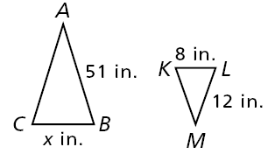
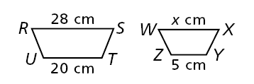
Lesson Quiz: Part 1
Find the value of x in each diagram.
1. ∆ABC ~ ∆MLK
34
2. RSTU ~ WXYZ
7

Slide 22
Lesson Quiz: Part 2
3. A girl that is 5 ft tall casts a shadow 4 ft long. At the same time, a tree casts a shadow 24 ft long. How tall is the tree?
30 ft
4. The lengths of the sides of a square are multiplied by 2.5. How is the ratio of the areas related to the ratio of the sides?
The ratio of the areas is the square of the ratio of the sides.

