Slide 1

Conditional Statements and Biconditional Statements
Warm Up
Lesson Presentation
Lesson Quiz
Holt McDougal Geometry
Holt Geometry

Slide 2
Warm Up
Determine if each statement is true or false.
1. The measure of an obtuse angle is less than 90°.
2. All perfect-square numbers are positive.
3. Every prime number is odd.
4. Any three points are coplanar.
F
T
F
T

Slide 3
Objectives
Identify, write, and analyze the truth value of conditional statements.
Write the inverse, converse, and contrapositive of a conditional statement.

Slide 4
Vocabulary
conditional statement
hypothesis
conclusion
truth value
negation
converse
inverse
contrapostive
logically equivalent statements

Slide 5
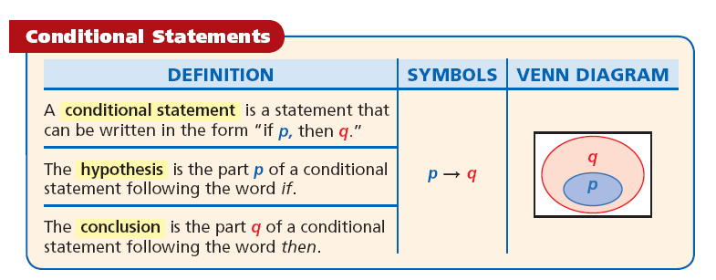
By phrasing a conjecture as an if-then statement, you can quickly identify its hypothesis and conclusion.

Slide 6
Example 1: Identifying the Parts of a Conditional Statement
Identify the hypothesis and conclusion of each conditional.
A. If today is Thanksgiving Day, then today is Thursday.
Hypothesis: Today is Thanksgiving Day.
Conclusion: Today is Thursday.
B. A number is a rational number if it is an integer.
Hypothesis: A number is an integer.
Conclusion: The number is a rational number.

Slide 7
Check It Out! Example 1
Identify the hypothesis and conclusion of the statement.
"A number is divisible by 3 if it is divisible by 6."
Hypothesis: A number is divisible by 6.
Conclusion: A number is divisible by 3.

Slide 8
Writing Math
“If p, then q” can also be written as “if p, q,” “q, if p,” “p implies q,” and “p only if q.”

Slide 9
Many sentences without the words if and then can be written as conditionals. To do so, identify the sentence’s hypothesis and conclusion by figuring out which part of the statement depends on the other.

Slide 10
Example 2A: Writing a Conditional Statement
Write a conditional statement from the following.
An obtuse triangle has exactly one obtuse angle.
An obtuse triangle
has exactly one obtuse angle.
Identify the hypothesis and the conclusion.
If a triangle is obtuse, then it has exactly one obtuse angle.

Slide 11
Example 2B: Writing a Conditional Statement
Write a conditional statement from the following.
If an animal is a blue jay, then it is a bird.
The inner oval represents the hypothesis, and the outer oval represents the conclusion.

Slide 12
Check It Out! Example 2
Write a conditional statement from the sentence “Two angles that are complementary are acute.”
Two angles that are complementary
are acute.
Identify the hypothesis and the conclusion.
If two angles are complementary, then they are acute.

Slide 13
A conditional statement has a truth value of either true (T) or false (F). It is false only when the hypothesis is true and the conclusion is false.
To show that a conditional statement is false, you need to find only one counterexample where the hypothesis is true and the conclusion is false.

Slide 14
Example 3A: Analyzing the Truth Value of a Conditional Statement
Determine if the conditional is true. If false, give a counterexample.
If this month is August, then next month is September.
When the hypothesis is true, the conclusion is also true because September follows August. So the conditional is true.

Slide 15
Example 3B: Analyzing the Truth Value of a Conditional Statement
Determine if the conditional is true. If false, give a counterexample.
If two angles are acute, then they are congruent.
You can have acute angles with measures of 80° and 30°. In this case, the hypothesis is true, but the conclusion is false.
Since you can find a counterexample, the conditional is false.

Slide 16
Example 3C: Analyzing the Truth Value of a Conditional Statement
Determine if the conditional is true. If false, give a counterexample.
If an even number greater than 2 is prime, then 5 + 4 = 8.
An even number greater than 2 will never be prime, so the hypothesis is false. 5 + 4 is not equal to 8, so the conclusion is false. However, the conditional is true because the hypothesis is false.

Slide 17
Check It Out! Example 3
Determine if the conditional “If a number is odd, then it is divisible by 3” is true. If false, give a counterexample.
An example of an odd number is 7. It is not divisible by 3. In this case, the hypothesis is true, but the conclusion is false. Since you can find a counterexample, the conditional is false.

Slide 18
Remember!
If the hypothesis is false, the conditional statement is true, regardless of the truth value of the conclusion.

Slide 19
The negation of statement p is “not p,” written as ~p. The negation of a true statement is false, and the negation of a false statement is true.

Slide 20
Related Conditionals
Definition | Symbols
A conditional is a statement that can be written in the form "If p, then q." | p → q

Slide 21
Related Conditionals
Definition | Symbols
The converse is the statement formed by exchanging the hypothesis and conclusion. | q → p

Slide 22
Related Conditionals
Definition | Symbols
The inverse is the statement formed by negating the hypothesis and conclusion. | ~p → ~q

Slide 23
Related Conditionals
Definition | Symbols
The contrapositive is the statement formed by both exchanging and negating the hypothesis and conclusion. | ~q → ~p

Slide 24
Example 4: Biology Application
Write the converse, inverse, and contrapositive of the conditional statement. Use the Science Fact to find the truth value of each.
If an animal is an adult insect, then it has six legs.

Slide 25
Example 4: Biology Application
If an animal is an adult insect, then it has six legs.
Converse: If an animal has six legs, then it is an adult insect.
No other animals have six legs so the converse is true.
Inverse: If an animal is not an adult insect, then it does not have six legs.
No other animals have six legs so the converse is true.
Contrapositive: If an animal does not have six legs, then it is not an adult insect.
Adult insects must have six legs. So the contrapositive is true.

Slide 26
Check It Out! Example 4
Write the converse, inverse, and contrapostive of the conditional statement “If an animal is a cat, then it has four paws.” Find the truth value of each.
If an animal is a cat, then it has four paws.

Slide 27
Check It Out! Example 4
If an animal is a cat, then it has four paws.
Converse: If an animal has 4 paws, then it is a cat.
There are other animals that have 4 paws that are not cats, so the converse is false.
Inverse: If an animal is not a cat, then it does not have 4 paws.
There are animals that are not cats that have 4 paws, so the inverse is false.
Contrapositive: If an animal does not have 4 paws, then it is not a cat; True.
Cats have 4 paws, so the contrapositive is true.

Slide 28
Related conditional statements that have the same truth value are called logically equivalent statements. A conditional and its contrapositive are logically equivalent, and so are the converse and inverse.

Slide 29
Helpful Hint
The logical equivalence of a conditional and its contrapositive is known as the Law of Contrapositive.

Slide 30
Lesson Quiz: Part I
Identify the hypothesis and conclusion of each conditional.
1. A triangle with one right angle is a right triangle.
2. All even numbers are divisible by 2.
3. Determine if the statement “If n² = 144, then
n = 12” is true. If false, give a counterexample.
H: A triangle has one right angle.
C: The triangle is a right triangle.
H: A number is even.
C: The number is divisible by 2.
False; n = –12.

Slide 31
Lesson Quiz: Part II
Identify the hypothesis and conclusion of each conditional.
4. Write the converse, inverse, and contrapositive of the conditional statement “If Maria’s birthday is February 29, then she was born in a leap year.” Find the truth value of each.
Converse: If Maria was born in a leap year, then her birthday is February 29; False.
Inverse: If Maria’s birthday is not February 29, then she was not born in a leap year; False.
Contrapositive: If Maria was not born in a leap year, then her birthday is not February 29; True.

Slide 32
Biconditional Statements
and Definitions
Warm Up
Lesson Presentation
Lesson Quiz
Holt McDougal Geometry
Holt Geometry

Slide 33
Warm Up
Write a conditional statement from each of the
following.
1. The intersection of two lines is a point.
2. An odd number is one more than a multiple of 2.
3. Write the converse of the conditional “If Pedro lives in Chicago, then he lives in Illinois.” Find its truth value.
If two lines intersect, then they intersect in a point.
If a number is odd, then it is one more than a multiple of 2.
If Pedro lives in Illinois, then he lives in Chicago; False.

Slide 34
Objective
Write and analyze biconditional statements.

Slide 35
Vocabulary
biconditional statement
definition
polygon
triangle
quadrilateral

Slide 36
When you combine a conditional statement and its converse, you create a biconditional statement.
A biconditional statement is a statement that can be written in the form “p if and only if q.” This means “if p, then q” and “if q, then p.”

Slide 37
p q means p q and q p
Writing Math
The biconditional “p if and only if q” can also be written as “p iff q” or p ↔ q.

Slide 38
Example 1A: Identifying the Conditionals within a Biconditional Statement
Write the conditional statement and converse within the biconditional.
An angle is obtuse if and only if its measure is greater than 90° and less than 180°.
Let p and q represent the following.
p: An angle is obtuse.
q: An angle’s measure is greater than 90° and less than 180°.

Slide 39
Example 1A Continued
Let p and q represent the following.
p: An angle is obtuse.
q: An angle’s measure is greater than 90° and less than 180°.
The two parts of the biconditional p ↔ q are p → q and q ← p.
Conditional: If an ∠ is obtuse, then its measure is greater than 90° and less than 180°.
Converse: If an angle's measure is greater than 90° and less than 180°, then it is obtuse.

Slide 40
Example 1B: Identifying the Conditionals within a Biconditional Statement
Write the conditional statement and converse within the biconditional.
A solution is neutral ↔ its pH is 7.
Let x and y represent the following.
x: A solution is neutral.
y: A solution’s pH is 7.

Slide 41
Example 1B Continued
Let x and y represent the following.
x: A solution is neutral.
y: A solution’s pH is 7.
The two parts of the biconditional x ↔ y are x → y and y → x.
Conditional: If a solution is neutral, then its pH is 7.
Converse: If a solution’s pH is 7, then it is neutral.

Slide 42
Check It Out! Example 1a
Write the conditional statement and converse within the biconditional.
An angle is acute iff its measure is greater than 0° and less than 90°.
Let x and y represent the following.
x: An angle is acute.
y: An angle has a measure that is greater than 0° and less than 90°.

Slide 43
Check It Out! Example 1a Continued
Let x and y represent the following.
x: An angle is acute.
y: An angle has a measure that is greater than 0° and less than 90°.
The two parts of the biconditional x ↔ y are x → y and y → x.
Conditional: If an angle is acute, then its measure is greater than 0° and less than 90°.
Converse: If an angle’s measure is greater than 0° and less than 90°, then the angle is acute.

Slide 44
Check It Out! Example 1b
Write the conditional statement and converse within the biconditional.
Cho is a member if and only if he has paid the $5 dues.
Let x and y represent the following.
x: Cho is a member.
y: Cho has paid his $5 dues.
The two parts of the biconditional x ↔ y are x → y and y → x.
Conditional: If Cho is a member, then he has paid the $5 dues.
Converse: If Cho has paid the $5 dues, then he is a member.

Slide 45
Example 2: Identifying the Conditionals within a Biconditional Statement
For each conditional, write the converse and a biconditional statement.
A. If 5x – 8 = 37, then x = 9.
Converse: If x = 9, then 5x – 8 = 37.
Biconditional: 5x – 8 = 37 if and only if x = 9.
B. If two angles have the same measure, then they are congruent.
Converse: If two angles are congruent, then they have the same measure.
Biconditional: Two angles have the same measure if and only if they are congruent.

Slide 46
Check It Out! Example 2a
For the conditional, write the converse and a biconditional statement.
If the date is July 4th, then it is Independence Day.
Converse: If it is Independence Day, then the date is July 4th.
Biconditional: It is July 4th if and only if it is Independence Day.

Slide 47
Check It Out! Example 2b
For the conditional, write the converse and a biconditional statement.
If points lie on the same line, then they are collinear.
Converse: If points are collinear, then they lie on the same line.
Biconditional: Points lie on the same line if and only if they are collinear.

Slide 48
For a biconditional statement to be true, both the conditional statement and its converse must be true. If either the conditional or the converse is false, then the biconditional statement is false.

Slide 49
Example 3A: Analyzing the Truth Value of a Biconditional Statement
Determine if the biconditional is true. If false, give a counterexample.
A rectangle has side lengths of 12 cm and 25 cm if and only if its area is 300 cm².

Slide 50
Example 3A: Analyzing the Truth Value of a Biconditional Statement
Conditional: If a rectangle has side lengths of 12 cm and 25 cm, then its area is 300 cm².
The conditional is true.
Converse: If a rectangle’s area is 300 cm², then it has side lengths of 12 cm and 25 cm.
The converse is false.
If a rectangle’s area is 300 cm², it could have side lengths of 10 cm and 30 cm. Because the converse is false, the biconditional is false.

Slide 51
Example 3B: Analyzing the Truth Value of a Biconditional Statement
Determine if the biconditional is true. If false, give a counterexample.
A natural number n is odd ↔ n² is odd.
Conditional: If a natural number n is odd, then n² is odd.
The conditional is true.
Converse: If the square n² of a natural number is odd, then n is odd.
The converse is true.
Since the conditional and its converse are true, the biconditional is true.

Slide 52
Check It Out! Example 3a
Determine if the biconditional is true. If false, give a counterexample.
An angle is a right angle iff its measure is 90°.
Conditional: If an angle is a right angle, then its measure is 90°.
The conditional is true.
Converse: If the measure of an angle is 90°, then it is a right angle.
The converse is true.
Since the conditional and its converse are true, the biconditional is true.

Slide 53
Check It Out! Example 3b
Determine if the biconditional is true. If false, give a counterexample.
y = –5 ↔ y² = 25
Conditional: If y = –5, then y² = 25.
The conditional is true.
Converse: If y² = 25, then
y = –5.
The converse is false.
The converse is false when y = 5. Thus, the biconditional is false.

Slide 54
In geometry, biconditional statements are used to write definitions.
A definition is a statement that describes a mathematical object and can be written as a true biconditional.

Slide 55
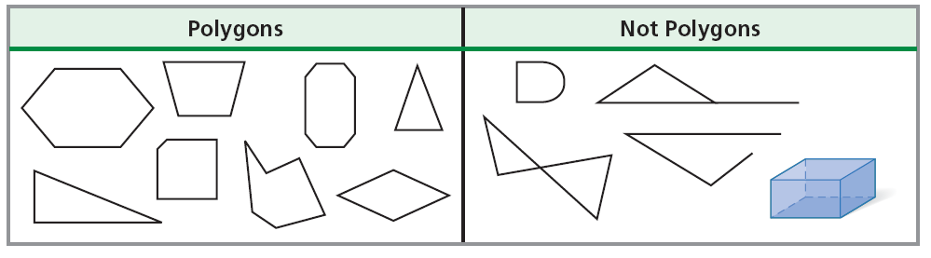
In the glossary, a polygon is defined as a closed plane figure formed by three or more line segments.

Slide 56
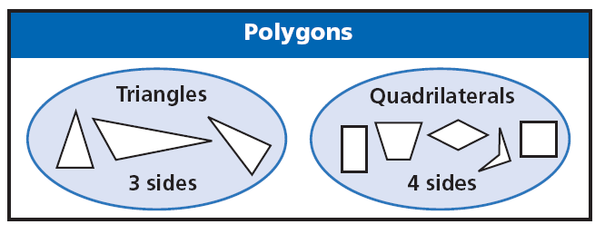
A triangle is defined as a three-sided polygon, and a quadrilateral is a four-sided polygon.

Slide 57
Helpful Hint
Think of definitions as being reversible. Postulates, however are not necessarily true when reversed.

Slide 58
Example 4: Writing Definitions as Biconditional Statements
Write each definition as a biconditional.
A. A pentagon is a five-sided polygon.
B. A right angle measures 90°.
A figure is a pentagon if and only if it is a 5-sided polygon.
An angle is a right angle if and only if it measures 90°.

Slide 59
Check It Out! Example 4
Write each definition as a biconditional.
4a. A quadrilateral is a four-sided polygon.
4b. The measure of a straight angle is 180°.
A figure is a quadrilateral if and only if it is a 4-sided polygon.
An ∠ is a straight ∠ if and only if its measure is 180°.

Slide 60
Lesson Quiz
1. For the conditional “If an angle is right, then its measure is 90°,” write the converse and a biconditional statement.
2. Determine if the biconditional “Two angles are complementary if and only if they are both acute” is true. If false, give a counterexample.
Converse: If an ∠ measures 90°, then the ∠ is right.
Biconditional: An ∠ is right iff its measure is 90°.
False; possible answer: 30° and 40°
3. Write the definition “An acute triangle is a triangle with three acute angles” as a biconditional.
A triangle is acute iff it has 3 acute ∠s.

