Slide 1
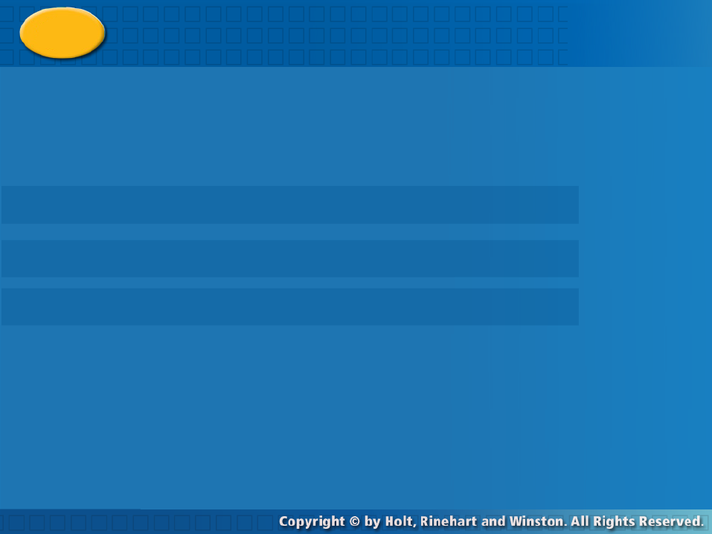
Precision and Accuracy
Warm Up
Lesson Presentation
Lesson Quiz
Holt McDougal Algebra1

Slide 2


Warm Up
Evaluate each expression for a = 3, b = –2,
c = 5.
1. 4a – b 2. 3b² – 5
3. ab – 2c
Solve each proportion.
4. 5.
14
7
−16
9
6.4

Slide 3
Warm Up
Convert each measure.
1. 3210 mm to centimeters
2. 18 in. to feet
3. 52.5 kg to grams
4. 2.5 lbs to ounces
321 cm
1.5 ft
52,500 g
40 oz

Slide 4
Warm Up Continued
Find each absolute value.
5. |–2| 6. |8.1|
7. |3 – 1.2| 8. |7 – 10|
2
8.1
1.8
3

Slide 5
Objectives
Analyze and compare measurements for
precision and accuracy. Choose an
appropriate level of accuracy when reporting
measurements.

Slide 6
Vocabulary
Precision
Accuracy
Tolerance

Slide 7
A precision is the level of detail in a
measurement and is determined by the
smallest unit or fraction of a unit that you
can reasonably measure.
The accuracy of a measurement is the closeness of a measured value to the actual or true value.
Tolerance describes the amount by which a measurement is permitted to vary from a specified value.

Slide 8
Example 1: Comparing Precision of Measurements
Choose the more precise measurement in each pair.
A. 0.8 km; 830.2 m
0.8 km
Nearest tenth of a kilometer
830.2 m
Nearest tenth of a meter
A tenth of a meter is smaller than a tenth of a kilometer, so 830.2 m is more precise.
B. 2.45 in.; 2.5 in.

Slide 9
Example 1: Continued
2.45 in.
Nearest hundredth of an inch
2.5 in.
Nearest tenth of an inch
A hundredth of an inch is smaller than a tenth of an inch, so 2.45 in. is more precise.
C. 100 cm; 1 m
100 cm
Nearest centimeter
1 m
Nearest meter
A centimeter is smaller than a meter, so 100 cm is more precise.

Slide 10
Check It Out! Example 1
Choose the more precise measurement in each pair.
1a. 2 lb; 17 oz.
2 lb
Nearest pound
17 oz
Nearest ounce
An ounce is smaller than a pound, so 17 oz is more precise.
1b. 7.85 m; 7.8 m.

Slide 11
Check It Out! Example 1 Continued
7.85 m
Nearest hundredth of a meter
7.8 m
Nearest meter
A hundredeth of a meter is smaller than a meter, so 7.85 m is more precise.
1c. 6 kg; 6000 g.
6 kg
Nearest kilogram
6000 g
Nearest gram
A gram is smaller than a kilogram, so 6000 g is more precise.

Slide 12
Example 2 : Comparing Precision and Accuracy
Ida works in a deli. She is testing the scales at the deli to make sure they are accurate. She uses a weight that is exactly 1 pound
and gets the following results:
Scale 1: 1.019 lb
Scale 2: 1.01 lb
Scale 3: 0.98 lb
A. Which scale is the most precise?
Scales 2 and 3 measure to the nearest hundredth of a pound. Scale 1 measures to the nearest thousandth of a pound.

Slide 13
Example 2 : Continued
Because a thousandth of a pound is smaller than a hundredth of a pound, Scale 1 is the most precise.
B. Which scale is the most accurate?.
For each scale, find the absolute value of the difference of the standard mass and the scale reading.
Scale 1: |1.000 – 1.019| = 0.019
Scale 2: |1.000 – 1.01| = 0.01
Scale 3: |1.000 – 0.98| = 0.02
Because 0.01 < 0.019 < 0.02, Scale 2 is the most accurate.

Slide 14
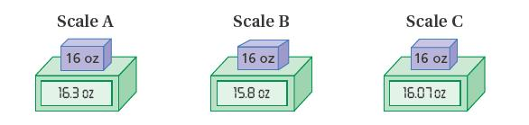
Check It Out! Example 2
A standard mass of 16 ounces is used to test three postal scales.
The results are shown below.
A. Which scale is the most precise?
Scales A and B measure to the nearest tenth of an ounce.

Slide 15
Check It Out! Example 2 Continued
Scale C measures to the nearest hundredth of an ounce.
Because a hundredth of an ounce is smaller than a thousandth of an ounce, Scale C is the most precise.
B. Which scale is the most accurate?
For each scale, find the absolute value of the difference of the standard mass and the scale reading.

Slide 16
Check It Out! Example 2 Continued
Scale 1: |16.00 – 16.3| = 0.3
Scale 2: |16.00 – 15.8| = 0.2
Scale 3: |16.00 – 16.07| = 0.07
Because 0.07 < 0.2 < 0.3, Scale C is the most accurate.

Slide 17
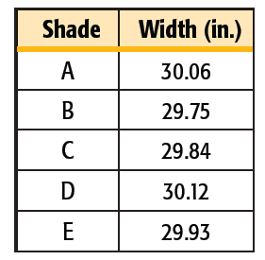
Example 3: Using a Specified Tolerance
Bright Days Blinds makes window shades. The width of a 30-inch shade should be within 0.18 in. of 30 in. A batch of shades has the widths shown in the table.

Slide 18
Example 3 : Continued
Do all of the shades measure within the specified tolerance? If not, which shade(s) are not within the specified tolerance?
30 – 0.18 = 29.82
30 in. ± 0.18 in. means that the shade must be
30 + 0.18 = 30.18
between 29.82 and 30.18 in.
No, Shade B measures 29.75 in., so it is not within the specified tolerance.

Slide 19
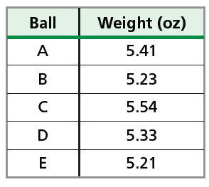
Check It Out! Example 3
A lacrosse ball must weigh 5.25 oz ± 0.25 oz. The weights of the lacrosse balls in one box are given in the table. Do all of the lacrosse balls weigh within the specified tolerance? If not, which lacrosse ball(s) are not within the specified tolerance?
5.25 oz ± 0.25 oz means that the lacrosse ball must weigh between 5.00 and 5.50 oz.

Slide 20
Check It Out! Example 3 Continued
5.25 – 0.25 = 5.00
5.25 + 0.25 = 5.50
No, Ball C is 5.54 oz, so it is not within the specified tolerance

Slide 21
Example 4: Using Tolerance Expressed as a Percent
Write the possible range of each measurement. Round to the nearest hundredth if necessary.
A. 12 lb ± 3%
12(0.03) = 0.36
Find 3% of 12.
12 lb  0.36 lb
Write the measurement and tolerance.
11.64 lb–12.36 lb
Write the measurement as a range.

Slide 22
Example 4: Continued
B. 15 oz ± 1.5%
15(0.15) = 0.225
Find 1.5% of 15.
15 oz  0.23 oz
Write the measurement and tolerance. Round to the nearest hundredth.
14.77 oz–15.23 oz
Write the measurement as a range.
C. 3 m ± 0.2%
3(0.002) = 0.006
Find 0.2% of 3.

Slide 23
Example 4: Continued
3 m  0.01 m
Write the measurement and tolerance. Round to the nearest hundredth.
2.99 m–3.01 m
Write the measurement as a range.

Slide 24
Check It Out! Example 4
Write the possible range of each measurement. Round to the nearest hundredth if necessary.
4a. 4.1 in. ± 5%
4.1(0.05) = 0.205
Find 5% of 4.1.
4.1 cm.  0.21 cm.
Write the measurement and tolerance. Round to the nearest hundredth.
3.89 cm.–4.31 cm.
Write the measurement as a range.

Slide 25
Check It Out! Example 4 Continued
4b. 475 m ± 2.5%
475(0.025) = 11.875
Find 2.5% of 475.
475 m  11.88 m
Write the measurement and tolerance. Round to the nearest hundredth.
463.12 m–486.88 m
Write the measurement as a range.
4c. 85 mg ± 0.5%
85(0.005) = 0.425
Find 0.5% of 85.

Slide 26
Check It Out! Example 4 Continued
85 mg  0.43 mg
Write the measurement and tolerance. Round to the nearest hundredth.
84.57 mg–85.43 mg
Write the measurement as a range.

Slide 27
Lesson Quiz : part-1
1. Choose the more precise measurement: 2.4 km; 2430 m
2430 m
2. Jorge works in a mail room. To test the accuracy of the scales in the mail room, he uses a weight that is exactly 8 oz. and gets the following results:
Scale 1: 8.02 oz
Scale 2: 7.8988 oz
Scale 3: 8.015 oz
2
a. Which scale is the most precise?
3
b. Which scale is the most accurate?

Slide 28
Lesson Quiz : Part-2
3. Monique is cutting wooden slats that are to be 20 in. long. Three slats have the following lengths:
A: 19.96875 in.
B: 19.875 in.
C: 20.0625 in.
a. Which slat(s), if any, do not fall within a tolerance of 0.0625 in.?
B
b. Which slat(s), if any, do not fall within a tolerance of 0.5%?
B

