Slide 1

Algebraic Proof
Warm Up
Lesson Presentation
Lesson Quiz
Holt McDougal Geometry
Holt Geometry

Slide 2

Warm Up
Solve each equation.
1. 3x + 5 = 17
2. r – 3.5 = 8.7
3. 4t – 7 = 8t + 3
4.
5. 2(y – 5) – 20 = 0
x = 4
r = 12.2
5 2
t = –
n = –38
y = 15

Slide 3
Objectives
Review properties of equality and use them to write algebraic proofs.
Identify properties of equality and congruence.

Slide 4
Vocabulary
proof

Slide 5
A proof is an argument that uses logic, definitions, properties, and previously proven statements to show that a conclusion is true.
An important part of writing a proof is giving justifications to show that every step is valid.

Slide 6
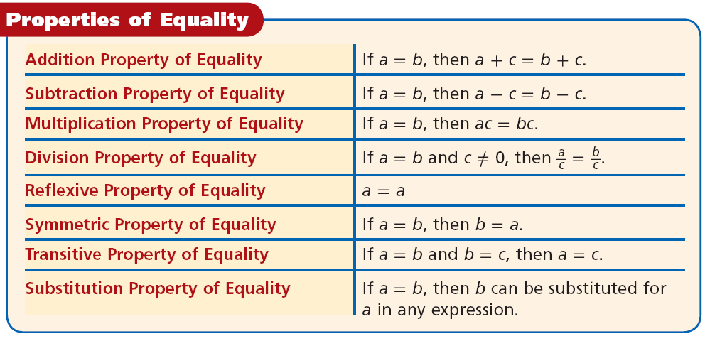

Slide 7
Remember!
The Distributive Property states that
a(b + c) = ab + ac.

Slide 8

Example 1: Solving an Equation in Algebra
Solve the equation 4m – 8 = –12. Write a justification for each step.
4m – 8 = –12 Given equation
+8 +8 Addition Property of Equality
4m = –4 Simplify.
Division Property of Equality
m = –1 Simplify.

Slide 9



Check It Out! Example 1
Solve the equation . Write a justification for each step.
Given equation
Multiplication Property of Equality.
t = –14
Simplify.

Slide 10

Example 2: Problem-Solving Application
What is the temperature in degrees Fahrenheit F when it is 15°C? Solve the equation F = C + 32 for F and justify each step.
9 5

Slide 11


Example 2 Continued
1
Understand the Problem
The answer will be the temperature in degrees Fahrenheit.
List the important information:
C = 15

Slide 12

Example 2 Continued
2
Make a Plan
Substitute the given information into the formula and solve.

Slide 13


Example 2 Continued
3
Solve
Given equation
Substitution Property of Equality
F = 27 + 32 Simplify.
F = 59 Simplify.
F = 59°

Slide 14


Example 2 Continued
4
Look Back
Check your answer by substituting it back into the original formula.
?
59 = 59
✓

Slide 15
Check It Out! Example 2
What is the temperature in degrees Celsius C when it is 86°F? Solve the equation C = (F – 32) for C and justify each step.
5 9

Slide 16

Check It Out! Example 2 Continued
1
Understand the Problem
The answer will be the temperature in degrees Celsius.
List the important information:
F = 86

Slide 17
Check It Out! Example 2 Continued
2
Make a Plan
Substitute the given information into the formula and solve.

Slide 18


Check It Out! Example 2 Continued
3
Solve
Given equation
Substitution Property of Equality
Simplify.
C = 30 Simplify.
C = 30°

Slide 19

Check It Out! Example 2 Continued
4
Look Back
Check your answer by substituting it back into the original formula.
?
30 = 30
✓

Slide 20
Like algebra, geometry also uses numbers, variables, and operations. For example, segment lengths and angle measures are numbers. So you can use these same properties of equality to write algebraic proofs in geometry.
Helpful Hint
    A B
AB represents the length AB, so you can think of AB as a variable representing a number.

Slide 21
Example 3: Solving an Equation in Geometry
Write a justification for each step.
NO = NM + MO
Segment Addition Post.
4x – 4 = 2x + (3x – 9)
Substitution Property of Equality
4x – 4 = 5x – 9
Simplify.
–4 = x – 9
Subtraction Property of Equality
5 = x
Addition Property of Equality

Slide 22
Check It Out! Example 3
Write a justification for each step.
m∠ABC = m∠ABD + m∠DBC
∠ Add. Post.
8x° = (3x + 5)° + (6x – 16)°
Subst. Prop. of Equality
8x = 9x – 11
Simplify.
–x = –11
Subtr. Prop. of Equality.
x = 11
Mult. Prop. of Equality.

Slide 23
You learned in Chapter 1 that segments with equal lengths are congruent and that angles with equal measures are congruent. So the Reflexive, Symmetric, and Transitive Properties of Equality have corresponding properties of congruence.

Slide 24
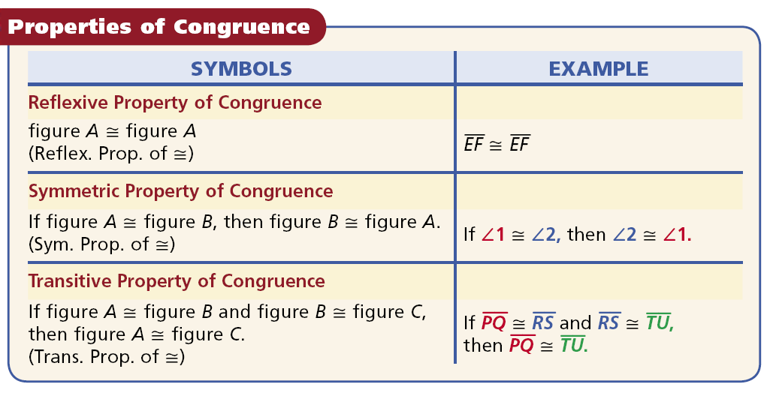

Slide 25
Remember!
Numbers are equal (=) and figures are congruent (≅).

Slide 26
Example 4: Identifying Property of Equality and Congruence
Identify the property that justifies each statement.
A. ∠QRS ≅ ∠QRS
B. m∠1 = m∠2 so m∠2 = m∠1
C. AB ≅ CD and CD ≅ EF, so AB ≅ EF.
D. 32° = 32°
Reflex. Prop. of ≅.
Symm. Prop. of =
Trans. Prop of ≅
Reflex. Prop. of =

Slide 27
Check It Out! Example 4
Identify the property that justifies each statement.
4a. DE = GH, so GH = DE.
4b. 94° = 94°
4c. 0 = a, and a = x. So 0 = x.
4d. ∠A ≅ ∠Y, so ∠Y ≅ ∠A
Sym. Prop. of =
Reflex. Prop. of =
Trans. Prop. of =
Sym. Prop. of ≅

Slide 28


Lesson Quiz: Part I
Solve each equation. Write a justification for each step.
1.
Given
z – 5 = –12
Mult. Prop. of =
z = –7
Add. Prop. of =

Slide 29

Lesson Quiz: Part II
Solve each equation. Write a justification for each step.
2. 6r – 3 = –2(r + 1)
6r – 3 = –2(r + 1)
Given
6r – 3 = –2r – 2
Distrib. Prop.
8r – 3 = –2
Add. Prop. of =
8r = 1
Add. Prop. of =
Div. Prop. of =

Slide 30
Lesson Quiz: Part III
Identify the property that justifies each statement.
3. x = y and y = z, so x = z.
4. ∠DEF ≅ ∠DEF
5. AB ≅ CD, so CD ≅ AB.
Trans. Prop. of =
Reflex. Prop. of ≅
Sym. Prop. of ≅

