Slide 1

Geometric Proof
Warm Up
Lesson Presentation
Lesson Quiz
Holt McDougal Geometry
Holt Geometry

Slide 2
Warm Up
Determine whether each statement is true or false. If false, give a counterexample.
1. It two angles are complementary, then they are not congruent.
2. If two angles are congruent to the same angle, then they are congruent to each other.
3. Supplementary angles are congruent.
false; 45° and 45°
true
false; 60° and 120°

Slide 3
Objectives
Write two-column proofs.
Prove geometric theorems by using deductive reasoning.

Slide 4
Vocabulary
theorem
two-column proof

Slide 5
When writing a proof, it is important to justify each logical step with a reason. You can use symbols and abbreviations, but they must be clear enough so that anyone who reads your proof will understand them.
Definitions
Postulates
Properties
Theorems
Hypothesis
Conclusion

Slide 6
Example 1: Writing Justifications
Write a justification for each step, given that ∠A and ∠B are supplementary and m∠A = 45°.
1. ∠A and ∠B are supplementary.
m∠A = 45°
Given information
2. m∠A + m∠B = 180°
Def. of supp ∠s
3. 45° + m∠B = 180°
Subst. Prop of =
Steps 1, 2
4. m∠B = 135°
Subtr. Prop of =

Slide 7
Helpful Hint
When a justification is based on more than the previous step, you can note this after the reason, as in Example 1 Step 3.

Slide 8
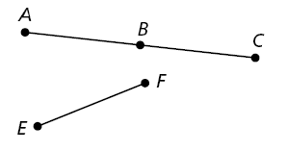
Check It Out! Example 1
Write a justification for each step, given that B is the midpoint of AC and AB ≅ EF.
1. B is the midpoint of AC.
Given information
2. AB ≅ BC
Def. of mdpt.
3. AB ≅ EF
Given information
4. BC ≅ EF
Trans. Prop. of ≅

Slide 9
A theorem is any statement that you can prove. Once you have proven a theorem, you can use it as a reason in later proofs.

Slide 10
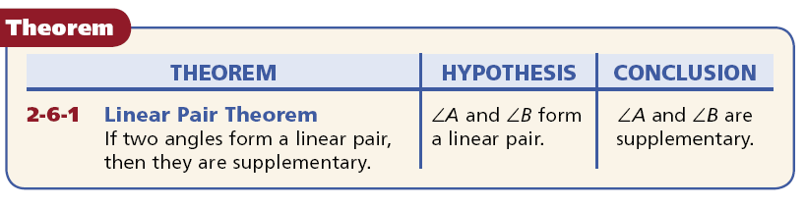

Slide 11
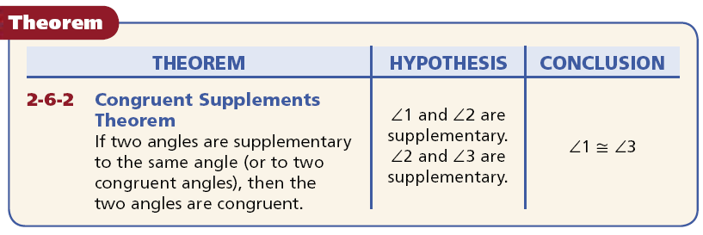

Slide 12
A geometric proof begins with Given and Prove statements, which restate the hypothesis and conclusion of the conjecture. In a two-column proof, you list the steps of the proof in the left column. You write the matching reason for each step in the right column.

Slide 13
Example 2: Completing a Two-Column Proof
Fill in the blanks to complete the two-column proof.
Given: XY
Prove: XY ≅ XY
Statements | Reasons
1. | 1. Given
2. XY = XY | 2. .
3. . | 3. Def. of ≅ segs.
Reflex. Prop. of =
≅

Slide 14
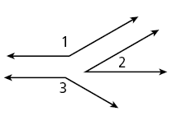
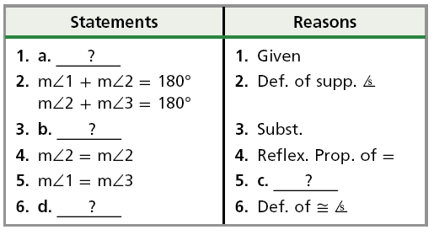
Check It Out! Example 2
Fill in the blanks to complete a two-column proof of one case of the Congruent Supplements Theorem.
Given: ∠1 and ∠2 are supplementary, and
∠2 and ∠3 are supplementary.
Prove: ∠1 ≅ ∠3
Proof:
∠1 and ∠2 are supp., and ∠2 and ∠3 are supp.
b. m∠1 + m∠2 = m∠2 + m∠3
c. Subtr. Prop. of =
d. ∠1 ≅ ∠3

Slide 15
Before you start writing a proof, you should plan out your logic. Sometimes you will be given a plan for a more challenging proof. This plan will detail the major steps of the proof for you.

Slide 16
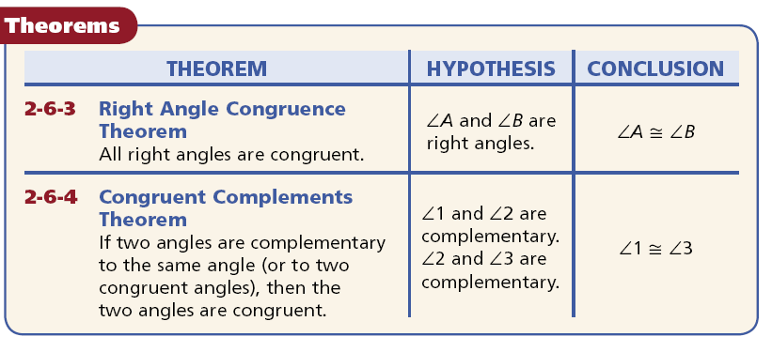

Slide 17
Helpful Hint
If a diagram for a proof is not provided, draw your own and mark the given information on it. But do not mark the information in the Prove statement on it.

Slide 18
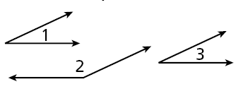
Example 3: Writing a Two-Column Proof from a Plan
Use the given plan to write a two-column proof.
Given: ∠1 and ∠2 are supplementary, and
∠1 ≅ ∠3
Prove: ∠3 and ∠2 are supplementary.
Plan: Use the definitions of supplementary and congruent angles and substitution to show that m∠3 + m∠2 = 180°. By the definition of supplementary angles, ∠3 and ∠2 are supplementary.

Slide 19
Example 3 Continued
Statements | Reasons
1. | 1.
2. | 2. .
3. . | 3.
4. | 4.
5. | 5.
∠1 and ∠2 are supplementary.
∠1 ≅ ∠3
Given
m∠1 + m∠2 = 180°
Def. of supp. ∠s
m∠1 = m∠3
Def. of ≅ ∠s
m∠3 + m∠2 = 180°
Subst.
∠3 and ∠2 are supplementary
Def. of supp. ∠s

Slide 20
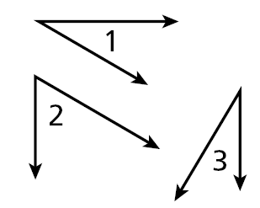
Check It Out! Example 3
Use the given plan to write a two-column proof if one case of Congruent Complements Theorem.
Given: ∠1 and ∠2 are complementary, and
∠2 and ∠3 are complementary.
Prove: ∠1 ≅ ∠3
Plan: The measures of complementary angles add to 90° by definition. Use substitution to show that the sums of both pairs are equal. Use the Subtraction Property and the definition of congruent angles to conclude that ∠1 ≅ ∠3.

Slide 21
Check It Out! Example 3 Continued
Statements | Reasons
1. | 1.
2. | 2. .
3. . | 3.
4. | 4.
5. | 5.
6. | 6.
∠1 and ∠2 are complementary.
∠2 and ∠3 are complementary.
Given
m∠1 + m∠2 = 90° m∠2 + m∠3 = 90°
Def. of comp. ∠s
m∠1 + m∠2 = m∠2 + m∠3
Subst.
m∠2 = m∠2
Reflex. Prop. of =
m∠1 = m∠3
Subtr. Prop. of =
∠1 ≅ ∠3
Def. of ≅ ∠s

Slide 22
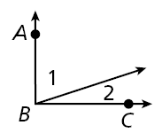
Lesson Quiz: Part I
Write a justification for each step, given that m∠ABC = 90° and m∠1 = 4m∠2.
1. m∠ABC = 90° and m∠1 = 4m∠2
2. m∠1 + m∠2 = m∠ABC
3. 4m∠2 + m∠2 = 90°
4. 5m∠2 = 90°
5. m∠2 = 18°
Given
∠ Add. Post.
Subst.
Simplify
Div. Prop. of =.

Slide 23
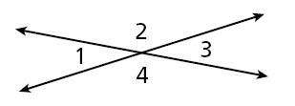
Lesson Quiz: Part II
2. Use the given plan to write a two-column proof.
Given: ∠1, ∠2 , ∠3, ∠4
Prove: m∠1 + m∠2 = m∠1 + m∠4
Plan: Use the linear Pair Theorem to show that the angle pairs are supplementary. Then use the definition of supplementary and substitution.
1. ∠1 and ∠2 are supp.
∠1 and ∠4 are supp.
1. Linear Pair Thm.
2. m∠1 + m∠2 = 180°,
m∠1 + m∠4 = 180°
2. Def. of supp. ∠s
3. m∠1 + m∠2 = m∠1 + m∠4
3. Subst.

