Slide 1

Flowchart and Paragraph Proofs
Warm Up
Lesson Presentation
Lesson Quiz
Holt McDougal Geometry
Holt Geometry

Slide 2
Warm Up
Complete each sentence.
1. If the measures of two angles are ? , then the angles are congruent.
2. If two angles form a ? , then they are supplementary.
3. If two angles are complementary to the same angle, then the two angles are ? .
equal
linear pair
congruent

Slide 3
Objectives
Write flowchart and paragraph proofs.
Prove geometric theorems by using deductive reasoning.

Slide 4
Vocabulary
flowchart proof
paragraph proof

Slide 5
A second style of proof is a flowchart proof, which uses boxes and arrows to show the structure of the proof.
The justification for each step is written below the box.

Slide 6
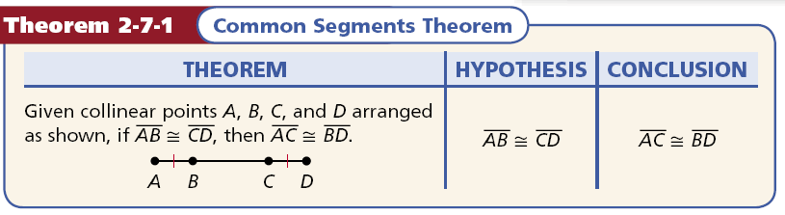

Slide 7
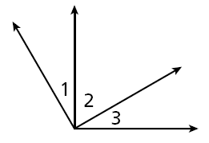
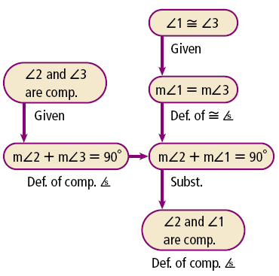
Example 1: Reading a Flowchart Proof
Use the given flowchart proof to write a two-column proof.
Given: ∠2 and ∠3 are comp.
∠1 ≅ ∠3
Prove: ∠2 and ∠1 are comp.
Flowchart proof:

Slide 8
Example 1 Continued
Two-column proof:
Statements | Reasons
1. ∠2 and ∠3 are comp.
∠1 ≅ ∠3
1. Given
2. m∠2 + m∠3 = 90°
2. Def. of comp. ∠s
3. m∠1 = m∠3
3. Def. of ≅ ∠s
4. m∠2 + m∠1 = 90°
4. Subst.
5. ∠2 and ∠1 are comp.
5. Def. of comp. ∠s

Slide 9

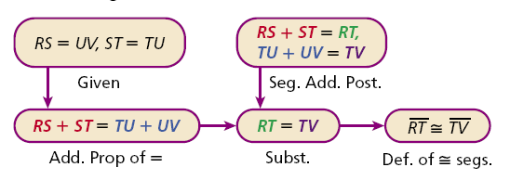
Check It Out! Example 1
Use the given flowchart proof to write a two-column proof.
Given: RS = UV, ST = TU
Prove: RT ≅ TV
Flowchart proof:

Slide 10
Check It Out! Example 1 Continued
Statements | Reasons
1. RS = UV, ST = TU
1. Given
2. RS + ST = TU + UV
2. Add. Prop. of =
3. RS + ST = RT,
TU + UV = TV
3. Seg. Add. Post.
4. RT = TV
4. Subst.
5. RT ≅ TV
5. Def. of ≅ segs.

Slide 11

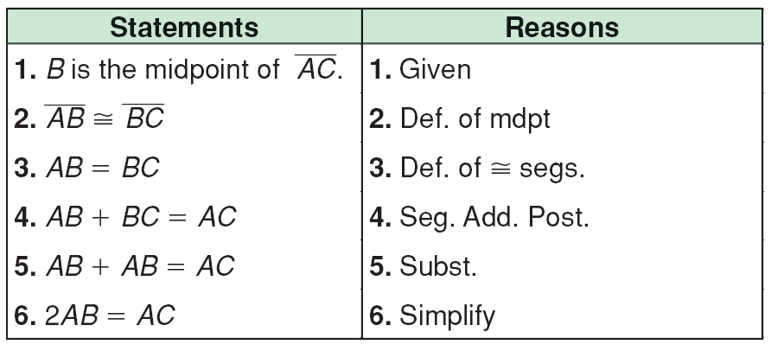
Example 2: Writing a Flowchart Proof
Use the given two-column proof to write a flowchart proof.
Given: B is the midpoint of AC.
Prove: 2AB = AC

Slide 12
Example 2 Continued
Flowchart proof:

Slide 13

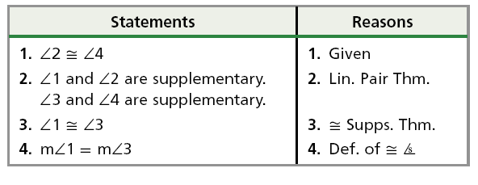
Check It Out! Example 2
Use the given two-column proof to write a flowchart proof.
Given: ∠2 ≅ ∠4
Prove: m∠1 ≅ m∠3
Two-column Proof:

Slide 14
Check It Out! Example 2 Continued

Slide 15
A paragraph proof is a style of proof that presents the steps of the proof and their matching reasons as sentences in a paragraph. Although this style of proof is less formal than a two-column proof, you still must include every step.

Slide 16
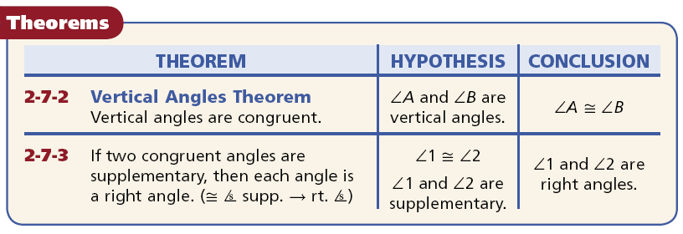

Slide 17
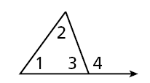
Example 3: Reading a Paragraph Proof
Use the given paragraph proof to write a two-column proof.
Given: m∠1 + m∠2 = m∠4
Prove: m∠3 + m∠1 + m∠2 = 180°
Paragraph Proof: It is given that
m∠1 + m∠2 = m∠4. ∠3 and ∠4 are
supplementary by the Linear Pair Theorem. So m∠3 + m∠4 = 180° by definition. By Substitution, m∠3 + m∠1 + m∠2 = 180°.

Slide 18
Example 3 Continued
Two-column proof:
Statements | Reasons
1. m∠1 + m∠2 = m∠4
1. Given
2. ∠3 and ∠4 are supp.
2. Linear Pair Theorem
3. m∠3 + m∠4 = 180°
3. Def. of supp. ∠s
4. m∠3 + m∠1 + m∠2 = 180°
4. Substitution

Slide 19
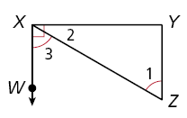
Check It Out! Example 3
Use the given paragraph proof to write a two-column proof.
Given: ∠WXY is a right angle. ∠1 ≅ ∠3
Prove: ∠1 and ∠2 are complementary.
Paragraph Proof: Since ∠WXY is a right angle, m∠WXY = 90° by the definition of a right angle. By the Angle Addition Postulate, m∠WXY = m∠2 + m∠3. By substitution, m∠2 + m∠3 = 90°. Since ∠1 ≅ ∠3, m∠1 = m∠3 by the definition of congruent angles. Using substitution, m∠2 + m∠1 = 90°. Thus by the definition of complementary angles, ∠1 and ∠2 are complementary.

Slide 20
Check It Out! Example 3 Continued
Statements | Reasons
1. ∠WXY is a right angle. | 1. Given
2. m∠WXY = 90° | 2. Def. of right angle
3. m∠2 + m∠3 = m∠WXY | 3. Angle Add. Postulate
4. m∠2 + m∠3 = 90° | 4. Subst.
5. ∠1 ≅ ∠3 | 5. Given
6. m∠1 = m∠3 | 6. Def. of ≅ ∠s
7. m∠2 + m∠1 = 90° | 7. Subst.
8. ∠1 and ∠2 are comp. | 8. Def. of comp. angles

Slide 21
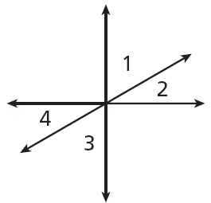
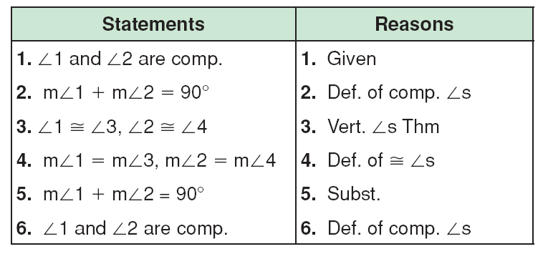
Example 4: Writing a Paragraph Proof
Use the given two-column proof to write a paragraph proof.
Given: ∠1 and ∠2 are complementary
Prove: ∠3 and ∠4 are complementary
m∠3 + m∠4 = 90°
∠3 and ∠4 are comp.

Slide 22
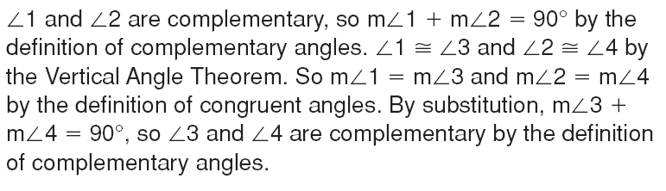
Example 4 Continued
Paragraph proof:

Slide 23

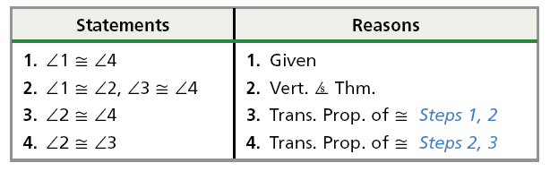
Check It Out! Example 4
Use the given two-column proof to write a paragraph proof.
Given: ∠1 ≅ ∠4
Prove: ∠2 ≅ ∠3
Two-column proof:

Slide 24
Check It Out! Example 4 Continued
Paragraph proof:
It is given that ∠1 ≅ ∠4. By the Vertical Angles Theorem, ∠1 ≅ ∠2 and ∠3 ≅ ∠4. By the Transitive Property of Congruence, ∠2 ≅ ∠4. Also by the Transitive Property of Congruence, ∠2 ≅ ∠3.

Slide 25
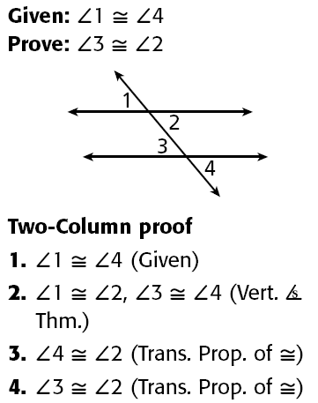
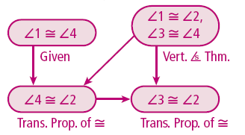
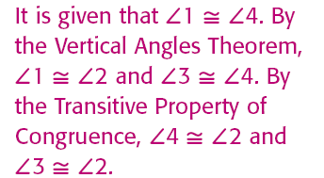
Lesson Quiz
Use the two-column proof at right to write the following.
1. a flowchart proof
2. a paragraph proof

