Slide 1

Perpendicular Lines
Warm Up
Lesson Presentation
Lesson Quiz
Holt McDougal Geometry
Holt Geometry

Slide 2


Warm Up
Solve each inequality.
1. x – 5 < 8
2. 3x + 1 < x
Solve each equation.
3. 5y = 90
4. 5x + 15 = 90
Solve the systems of equations.
5.
x < 13
y = 18
x = 15
x = 10, y = 15

Slide 3
Review Notes: Perpendicular Lines on pg. 48
Complete #1-5 in notes

Slide 4
Complete pg. 61 in workbook
I reminded you to bring your workbooks everyday

Slide 5
Complete your Inbox Task
You may look for examples on this powerpoint

Slide 6
Objective
Prove and apply theorems about perpendicular lines.

Slide 7
Vocabulary
perpendicular bisector
distance from a point to a line

Slide 8
The perpendicular bisector of a segment is a line perpendicular to a segment at the segment’s midpoint.
The shortest segment from a point to a line is perpendicular to the line. This fact is used to define the distance from a point to a line as the length of the perpendicular segment from the point to the line.

Slide 9
Example 1: Distance From a Point to a Line
A. Name the shortest segment from point A to BC.
The shortest distance from a point to a line is the length of the perpendicular segment, so AP is the shortest segment from A to BC.
B. Write and solve an inequality for x.
AC > AP
AP is the shortest segment.
x – 8 > 12
Substitute x – 8 for AC and 12 for AP.
+ 8
+ 8
Add 8 to both sides of the inequality.
x > 20

Slide 10
Check It Out! Example 1
A. Name the shortest segment from point A to BC.
The shortest distance from a
point to a line is the length of
the perpendicular segment, so
AB is the shortest segment from
A to BC.
B. Write and solve an inequality for x.
AC > AB
AB is the shortest segment.
12 > x – 5
Substitute 12 for AC and x – 5 for AB.
+ 5
+ 5
Add 5 to both sides of the inequality.
17 > x

Slide 11
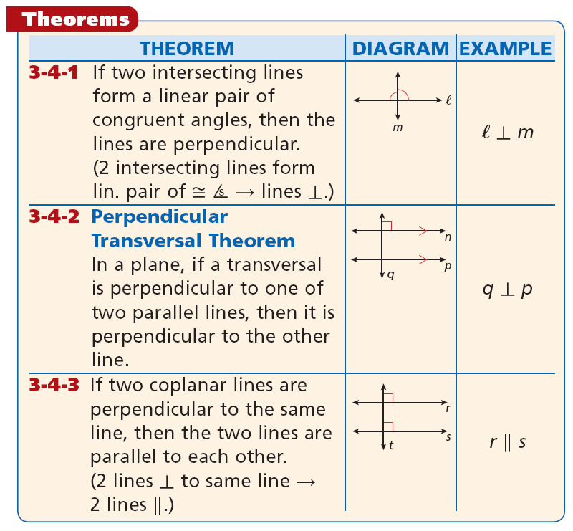
HYPOTHESIS
CONCLUSION

Slide 12
Example 2: Proving Properties of Lines
Write a two-column proof.
Given: r || s, ∠1 ≅ ∠2
Prove: r ⊥ t

Slide 13
Example 2 Continued
Statements | Reasons
1. r || s, ∠1 ≅ ∠2
1. Given
2. ∠2 ≅ ∠3
2. Corr. ∠s Post.
3. ∠1 ≅ ∠3
3. Trans. Prop. of ≅
4. 2 intersecting lines form lin. pair of ≅ ∠s  lines ⊥.
4. r ⊥ t

Slide 14


Check It Out! Example 2
Write a two-column proof.
Given:
Prove:

Slide 15



Check It Out! Example 2 Continued
Statements | Reasons
1. ∠EHF ≅ ∠HFG
1. Given
2.
2. Conv. of Alt. Int. ∠s Thm.
3.
3. Given
4.
4. ⊥ Transv. Thm.

Slide 16
Example 3: Carpentry Application
A carpenter’s square forms a
right angle. A carpenter places
the square so that one side is
parallel to an edge of a board, and then draws a line along the other side of the square. Then he slides the square to the right and draws a second line. Why must the two lines be parallel?
Both lines are perpendicular to the edge of the board. If two coplanar lines are perpendicular to the same line, then the two lines are parallel to each other, so the lines must be parallel to each other.

Slide 17
Check It Out! Example 3
A swimmer who gets caught in a rip current should swim in a direction perpendicular to the current. Why should the path of the swimmer be parallel to the shoreline?

Slide 18
Check It Out! Example 3 Continued
The shoreline and the path of the swimmer should both be ⊥ to the current, so they should be || to each other.

Slide 19
Lesson Quiz: Part I
1. Write and solve an inequality for x.
2x – 3 < 25; x < 14
2. Solve to find x and y in the diagram.
x = 9, y = 4.5

Slide 20
Lesson Quiz: Part II
3. Complete the two-column proof below.
Given: ∠1 ≅ ∠2, p ⊥ q
Prove: p ⊥ r
Proof
Statements | Reasons
1. ∠1 ≅ ∠2 | 1. Given
2. q || r
3. p ⊥ q
4. p ⊥ r
2. Conv. Of Corr. ∠s Post.
3. Given
4. ⊥ Transv. Thm.

